Slide 1
Integrating Word, Excel, Access, and PowerPoint
MODULE 9
Notes:
Module 9 is all about Integrating Word, Excel, Access and PowerPoint.

Slide 2
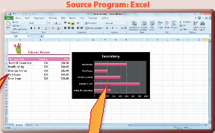
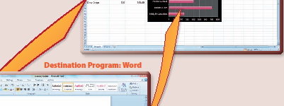
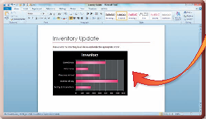
© Paradigm Publishing, Inc.
2
Notes:
A key advantage in using the Office 2010 suite is that you can integrate data between the application programs.

Slide 3
Skills You Learn
Export a Word Outline to PowerPoint
Insert an Excel Chart in Word
Base an Access database on Excel data
Notes:
In this module, you export a Word outline of a business plan into PowerPoint to create a new presentation. You then enhance a business letter by inserting an Excel chart into a Word document. You also copy Excel data into an Access table.

Slide 4
Guidelines for Integrating
Integrating means that you bring together two or more different application files.
First you create a document or file in the Office application that best suits the data. That application is called the source program.
Then you copy or export that file or its data to one of the other applications, called the destination program.

Slide 5
Guidelines for Integrating, continued
When you integrate data or objects from one application into another, you can choose between two methods: 1) copying and pasting or 2) embedding or linking the data or object.
Embedding and linking are notably different.
When you embed an object, such as an Excel chart in a Word document, the chart becomes a separate object in the Word document.
In contrast, if you link the chart, it then resides, or has its home, in the Excel workbook. Because it is a linked object, when you change the chart in the Excel workbook, it will automatically be updated in the Word document.
Notes:
The embed option and the link option both have an advantage over copying and pasting, because you can edit an embedded or a linked object using the tools of the source program.

Slide 6
Skill 1: Export a Word Outline to PowerPoint
Open the Word file you wish to use in your presentation.
Click the Customize Quick Access Toolbar button.
Click More Commands at the drop-down list.
Click the Choose commands from list box arrow.
Click All Commands.
Scroll through the list box and then double-click Send to Microsoft PowerPoint. Click OK.
Click the Send to Microsoft PowerPoint button in the Quick Access toolbar. PowerPoint opens and the presentation displays on the screen.
Save the PowerPoint presentation.
Notes:
Some people prefer to plan their PowerPoint presentations by creating an outline in Word and then exporting that content to PowerPoint to work on slide design. PowerPoint creates new slides based on the heading styles that you used in the Word outline. PowerPoint creates slide titles from text that you formatted with the Heading 1 style. Paragraphs you formatted in the Heading 2 style become the first level bulleted text. Paragraphs you formatted in the Heading 3 style become the second-level bulleted text, and so on.

Slide 7
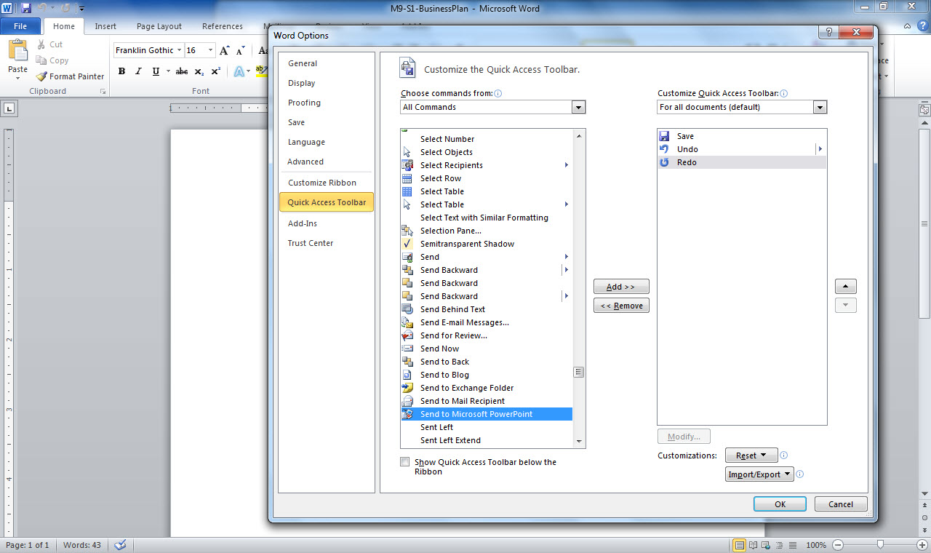
Quick Access Toolbar
Commands drop-down list
Send to Microsoft PowerPoint
Notes:
Notice that the commands are listed in alphabetical order. You are saving the file in PowerPoint and the file has a .pptx extension, even though you initially
opened the file in Word, with a .docx extension.

Slide 8
Exporting a PowerPoint Presentation to Word You can also export a PowerPoint presentation to Word. You may want to do this so that you can use Word’s features to customize your handout formatting.
Notes:
Another reason to export a PowerPoint presentation to Word might be to use the contents of your presentation as the basis for a report or other document. To send presentation data to Word, click the File tab, click the Save & Send tab, click Create Handouts, and then click the Create Handouts button. In the Send To Microsoft Word dialog box that displays, click a layout option and then click OK.

Slide 9
Skill 2: Insert an Excel Chart in Word
Open the Word file in which you wish to insert the chart.
Press Ctrl + End to move the insertion point to the end of the document or click in the document at the place of insertion.
Open the Excel file that contains the chart.
Click a blank area of the chart to select it.
Click the Copy button in the Clipboard group on the Home tab.
Notes:
You can copy an Excel chart to a Word document. When you do so, you have the option to link the chart. When you link the chart, you will be able to edit the object in Excel (called the source program) even though the chart is in a Word document.

Slide 10
Skill 2: Insert an Excel Chart in Word, continued
Click the Word button on the Taskbar.
Click the Paste button arrow in the Clipboard group on the Home tab.
Click the Keep Source Formatting & Link Data button (the fourth button under Paste Options).
Save the Word document.
Close Word and Excel.
Notes:
Another advantage is that if you change the chart in Excel, the chart will also be updated in Word (called the destination program) if the destination file is open on the same computer when the source file is edited. Thus, you will always have an up-to-date chart.

Slide 11
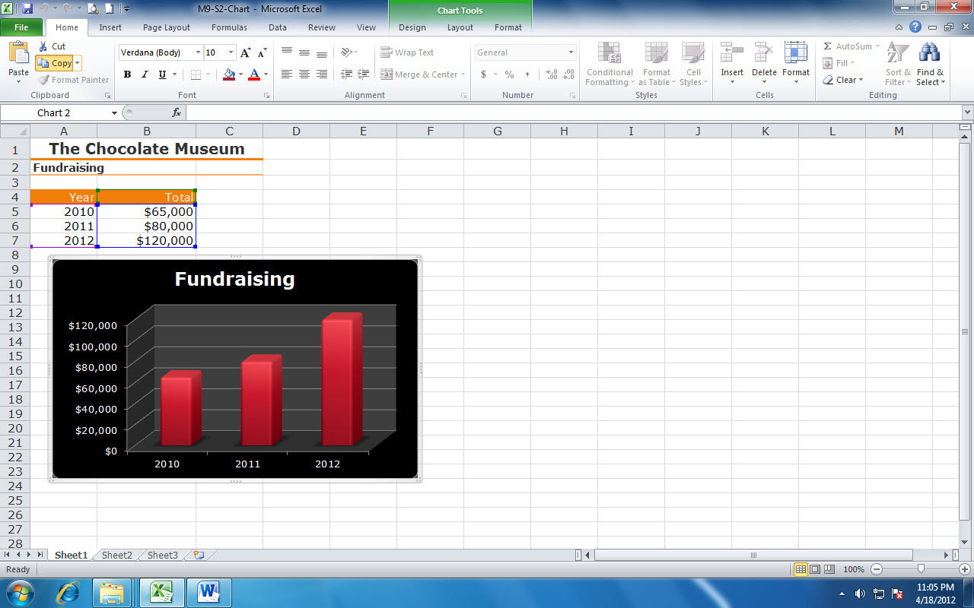
Copy button
Chart selected in Excel
Select Word on the taskbar to move to the Word document
Notes:
Here you see the chart selected in Excel. Clicking the Copy button copies the chart for insertion into the destination document.

Slide 12
Paste button
Paste option selected
Chart pasted into Word document
Notes:
Here you see the chart pasted into the Word document. The paste option to Keep Source Formatting and Link Data was used to keep the Excel formatting and link the data to the Excel spreadsheet. Since it is linked, any changes made to the Excel spreadsheet will then show in the chart in the Word document. You can see the linked object (chart) in the Word document but the object itself is located in its original Excel file. Click the Use Destination Theme & Link Data button to link the chart and change the chart formatting to match the formatting in the document.

Slide 13
Editing and Formatting a Linked Chart in Word In Word, click a linked chart to display the Chart Tools Design, Layout, and Format tabs. You can use options on these tabs to format and edit the linked chart without having to leave Word.
Notes:
To change the chart style, click the Chart Tools Design tab and then select a chart style from the Chart Styles gallery. The Chart Tools Layout tab includes options for adding chart titles and data labels. This tab also includes options for changing shape styles and WordArt styles.

Slide 14
Skill 3: Base an Access Database on Excel Data
Open the Access database in which you wish to insert the data.
If a security warning appears immediately below the ribbon, click the Enable Content button.
Open the table in which you wish to insert the data. The table currently does not contain any records.
Open the Excel file that contains the data.
Select the cells that contain the data.
Click the Copy button in the Clipboard group on the Home tab.
Notes:
Add new records to an Access database by directly typing them in or by copying the information from a Word or Excel file. Copying existing data can help you avoid mistakes that can sometimes occur when retyping data.

Slide 15
Skill 3: Base an Access Database on Excel Data, cont.
Click the Access button on the Taskbar.
Click the Paste button arrow in the Clipboard group on the Home tab.
Click Paste Append.
At the warning box asking if you are sure you want to paste the records, click Yes.
Close Access and Excel.

Slide 16
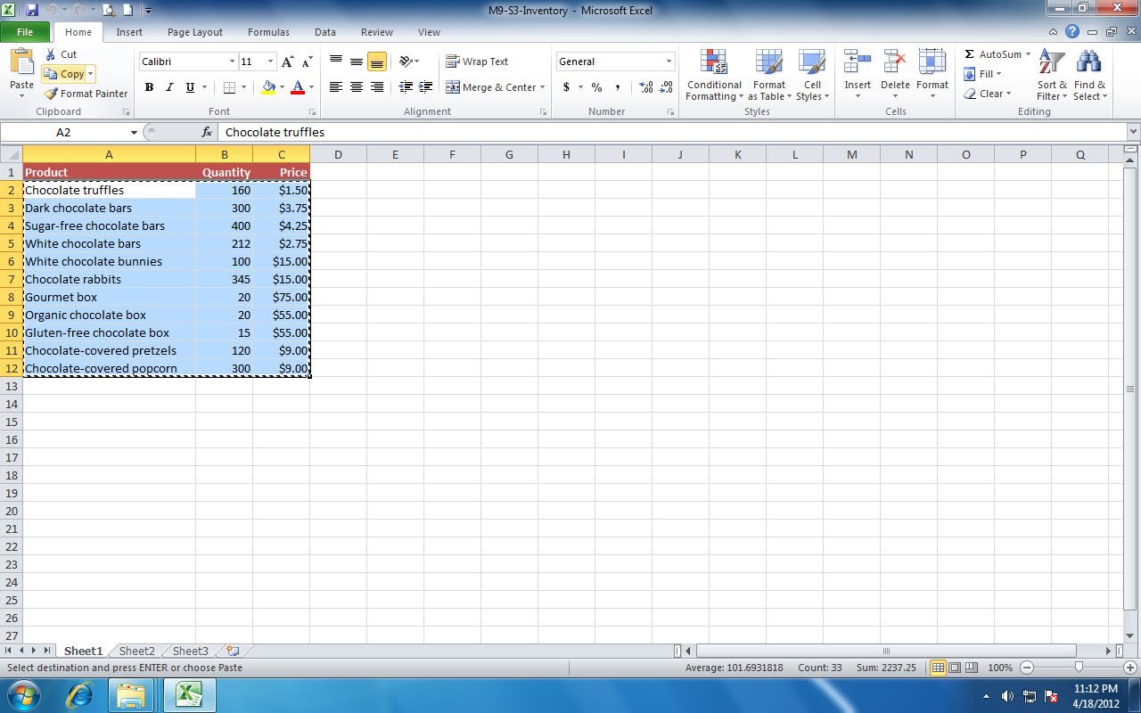
Copy button
Cells selected in Excel
Notes:
Here you see the range A1:C12 selected in Excel. Clicking the Copy button copies the data.

Slide 17
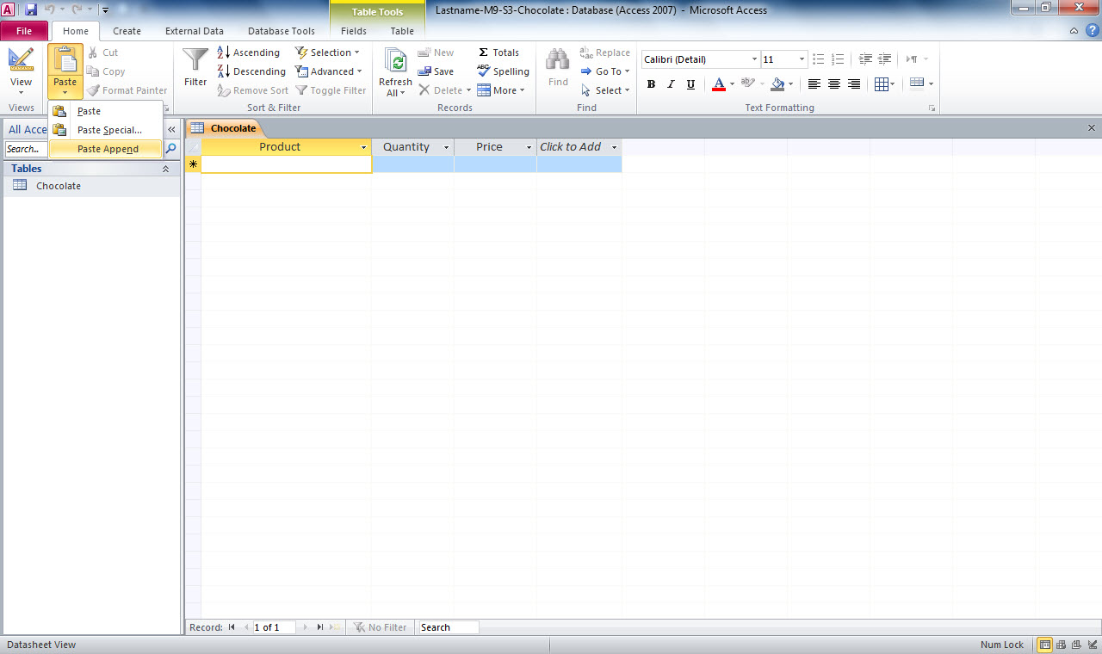
Paste button
Paste Append selected in Access
Notes:
Here you see Paste Append selected in Access. You select the Paste Append command because you are adding records to an existing table.

Slide 18
Importing Excel Data Another way to enter data into an Access table is to import the data from an existing Excel file. When you import data, the file is converted for use by the destination application.
Notes:
To import an Excel file, click the External Data tab in Access and then click the Excel button in the Import & Link group. You can then select the Excel file and specify other import options in the Import Spreadsheet Wizard dialog box.

