Slide 1
Microsoft PowerPoint 2010
MODULE 8
Chapter 1: Creating a Presentation
Chapter 2: Working with Slide Masters and
Handouts
Chapter 3: Adding Visual Elements and Sound
Chapter 4: Completing, Running, and Sharing Your Show
Notes:
In Module 8, you learn about Microsoft PowerPoint 2010. Chapter 1 covers creating a presentation including entering and editing text. Chapter 2 deals with changing formatting in Slide Master View that help improve the look of your documents. In Chapter 3, you add visual elements and sound to add visual appeal. Finally, Chapter 4 covers completing, running and sharing your show.

Slide 2
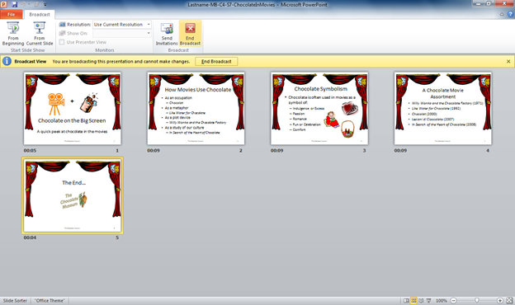
Chapter 4
Completing, Running, and
Sharing Your Show
Notes:
The fourth chapter in the PowerPoint module deals with completing, running, and sharing your show.
.

Slide 3
Skills You Learn
Check spelling
Run a show
Rehearse timings
Set up the show
Print presentation notes
Broadcast a presentation to the Web
Notes:
When you finish the contents of your presentation, you are not quite done. You should always perform a final spelling check to make sure that no embarrassing errors lurk in your text. You also have to specify settings for how your slide show should run. The settings control how your show moves forward from slide to slide, either manually with a click or key press, or automatically using recorded slide timings. You can also set up a show to loop continuously so that it plays over and over again.
You might want to print a copy of your slides for your own reference, print handouts for your audience, or print speaker notes that you would use while presenting or for studying the topic later. You can also use the powerful tools in PowerPoint to broadcast your presentation online where it can be viewed by others as you navigate through the slides.

Slide 4
Skill 1: Check Spelling
Click the Review tab.
Click the Spelling button in the Proofing group. This opens the Spelling dialog box.
Make any corrections you feel are necessary by either clicking the Change button to correct the spelling of the word or clicking the Ignore or Ignore All button.
When the message appears saying the spelling check is complete, click OK.
Save the file.
Notes:
It is very important that your spelling be correct so your audience takes your message seriously. PowerPoint’s built-in spelling check feature handles most of this for you, but you need to make a few decisions along the way.

Slide 5
Review tab
Spelling button
Spelling dialog box
Notes:
In M8-C4-S1-ChocolateInMovies.pptx, you can see the Spelling dialog box open and it is prompting for a spelling change for “Chocolat.” You can select Ignore or Ignore All if you know the word is spelled correctly. If you are certain that a word only appears once, it is okay to click Ignore. But if it is possible that a word appears more than once, choose Ignore All.

Slide 6
Add Words to the Spelling Check Dictionary Any word not found in the dictionary is questioned during the spelling check. If you often use a word that the spelling check questions, you can add that word to the spelling check dictionary.
Notes:
If you often use a word that the spelling check questions, such as your company name or your last name, you can add that word to the spelling check dictionary. Just click the Add button when that word is questioned as you run the spelling check. Once you add a word to the dictionary, it no longer appears in the Not in Dictionary text box.

Slide 7
Skill 2: Run a Show
Click the Slide Show tab.
Click the From Beginning button to display the slide show from the first slide.
Press the Right Arrow key one time to proceed from Slide 1 to Slide 2.
Press the Left Arrow key one time to move from Slide 2 back to Slide 1.
Click your mouse to move from Slide 1 to Slide 2.
Press the spacebar one time to move from Slide 2 to Slide 3.
Notes:
You run a slide show by switching to Slide Show view. The tools available in that view help you to navigate through your slides. Depending on whether you have set up a show to advance manually or automatically, running a show works differently. In this skill, you work with a show set up to advance manually.
If it is not already open, open the file you saved in the previous skill. You will not be making changes to this file in this skill.

Slide 8
Skill 2: Run a Show, continued
Press the Backspace key one time to move from Slide 3 to Slide 2.
Right-click the mouse, click Go to Slide in the pop-up menu, and then click 4. This takes you to Slide 4.
Click the left arrow button in the Slide Show toolbar on the bottom-left corner of the screen to navigate from Slide 4 to Slide 3.
Right-click the current slide and click End Show in the pop-up menu. This returns you to the Normal view.

Slide 9
Slide Show tab
From Beginning button
Notes:
Here in M8-C4-S1-ChocolateInMovies.pptx, you see the From Beginning button on the Slide Show tab. If you are using an LCD display or television to show your presentation, check the device’s user manual to make sure you set up the display equipment properly.

Slide 10
Backspace key
Left Arrow key
Spacebar
Right Arrow key
Notes:
You can also advance one slide by pressing the Page Down key.

Slide 11
Go to Slide option
Notes:
Here you see Slide 2 in Slide Show view. You can go back one slide by pressing the Page Up key.

Slide 12
Left arrow button
Notes:
Click the left arrow button in the Slide Show toolbar on the bottom-left corner of the screen to navigate from Slide 4 to Slide 3 (Chocolate Symbolism).

Slide 13
End Show option
Notes:
Right-click the current slide and click End Show in the shortcut menu. This returns you to the Normal view.

Slide 14
Highlighting Slides During a Show When running a slide show manually, a presenter
can use the digital pen or a highlighter to draw viewers’ attention to specific items on a slide.
Notes:
Access these tools from the Slide Show toolbar in the bottom-left corner of the slide. Click the Pen button and then click Pen in the pop-up menu to turn the mouse pointer into a small circle. Using the mouse, draw a circle around a key word on the slide. Erase the markings you made on the slide by clicking the Pen button and then clicking the Erase All Ink on Slide option. Note that you cannot access the Slide Show toolbar when you set up your show to run automatically.

Slide 15
Skill 3: Rehearse Timings
Click the Slide Show tab.
Click the Rehearse Timings button in the Set Up group. Read the slide while the timer runs. Note how long it takes to read the slide content by noting the time in the Recording dialog box.
Select the time in the timing box (to make the timer stop running), type the time, and then press Enter.
Type the times in the timing boxes for the rest of your slides.
At the warning box indicating the total time, click Yes. This opens the presentation in Slide Sorter view. You can see the assigned times for each slide in the presentation.
Save the file.
Notes:
If no speaker will be present to run the show, you need to record timings for how long each slide should display before advancing to the next slide. PowerPoint uses those timings to automatically advance the show.

Slide 16
Slide Show tab
Rehearse Timings button
Notes:
Notice the Rehearse Timings button selected in M8-C4-S3-ChocolateInMovies.pptx. You can also allow the timer to run and then press Enter when you wish to stop the timer.

Slide 17
Select the time
Notes:
The idea is to provide an appropriate amount of time for the slide to display, depending on the amount of information on the slide.

Slide 18
Recording a Narration If you wish, you can record a narration to play along with your slide show.
Notes:
When you record a narration, you can save timings that match the length of each slide’s narration. Use the Record Slide Show button in the Set Up group on the Slide Show tab to record a narration, such as the one contained in the Notes area of the movie slide show.

Slide 19
Skill 4: Set Up the Show
Click the Slide Show tab.
Click the Set Up Slide Show button in the Set Up group.
Click the Browsed at a kiosk (full screen) option in the Show type section.
Confirm that the Using timings, if present option is selected in the Advance slides section.
Click OK.
Save the file.
Run the show. Press Esc to close it when it’s done.
Notes:
The show type determines how a show is played back. There are three playback options. One option is to have the presentation given by a live speaker. With this choice, the speaker provides information and would typically forward each slide when he or she is ready to go to the next topic. Another option is to allow the show to be run by a viewer using onscreen controls. The final option is to have the show run on its own, continuously looping through the slide series over and over again. When you set up a show to run on its own, the timings you save determine when the show moves from one slide to another.

Slide 20
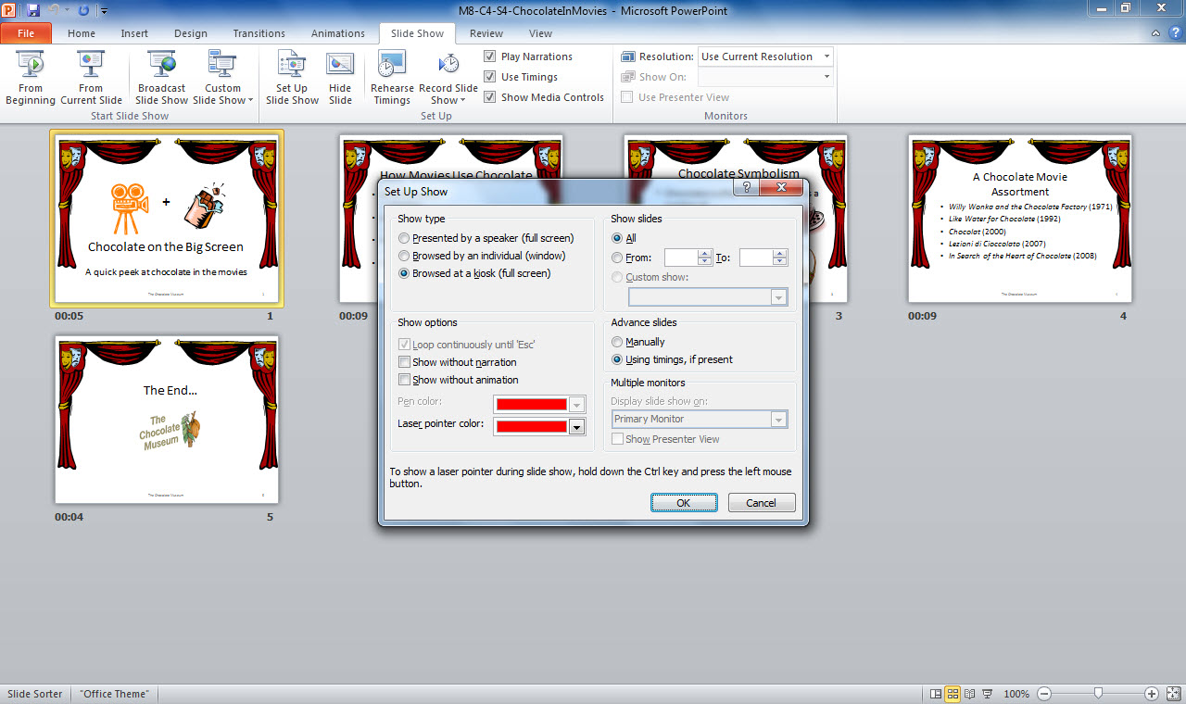
Set Up Slide Show button
Set Up Show options
Notes:
Here you see the Set Up Show options open in M8-C4-S4-ChocolateInMovies.pptx. When you select the Browsed at a kiosk (full screen) setting, viewers cannot control the show.

Slide 21
Creating a Custom Show Creating a custom show allows you to select only certain slides from those in a larger presentation.
Notes:
For example, if you have a large presentation about student government, you might want to create a shorter version of only those slides specifically about school administration. To create a custom show, first click the Slide Show tab, click the Custom Slide Show button in the Start Slide Show group, and then click Custom Shows from the drop-down list to open the Custom Show dialog box.
Click the New button to open the Define Custom Show dialog box. Name the custom slide show by typing the name in the Slide show name text box. Choose a slide you wish to include in your show by clicking the slide number on the left. Click the Add button to move that slide to the Slides in custom show list. When you have added all the slides you want to include in your custom show, click OK and then click Close. Your custom show will then be available as a Custom show selection in the Set Up Show dialog box. Access that box by clicking the Set Up Slide Show button in the Set Up group.

Slide 22
Checkpoint 1
If you want the spelling check feature to leave all instances of a spelling alone, choose this while running the spelling check.
Ignore
Ignore All
Change All
None of the above
Before you give an in-person presentation to a large group, you must
obtain a copyright for the materials.
connect display equipment to your computer.
save a backup copy.
add timings.
Answer
Answer
The spelling check feature is based on
an online dictionary.
your past spelling choices.
a built-in dictionary.
Wikipedia.
One way to manually advance from one slide to the next is to
click your left mouse button.
press Backspace.
press Escape.
All of the above
Answer
Answer
Next Slide
Notes:
In Slide Show View, click the Answer button for Question 1 after you believe that you know the correct answer. The correct answer will be displayed. Then click the Answer button for Question 2 and the answer will appear. Continue repeating these steps for all four questions in order. When complete, click the Next Slide button.

Slide 23
Skill 5: Print Presentation Notes
Click the File tab.
Click the Print tab.
In the Settings category, click the Full Page Slides option.
In the Print Layout section of the drop-down list, click Notes Pages.
Click the Print button. The slides in the presentation print as Notes pages on your default printer.
Notes:
When you have finalized your presentation and checked your spelling, you may want to print copies of it. You can print full-page slides, print audience handouts that include any of several combinations of single or multiple slides oriented horizontally or vertically on the page, or print each slide with its accompanying speaker notes.

Slide 24
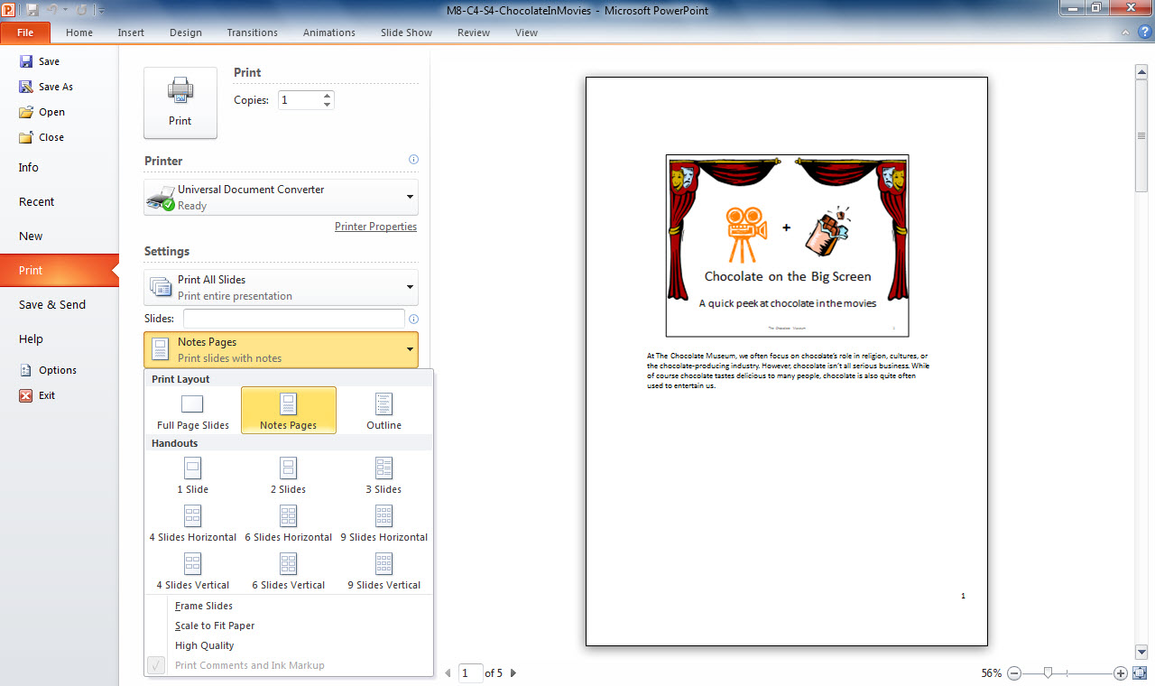
Print button
Notes Pages
Notes:
If you want to print a subset of slides, click the first setting (by default, Print All Slides) and choose to print the currently active slide or click Custom Range and enter a range of slides to print. In the Print Layout section, you have two other options: Full Page Slides or Outline. The default option is Full Page Slides.

Slide 25
Advanced Print Settings There are a few more settings you can select to affect how your document prints.
Notes:
You can choose to collate copies so that multiple copies print as sets (rather than printing three page 1s in a stack, three page 2s in a stack, and so on). You can also choose to print in color or on both sides of the paper (which may require that you turn over the paper in your printer after printing the first side). All these options are available in the Print menu.

Slide 26
Skill 6: Broadcast a Presentation to the Web
Click the File tab.
Click the Save & Send tab.
Click Broadcast Slide Show in the Save & Send category.
Click the Broadcast Slide Show option in the Broadcast Slide Show category.
In the Broadcast Slide Show dialog box, click the Start Broadcast button.
Enter your email address and password in the text boxes provided in the Connecting to pptbroadcast.officeapps.live.com dialog box.
Click OK.
Notes:
PowerPoint provides a powerful feature for broadcasting your presentation online in real time. Broadcasting is completely free and uses the PowerPoint Broadcast Service, so you don’t even need your own website to broadcast. However, you are required to first have a Windows Live account, which is also free and is easy to set up by visiting www.WindowsLive.com.
If it is not already open, open M8-C4-S4-ChocolateInMovies.pptx, the file you saved in Skill 4, and save the file as Lastname-M8-C4-S6-ChocolateInMovies, but replace Lastname with your last name. Be sure to save the file in your Module 8 working folder on your storage medium.

Slide 27
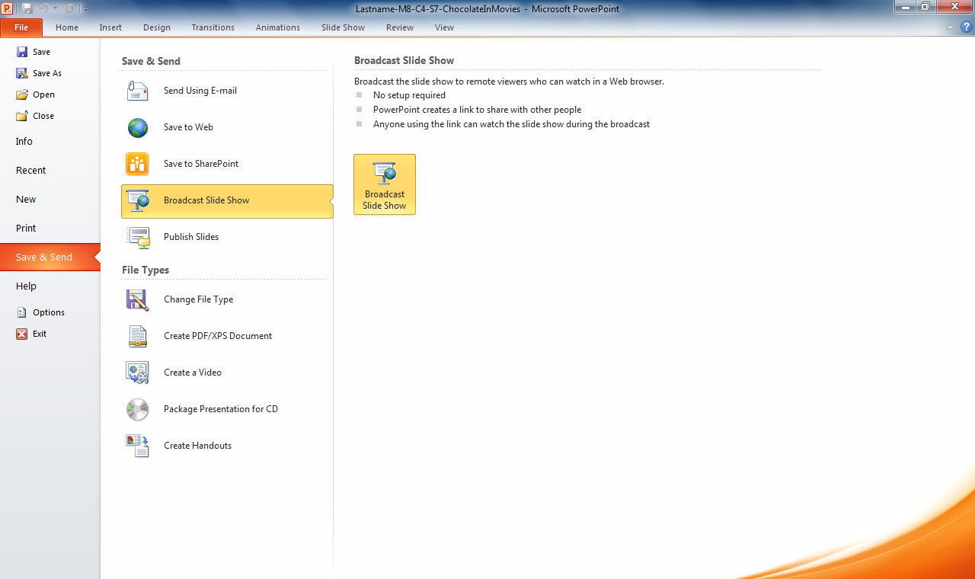
1. Click the File tab.
4. Click Broadcast Slide Show.
3. Click Broadcast Slide Show.
2. Click the Save & Send tab.
Notes:
To broadcast Lastname-M8-C4-S6-ChocolateInMovies.pptx to the Web, start by clicking the File tab. Click the Save & Send tab and then click Broadcast Slide Show in the Save & Send category. Click the Broadcast Slide Show option in the Broadcast Slide Show category.

Slide 28
Skill 6: Broadcast a Presentation to the Web, continued
In the Broadcast Slide Show dialog box, click Send in Email and send the link to yourself.
Click the Start Slide Show button to begin the live presentation. Individuals who have followed the hyperlink provided can watch the presentation as you run it. The slides advance automatically according to the timings set in the slide show. The show continues to loop from the end back to the beginning.
Press Esc when you are done watching the slide show.
Click the End Broadcast button.
At the warning box indicating that all remote viewers will be disconnected if you continue, click End Broadcast.
Close the file.

Slide 29
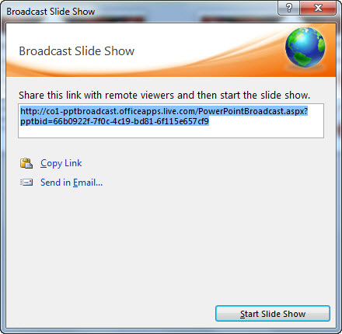
Send in Email option
Start Slide Show button
Notes:
In the Broadcast Slide Show dialog box, click Send in Email and send the link to yourself. Click the Start Slide Show button to begin the live presentation. Individuals who have followed the hyperlink can watch the presentation as you run it. The slides advance automatically according to the timings set in the slide show.

Slide 30
End Broadcast button
Notes:
Click the End Broadcast button on the Broadcast tab to end the broadcast.

Slide 31
Save a Presentation to the Web Using SkyDrive You can also save a presentation to the Web by clicking the File tab, clicking the Save & Send tab, and then clicking the Save to Web option in the Save & Send category.
Notes:
Use your Windows Live account login and password. You can set the file to be shared and share the Windows Live SkyDrive link with others.

Slide 32
Checkpoint 2
Pressing the P key while running a slide show
ends the show.
takes you to the next slide.
takes you to the previous slide.
restarts the show.
In PowerPoint you can print
full page slides.
handouts.
notes.
All of the above
Answer
Answer
If you want your slide presentation to run continuously at a professional trade show, you must
rehearse your presentation timings in advance.
uncheck Use timings if present.
log in to your Windows Live account.
create a custom show.
The Slide Show type option that is typically used to advance manually from slide to slide is
browsed by an individual (window).
browsed at a kiosk (full screen).
presented by a speaker (full screen).
looped continuously until the Esc key is pressed.
Answer
Answer
Next Slide
Notes:
In Slide Show View, click the Answer button for Question 5 after you believe that you know the correct answer. The correct answer will be displayed. Then click the Answer button for Question 6 and the answer will appear. Continue repeating these steps for all four questions in order. When complete, click the Next Slide button.

Slide 33
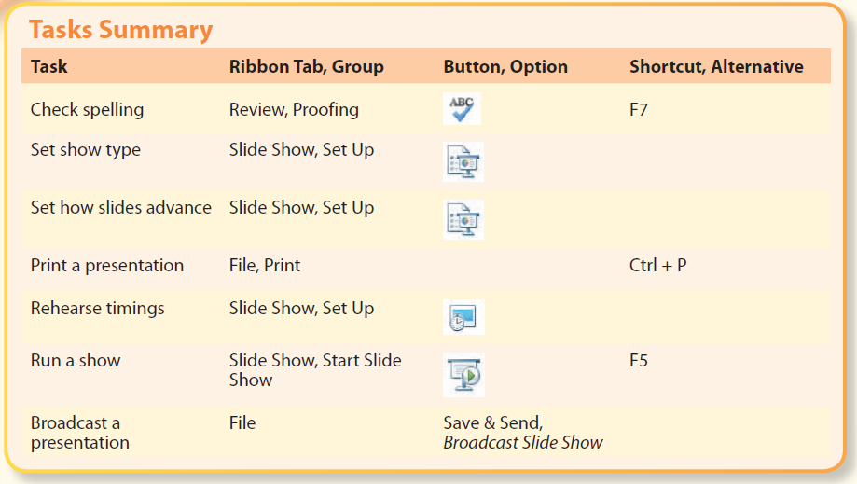
Tasks Summary
Notes:
Here is a summary of the PowerPoint Chapter 4 tasks.

