Slide 1
Microsoft PowerPoint 2010
MODULE 8
Chapter 1: Creating Documents
Chapter 2: Working with Slide Masters and
Handouts
Chapter 3: Working with Tables and Objects
Chapter 4: Polishing and Publishing Your Documents
Notes:
In Module 8, you learn about Microsoft PowerPoint 2010. Chapter 1 covers creating a presentation including entering and editing text. Chapter 2 deals with changing formatting in Slide Master View that help improve the look of your documents. In Chapter 3, you add visual elements and sound to add visual appeal. Finally, Chapter 4 covers completing, running and sharing your show.

Slide 2
Chapter 3
Adding Visual Elements
and Sound
Notes:
The third chapter in the PowerPoint module deals with adding visual elements and sound.

Slide 3
Skills You Learn
Insert an object on a slide
Format a picture
Add transitions
Add sound
Add animations
Choose animation effects
Notes:
PowerPoint slides use words to communicate the ideas in your presentation, but visuals can help reinforce those ideas and make your slides more attractive. Visuals may include photos or illustrations, transition effects for moving from one slide to another, and animated sequences that can include sound. When you combine these elements in your presentation, you both get your message across and keep your audience engaged and entertained.

Slide 4
What You Will Create
Create a PowerPoint presentation that uses visual and media elements.
Photos
Drawings
Animations
Sounds
Create effects to transition between slides.
Notes:
In this chapter, you learn how to work with visual objects in slides and perform basic formatting on those objects. You use animations that put slide objects in motion. You also add sounds to the objects on your slides.

Slide 5
Skill 1: Insert an Object on a Slide
To insert clip art:
Click the appropriate slide in the Slides/Outline pane to display it.
Click the Clip Art button to display the Clip Art task pane.
In the Clip Art task pane, click the Search for text box and search for clip art you wish to use.
Click the clip art image you wish to insert.
Click the Clip Art task pane Close button.
Notes:
You can use the Clip Art feature of PowerPoint to search for and insert objects, including illustrations, photos, videos, and sounds. In any layout containing a Content placeholder, you can quickly access Clip Art by clicking one of the placeholder buttons.

Slide 6
Skill 1: Insert an Object on a Slide, continued
To insert a picture:
Click the appropriate slide in the Slides/Outline pane.
Click the Insert tab.
Click the Picture button in the Images group.
In the Insert Picture dialog box that appears, select a picture and click Insert.
If necessary, resize the picture.
Notes:
You can also insert a graphic file of your own or insert clip art on any slide by using the Insert menu.

Slide 7
Selected Slide
Clip Art button
Notes:
In M8-C3-S1-ChocProcessing.pptx, you can see the slide selected and the Clip Art button.

Slide 8
Close button
Search for text box
Clip Art images
Notes:
On the Insert tab, click the Clip Art button in the Images group. To open your search to all types of images, click the arrow at the right of the Results should be field and insert a check mark in the All media types check box.

Slide 9
Insert tab
Picture button
Notes:
To add a picture, display a layout with a content placeholder and click the Picture button on the Insert tab.

Slide 10
Insert Visuals in Masters If you want
to use a graphic on every slide or on most
slides in a presentation, you should use the
procedures in this skill to insert the image
in the Slide Master view.
Notes:
With that method, you only have to insert the item once, and it appears on every slide. See the previous chapter for detailed information on using
masters.

Slide 11
Skill 2: Format a Picture
Click the appropriate slide in the Slides/Outline pane.
Right-click the picture and click Format Picture in the shortcut menu.
In the Format Picture dialog box, select the formatting you wish to apply.
Click the Close button to close the Format Picture dialog box.
Notes:
PowerPoint provides several tools for formatting pictures, including the ability to set a border around a picture, add shadows or a glowing effect to the border, modify photo colors and brightness, and crop or resize the image. You can take advantage of these tools to transform a commonly used piece of Clip Art, or even your own image, from ordinary to unique.

Slide 12
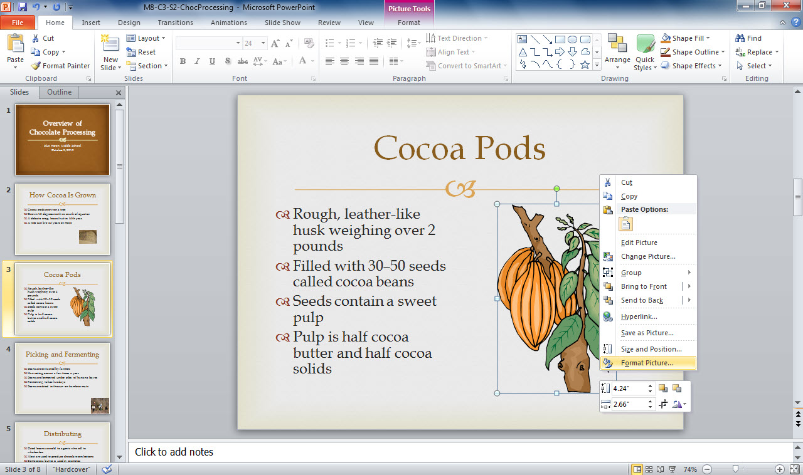
Format Picture option in the shortcut menu
Selected slide
Notes:
In M8-C3-S2-ChocProcessing.pptx, you can see the shortcut menu that is displayed after right-clicking the picture. Another way is to click the Picture Tools Format tab and use the Picture Border and Picture Effects galleries in the Picture Styles group to make changes.

Slide 13
Arranging Objects If you place more than one image on a slide, you can arrange objects so that one appears to be in the front with the others tucked beneath.
Notes:
To create this effect, select one of the images to make it active, which displays the Picture Tools Format tab. In the Arrange group, use the Bring Forward and Send Backward options to change an object’s position relative to the other images.

Slide 14
Skill 3: Add Transitions
Click the Home tab.
Click the appropriate slide in the Slides/Outline pane to display it.
Click the Select button in the Editing group.
Click Select All from the drop-down list. This action selects all of the slides in the Slides/Outline pane.
Click the Transitions tab.
In the Transition to This Slide group, click the button for the transition you wish to apply. A small transition icon (resembling a sliding star) appears below all slide numbers in the Slides/Outline pane, indicating that the transition is applied to each slide.
Notes:
You can set up sounds to accompany transitions in your presentation. You can easily apply transition effects to a single slide, to multiple slides, or to all slides in a presentation. In addition, you can control the duration of the transition effect.

Slide 15
Skill 3: Add Transitions, continued
Save the file.
Click the Slide Show tab.
Click the From Beginning button in the Start Slide Show group.
Navigate through the slide show to view the transition effects you applied. Click your mouse once at the end of the slide show to return to the Normal view.

Slide 16
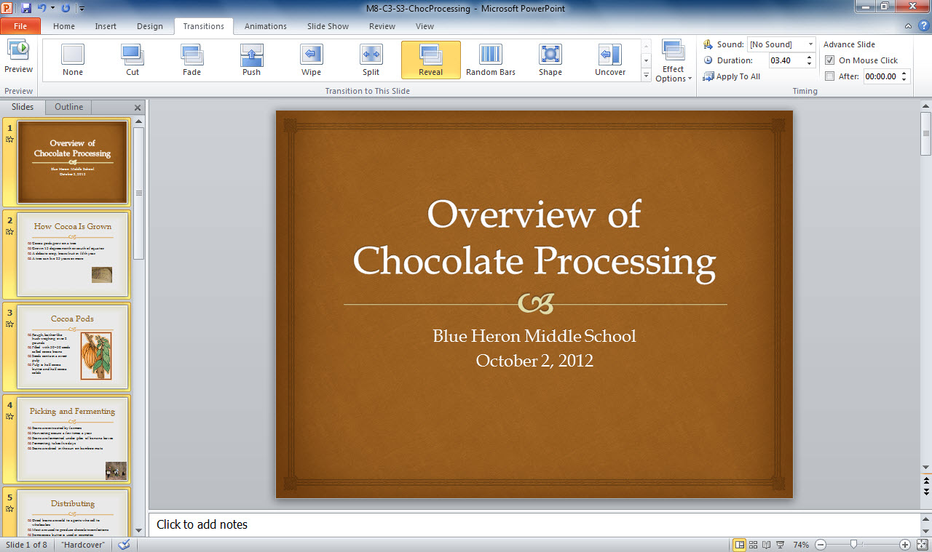
Transitions tab
More button
Transition effects selection buttons
Transition icon
Notes:
Notice in M8-C3-Se-ChocProcessing.pptx, that all of the slides have been selected. To view more effects in the Transitions to This Slide group, click the More button (marked by a down-pointing arrow with a dash above it and located at the right of the transitions options row).

Slide 17
Removing Transitions Using too many
transitions in a single presentation can be
distracting for your audience. If you decide that you have too many transitions, you can remove one.
Notes:
To remove a transition, click the slide or slides where the transition is applied and click the Transitions tab. In the Transition to This Slide group, click the None button in the transitions gallery.

Slide 18
Checkpoint 1
To insert an object on a slide you can click icons in the
content placeholder.
Insert tab.
Clip Art task pane.
All of the above
To insert a picture that is located on a disc,
click the Clip Art button in a content placeholder.
click the Insert tab and then click the Clip Art button.
click the Insert tab and then click the Picture button.
None of the above
Answer
Answer
To narrow results in clip art searches to only certain types of graphics, you can change the selection in the
content placeholder.
Results should be option in the Clip Art task pane.
Search for option in the Clip Art task pane.
Include Office.com content option.
Which formatting effects can you apply to pictures?
borders
adjusting picture brightness
modifying picture colors
All of the above
Answer
Answer
Next Slide
Notes:
In Slide Show View, click the Answer button for Question 1 after you believe that you know the correct answer. The correct answer will be displayed. Then click the Answer button for Question 2 and the answer will appear. Continue repeating these steps for all four questions in order. When complete, click the Next Slide button.

Slide 19
Skill 4: Add Sound
In the Slides/Outline pane, select the last slide in the presentation.
Click the Transitions tab.
In the Timing group, click the down arrow next to the Sound field to display a menu of sounds.
Click Applause in the drop-down list to apply this sound to the selected slide. Now, when the last slide appears during a slide show, this sound plays.
Click the down arrow next to the Duration field twice to change the time to 03.00.
Notes:
Transitions can be accompanied by sounds. You may successfully use a carefully chosen sound for one or two transitions within the presentation. For example, if you displayed great sales numbers for the quarter, you might add the brief sound of applause, or if you display a slide containing a photo, you might add the camera click sound.

Slide 20
Skill 4: Add Sound, continued
Save the file.
Preview the applied sound and animation for the last slide by clicking the Slide Show view button at the bottom of the screen.
After previewing the slide, press Esc to return to the Normal view.
Notes:
Be careful that you do not overuse sounds. Playing a sound for every transition can annoy your audience and detract from your message. Use sounds rarely and strictly for emphasis or fun.

Slide 21
Sound button drop-down arrow
Sound options
The last slide
Notes:
In M8-C3-S4-ChocProcessing.pptx, you see the sound options displayed on the Transitions tab. Hover your mouse pointer over a sound option to preview the sound.

Slide 22
Using Your Own Audio in a Presentation You can use any audio file that you have created or downloaded in your PowerPoint presentation.
Notes:
Simply click the Insert tab and click the Audio button. Browse to locate the audio file on your computer or storage medium and insert it. A small speaker icon appears on your slide with a play button during the slide show. Click the Play button to play the audio.

Slide 23
Skill 5: Add Animations
Click the appropriate slide in the Slides/Outline pane.
In the Slide pane, click anywhere in the title placeholder.
Click the Animations tab.
In the Animation group, click an option to apply the animation to the title. A 1 appears on the slide next to the title to show it is the first animation.
Click the Animation Pane button in the Advanced Animation group to open the Animation pane.
Notes:
Whereas transitions apply effects when a slide appears, animations apply effects to how the content on each slide appears. For example, you can have a heading zoom in or a picture fade in. You can use tools on the Animations tab or in the Animation pane to control what causes the effect to play—for example, when you click your mouse or when another animation starts. Animations can be applied to text or image objects.

Slide 24
Skill 5: Add Animations, continued
Click the Play button to preview the animations applied to the current slide.
Click the arrow at the right of an animation in the Animation pane.
Click Start With Previous from the drop-down menu. This causes the animation of the subtitle to begin when the animation of the title begins.
Click the Play button in the Animation pane to preview timing.
Close the Animation pane.

Slide 25
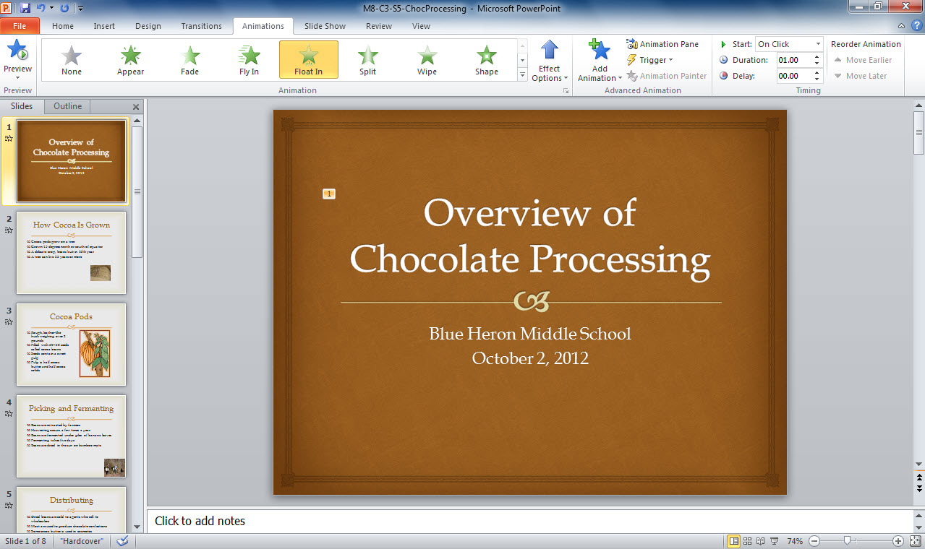
Animations tab
Animation options
Number 1 for first animation
Notes:
M8-C3-S5-ChocProcessing.pptx shows an animation applied to the first slide. Notice the small number 1 on the slide next to the title. In a content placeholder with multiple entries of text, you can apply animation to animate each bullet point separately and in number order.

Slide 26
More Animation Effects If you don’t like any of the effects shown in the Animation gallery, be sure to explore the options at the bottom of the expanded gallery.
Notes:
These offer additional entrance, emphasis, and exit effects, as well as motion paths. Motion path animations move the entire object along a path on your slide, such as around a circle or six-pointed star.

Slide 27
Skill 6: Choose Animation Effects
Click the appropriate slide in the Slides/Outline pane.
Click the Animations tab.
Click the subtitle placeholder.
Click an animation effect in the Animation group.
Click a direction in the Direction section.
Click the Preview button to view the animation.
Click the website address and then click an option in the Animation group to apply a different animation style to the website address.
Click the Preview button to view the animation.
Notes:
You can refine animation styles in a variety of ways. For example, if you animate text so that it flies in, you can also choose the direction from which it enters. The ways in which you can refine an animation style depend on the style you choose. In this skill, you experiment with adding and refining a couple of animation styles.
If it is not already open, open M8-C3-S5-ChocProcessing.pptx, the file you saved in the previous skill, and save the file as Lastname-M8-C3-S6-ChocProcessing, but replace Lastname with your last name. Be sure to save the file in your Module 8 working folder on your storage medium.

Slide 28
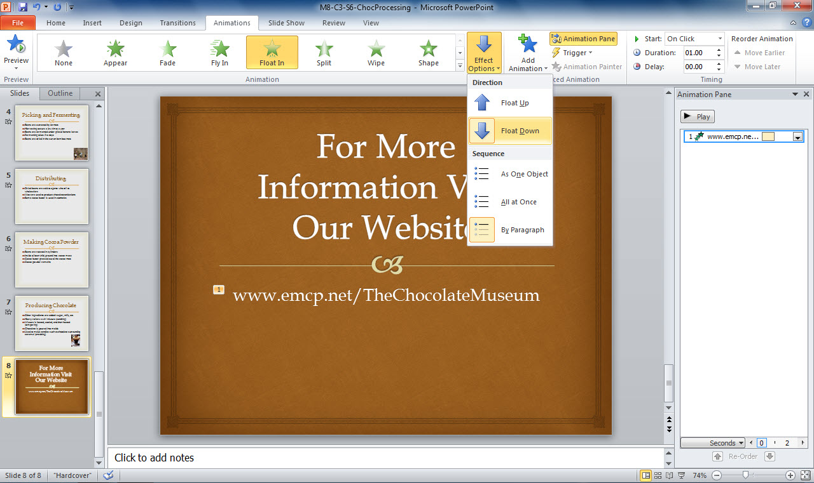
Preview button
Effect Options button
Animations tab
Direction options
Notes:
Notice the options on the Animations tab in Lastname-M8-C3-S6-ChocProcessing.pptx.

Slide 29
Timing Animations You can change the timing of animations with the Duration and Delay fields in the Timing group on the Animations tab.
Notes:
Select an object with animation applied and use the Duration field to set the length of time the animation should play. Use the Delay field to set the length of delay between two animations. You can animate the bullet points in your presentation by, for example, having them fade in or out or slide into place.

Slide 30
Checkpoint 2
One button you use to arrange objects on your slide is
Group.
Bring Forward.
Picture Effects.
Text Direction.
Sounds can accompany
animations.
transitions.
title slides.
All of the above
Answer
Answer
Animations effect
what appears when you move from one slide to another.
transition sounds.
how the content of each slide appears.
videos inserted into your presentation.
Transitions are effects that occur
when you move from one slide to another.
when you click an animation button.
when you display bullet points on a slide.
if you play several animations on one slide.
Answer
Answer
Next Slide
Notes:
In Slide Show view, click the Answer button for Question 5 after you believe that you know the correct answer. The correct answer will be displayed. Then click the Answer button for Question 6 and the answer will appear. Continue repeating these steps for all four questions in order. When complete, click the Next Slide button.

Slide 31
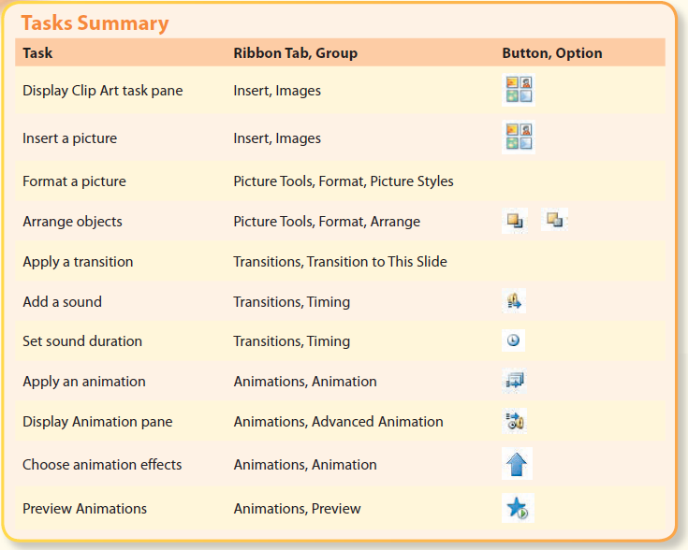
Tasks Summary
Notes:
Here is a summary of the PowerPoint Chapter 3 tasks.

