Slide 1
Microsoft Access 2010
MODULE 7
Chapter 1: Working with Databases
Chapter 2: Using Forms and Tables
Chapter 3: Working with Queries and Reports
Notes:
In Module 7, you learn about Microsoft Access 2010. Chapter 1 covers working with databases including entering data and navigating. Chapter 2 deals with using forms and tables. In Chapter 3, you will work with queries and create and display reports.

Slide 2
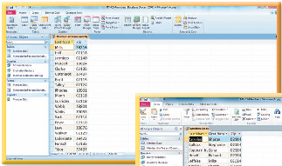
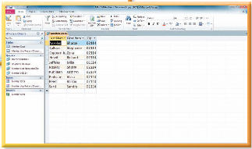
Working with Queries and Reports
Chapter 3
Notes:
The third chapter in the Access module deals with working with queries and reports.

Slide 3
Skills You Learn
Use the Query Wizard
Create a query in Design view
Use more than one table in a query
Create a report
Preview a report
Notes:
This chapter is about creating queries to find the information you are looking for within an Access database. You will also learn how to create, preview, and print a report.

Slide 4
Chapter 3: Working with Queries and Reports
A Query
Is an easy way to find the information you are looking for
Asks a question of the database
Shows only the data that you want to view at any given time
Can look at fields from a single table or multiple tables
Results can be sorted or filtered and arranged in the order you prefer
A Report
Can be created by using the information in a table or in a query
Can be distributed in printed or electronic form
Can be sorted, grouped, and/or formatted
Notes:
A database may contain hundreds of records that are divided among many related tables. An easy way to find the information you are looking for is to create and run a query. A query shows only the data that you want to view at any given time. You can look at a limited number of fields from a single table or draw fields from multiple tables to view that data together.
You can use the information in a table or in a query to create a professional-looking report.

Slide 5
Skill 1: Use the Query Wizard
Open the file and click the Enable Content button.
Click the appropriate table in the Navigation pane.
Click the Create tab.
Click the Query Wizard button in the Queries group.
In the New Query dialog box, select Simple Query Wizard.
Click the fields you want in your query in the Available fields list box and use the single right arrow button (>) to add the fields to the query.
Notes:
Once you have entered information into a database, you can query the database to find records that meet certain criteria. A query pulls, or extracts, data from one or more tables.

Slide 6
Skill 1: Use the Query Wizard, continued
Select the Detail or Summary option and then click Next.
Select the text in the Title text box and add a title for your query.
Make sure the Open the query to view information option is selected and then click Finish to direct the query to run and view the results.
Close the query.
Notes:
Note: Be sure to open all database files from your working folder on your storage medium. Access database files opened directly from the Student Resources CD are read-only.

Slide 7
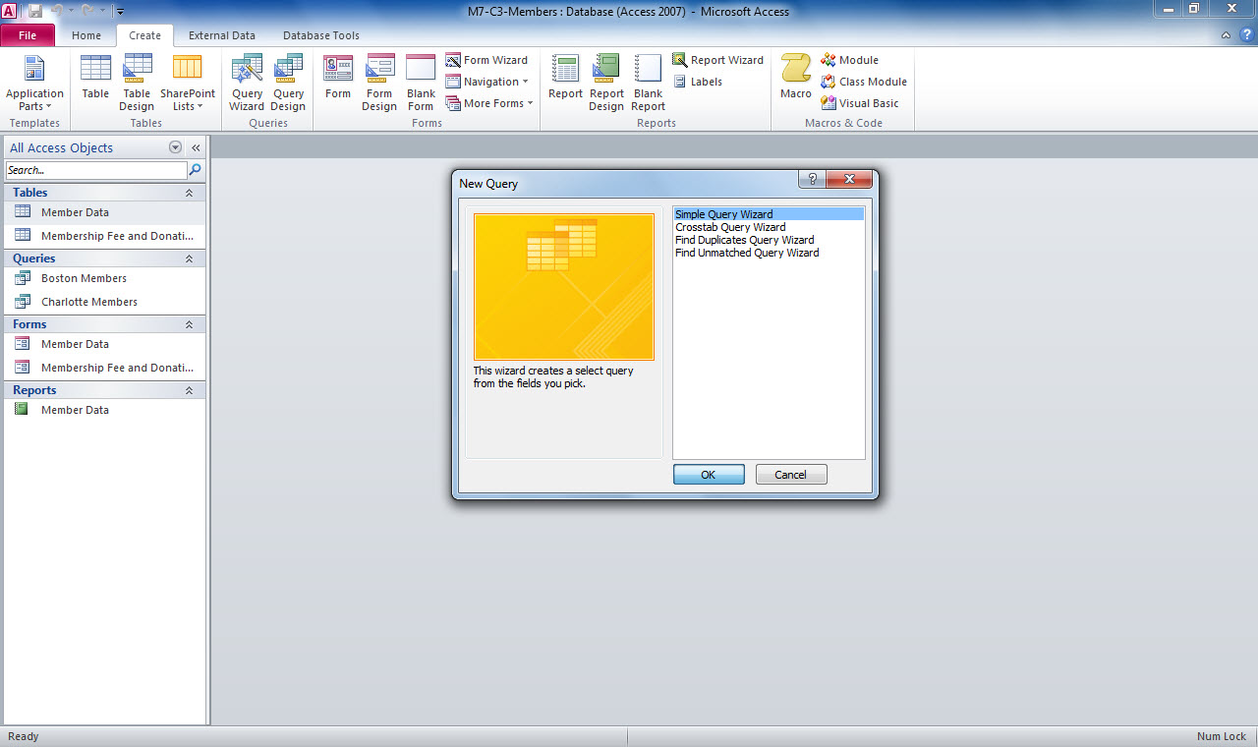
Query Wizard button
New Query dialog box
Notes:
In M7-C3-Members.accdb, the table Member Data has been selected in the Navigation pane. The New Query dialog box was opened by selecting the Query Wizard button in the Queries group on the Home page.

Slide 8
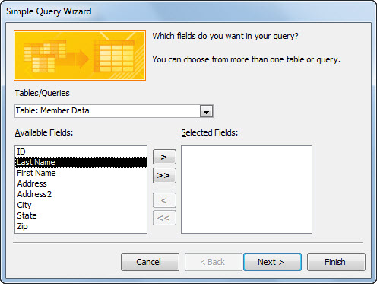
Table name
Field selected for query use
Single arrow button
Notes:
Here you select the appropriate fields to use in your query. Select the field, then use the right arrow button to move the field to the Selected Fields box. Click the Next button to move to the next option. If you need to select all available fields, click the double right arrow button (>>).

Slide 9
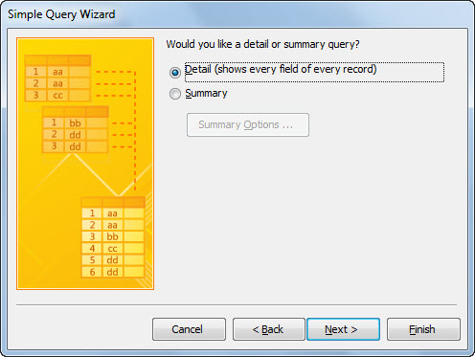
Detail or Summary option
Next button
Notes:
Select the Detail or Summary option and then the Next button to move to the next Wizard option.

Slide 10
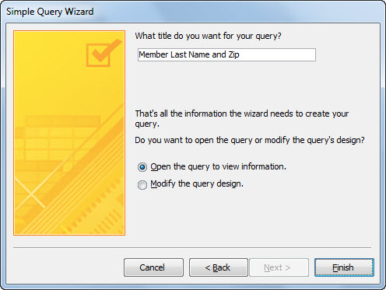
Title text box
Open the query to view information
Finish button
Notes:
Add a title to your query and select whether you want to open the query to view the query information or modify the query design. Click the Finish button to complete the tasks and close the Query Wizard. The new query will now appear in the Queries list in the Navigation pane.

Slide 11
Deciding to Query or to Filter When you create a query, Access saves the query as an object in the database. Because the query is saved, you can run it again at a later time without having to recreate the query. In contrast, filtering displays the results
temporarily.
Notes:
Another advantage of running a query is that you can easily create a report from a query, giving you the option of presenting the query results in a
professional format

Slide 12
Skill 2: Create a Query in Design View
Open the database and click the Create tab.
Click the Query Design button in the Queries group.
Click the table name in the Tables tab of the Show Table dialog box.
Click Add and close the Show Table dialog box.
Double-click the fields in the table field list box that you wish to use in your query. The fields are added to the query design grid at the bottom of the window.
Notes:
You can create a query in Design view by using the query design grid. When you create a query in Design view, you have more options and more control than you do with the Query Wizard.

Slide 13
Skill 2: Create a Query in Design View, continued
Click the sort cell in any fields that you may wish to have sorted in your query. Click the drop-down arrow and select the sort view (ascending or descending).
Click the criteria cell in the field you wish to use and add any criteria necessary.
On the Query Tools Design tab, click the Run button in the Results group to display the results in a datasheet.
Click the Save button and name your query. Close the query.

Slide 14
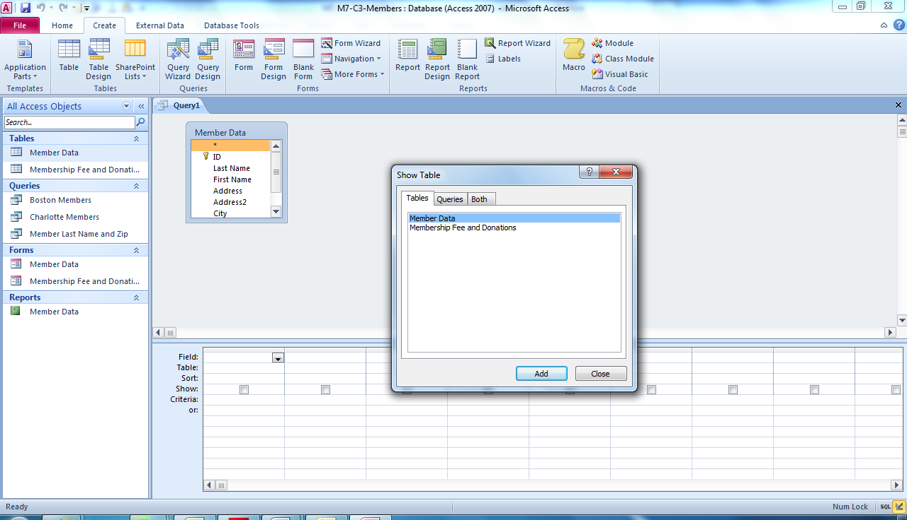
Query Design button
Show Table dialog box
Notes:
Using M7-C3-Members.accdb, you can create a query in Design view. Select the table you wish to use in the Show Table dialog box.

Slide 15
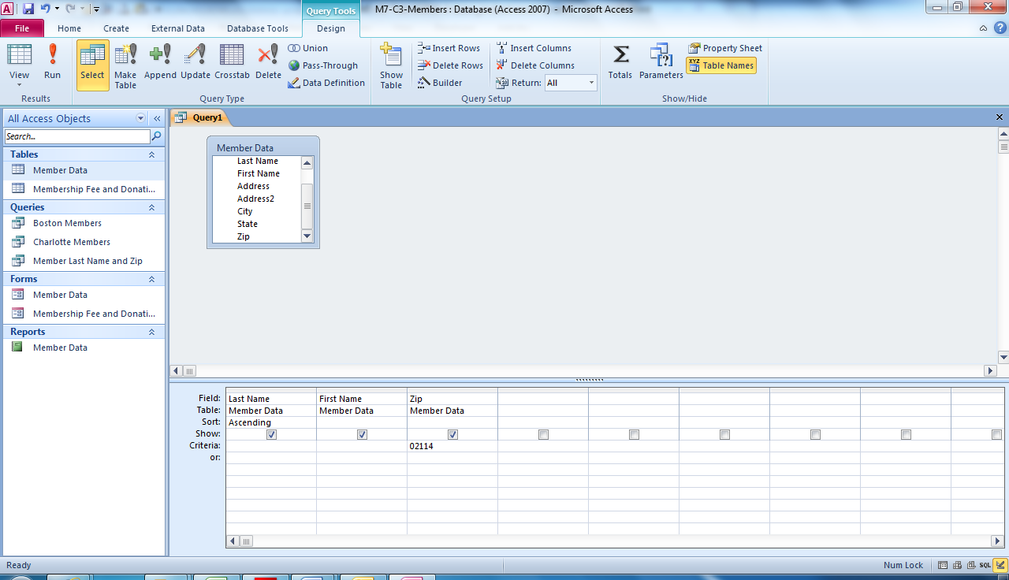
Table Field list box
Query Design grid
Sort cell
Criteria cell
Notes:
Here you see the fields in the Query Design grid. Notice the Ascending sort selected in the Last Name field along with the Zip criteria in the Criteria cell.

Slide 16
Specifying Criteria You can also create a query with criteria from more than one field and you can use wildcards to represent any combination of letters, numbers, and special symbols.
Notes:
For example, to find all members of The Chocolate Museum whose last names start with the letter S and who also live in Boston, you would type Boston in the Criteria row of the City field and then type S* in the Criteria row of the Last Name field. The * is a wildcard.

Slide 17
Skill 3: Use More Than One Table in a Query
Open the database and click the Create tab.
Click the Query Design button in the Queries group.
Click the table name in the Tables tab of the Show Table dialog box.
Click the second table name in the Tables tab of the Show Table dialog box.
Click Close to close the Show Table dialog box.
Notes:
Tables in a database can be related through a common column of data. Such database design features are helpful because the tables do not need to contain a lot of duplicate data and, as a result, the database operates more efficiently. When Access tables are related, you can pull data from more than one table to create a query.

Slide 18
Skill 3: Use More Than One Table, continued
Double-click the fields in the first table field list box that you wish to use in your query. The fields are added to the query design grid at the bottom of the window.
Double-click the fields in the second table field list box that you wish to use.
Add any sorting and criteria necessary.
Click the Run button in the Results group.
Save and close the query.

Slide 19
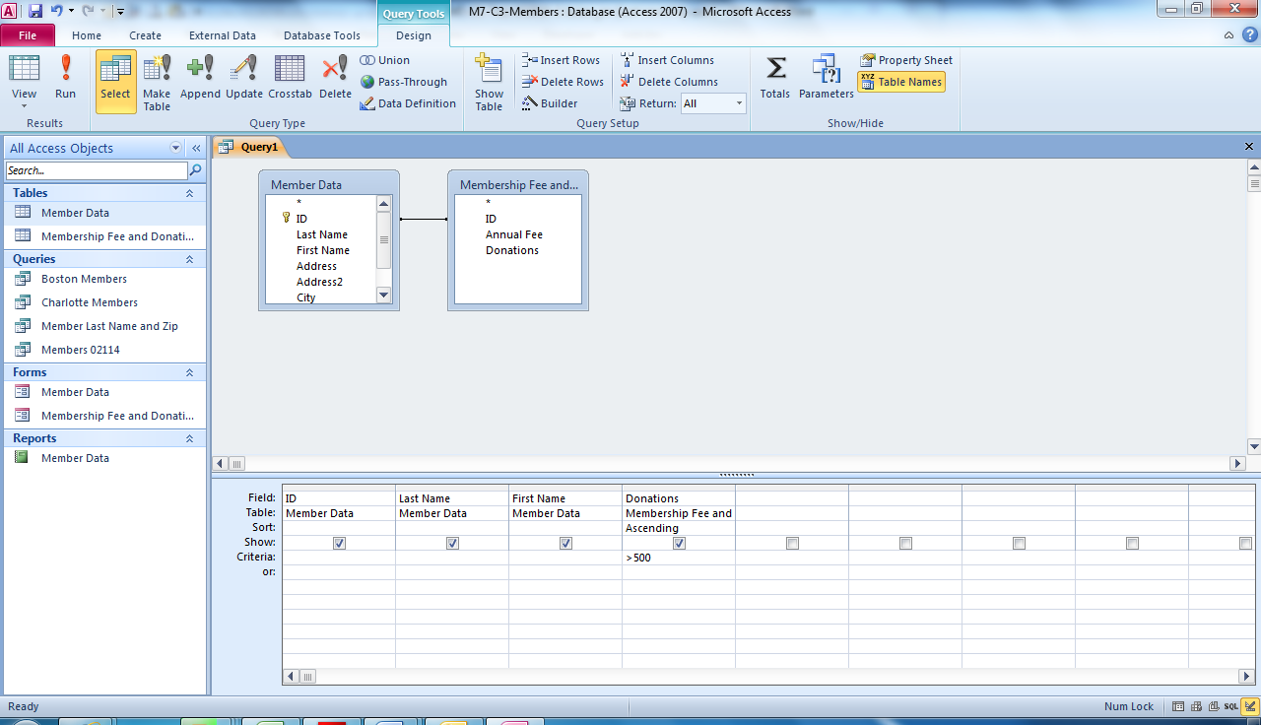
Two tables showing with relationship line
Fields from both tables included in query design grid
Notes:
In M7-C3-Members.accdb, you see two tables showing with a relationship line between them. In the Query Design grid, fields from both tables have been used. In addition to > (greater than), you can use other relational operators in your criteria, including > = (greater than or equal to), < (less than),
< = (less than or equal to), = (equal to), and < > (not equal to) as search criteria.

Slide 20
Reviewing Relationships In most cases, an Access table is related to at least one other table in the database.
Notes:
You can view the existing table relationships by clicking the Relationships button in the Relationships group on the Database Tools tab. Then click the All Relationships button to display all existing relationships.

Slide 21
Skill 4: Create a Report
With the database open, click the table or query you wish to use for your report.
Click the Create tab and the Report button in the Reports group to display the report in Layout view.
Click the Themes button in the Themes group and add an appropriate theme to your report.
Click the Group & Sort button in the Grouping & Totals group to display the Group, Sort, and Total pane. Select any sorting options.
Notes:
Reports present Access data in an attractive, easy-to-print format. A report is based on multiple, related tables or queries. When you create a report, Access links the report to the objects (query and/or tables) you used to create that report. Because the report is linked, it always displays current data.

Slide 22
Skill 4: Create a Report, continued
Click a Total cell to make it active.
Hover the mouse pointer over the border of the cell until the pointer becomes a double-headed arrow and then double-click the cell border to AutoFit the cell.
Select the Add a Group button in the Group, Sort, and Total pane and select an option to group the report.
Name and save the report. Close the report.
Notes:
You can create a report in several ways. When you use the Report button to create a report, the report is displayed in Layout view, where you can then format it.

Slide 23
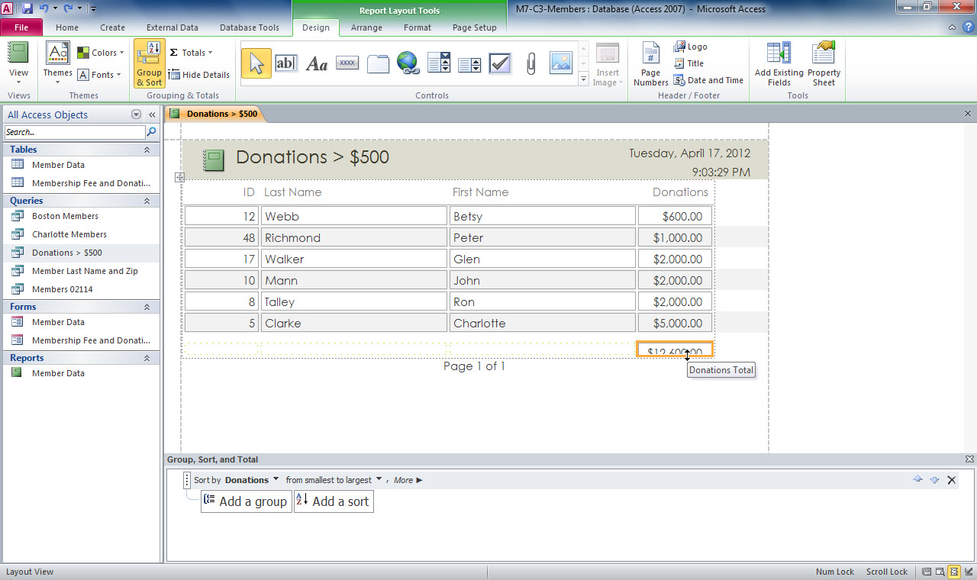
Group & Sort button
Total cell selected
Group, Sort, and Total pane
Notes:
Using the Donations > $500 query in M7-C3-Members.accdb, the Report Layout Tools Design tab is now the active tab. Notice the Group, Sort, and Total pane at the bottom of the report.

Slide 24
Formatting a Report The Report Layout
Tools Design tab contains options for
formatting a report.
Notes:
You can click the Logo button to add a business logo to the report. You can also modify the title and the date and time that are displayed by default in the report. Double-click the title to modify it or click the Date and Time button to display the date and time format options. The Report Layout Tools Format tab also contains options for formatting a report. You can click a cell in the report and then change options, such as the font, font size, text color, or fill color. You can also add a background image to the report.
The Report Layout Tools Arrange tab contains options for inserting rows and columns and altering the layout of the report. The Report Layout Tools Page Setup tab contains options for formatting the page size and the page layout.

Slide 25
Skill 5: Preview a Report
Double-click the report you wish to preview in the Navigation pane.
Click the down arrow on the View button in the Views group on the Home tab.
Select Print Preview from the drop-down list.
On the Print Preview tab, click the Landscape button in the Page Layout group to change the print orientation to landscape.
Click the Print button.
Notes:
Before printing a report, it is good practice to use the Print Preview feature to view what the printed copy will look like and adjust the print settings, if necessary. The Print Preview tab in Access contains print and page layout options as well as options for exporting the report to another format, such as PDF. When you preview the report, you need to check the presentation of the data and the page setup.

Slide 26
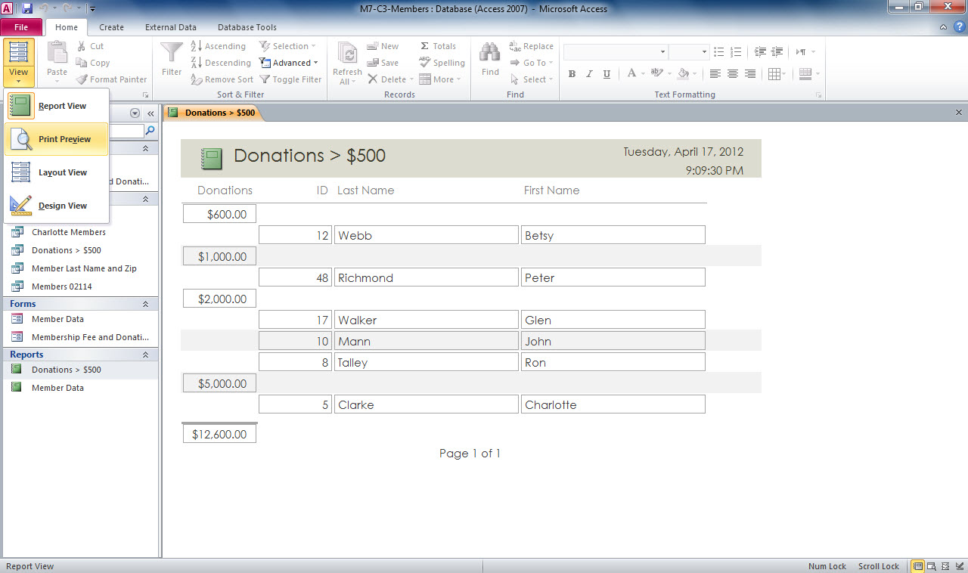
View button
Print Preview
Notes:
In M7-C3-Members.accdb, you can see the Print Preview button selected in the View drop-down options. Another way is to right-click a report object
in the Navigation Pane and then select Print Preview.

Slide 27
Saving a Report as a PDF File You may want to save a report as a PDF file. You can save an Access report in other formats.
Notes:
PDF allows anybody to use a free reader program to view the report with its formatting intact, so the report looks the same on every computer. To save a report as a PDF file, click the PDF or XPS button in the Print Preview tab, type a file name, and then click the Publish button in the Publish as PDF or XPS dialog box.

Slide 28
Checkpoint
Which of the following asks a question of the database?
table
form
query
report
Which button changes the print orientation from the default setting of Portrait?
Group & Sort
Themes
Landscape
Print
Answer
Answer
You can distribute a database report
in printed format.
in electronic format.
as a PDF file.
All of the above
Which view do you use to change the print orientation?
Form view
Datasheet view
Print Preview
Design view
Answer
Answer
Next Slide
Notes:
In Slide Show View, click the Answer button for Question 1 after you believe that you know the correct answer. The correct answer will be displayed. Then click the Answer button for Question 2 and that answer will appear. Continue repeating these steps for all four questions in order. When complete, click the Next Slide button.
These Checkpoints are designed to provide you with an opportunity to reflect on a few concepts at a time.

Slide 29
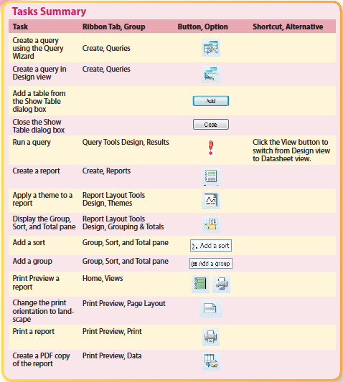
Tasks Summary
Notes:
Here is a summary of the Access Chapter 3 tasks.

