Slide 1
Microsoft Access 2010
MODULE 7
Chapter 1: Working with Databases
Chapter 2: Using Forms and Tables
Chapter 3: Working with Queries and Reports
Notes:
In Module 7, you learn about Microsoft Access 2010. Chapter 1 covers working with databases including entering data and navigating. Chapter 2 deals with using forms and tables. In Chapter 3, you will work with queries and create and display reports.

Slide 2
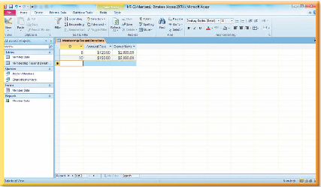
Using Forms and Tables
Chapter 2
Notes:
The second chapter in the Access module deals with using forms and tables.

Slide 3
Skills You Learn
Create a table
Enter data in a table
Create a form
Enter data in a form
Notes:
This chapter is about creating tables and entering data in a table. We will also learn about creating a form and entering data in a form.

Slide 4
Chapter 2: Using Forms and Tables
When creating a table
Give each field a name
Assign a field type
AutoNumber field: automatically stores a number that is one greater than the last number used
Text field: stores characters and numbers that do not require calculations
Number field: stores numbers only
Date/Time field: stores dates and times
Currency field: stores dollar amounts
Use Design view to create the table; Datasheet view to enter records
Notes:
In this chapter, you learn to create a table and a form. When you create a table, you need to give each field a name and also assign a field type. The field type tells Access which type of data you will be storing in that field. Access has several views that you use to perform different tasks. To switch views, you use the View button arrow on the Home tab.

Slide 5
Chapter 2: Using Forms and Tables, continued
A form
Can also be used to enter data.
Provides a user-friendly interface to enter data to be stored in a table.
Adds the record to the corresponding table just as if you added the record directly into the table in Datasheet view.
Initially displays in Layout view, when you use the Form button to create it.
Can be edited in either Design or Layout view.
Must be switched to Form view to add records to the underlying table.
Notes:
You can enter data in a table or a form. When you enter a record using a form, that record is added to the corresponding table just as if you added the record directly into the table in Datasheet view.

Slide 6
Skill 1: Create a Table
Open the file and click the Enable Content button.
Click the Create tab.
Click the Table Design button in the Tables group so that you can create the table in Design view.
In the first field in the Field Name column, type the first field name and then press the Tab key.
In the first field in the Data Type column, click the drop-down arrow and then click the data type.
Notes:
You create a table in Design view. You need to name each field and select a data type for each field in the table. When you save the table, Access asks you if you want to make one of the fields a primary key. You won’t assign a primary key to the table you create in this skill, but you should know that a primary key can be assigned to one of the fields in a table, such as a member ID number, to make sure no two records in a table are the same. The primary key column cannot contain duplicate entries.

Slide 7
Skill 1: Create a Table, continued
Continue adding Field Names and Data Types to the table until you have added all of the field names necessary.
Click the Save button on the Quick Access toolbar.
Type the table name in the Table Name text box in the Save As dialog box.
Click OK and then click No in the warning box indicating that a primary key is not selected.
Click Close to close the table.

Slide 8
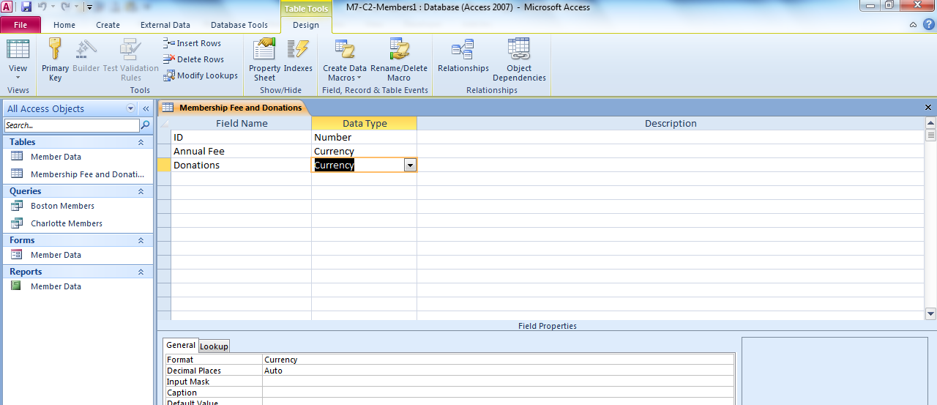
Field Name column
Data Type drop-down arrow
Notes:
In M7-C2-Members.accdb, a table is being added in Design view. You can see the Field Names and Data Types listed along with the drop-down arrow for the Data Type column. The field in the Description column, to the right of the Data Type column, is optional. You can use it to describe the contents of the field.

Slide 9
Changing Field Size Some field types have a specified or a maximum field size. Change this setting in the Field Properties section of the Design view window.
Notes:
Text fields can store up to 255 characters. If you want to limit a Text field to fewer characters (such as limiting fields for phone numbers or zip codes to help
reduce data entry errors), replace the Field Size value of 255 with another value. A field size cannot be set for date/time, currency, or hyperlink fields.

Slide 10
Skill 2: Enter Data in a Table
To enter data using a table:
Double-click the table you wish use in the Navigation pane.
Add the information to create a new record, using the Tab key to move between fields.
You can use the Copy button and the Paste button in the Clipboard group on the Home tab to copy similar record information in the table.
Use the record selection area to the left of the record to select all of the fields in the record.
Use the record selection area to the left of the record to paste all of the fields in the record. Make necessary changes to the data.
Close the table.
Notes:
The new table is an object in the database. Typing records is one way to enter data in a table. You can also copy and paste data from other programs or
databases, which saves time and also helps to prevent data entry errors. Adding records is sometimes referred to as populating the database.

Slide 11
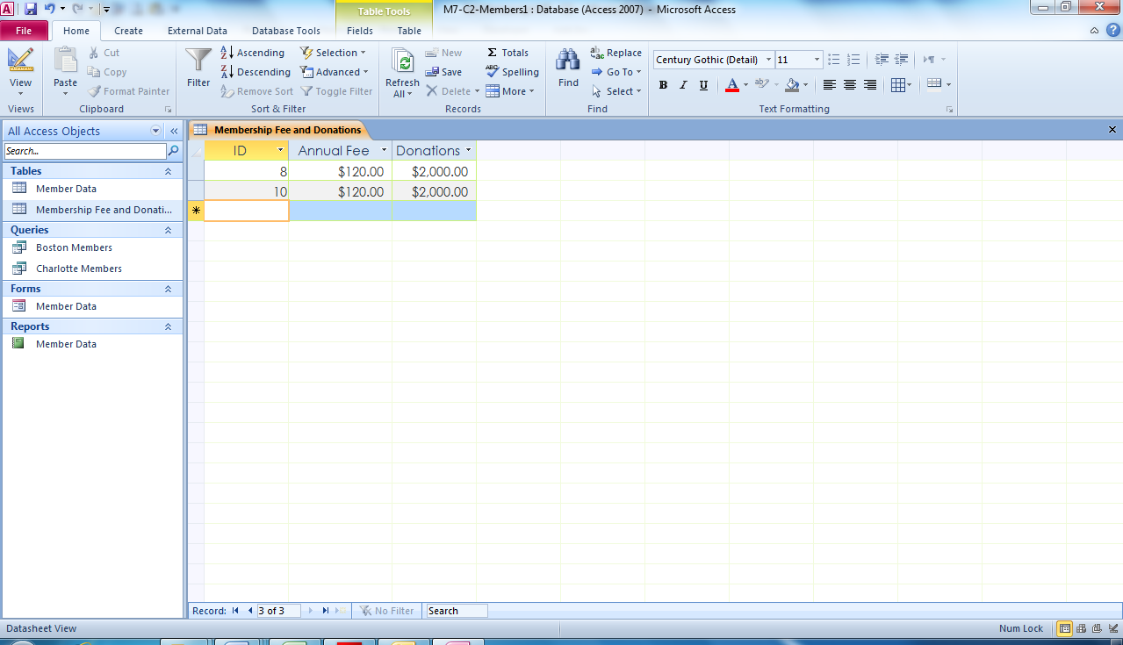
Copy and Paste button area
Record Selection area
Notes:
Here, in M7-C2-Members.accdb, you can see the Record Selection area along with the Copy and Paste buttons in the Clipboard group on the Home tab. You can use copy and paste to save time when a new record is almost identical to an existing record. After pasting, you change only the part of the record that differs. In this case, all of the record data is the same except the ID field.

Slide 12
Copying and Pasting Data Another way to populate a table is to copy existing data from a Word or Excel file into an Access table. To copy all of the data from a Word source, first separate the data by tabs or copy it from a table.
Notes:
Whether you copy the data from Word or Excel, the data has to match the fields in the Access table. Click the record selection area for the next blank record before pasting the data. Note that you may copy and paste multiple records.

Slide 13
Skill 3: Create a Form
Click the appropriate table in the Navigation pane.
Click the Create tab.
Click the Form button in the Forms group to display a form.
Adjust the size of all of the fields by hovering the mouse over the right border of the field until it becomes a two-headed arrow, press and drag the right border to the left until the box is about half of its original size, and then release the mouse button.
Notes:
A form is a database object used for entering records in a table. You can also use a form to view existing records. Most forms show only one record at a time, which provides a simple interface for entering data and helps you to avoid data entry mistakes. A new form can be based on one or more database objects. When you first create a new form, it displays in Layout view, where you can format it.

Slide 14
Skill 3: Create a Form, continued
On the Form Layout Tools Design tab, in the Header/Footer group, click the Date and Time button and click OK in the dialog box to add the date and time.
Click the Save button on the Quick Access toolbar.
Add the form name in the Save As dialog box.
You will see the form name added to the Navigation pane.
Click Close to close the form.

Slide 15
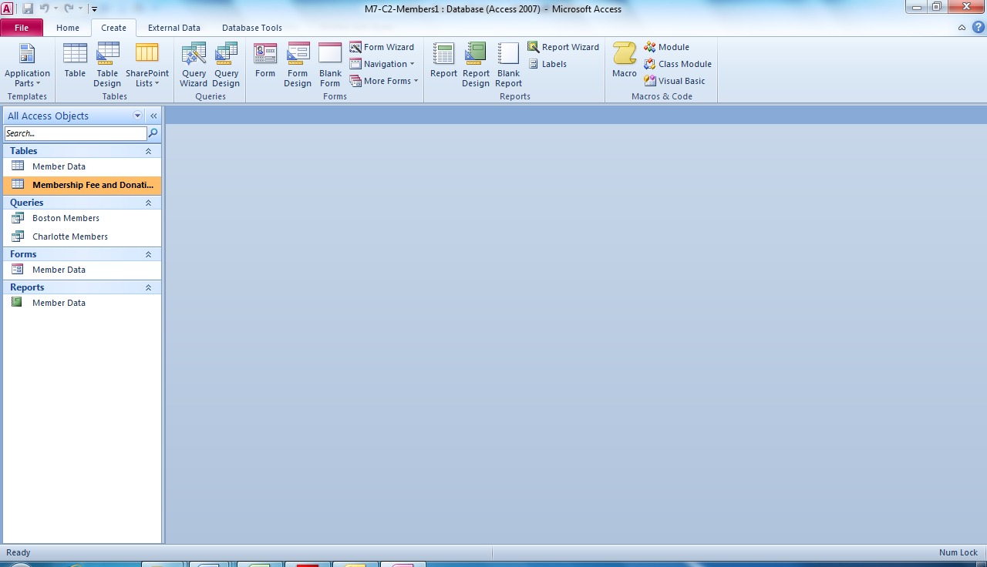
Form button on Create tab
Table listed in Navigation pane
Notes:
Using M7-C2-Members.accdb, you can see the Membership Fee and Donation table is selected in the Navigation pane. Clicking the Form button in the Forms group on the Create tab displays a form. You can also use the Form Design button to create a form. In that case, the form displays in Design view,
instead of in Layout view.

Slide 16
Changing Form Formatting and Views When you create a form, the Form Layout Tools tabs for Design, Arrange, and Format are displayed on the ribbon. You can use options on the Form Layout Tools Format tab to change the font, font size, and font style.
Notes:
You can also use the options on the Form Layout Tools Arrange tab to insert fields or alter the order of the fields. You can use options on the Form Layout Tools Design tab to add an image to the form or to change the form’s theme. However, you cannot enter records in the form until you switch to Form view. To do so, click the View button arrow and select Form view.

Slide 17
Skill 4: Enter Data in a Form
Double-click the form you wish use in the Navigation pane.
In the Record Navigation bar, click the New (blank) record button.
Type the data in the fields and use the Tab key to move to the next field. When you use the Tab key in the last field on the record, you will move to the next record or a new blank form.
Add all of the data into the records.
Close the form.
Notes:
When you open a form from the Navigation pane, it opens in Form view. You use this view to enter data in a form. The Record Navigation bar displays at the bottom of the form. You can add a new record by clicking the New (blank) record button in the Record Navigation bar. Use the Tab key to move between fields as you enter data in a record. If you press the Tab key after you enter data in the last field, a new blank form displays.

Slide 18
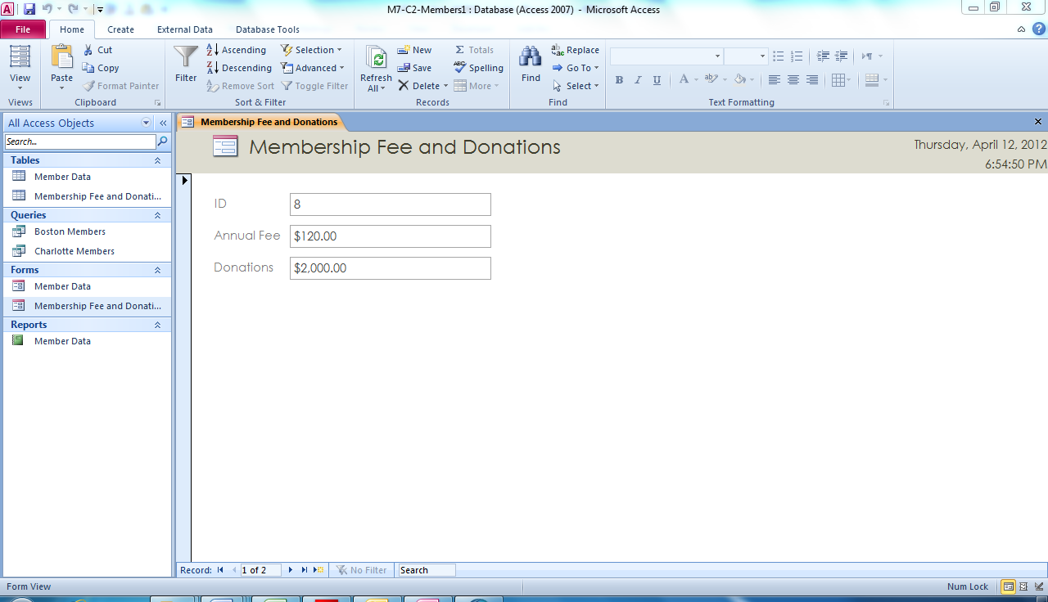
Use the Tab key to move between fields.
Form selected in Navigation pane
New (blank) Record button
Notes:
In M7-C2-Members.accdb, you can see the Membership Fee and Donation form. Notice the New (blank) Record button on the Record Navigation bar on the bottom of the form. Use the Tab key to move from field to field.
If the form does not display in the Navigation pane, click the down-pointing arrow in the Navigation pane header and click All Access Objects. When you
enter data in a form, Access saves the data automatically.

Slide 19
Using Record Controls The Record Navigation bar indicates which record is currently displayed and how many records the table contains. You can use record controls to scroll through the records.
Notes:
Record controls display at the bottom of an open form and include arrow buttons for moving directly to the First record, Previous record, Next record, and Last record.

Slide 20
Checkpoint 1
Which field type would you use to store dollar amounts?
Text
Number
AutoNumber
Currency
Which action selects an entire record?
Press the Tab key.
Click the Record button.
Click the first field in the record.
Click the Record Selection area.
Answer
Answer
Which view do you use to enter records in a table?
Design view
Datasheet view
Print Preview
Layout view
Which button creates a form and displays it in Layout view?
Form
Design
Report
Layout
Answer
Answer
Next Slide
Notes:
In Slide Show View, click the Answer button for Question 1 after you believe that you know the correct answer. The correct answer will be displayed. Then click the Answer button for Question 2 and that answer will appear. Continue repeating these steps for all four questions in order. When complete, click the Next Slide button.
These Checkpoints are designed to provide you with an opportunity to reflect on a few concepts at a time.

Slide 21
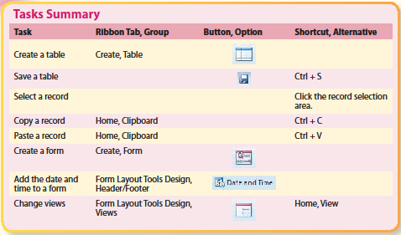
Tasks Summary
Notes:
Here is a summary of the Access Chapter 2 tasks.

