Slide 1
Microsoft Access 2010
MODULE 7
Chapter 1: Working with Databases
Chapter 2: Using Forms and Tables
Chapter 3: Working with Queries and Reports
Notes:
In Module 7, you learn about Microsoft Access 2010. Chapter 1 covers working with databases including entering data and navigating. Chapter 2 deals with using forms and tables. In Chapter 3, you will work with queries and create and display reports.

Slide 2
Microsoft Access Overview
A database is an organized collection of related data.
Databases such as Access use an object called a table to enter and organize data. When you open a table in Access, the table displays in a datasheet.
A field is a set of information that is stored in the database.
Each field has a field name, such as Product ID, Model, Product Description, or Unit Price.
A collection of related fields is called a record.
Access is a relational database, meaning that Access uses a series of related tables to organize the database.
Notes:
Computers today enable you to store large amounts of data and to quickly retrieve and organize that data. Much of the information you retrieve from a computer or from a website is stored in a database. To understand how databases work, you need to learn some database terminology.

Slide 3
Microsoft Access Overview, continued
Each table is usually related to at least one other table by sharing a column of data.
To enter records into a database, you can either enter the data directly into the table or fill in user-friendly forms that are designed for data entry. When you enter data in a form, that information is also entered into the corresponding table.
Once you have entered records into a database, you can use Access to answer queries or questions about the data.
You can also generate printed reports about the stored data.
Use Access when you need to organize and store large amounts of data, such as employee or inventory records.
Notes:
By organizing information in a database, you will be able to quickly find the data and answers you need.

Slide 4
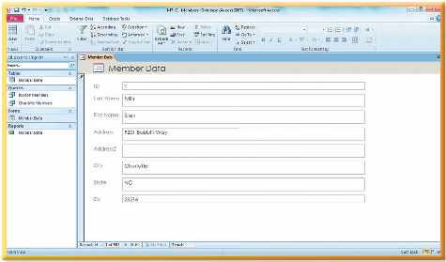
Working with Databases
Chapter 1
Notes:
The first chapter in the Access module deals with working with databases.

Slide 5
Skills You Learn
Open and navigate a database
Enter data
Edit data
Sort data
Filter data
Format a datasheet
Use existing queries and reports
Notes:
This chapter is about opening and navigating a database and entering, editing, sorting, and filtering data. You will format a datasheet and use existing queries to ask questions of your data. You will also display reports.

Slide 6
Chapter 1: Working with Databases
The Access database application is used to
manage large amounts of data
enter and organize data
use forms to enter data
once data has been entered, organize the data by sorting and filtering it
run a query
display a report
Notes:
Computers today enable you to store large amounts of data and to quickly retrieve and organize that data. Much of the information you retrieve from a computer or from a website is stored in a database. To understand how databases work, you need to learn some database terminology.

Slide 7
Skill 1: Open and Navigate a Database
Open the file and click the Enable Content button.
Review the objects listed in the Navigation pane and then double-click the appropriate table. The table displays in a datasheet and the first record is selected.
Click the Next record button in the Record Navigation bar to select the second record.
Click the Last record button in the Record Navigation bar to select the last record in this table.
Click the Close button to close the table.
Notes:
When a database opens, you do not see a document as you do in Word or a workbook as you do in Excel. Instead, you see a Navigation pane on the left side of the window that lists the names of the objects that make up the database. This list of objects includes all tables, forms, queries, and reports that are part of the database. To open an object, you double-click the object in the Navigation pane.

Slide 8
Skill 1: Open and Navigate a Database, continued
In the Navigation pane, double-click the appropriate form. The form displays only one record.
Click the Next record button in the Record Navigation bar to display the next record.
Click the New (blank) record button in the Record Navigation bar to display a new blank record. However, do not enter any new data at this time.
Click the Close button to close the form.

Slide 9
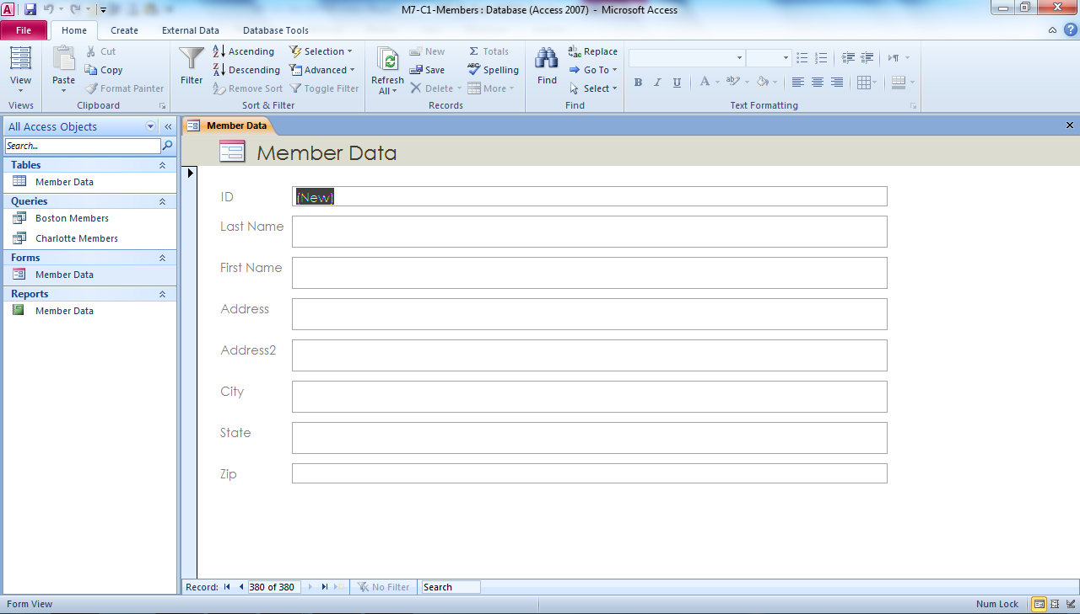
Navigation pane
Navigation bar
Notes:
In M7-C1-Members.accdb, you can see the Member Data form open. A form displays only one record at a time.

Slide 10
Opening More Objects You can have
more than one object open at a time in
Access. For example, you can open a table
and then open a second table or a form.
Notes:
Switch between open objects by clicking the tab at the top of the object. Each tab contains the name of the object and an icon that indicates the object type.

Slide 11
Skill 2: Enter Data
To enter data using a table:
Double-click the table you wish use in the Navigation pane.
Click the New (blank) record button in the Record Navigation bar.
Press tab and add the information to create a new record, pressing Tab to move to the next field.
Close the table.
Notes:
You can enter data in a table or in a form. Entering data in a table is useful for comparing records because you can see multiple records at once. However, this method can be confusing if you are entering a record with a lot of fields and you have to scroll through the fields. A form only displays one record at a time, and you usually do not have to scroll to enter the data for a record. Entering data into a form can also help you to avoid data entry errors.

Slide 12
Skill 2: Enter Data, continued
To enter data using a form:
In the Navigation pane, double-click the form you wish to use.
Click the New (blank) record button in the Record Navigation bar.
Press the Tab key and then add the information to create a new record, pressing Tab to move to the next field.
Close the form.

Slide 13
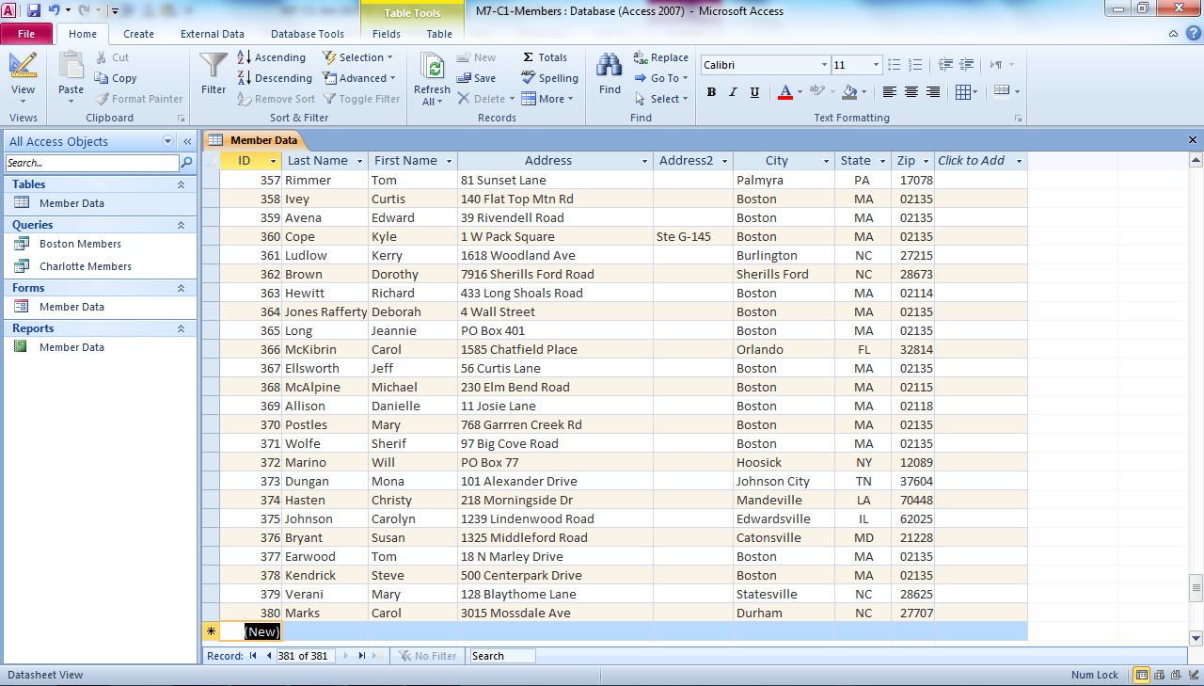
Add new record here
New (blank) record button
Notes:
Using M7-C1-Members.accdb, you can enter your new record directly into the Member Data table. The ID field is an AutoNumber field. For such fields, the new record will automatically be assigned the next number.

Slide 14
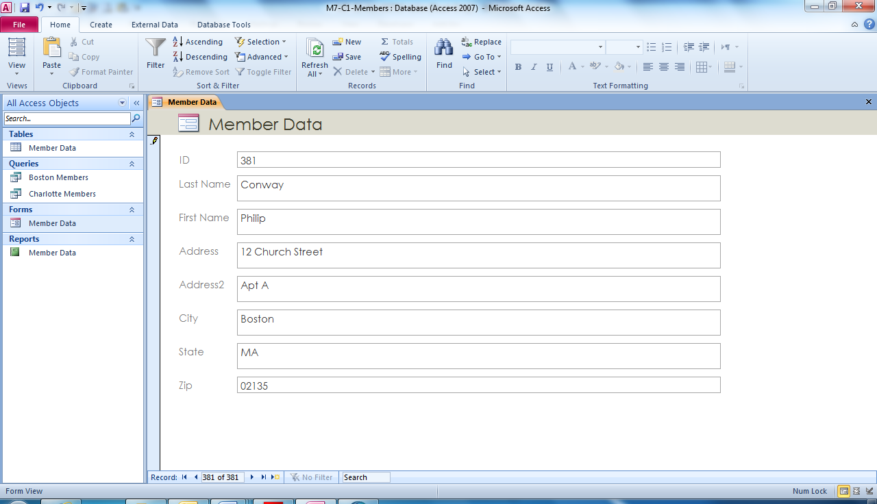
New (blank) record button
Notes:
Here in the Member Data form in M7-C1-Members.accdb, a new record was added using the New (blank) record button. Access automatically saves records that you enter in a table or a form. So you do not have to save your file before closing the table.

Slide 15
Checking Spelling The information that you enter into a database must be correct so that you can run queries and reports successfully and avoid problems down the road. In addition to proofreading your formulas and cell references, use spell check to check the correctness of your data.
Notes:
To check spelling, click the Spelling button on the Home tab. If Access finds any spelling errors, it displays a dialog box you can use to correct errors.

Slide 16
Skill 3: Edit Data
To edit data using a table:
Double-click the table you wish use in the Navigation pane.
In the record you wish to edit, double-click the text in the appropriate column.
Type the correct text and press the tab key.
Close the table.
Notes:
A database stores a lot of information, but the information is only useful if the records in the database are kept up-to-date.

Slide 17
Skill 3: Edit Data (continued)
To edit data using a form:
In the Navigation pane, double-click the form you wish to use.
Using the Record Navigation bar, locate the record you wish to edit.
Double-click the text you wish to edit in the appropriate field.
Type the correct text and press the tab key.
Close the form.

Slide 18
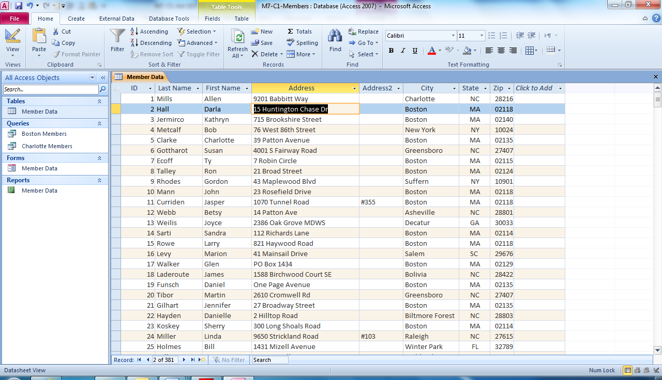
Add new text
Notes:
In M7-C1-Members.accdb, you see the Address text currently selected in the Member Data table. Type the new text and use the Tab key to move to a new field.

Slide 19
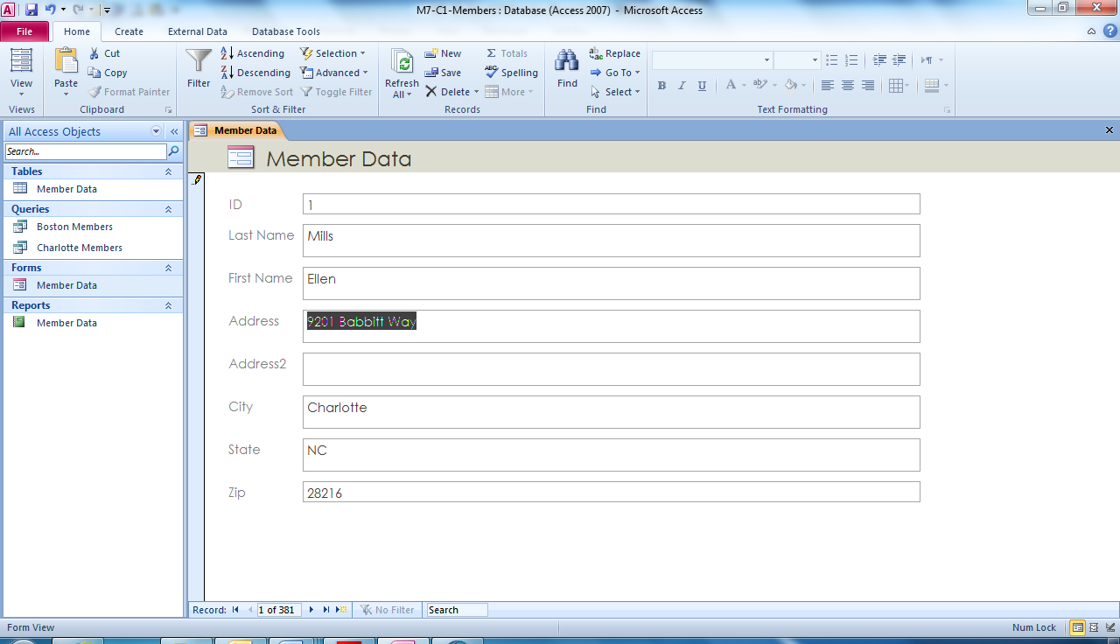
Text to be added here
Notes:
Using M7-C1-Members.accdb, select the form and then select the text in the field you wish to change. Type your new text and use the Tab key to move to the next field.

Slide 20
Deleting a Record Locate the specific record in the table. Click the record selection area, which is the
gray box to the left of the record’s first field. Next, click the Home tab and click the Delete button arrow. In the drop-down menu, click Delete Record and then click Yes to confirm the deletion.
Notes:
In certain instances, you will need to delete records to keep your database up-to-date.

Slide 21
Checkpoint 1
The Navigation pane lists all _____ in the database.
records
worksheets
objects
macros
A group of related fields, such as all the information about one employee, is stored in a
field.
column.
record.
row.
Answer
Answer
You can enter data in a
table.
form.
All of the above
None of the above
In a form, you usually see
one field.
one record.
one table.
the entire database.
Answer
Answer
Next Slide
Notes:
In Slide Show View, click the Answer button for Question 1 after you believe that you know the correct answer. The correct answer will be displayed. Then click the Answer button for Question 2 and that answer will appear. Continue repeating these steps for all four questions in order. When complete, click the Next Slide button.
These Checkpoints are designed to provide you with an opportunity to reflect on a few concepts at a time.

Slide 22
Skill 4: Sort Data
Double-click the table you wish use in the Navigation pane.
Click the text in the first record of the column you wish to sort.
On the Home tab, click the Ascending button in the Sort & Filter group. The records are now sorted in that column, in alphabetical order.
Click the Remove Sort button to remove the sort. The records are no longer sorted in that column.
Close the table. Select No in the dialog box that appears. You have not made any permanent changes to the design and do not need to save the table.
Notes:
It is good practice to enter database records in the order in which you receive them. However, when you are looking for specific information, you may find it helpful to sort a table by a particular column, such as Last Name rather than by date entered, so that you can easily find the information you are looking for.

Slide 23
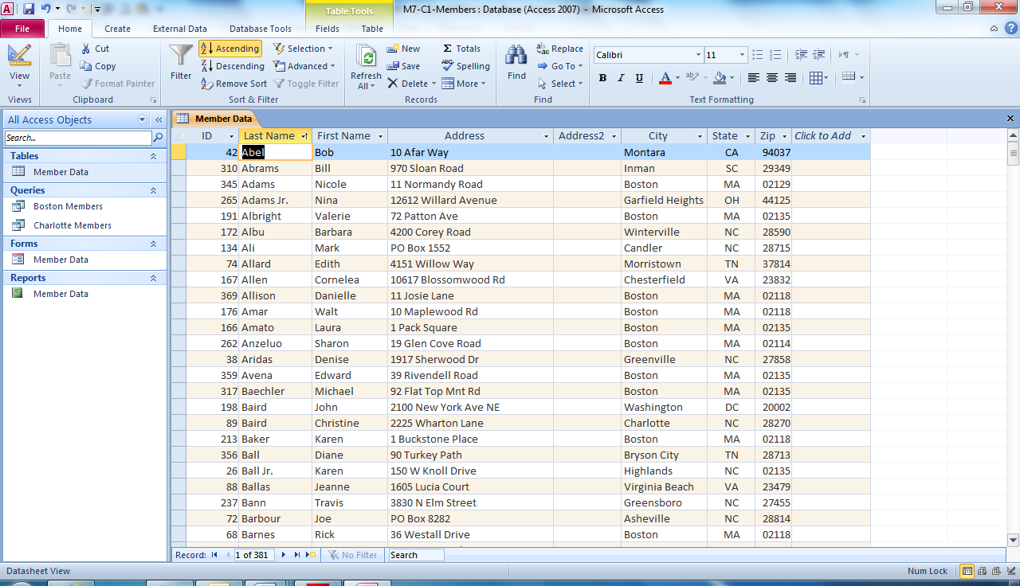
Ascending sort button
Selected text
Notes:
Here you see the first record in the Last Name field in the Member Data table in M7-C1-Members.accdb is selected. By clicking the Ascending button in the Sort & Filter group on the Home page, the data is sorted by Last Name.
Ascending means to sort alphabetically from A to Z. You can also click the drop-down arrow in the Last Name column heading and then click Sort A to Z.

Slide 24
Sorting a Form When you sort records in a
table, the sort affects only that table. It does
not affect the order of records displayed in
the related form.
Notes:
You can sort the data in a single field in a form by clicking a field entry box and then clicking either the Ascending button or the Descending button in the Sort & Filter group on the Home tab.

Slide 25
Skill 5: Filter Data
Double-click the table you wish use in the Navigation pane.
Click the text in the first record of the column you wish to filter.
On the Home tab, click the Filter button in the Sort & Filter group.
Click the (Select All) check box. All of the check marks are cleared from the check boxes in the drop-down filter list.
Scroll down the list and click the text you wish to use for the filter.
Click OK. Only those records are displayed and all of the displayed records have the entry text you wish displayed in that column.
On the Home tab, click the Toggle Filter button to redisplay the other records in the table.
Close the table. If prompted to save any changes, click No.
Notes:
If you are looking for specific records, you can filter the records based on data in a specific field. When you apply a filter, records that do not meet the condition you specify are temporarily hidden from view. But when you remove the filter, those records that have been “hidden” in the table redisplay.

Slide 26
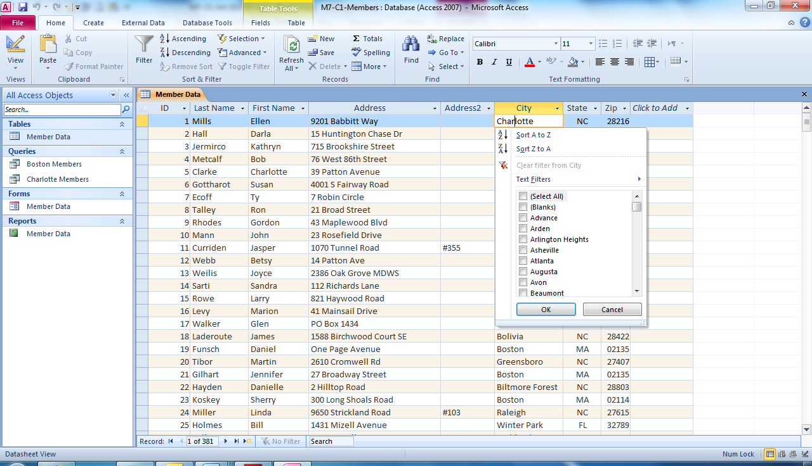
Filter button
Text in City column selected
Notes:
Using M7-C1-Members.accdb, you can filter the data in the City column by clicking in the first record in that column and then clicking the Filter button in the Sort & Filter group on the Home page tab. You can also click the drop-down arrow in the column heading to filter data.

Slide 27
Learning More about Filtering Data You can filter records based on more than one piece of information in a particular field. To do so, click all names you wish to filter with in the drop down filter-list.
Notes:
You can also filter by more than one column. Click in another column, to select records you wish to filter.

Slide 28
Skill 6: Format a Datasheet
Double-click the table you wish use in the Navigation pane.
Click the first record in the column you wish to format.
On the Home tab, click the Align Text Left button in the Text Formatting group. The formatting is applied to all of the records in this column.
To change the Font Size, click the list arrow in the Text Formatting group.
The font size changes for the entire table.
If a column displays #####, move the mouse pointer over the right border of the column heading. When the pointer changes to a double-arrow, double-click. The column widens to display all the data in the column.
Close the table. Select Yes to save any changes.
Notes:
When you open a table, it displays in a datasheet. A datasheet organizes the data in rows and columns. You may want to apply formatting, such as bold and italic, or change the font size to make the datasheet easier to read. You can also align the data in a column and adjust the width of a column so that all of the data in a field displays.

Slide 29
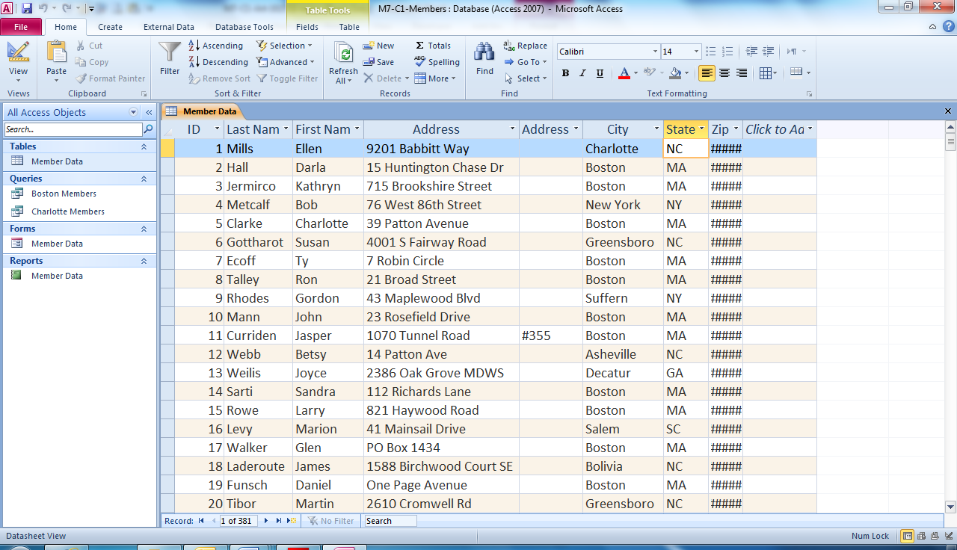
Alignment
Font size
Column you wish to format
Notes:
Here in M7-C1-Members.accdb, you can see the State column is selected. Selecting the left alignment button will change the alignment and selecting a new font size will change the font size. #### in the Zip column indicates that the column is not wide enough to display all of the data for the data contained in that column.

Slide 30
Learning More about Formatting a Datasheet By default, every other row in a datasheet has a different background color. You can change the background color of every second row by clicking the Alternate Row Color button in the Text Formatting group on the Home tab and selecting a different color.
Notes:
Also by default, the horizontal and vertical gridlines display. Visible gridlines help you to clearly see the borders of each cell in the datasheet. You can change the gridlines that are displayed by clicking the Gridlines button in the Text Formatting group on the Home tab.

Slide 31
Skill 7: Use Existing Queries and Reports
To use an existing query:
Double-click the query you wish to use in the Navigation pane.
The query will display all the records that meet the conditions of the query.
Close the query.
To use an existing report:
Double-click the report you wish use in the Navigation pane.
The report displays the records from a combination of one or more queries and tables.
Close the report.
Notes:
You create a query to find records that meet a certain condition. The records are pulled from one or more tables, in a process called extracting. You can also display a report that has been saved in the database. A report presents data from a combination of one or more tables and queries.

Slide 32
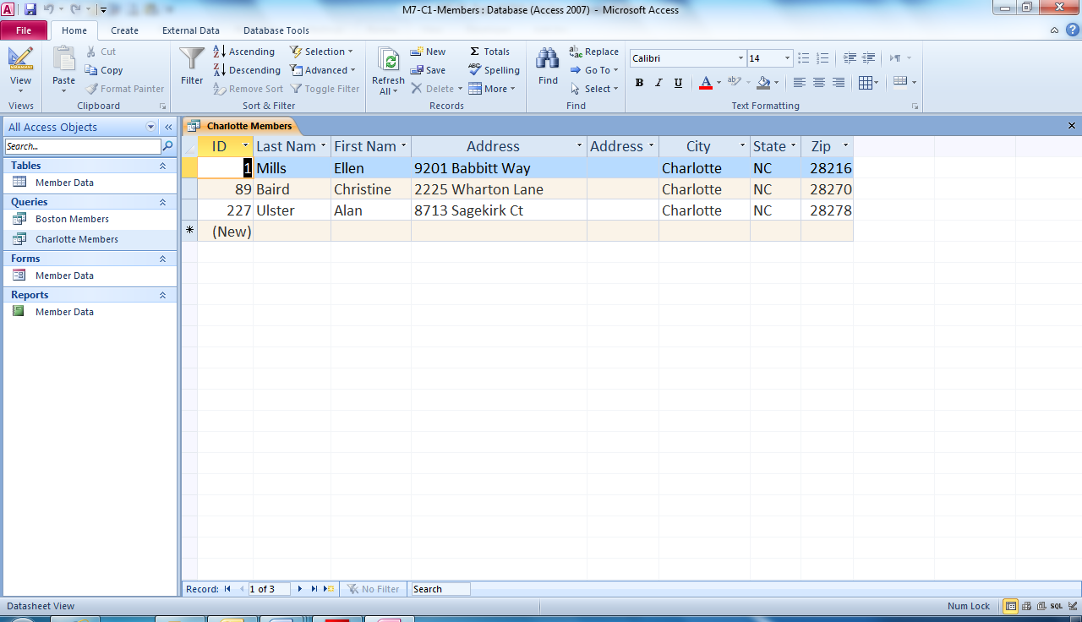
Existing queries
Existing reports
Notes:
Using existing reports and queries in M7-C1-Members.accdb, you can run a report or query. Just double-click the report or query you wish to use. Creating a query differs from simply filtering records. Because a query is an Access object, it is saved with the database. As a result, once you create a query, you can run it over and over again.

Slide 33
Printing an Object You can print any open objects, including tables, forms, queries, and reports. To print an active object, click the File tab and then click the Print tab.
Notes:
You have three print options to choose from. Click Quick Print to print the object when you are sure you don’t need to change any print settings. Or, click Print to display the Print dialog box, where you can change print settings, such as the number of copies. You should always click Print Preview, the third
option, to view the object before you print it.

Slide 34
Checkpoint 2
Which of the following is a valid method for moving between cells in a table?
Press Tab.
Press the Right Arrow key.
Click a cell.
All of the above
Which action temporarily displays records matching the criteria you specify for one or more fields?
sort
hide
filter
parse
Answer
Answer
Which sort arranges data alphabetically from A to Z?
ascending
descending
reverse
None of the above
The _____ group on the Home tab has choices for formatting the datasheet.
Sort & Filter
Records
Find
Text Formatting
Answer
Answer
Next Slide
Notes:
In Slide Show View, click the Answer button for Question 5 after you believe that you know the correct answer. The correct answer will be displayed. Then click the Answer button for Question 6 and that answer will appear. Continue repeating these steps for all four questions in order. When complete, click the Next Slide button.
These Checkpoints are designed to provide you with an opportunity to reflect on a few concepts at a time.

Slide 35
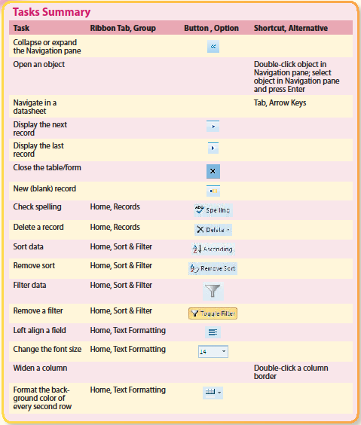
Tasks Summary
Notes:
Here is a summary of the Access Chapter 1 tasks.

