Slide 1
Microsoft Excel 2010
MODULE 6
Chapter 1: Creating an Excel Workbook
Chapter 2: Working with Formulas and Functions
Chapter 3: Formatting Cells
Chapter 4: Working with Charts
Notes:
In Module 6, you learn about Microsoft Excel 2010. Chapter 1 covers creating an Excel Workbook including entering data and navigating. Chapter 2 deals with performing calculations. In Chapter 3, you use formatting tools to add visual appeal, and finally, in Chapter 4, you will learn about working with charts and graphs.

Slide 2
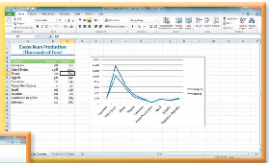
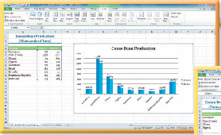
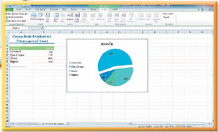
Working with Charts
Chapter 4
Notes:
The fourth chapter in the Excel module deals with working with charts.

Slide 3
Skills You Learn
Create a line chart
Modify chart data
Create a column chart
Add chart labels
Create a pie chart
Modify a pie chart
Notes:
This chapter is about creating and modifying charts. You can create a variety of chart types in Excel, including pie, bar, and line.

Slide 4
Chapter 4: Working with Charts
Chart types in Excel can include:
Pie Charts
circular chart that is divided into parts
each part represents a piece of the whole pie, or a percentage of the total
Bar Chart or Column Chart
will compare differences between values
a bar chart has horizontal bars and a column chart has vertical bars
Line Charts
illustrate changes over time
illustrate trends over time
Notes:
If you have a lot of numbers in a worksheet, a chart can simplify your understanding of the data by showing it in a visual arrangement. When you represent the data in a chart, you can easily show patterns or trends in the data.

Slide 5
Skill 1: Create a Line Chart
Select the cells that contain the data you wish to include in your chart.
Click the Insert tab.
Click the Line button in the Charts group to display a gallery of line charts.
Click the appropriate chart subtype to insert your chart.
Reposition the chart by moving the mouse pointer over the chart border so it changes to a four-headed arrow and then drag the chart so that it is placed in the proper position.
Resize the chart by positioning the mouse pointer over a corner of the chart border so that the mouse pointer changes to a two-headed diagonal arrow and dragging the chart to the proper size.
Notes:
The line chart can use multiple series of data from the worksheet. Once you create the line chart, you move and size the chart.

Slide 6
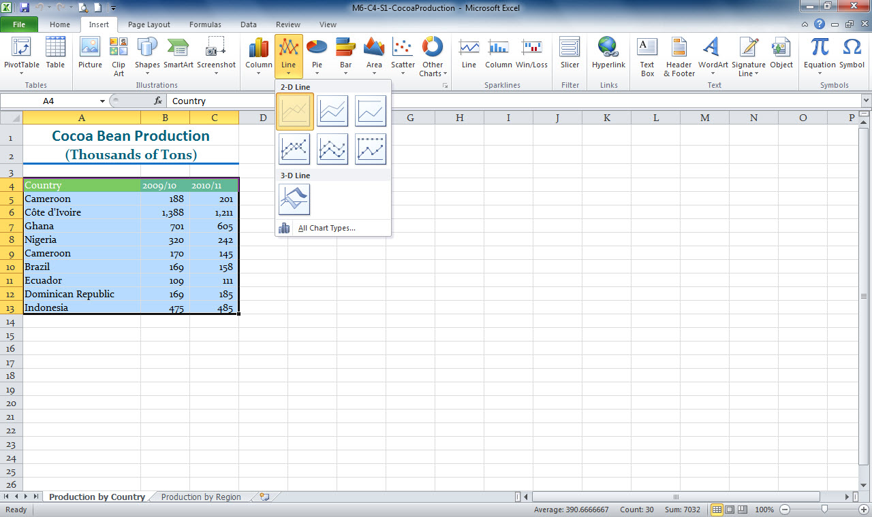
Line button
Line chart options
Selected data to be included in the chart
Notes:
When creating a chart, rest the mouse pointer on a chart subtype to display the name of the chart. In this line chart in M6-C4-S1-CocoaProduction.xlsx, the chart legend tells you which line belongs to which category of data.

Slide 7
Moving the Chart Location By default, a chart is placed in the existing worksheet. You can move the chart to a new worksheet. This option automatically changes the chart to a full-screen size.
Notes:
You can move the chart to a new worksheet by first selecting the chart. When you select a chart, the Chart Tools Design tab becomes the active tab. To move the chart, click the Move Chart button in the Location group and then select the New sheet option in the Move Chart dialog box.

Slide 8
Skill 2: Modify Chart Data
To modify existing data
With the chart selected on the worksheet, drag the selection handle for the blue selection box (located in the corner of the selected data) until you have changed to the new range you wish to specify.
The chart updates automatically.
To insert new data by adding it to the worksheet
Right-click the row or column heading below or to the right of where you wish to add your data.
Click Insert to insert a row or column
Type the new data to add the data to the chart
The chart will update automatically.
Notes:
When you select a chart, colored boxes appear around the data that you used to create the chart. Different colored boxes appear around the different parts of the chart. If you change a number in the data series or add another row to the data series, the chart automatically updates because it is linked to the worksheet data.

Slide 9
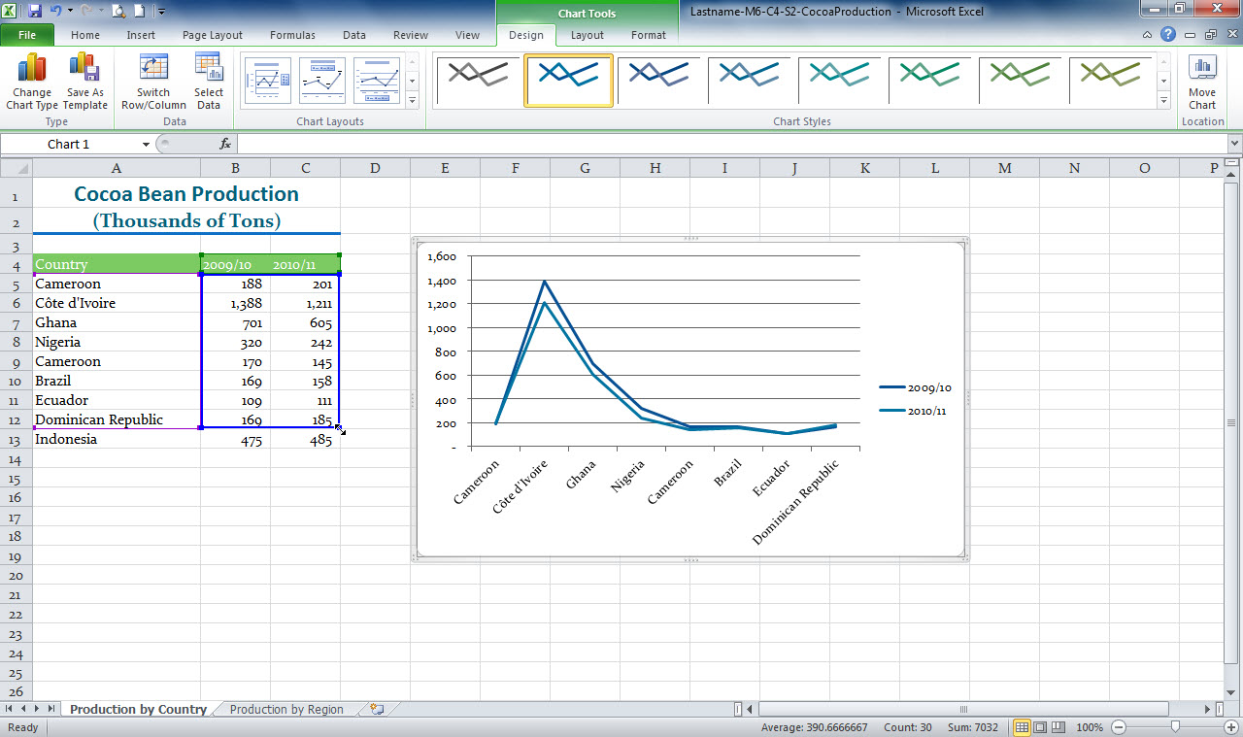
Blue selection box around chart data
Chart selected
Selection handle
Notes:
In Lastname-M6-C4-S2-Cocoa Production.xlsx, you see that the chart has been selected and the blue selection box around the chart data is showing. The data series used to create this chart has a blue box around it. To add the data in row 13 to the chart, drag the selection handle on the bottom right of the selection box down to include the row 13 data.

Slide 10
Editing Chart Data Sometimes when you create a chart, the labels along an axis or in the legend do not appear just the way you would like. You can use the Select Data button in the Data group on the Chart Tools Design tab to edit this chart data.
Notes:
Clicking the Select Data button displays a dialog box that shows the current axis labels and legend data. You can click the Edit button and then select the correct cells in the worksheet to change the labels or the information in the legend.

Slide 11
Skill 3: Create a Column Chart
Select the cells that contain the data you wish to include in your chart.
Click the Insert tab.
Click the Column button in the Charts group to display a gallery of column charts.
Click the appropriate chart subtype to insert your chart.
Reposition the chart by moving the mouse pointer over the chart border so it changes to a four-headed arrow and then drag the chart so that it is placed in the proper position.
Resize the chart by positioning the mouse pointer over a corner of the chart border so that the mouse pointer changes to a two-headed diagonal arrow and dragging the chart to the proper size.
Notes:
Column charts compare differences between values over time.

Slide 12
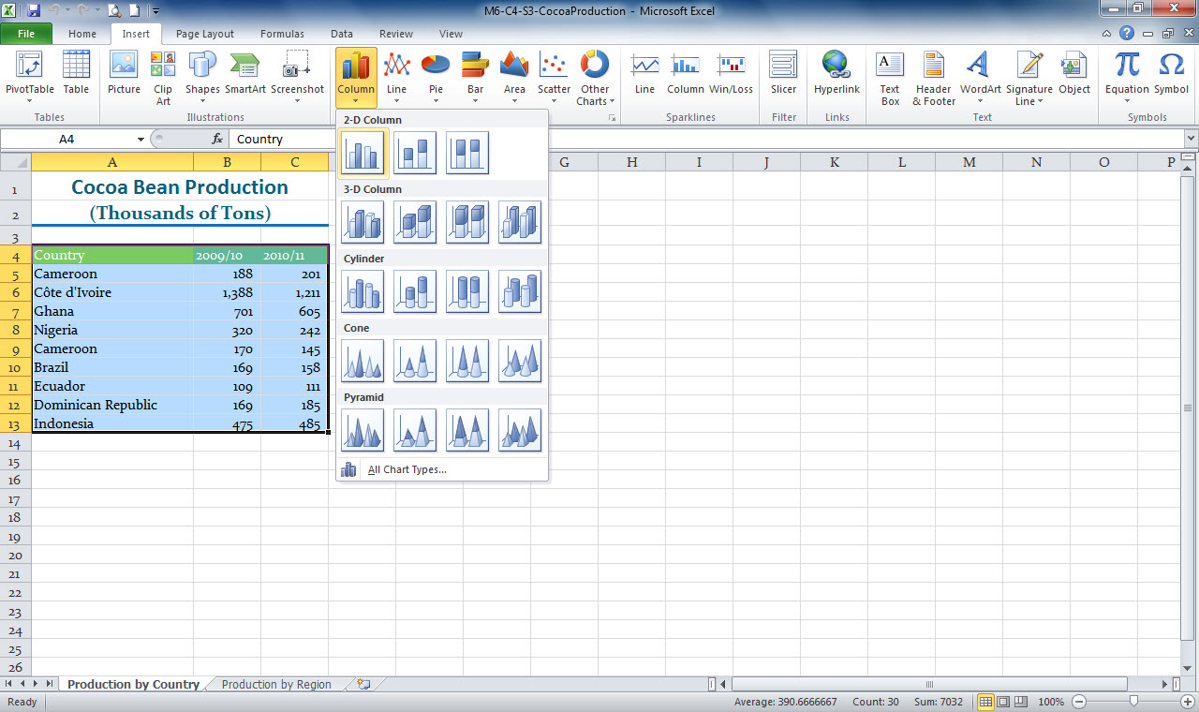
Column button
Column chart options
Selected data to be included in the chart
Notes:
In M6-C4-S3-CocoaProduction.xlsx, the data has been selected that is necessary to include in the Column chart. Using the Column button, the Column chart options are displayed for selection.

Slide 13
Changing the Chart Type Bar charts, like column charts, can clearly show differences in charted values, and you can easily change a column chart into a bar chart.
Notes:
To change the chart type, select the chart and click the Chart Tools Design tab. Click the Change Chart Type button in the Type group and then click Bar in the left pane. Select a bar chart subtype in the right pane and then click OK.

Slide 14
Skill 4: Add Chart Labels
Click the border of the chart on the worksheet.
Click the Chart Tools Layout tab.
Click the Chart Title button or Data Labels button in the Labels group.
Click the appropriate option.
Enlarge the chart by dragging a corner of the chart border, if necessary.
Notes:
You can add labels to a chart to make its elements easier to understand. You can also add individual data labels to show the quantity that a single column or pie slice represents. When you create a chart, Excel adds some labels automatically, based on the data you selected to create the chart. You can add other labels using options on the Chart Tools Layout tab.

Slide 15
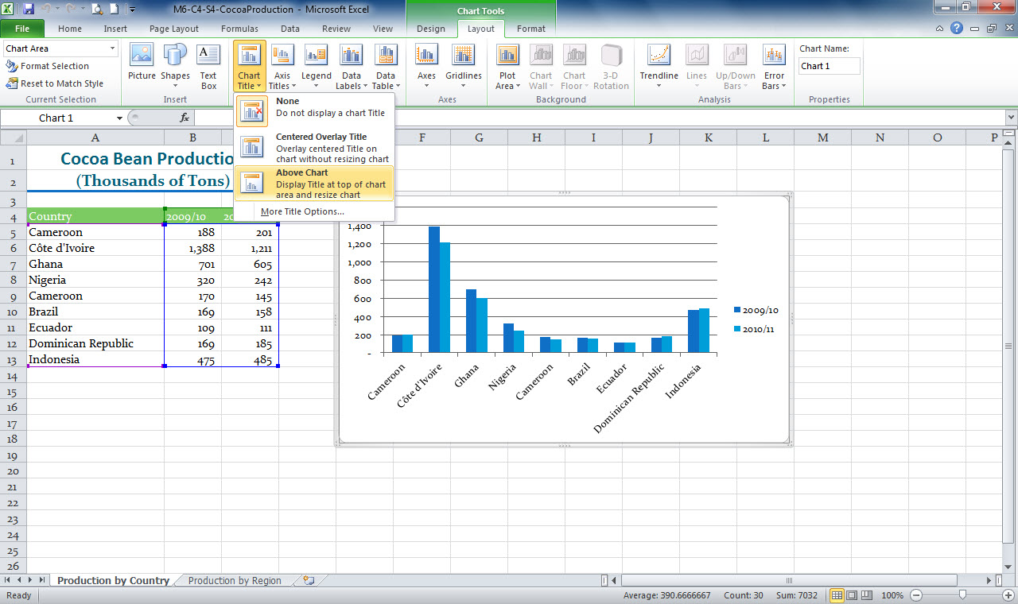
Chart Title button
Chart selected
Chart Title options displayed
Notes:
In M6-C4-S4-CocoaProduction.xlsx, you see the chart selected and the Chart Tools Layout tab displayed. Selecting the Chart Title button displays the Chart Title options.
You can place data labels in various places, such as at the Outside End of the data point, the Inside End of the data point, and Center on the data point. For some chart types, you can also select a Best Fit option that places the data labels where Excel determines they fit best in the chart.

Slide 16
Adding Axis Titles Along with a chart title, you may want to add titles to the vertical and horizontal axes to describe what the numbers or labels along each axis represent.
Notes:
You can use the Axis Titles button in the Labels group on the Chart Tools Layout tab to add titles to the horizontal and vertical axes.

Slide 17
Skill 5: Create a Pie Chart
Select the cells that contain the data you wish to include in your chart.
Click the Insert tab.
Click the Pie button in the Charts group to display a gallery of pie charts.
Click the appropriate chart subtype to insert your chart.
Reposition the chart by moving the mouse pointer over the chart border so it changes to a four-headed arrow and then drag the chart so that it is placed in the proper position.
Resize the chart by positioning the mouse pointer over a corner of the chart border so that the mouse pointer changes to a two-headed diagonal arrow and dragging the chart to the proper size.
Notes:
A pie chart is a circular chart that is divided into parts. Each part represents a percentage of the total quantity.

Slide 18
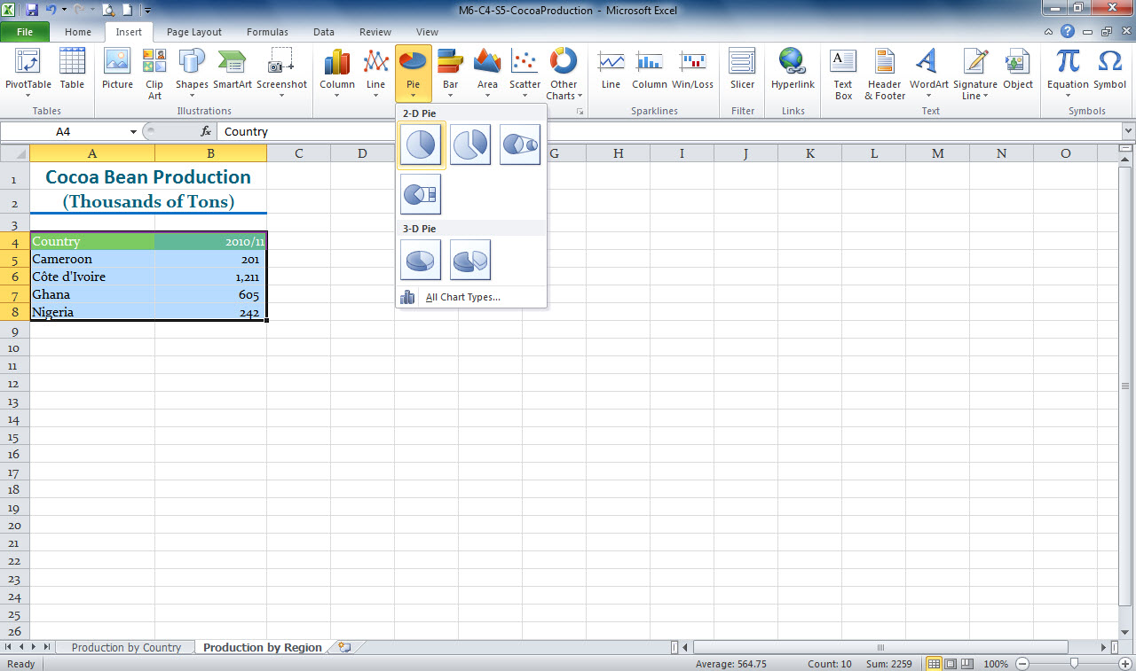
Pie button
Pie chart options
Selected data to be included in the chart
Notes:
In M6-C4-S5-CocoaProduction.xlsx, the data has been selected that is necessary to include in the Pie chart. A pie chart can contain only one data
series. Using the Pie button, the Pie chart options are displayed for selection.

Slide 19
Changing the Chart Legend The chart legend tells you which piece of data each colored slice or line represents.
Notes:
By default, Excel places the legend at the right side of the chart. You can change the position of the legend by clicking the Legend button in the Chart Tools Layout tab and selecting an option from the dropdown list. You can even remove the legend if you think the reader can easily understand the chart without it.

Slide 20
Skill 6: Modify a Pie Chart
To modify a Data Series
Double-click a slice of the pie chart to open the Format Data Series dialog box.
Drag the pie slices to the appropriate angle.
Click a blank area of the chart to deselect the pie piece.
To modify Data Labels
Click the Chart Tools Layout tab.
Click the Data Labels button in the Labels group.
Click More Data Label Options to display the Format Data Label dialog box and select your options.
Click the Legend button in the Labels group to format the legend.
Notes:
You can rotate the pie chart and you can explode a slice away from the rest of the pie chart. An exploded slice sits outside the circle of the pie, to call attention to the content or data it represents. Also, by default, data labels display as numbers or figures, such as 1011. However, the data labels in pie charts typically display as a percentage, such as 80%.

Slide 21
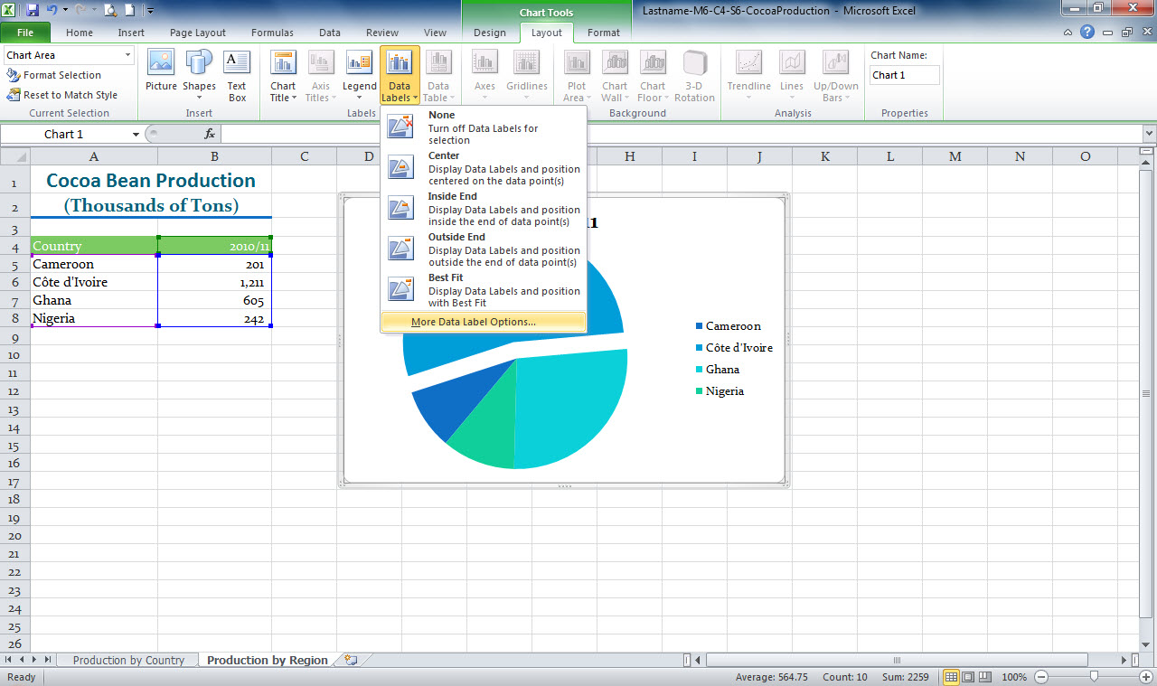
Chart Tools Layout tab
Data Labels button
Data Labels options
Notes:
Here in Lastname-M6-C4-S6-CocoaProduction.xlsx, the pie chart is selected. This opens the Chart Tools Layout tab. Clicking the Data Labels button shows the Data Labels options.

Slide 22
Changing Pie Chart Themes and Styles When you create a chart, the theme applied to the workbook file determines the chart colors. If you apply a different theme to the file, using the Theme button in the Page Layout tab, the colors in the chart update automatically.
Notes:
Another way to modify the chart colors is to apply a chart style. Chart styles change the chart color, and they may also change the chart background color
and apply other effects. You can change the chart style by clicking the More button to the right of the Chart Styles group on the Chart Tools Design tab and then clicking a different chart style.

Slide 23
Checkpoint
What chart type would best compare the attendance at an annual meeting for the past four years?
column
line
pie
All of the above
What chart type would best show how much of a company’s total salary budget was spent on each department in the company?
bar
column
line
pie
Answer
Answer
Which chart type would best show the average monthly rainfall for a year?
bar
column
line
pie
A descriptive heading for a chart is a chart
layout.
legend.
label.
title.
Answer
Answer
Next Slide
Notes:
In Slide Show View, click the Answer button for Question 1 after you believe that you know the correct answer. The correct answer will be displayed. Then click the Answer button for Question 2 and that answer will appear. Continue repeating these steps for all four questions in order. When complete, click the Next Slide button.
These Checkpoints are designed to provide you with an opportunity to reflect on a few concepts at a time.

Slide 24
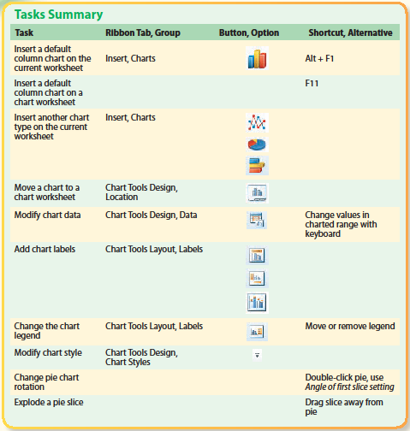
Tasks Summary
Notes:
Here is a summary of the Excel Chapter 4 tasks.

