Slide 1
Microsoft Excel 2010
MODULE 6
Chapter 1: Creating an Excel Workbook
Chapter 2: Working with Formulas and Functions
Chapter 3: Formatting Cells
Chapter 4: Working with Charts
Notes:
In Module 6, you learn about Microsoft Excel 2010. Chapter 1 covers creating an Excel Workbook including entering data and navigating. Chapter 2 deals with performing calculations. In Chapter 3, you use formatting tools to add visual appeal and finally, in Chapter 4, you will learn about working with charts and graphs.

Slide 2
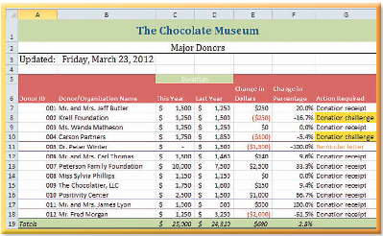
Formatting Cells
Chapter 3
Notes:
The third chapter in the Excel module is about formatting cells.

Slide 3
Skills You Learn
Apply number formats
Work with other formatting tools
Adjust column width and row height
Fill cells with a color
Add borders
Merge cells
Notes:
This chapter is about applying formatting to cells. Applying formatting to worksheet cells provides organization and context. Formatting also clarifies the meaning of the data. For example, to specify whether Excel should format a cell value as a date, currency amount, or percentage, you would apply a number format.

Slide 4
Chapter 2: Formatting Cells
Applying formatting
Provides organization and content
Clarifies the meaning of the data
Determines how labels and values look
Can change column width and row height to display labels correctly
Groups data visually
Notes:
Other formatting tools, such as those that control font and size, determine how labels and values look and align within cells. You can also change the column width and row height to ensure entries display completely and correctly.
You can use other tools to group data visually. You can apply a new fill color to cells that contain the column labels in a worksheet, or add a border around a range, or even merge cells together. You learn how to use formatting to enhance a worksheet in this chapter.

Slide 5
Skill 1: Apply Number Formats
Make the cell you wish to format the active cell.
Enter the cell content and press Ctrl + Enter.
Click the Number Format list box arrow in the Number group on the Home tab.
Click the number format you wish to apply. The width of the column will increase automatically to accommodate a longer number format.
If necessary, select the number of decimals to use.
If you do not see a number format you can use, you can use the Custom Number Format to apply a custom style.
Click OK.
Notes:
When you type an entry into a cell, it is automatically formatted according to the General format. When you type a date in a cell, Excel recognizes it and formats it automatically as a date. You can apply formats to add dollar signs, commas, and other characters to the cells. Applying a new format changes the display of an entry.
The number format applied to a cell holding numerical data determines how Excel displays the number. You can apply other formats, such as date, currency, or percentage, and change number formats as needed.

Slide 6
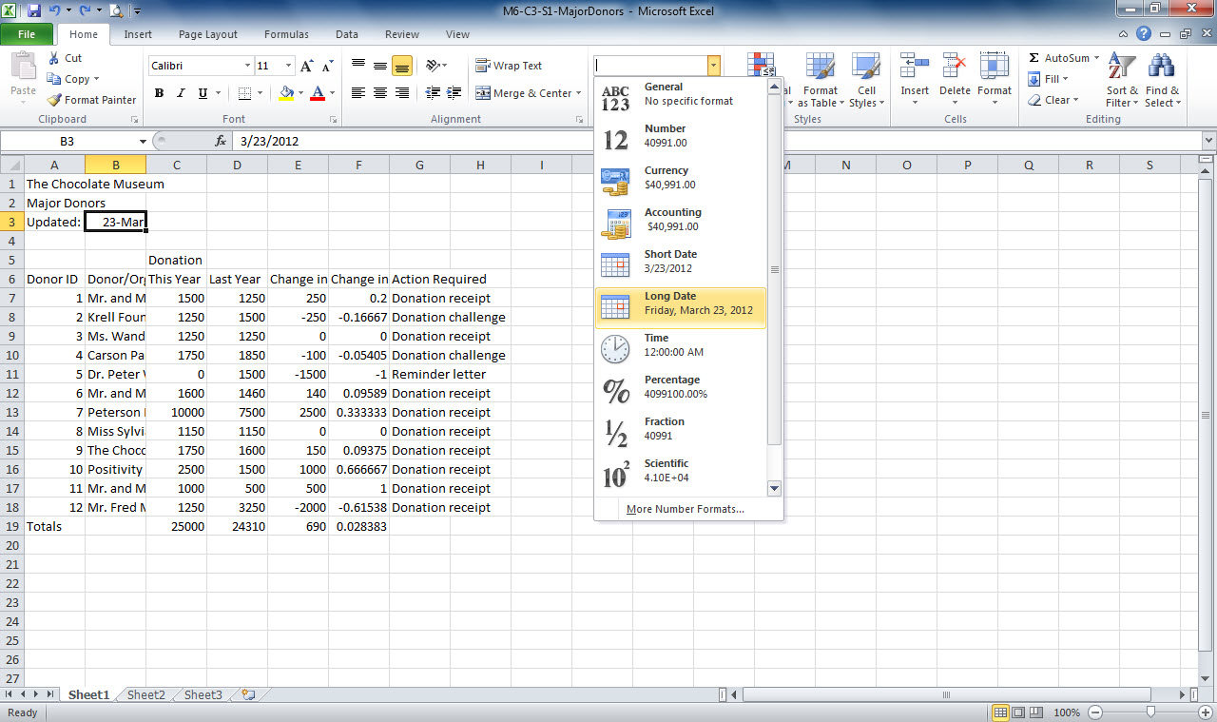
Number Format list box arrow
Active cell
List of number formats
Notes:
Here in M6-C3-S1-MajorDonors.xlsx, you can see cell B3 is the active cell. By selecting the Number Format list box arrow, you will see a list of number formats that can be applied to the active cell. Excel will recognize some number formats when you type special symbols, such as dollar signs and percent
signs.
When applying a date format, if you do not include the year, Excel will assume you want the current year. Dates are stored as sequential serial numbers so they can be used in calculations.

Slide 7
More Choices for Number Formatting Some variations of the number formats are available as styles in the Cell Styles gallery.
Notes:
Click the Home tab and then click the Cell Styles button in the Styles group to access the gallery. The Number Format section of the gallery lists the number styles you can apply. You also can click New Cell Style to create a custom cell style to apply to the selected cell or range.

Slide 8
Skill 2: Work with Other Formatting Tools
To apply a style
Make the cell you wish to format the active cell.
Click the Cell Styles button in the Styles group on the Home tab.
Click a section to apply the appropriate style to the selected cell.
Notes:
Excel lets you apply a variety of formats to cells to change the basic look of a worksheet. You also can use the Increase Font Size and Decrease Font Size buttons to adjust the size of the contents of selected cells. You can also apply bold, italic, and underlining, as well as change the color of the text and the cell background. Use the alignment tools to change the vertical and horizontal alignment of cell entries.

Slide 9
Skill 2: Work with Other Formatting Tools, cont.
To change the font
Select a cell or drag to select a range.
Click the Font list box arrow in the Font group.
Select the appropriate font.
Select cell alignment in the Alignment group on the Home tab, if necessary.
Select bold, italics, or font color in the Font group on the Home tab, if necessary.
Notes:
The Cell Styles button in the styles group of the Home tab lets you apply several formatting settings at once.

Slide 10
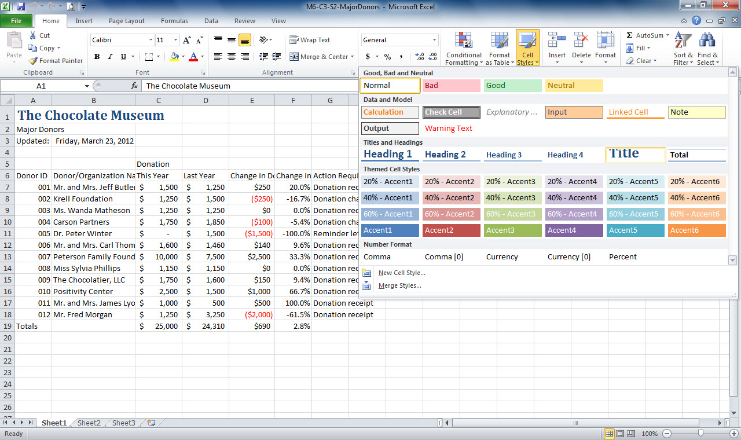
Font list arrow
Cell styles button
Active cell
Select appropriate style
Notes:
In M6-C3-S2-MajorDonors..xlsx, you see that cell A1 is the active cell. Using the Cell Styles button, you can select from a list of styles. If you want to
combine a cell style with other Font group formatting, apply the style first. You can also select a font using the Font list arrow in the Font group. Font size is measured in points (pt), with each point equal to 1/72nd of an inch. To apply underlining to text, use the keyboard shortcut Ctrl + U or the Underline button in the Font group on the Home tab.

Slide 11
Changing the Theme You can change
the overall look of the worksheets in a workbook simply by changing the theme.
Notes:
The theme supplies the overall formatting settings for the workbook file, including the theme fonts (those used by default for that specific theme), theme colors, theme effects, and cell styles. If you have applied your own cell styles or if you have chosen a theme and decide you do not like it, you can choose another. You can do so by clicking the Themes button in the Themes group on the Page Layout tab and then clicking the theme you want. Pointing to any theme displays a Live Preview of the changes it applies.

Slide 12
Skill 3: Adjust Column Width and Row Height
Make the cell you wish to format the active cell.
Click the Format button in the Cells group on the Home tab.
Click Row Height in the Cell Size section of the drop-down list.
Type the row height you wish to use.
Click the appropriate alignment button in the Alignment group on the Home tab.
If changing column width, click Column Width in the Cell Size section of the drop-down list.
Type the column width and click OK.
Notes:
When you perform some actions, such as when you change the cell format, Excel automatically widens a column or increases the height of a row. If you make a change and Excel doesn’t automatically widen the column or increase the height of the row to accommodate the changed entry, you could find
that some entries don’t fit into their cells. If the cell to the right is empty, the long entry simply runs over into the cell(s) to the right. But if the cell to the right is not empty and the entry is text, Excel only displays as much of the entry that fits in the cell, hiding the rest. If the entry is a number that is too
large to display in the cell width, Excel displays a string of pound signs (######) to cue you that the numeric cell entry does not fit. You need to resize the column.

Slide 13
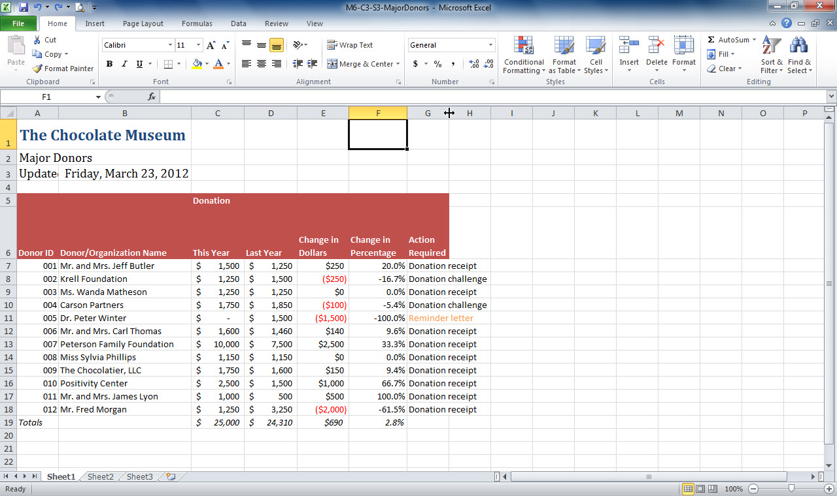
Format button in the Cells group
Left and right-pointing arrow
Notes:
Using M6-C3-S3-MajorDonors.xlsx, you can also click the AutoFit Column Width button in the Cell Size section of the Format button in the Cells group to AutoFit the column to its widest entry. Another way is to move the mouse pointer over the border of the column heading you wish to resize until the mouse pointer becomes a vertical line with a left and right-pointing arrow, and double-click to allow Excel to AutoFit the column size.
Note: When text wrapping is applied to cells in a row, the row height does not decrease automatically to fit the text. You have to manually reduce the row height to fit the text.

Slide 14
Changing Column Width Default Settings With the default Office Theme applied, the default column width is 8.43 characters and the default row height is 15 points. Changing the theme applied to the workbook may change these defaults.
Notes:
You can adjust the default column setting by clicking Default Width on the Format menu in the Cells group on the Home tab. A dialog box then displays
for you to enter a new Standard column width for the workbook.

Slide 15
Skill 4: Fill Cells with a Color
Make the cell you wish to format the active cell.
Click the Fill Color button arrow in the Font group on the Home tab.
Select the Fill Color you wish to use.
Drag to select the range in which you wish to apply to color, if appropriate.
Click the Fill Color button in the Font group on the Home tab. Excel fills the selection with the color you clicked.
Notes:
You can color fill a selected cell or cell range independent of other settings. Click the drop-down arrow for the Fill Color tool in the Font group on the Home tab to display a gallery of colors. You can then click a color to apply it to the selection. Conveniently, the color you applied most recently appears on the button itself. You can simply click the button to apply that same color to other selections.

Slide 16
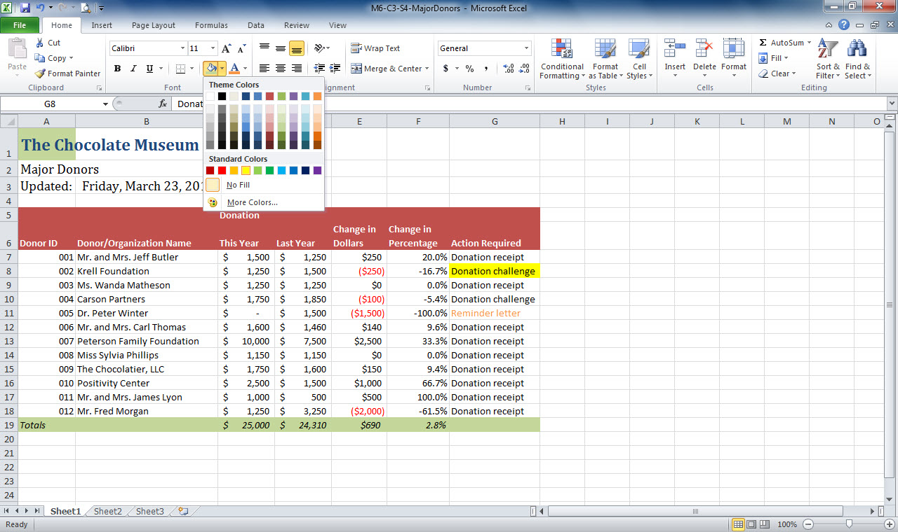
Fill Color button arrow
Fill Color options
Notes:
In M6-C3-S4-MajorDonors.xlsx, you see the Fill Color button arrow has been selected and the Fill Color options are available. Here you can select the fill color you wish to apply.
Another way to apply formatting is by using the Format Painter button in the Clipboard group of the Home tab. Make the cell with the formatting you wish to apply the active cell, click the Format Painter button, and then click the cell you wish to format.

Slide 17
Skill 5: Add Borders
Select the cell or range of cells in which you wish to add the border.
Click the Borders button arrow in the Font group on the Home tab.
Click the appropriate border in the Borders section of the drop-down list to apply the border.
Use the Ctrl key to select non-contiguous cells or a range of cells.
Use the More Borders option from the Borders button arrow in the Font group on the Home tab for more border options.
Notes:
Applying a border around a cell or cell range in a worksheet provides another way to group or emphasize the data visually. Borders can be
especially useful when you use the default print setting and print a worksheet without cell gridlines.

Slide 18
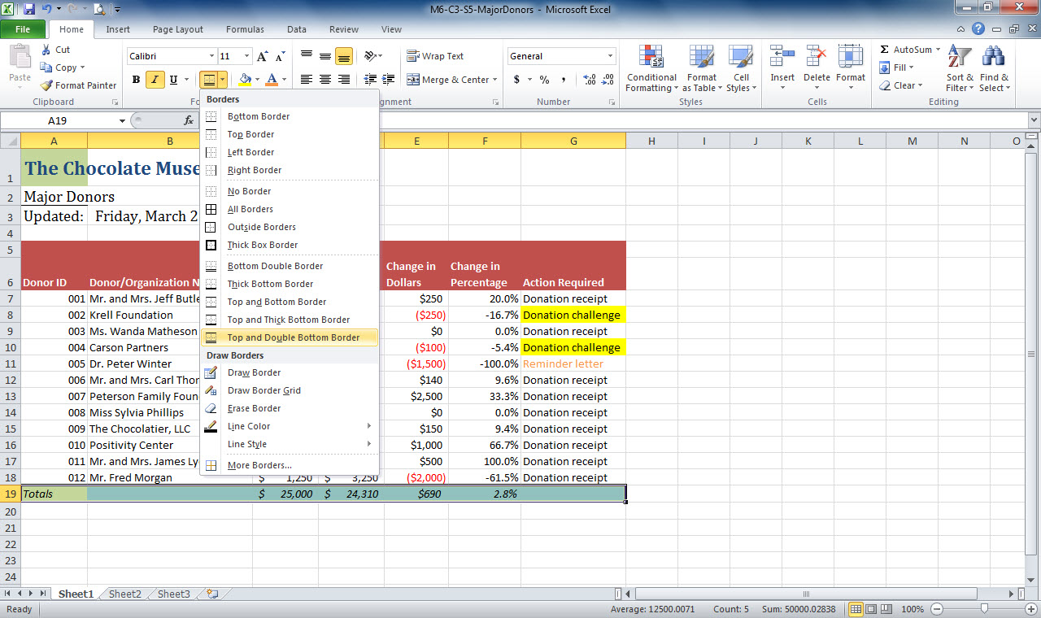
Borders button arrow
Borders options
Range selected
Notes:
Here in M6-C3-S5-MajorDonors.xlsx, notice the Borders button arrow in the Font group has been selected. You can select a border from the drop-down list or More Borders at the bottom of the list for more options.

Slide 19
More Border Options When you click
More Borders to display the Format Cells dialog box, you can see a Style list that enables you to choose another border weight or a different border appearance, such as dashed or dotted.
Notes:
Because these border styles in More Borders are a bit less formal than a plain cell border or outline, you should use them sparingly, especially in business documents.

Slide 20
Skill 6: Merge Cells
Drag to select the cells you wish to merge.
On the Home tab, click the Merge & Center button arrow in the Alignment group.
Click the appropriate merge option from the drop-down list.
Be sure to check all formatting when merging and centering. In some cases, merging will remove the previously applied border, so you must reapply the border.
Notes:
To enhance the readability of a worksheet, you might choose to center the sheet title across all the columns of data in the sheet. In Excel you can use the Merge & Center button in the Alignment group on the Home tab to combine selected cells into a single cell. The combined text is centered in the single cell.

Slide 21
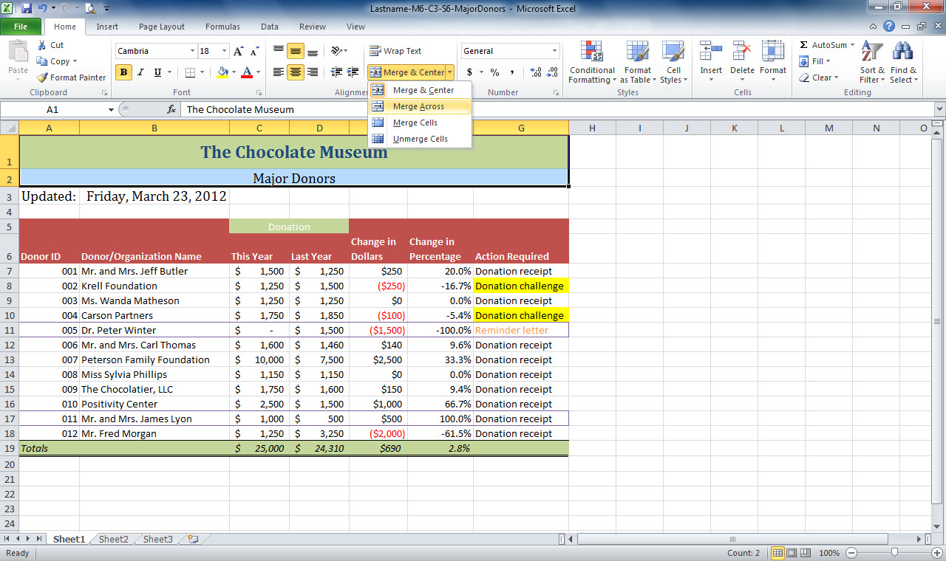
Merge and Center button arrow
Merge and Center options
Range selected to merge
Notes:
Here in Lastname-M6-C3-S6-MajorDonors.xlsx, cells A1:G2 have been selected to merge. You can see the options to merge in the drop-down list displayed when the Merge and Center button arrow is selected. The cell address listed in the Name box in the top-left corner is the address for the far left cell in the merged range.

Slide 22
Designing Worksheets Keeping your design simple and taking advantage of the color palette supplied by the theme helps you to design professional workbooks and worksheets that highlight the most important data for decision making.
Notes:
You can create a balanced appearance in a completed worksheet by using the same fill color for the top and bottom rows and limiting the number of formats applied.

Slide 23
Checkpoint
Use the Format Painter to
choose a background color for a cell.
shrink the width of the text in a cell.
copy formatting from one cell to another cell.
copy a formula from one cell to another cell.
Use the _____ feature to combine multiple cells into a single cell.
Wrap Text
Merge and Center
Borders
Cell Styles
Answer
Answer
Excel stores dates as
labels.
cell references.
sequential serial numbers.
All of the above
These may include font, border fill, and other formatting settings.
wrap text
Merge and Center
borders
cell styles
Answer
Answer
Next Slide
Notes:
In Slide Show View, click the Answer button for Question 1 after you believe that you know the correct answer. The correct answer will be displayed. Then click the Answer button for Question 2 and that answer will appear. Continue repeating these steps for all four questions in order. When complete, click the Next Slide button.
These Checkpoints are designed to provide you with an opportunity to reflect on a few concepts at a time.

Slide 24
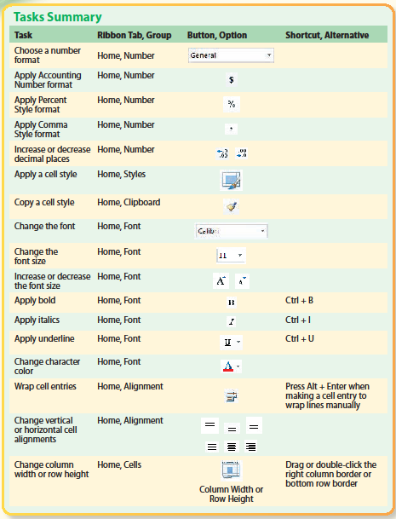
Tasks Summary
Notes:
Here is a summary of the Excel Chapter 3 tasks.

Slide 25
Tasks Summary, continued
Notes:
Here is a continued summary of the Excel Chapter 3 tasks.

