Slide 1
Microsoft Excel 2010
MODULE 6
Chapter 1: Creating an Excel Workbook
Chapter 2: Working with Formulas and Functions
Chapter 3: Formatting Cells
Chapter 4: Working with Charts
Notes:
In Module 6, you learn about Microsoft Excel 2010. Chapter 1 covers creating an Excel Workbook including entering data and navigating. Chapter 2 deals with performing calculations. In Chapter 3, you use formatting tools to add visual appeal and finally, in Chapter 4, you will learn about working with charts and graphs.

Slide 2
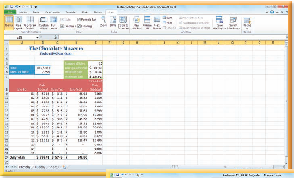
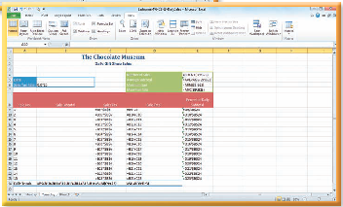
Working with Formulas and Functions
Chapter 2
Notes:
The second chapter in the Excel module deals with working with formulas and functions.

Slide 3
Skills You Learn
Enter a formula
Enter a function
Insert a function
Use AutoSum
Use absolute and relative cell references
Copy and paste cell contents
Edit cell contents
Use Show Formulas
Notes:
This chapter is about entering formulas and functions. You will use AutoSum and learn about absolute and relative cell references. You will copy and paste cell contents and edit cell contents. Finally you will use Show Formulas to show your formulas on the worksheet.

Slide 4
Chapter 2: Working with Formulas and Functions
Excel
can perform calculations using data
Financial tracking
Business decision making
Trend analysis
recalculates formulas when you change the data in your worksheet
will automatically adjust formulas copied from cell to cell
Notes:
Excel offers more than the ability to simply organize data in neat rows and columns; it can also perform calculations using that data. You can use calculations to determine the payments on a new car, to decide which home would be a better buy, or to budget for your next family vacation. You can use it to make business decisions and quickly create complicated calculations, even if you are not a math lover.
Excel also offers a number of shortcuts for quickly building formulas and for creating complex formulas using a calculation feature called functions. Formulas can be copied from cell to cell and they will automatically adjust relative to the cell they are copied to. When you make a cell containing a formula the active cell, you see the result of the formula in the cell but see the formula in the Formula bar.

Slide 5
Skill 1: Enter a Formula
Select the cell in which you wish to enter the formula.
To add the cells B8 to B18, type =B8+B9+B10+B11+B12+B13+B14+B15+B16+B17+B18.
Press Ctrl + Enter. The calculated value displays in the active cell and the formula displays in the Formula bar.
You can also press an arrow key, which will enter the value and make an adjacent cell active.
Another way is to type the formula into the Formula bar. Click the Formula bar Enter button (looks like a check mark) to the left of the formula to finish entering the formula in the active cell.
Notes:
In Excel, you can enter formulas directly in cells or use the Formula bar. There are rules for creating formulas. If you don’t follow the rules, Excel indicates an error.
When you enter a formula, always type an = (equals) sign first, and then enter the rest of the formula. You can enter a number or a cell reference in a formula. When you finish entering the formula, the cell displays the calculated result. If you later update the data in any cells referenced in the formula, Excel will automatically recalculate and display the updated result. After you have entered a formula in a cell, you can edit it.

Slide 6
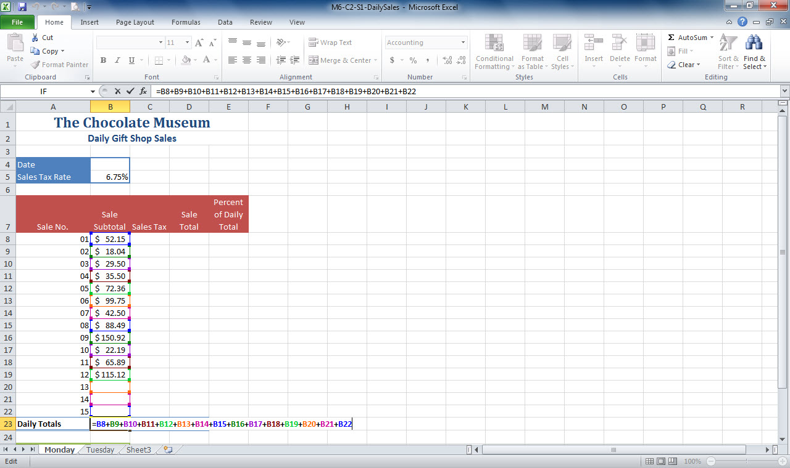
Formula bar
Formula in active cell
Notes:
In M6-C2-S1-DailySales.xlsx, you can see the formula in the active cell. The formula appears in both the Formula bar and the cell as you type it or when you later select the cell. Click the Formula bar Cancel button (looks like an x) to cancel the cell entry.
Another way: Rather than typing a cell reference into a formula, click the cell on the worksheet to add it to the formula.

Slide 7
Calculating in Excel Excel follows the standard mathematical order of operations when evaluating formulas. This means that Excel performs multiplication (*) and division (/) before performing addition (+) and subtraction (-). If the operator precedence is the same, Excel calculates from left to right. Adding parentheses enables you to control the calculation order.
Notes:
Parentheses must be used in pairs, and you can use multiple pairs. Excel calculates from the innermost set of parentheses outwards. For example, the formula =5+6*3 calculates to 23, because Excel multiplies first. In contrast, =(5+6)*3 calculates to 33, because Excel adds the values in parentheses first.

Slide 8
Skill 2: Enter a Function
Select the cell in which you wish to enter the function.
To add the current date function, type =TODAY in the Formula bar.
Press Enter to finish. The current date appears in the active cell.
Again click in a cell to make it active.
Type =SUM in the active cell.
Drag to select the range you wish to sum.
Click the Formula bar Enter button (looks like a check mark) to the left of the formula to finish entering the formula that sums.
Notes:
Each Excel function has a name and performs a predefined calculation when you include it in a formula. Excel offers dozens of functions in several different categories, such as Math & Trig, Financial, Logical, Statistical, Lookup, and more. The function name typically indicates what type of calculation the function performs.
Most functions require one or more arguments surrounded by parentheses. The arguments are the values on which the function performs its calculations. For example, the SUM function needs to know which numbers to add.

Slide 9
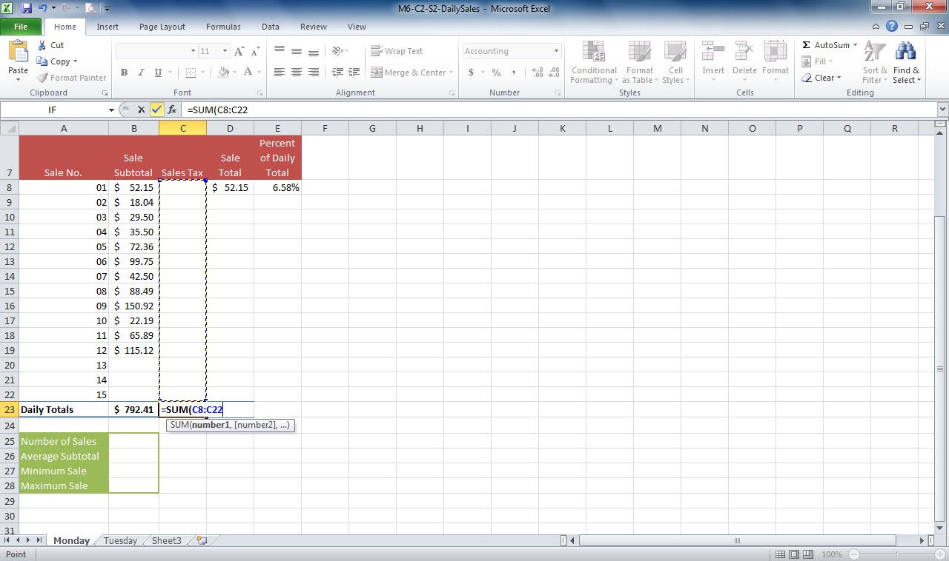
Formula bar Enter button
Formula bar displays function
Drag to select range to sum
Active cell with function
Notes:
In M6-C2-S2-DailySales.xlsx, you see that function is showing in the active cell and the Formula bar. The range above the active cell is selected to sum. Use the Formula Bar Enter button to enter the function into the active cell.
Functions are not case sensitive, so typing them in all lowercase letters also works. When you are typing in a function, a ScreenTip appears to help you type the proper arguments.

Slide 10
Skill 3: Insert a Function
Select the active cell.
Click the Insert Function button on the Formula bar to open the Insert Function dialog box.
Type the function name to replace the contents of the Search for a function text box.
Click the Go button.
Click OK to close the Insert Function dialog box. The Function Arguments dialog box appears, with the contents of the Value1 text box selected. (Each text box represents an argument.)
Drag over the range you wish to enter in the Value1 text box.
Click OK. The result appears in the active cell.
Notes:
You can insert a function using buttons in the Function Library group on the Formulas tab. Function buttons include Financial, Logical, and Math & Trig. If you don’t know the name of the function you need but know what you want it to do, you can find the function in the Function dialog box. Here you can type a brief description and view a list of possible matches. Click an item in the list to view its arguments and a description of what it does.

Slide 11
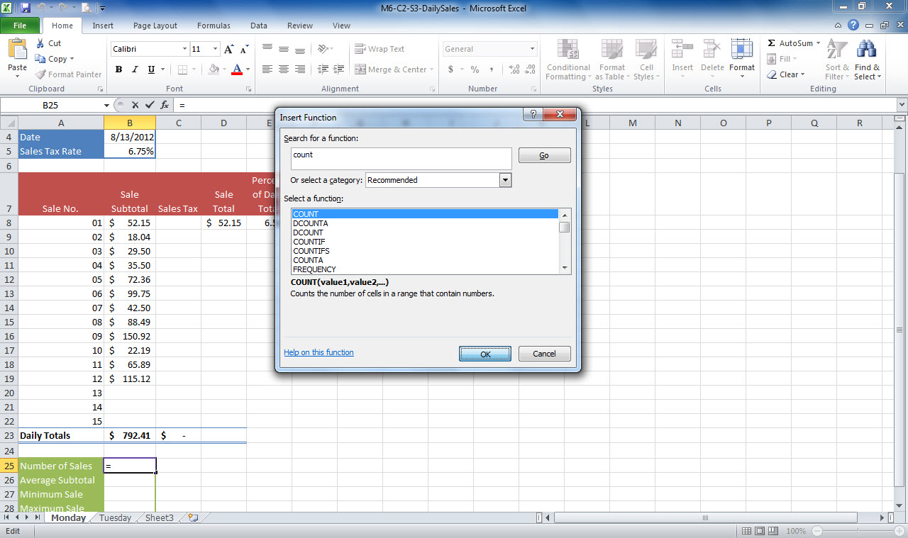
Insert Function button
Insert Function dialog box
Active cell
Notes:
In M6-C2-S3-DailySales.xlsx, the Insert Function dialog box is open and the function Count is selected. You can also choose a function from a list of categories in the Function Library group on the ribbon’s Formula tab.

Slide 12
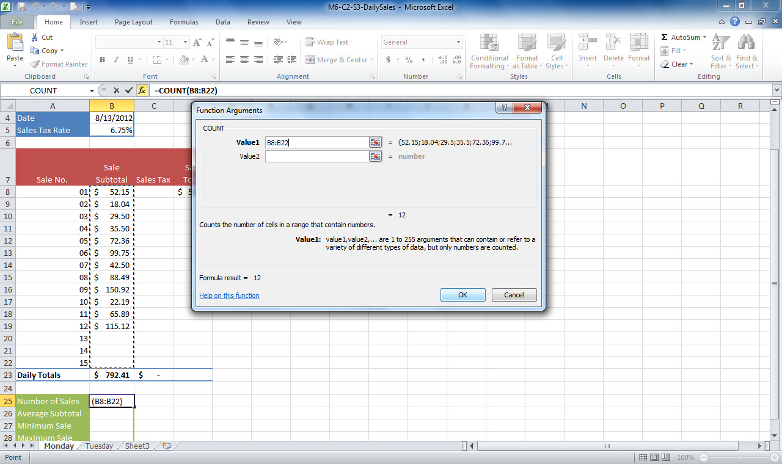
Formula bar shows function
Function Argument dialog box
Value 1 Collapse Dialog button
Notes:
You can drag the dialog box to move it out of the way if it is covering the cell ranges. The dialog box collapses automatically, but you also could use the Collapse Dialog button at the right end of the text box to collapse and expand the dialog box.

Slide 13
Inserting Multiple Arguments More complex functions require multiple arguments. When you are typing in a function and need to include multiple arguments—such as multiple cell or range addresses or other values—add a comma between arguments.
Notes:
For example, the IF function is used to display one value if a condition is true and another value if false and requires multiple arguments, such as
= IF(A5> 100,1,0).

Slide 14
Skill 4: Use AutoSum
Click the Home tab.
Drag over the range you wish to sum.
Observe the Average, Count, and Sum values that appear in the Status bar.
Click the active cell.
In the Editing group on the Home tab, click the AutoSum button.
Press Enter to accept the suggested range and insert the formula in the active cell
Notes:
The AutoSum feature provides a quick way to enter commonly used functions into a formula. These functions include SUM, AVERAGE, COUNT, MIN, and MAX.

Slide 15
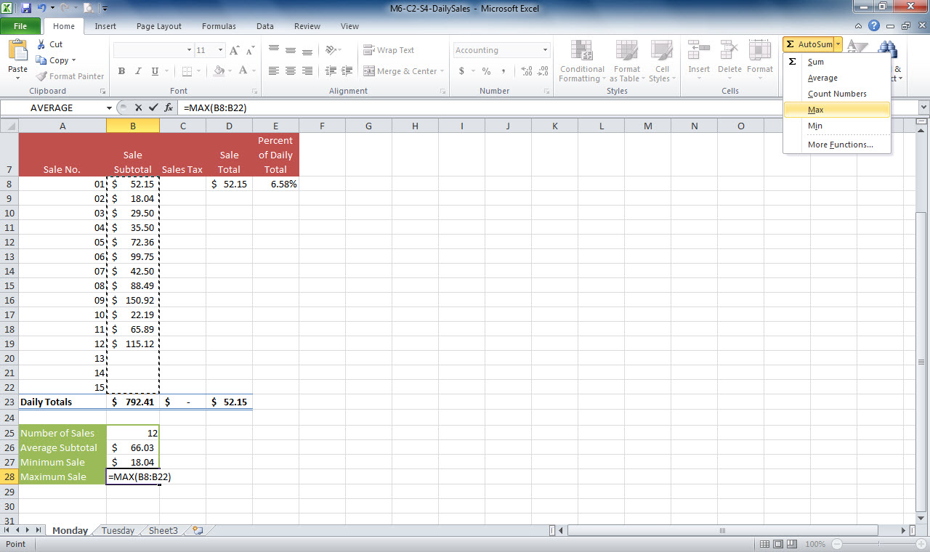
AutoSum button
Range selected
Active cell with function
Notes:
In M6-C2-S4-DailySales.xlsx, you see the AutoSum button has been selected and the function Max chosen. You can see the function in the active cell and the range to sum selected.

Slide 16
Using Additional Functions In addition to MIN, MAX, AVERAGE, SUM, COUNT, and TODAY, there are several other functions that you will find valuable as you begin exploring Excel.
Notes:
The IF function permits you to test a condition and perform different computations based on the result. COUNTIF counts the number of cells that meet a specified condition. The PMT function calculates the payment amount of a loan.

Slide 17
Checkpoint 1
Start every formula by typing this.
+
@
=
-
You can enter _____ in a cell to tell Excel what to calculate.
numbers
cell references
range references
All of the above
Answer
Answer
The order in which Excel calculates orders is called
order of priority.
order of hierarchy.
operator processing.
order of operations.
Functions
are grouped by category.
can be entered directly into a cell.
can be entered as a result of a search.
All of the above
Answer
Answer
Next Slide
Notes:
In Slide Show View, click the Answer button for Question 1 after you believe that you know the correct answer. The correct answer will be displayed. Then click the Answer button for Question 2 and that answer will appear. Continue repeating these steps for all four questions in order. When complete, click the Next Slide button.
These Checkpoints are designed to provide you with an opportunity to reflect on a few concepts at a time.

Slide 18
Skill 5: Use Absolute and Relative Cell References
Select the cell in which you wish to type the formula.
Type the formula.
Press the F4 key on your keyboard. Excel changes the formula, making the second cell reference an absolute reference.
Press Ctrl + Enter to finish creating the formula with the absolute reference.
Notes:
Cell references in formulas can be either relative or absolute. A relative cell reference will change if you copy or move the formula. If you don’t want a cell reference to change when you are copying a formula, make it an absolute reference by placing a dollar sign before the column letter and row number. Use an absolute reference when a formula contains a key piece of data, such as tax rate or interest rate. To create an absolute reference, type dollar signs before the column letter and row number as you enter the cell reference into a formula.

Slide 19
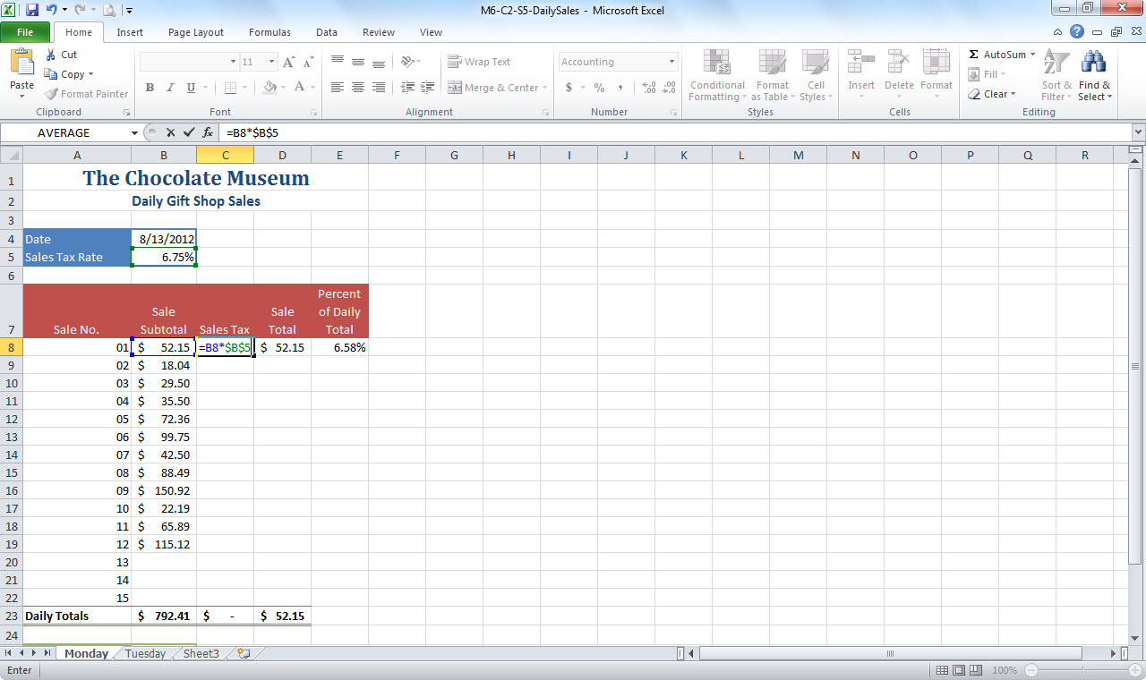
Absolute reference in Formula bar
Formula with absolute reference in active cell
Notes:
Here in M6-C2-S5-DailySales.xlsx, notice the dollar signs in the second cell reference in cell C8. This is an absolute reference to cell B5. When copying this formula, the reference to cell B5 will not change. The reference to cell B5 is made to be an absolute cell reference because the same sales tax rate applies to all of the sold items.

Slide 20
Placing Reference Data Choosing a good
position for key data referenced by formulas on a worksheet can save you trouble later.
Notes:
If you need to change the value in a cell or cell(s) referenced in formulas throughout the worksheet, placing that information near the top of the worksheet makes it more accessible. Some worksheet designers set up an input range at the top of the worksheet to give the workbook user clear direction about where to enter values.

Slide 21
Skill 6: Copy and Paste Cell Contents
Drag to select the range you wish to copy.
On the Home tab, click the Copy button in the Clipboard group.
Make the cell in which you wish to copy the active cell.
Click the Paste button in the Clipboard group on the Home tab.
Since the copied cell contents are still in the clipboard memory, you can copy them to other cells by making those cells active and pressing the Enter key.
If you see a number of #DIV/0! errors appearing in the copied range, it is because the original formula does not have an absolute reference, but needs to.
Notes:
Often, a worksheet or workbook will contain cell content, such as data values and formulas, that repeats. You can save time entering duplicate data by using the Copy and Paste buttons. You can also use the Cut and Paste buttons to move data or formulas from one location on a worksheet to another. When
copying cells that contain formulas, the relative cell references will adjust when the formula is pasted. However, absolute cell references will not.
Relative references also adjust when you insert or delete rows or columns.

Slide 22
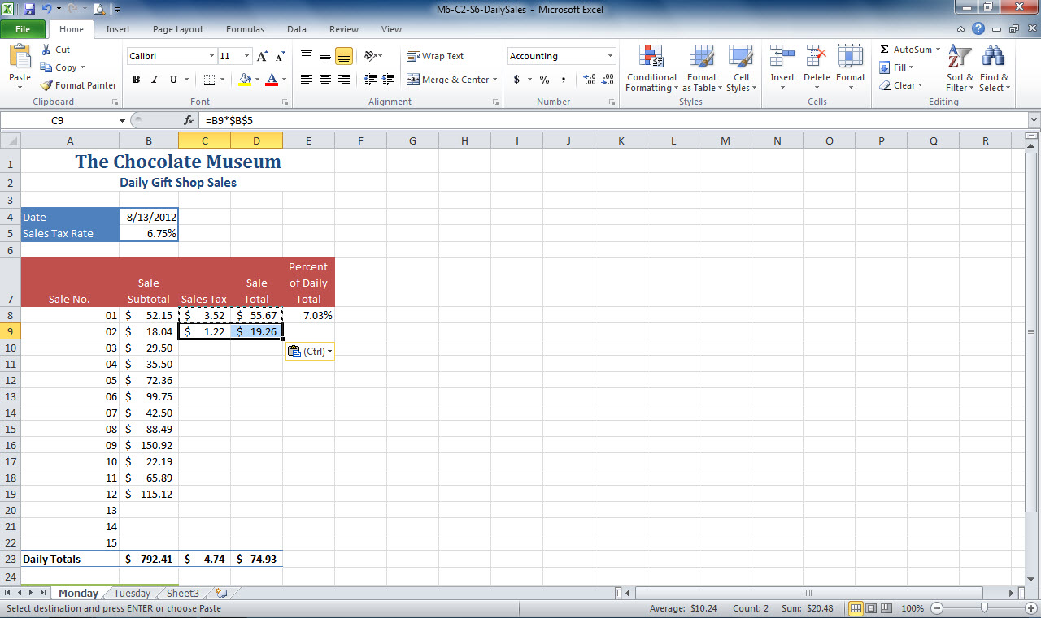
Copy and Paste buttons
Cells selected to copy
Cells selected to paste
Notes:
Here in M6-C2-S6-DailySales.xlsx, cells C8:D8 have been selected to copy. Cells C9:D9 were then selected and the paste button was pressed to copy the content from C8:D8 into C9:D9. Since the formula we are copying has an absolute reference in it, the reference to cell B5 in the formula will not change when copied to another cell.
Excel pastes copied information to the Office Clipboard, a memory holding area for copied and cut information. The Clipboard can store up to 24 items. Click the dialog box launcher in the Clipboard group on the Home tab to open the Office Clipboard to choose a selection to paste. Click Paste if you expect to paste copied cells into more than one location. Press Enter to paste the content for a single or the final time. Pressing the Esc key on your keyboard clears the flashing marquee.

Slide 23
Using Paste Button Options Clicking the
bottom half of the Paste button (with the
down arrow on it) in the Clipboard group
on the Home tab displays additional paste
options.
Notes:
The numerous choices in the Paste Button Options enable you to achieve outcomes not possible without the Paste option. You also can access the Paste
choices by clicking the Paste Options button that appears at the lower right corner of any pasted cell or range.

Slide 24
Skill 7: Edit Cell Contents
There are many ways to edit cell contents. You can
Make the cell you wish to edit active and type the new contents.
Double-click the cell, type the new contents, and press Enter.
Click in the Formula bar, type the new contents, and press Ctrl + Enter.
Make the cell you wish to edit active and click Delete to remove contents.
Make the cell you wish to edit active and click the Clear button in the Editing Group on the Home tab. Click Clear Contents.
Use the F2 key to open a cell for editing.
Notes:
When you want to use different labels for data, update the data to reflect new information, or make corrections to formulas, you have to edit a cell’s contents. Excel offers a number of methods for removing or changing cell contents. You can edit a cell’s content directly in the cell or in the Formula bar. You can also use the Clear button in the Editing group on the Home tab to edit a cell’s contents.

Slide 25
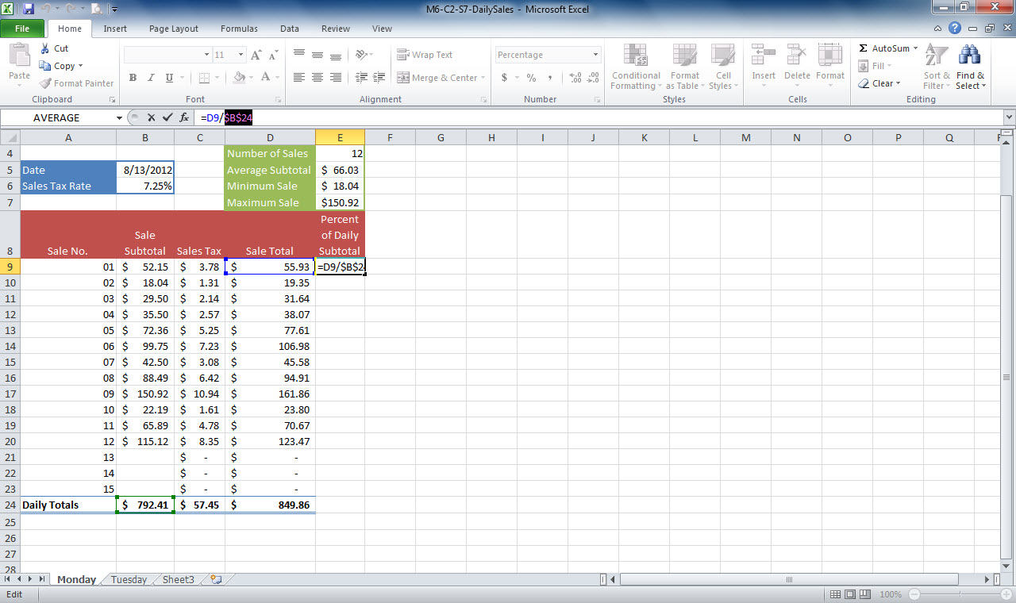
Edit cell contents in Formula bar
Clear button in Editing group
Edit cell contents in active cell
Notes:
In M6-C2-S7-DailySales.xlsx, you see a formula being edited in the Formula bar. You can also use the active cell to edit cell contents. Pressing F2 or double-clicking in a cell to edit it puts Excel in Edit mode, and the left end of the Status bar displays Edit.
Select Clear Contents from the Clear button drop-down menu in the Editing group on the Home tab to clear the contents of a cell. Changing cell contents does not change the formatting. To remove formatting, click the Clear button and then select Clear Formats.

Slide 26
Using the Clear Button Options The menu for the Clear button in the Editing group on the Home tab offers additional choices so you can specify exactly what to clear from the selected cell or range.
Notes:
You can take separate actions by selecting only Clear Formats, Clear Comments, or Clear Hyperlinks, or you can use Clear All to clear both the cell contents and any formatting and comments.

Slide 27
Skill 8: Use Show Formulas
To show formulas
Click the sheet tab in which you wish to show formulas.
Click the Formulas tab.
Click the Show Formulas button in the Formula Auditing group.
Notes:
Rather than clicking cells one by one to review their formulas in the Formula bar, you can use the Show Formulas feature to display all the formulas on the worksheet at once. This makes it easy for you to thoroughly review all cell references and formula structures so that you can ensure that the worksheet
calculations are correct.

Slide 28
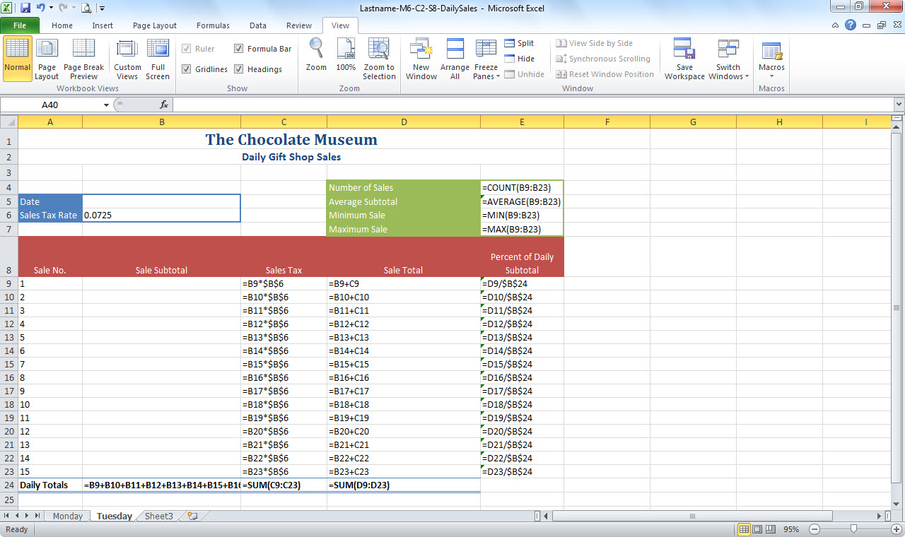
Formulas displayed after selecting Show Formulas
Notes:
Here you see the formulas displayed in Lastname-M6-C2-S8-DailySales.xlsx. You can click the Show Formulas button again to hide the formulas.

Slide 29
Printing a Worksheet with Formulas
Shown If you print while formulas are
displayed, the formulas print but the cell
contents do not.
Notes:
This type of printout can provide a handy reference to how the data in the sheet is constructed. Make sure when printing in this situation that you review the print preview carefully. You may need to adjust print settings, such as orientation and margins.

Slide 30
Checkpoint 2
Most functions require one or more _____ that specify what to calculate.
lists
rows
arguments
All of the above
A reference that remains unchanged when you copy a formula is called a(n)
fixed reference.
absolute reference.
relative reference.
circular reference.
Answer
Answer
The _____ group on the Home tab contains the tools for copying and pasting.
Clipboard
Font
Number
Editing
Press _____ to remove the contents of the selected cells.
Backspace
Tab
Spacebar
Delete
Answer
Answer
Next Slide
Notes:
In Slide Show View, click the Answer button for Question 5 after you believe that you know the correct answer. The correct answer will be displayed. Then click the Answer button for Question 6 and that answer will appear. Continue repeating these steps for all four questions in order. When complete, click the Next Slide button.
These Checkpoints are designed to provide you with an opportunity to reflect on a few concepts at a time.

Slide 31
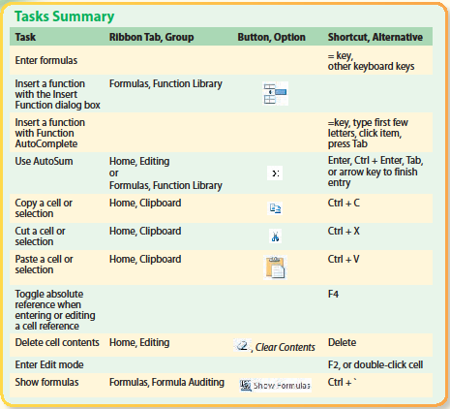
Tasks Summary
Notes:
Here is a summary of the Excel Chapter 2 tasks.

