Slide 1
Microsoft Word 2010
MODULE 5
Chapter 1: Creating Documents
Chapter 2: Formatting Documents
Chapter 3: Working with Tables and Objects
Chapter 4: Polishing and Publishing Your Documents
Notes:
In Module 5, you learn about Microsoft Word 2010. Chapter 1 covers creating documents including entering and editing text. Chapter 2 deals with formatting tools that help improve the look of your documents. In Chapter 3, you work with tables to help organize information and objects to add visual appeal. Finally, Chapter 4 covers features for reviewing and finalizing your document and printing it or publishing it online.

Slide 2
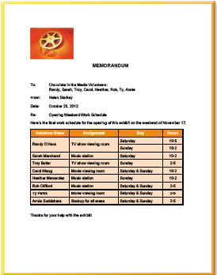
FINALIZING AND SHARING Documents
Chapter 4
Notes:
The fourth chapter in the Word module deals with finalizing and sharing documents.

Slide 3
Skills You Learn
Turn on Review features
Send a document via email
Make changes and add comments
Accept or reject changes and review comments
Create a PDF document
Publish to the Web
Notes:
Word makes it easy to create the input of several people through the tools on the Review tab. These tools allow others to make changes that can be tracked and to insert comments with suggestions or questions. You can then review their suggested changes and choose which ones to accept or reject.
Word also allows you to share documents in several ways: by sending them as email attachments or by posting them to the Web in PDF format (a format that doesn’t require you to have the originating software).

Slide 4
Chapter 4: Finalizing and Sharing Documents
Finalizing
Allows you to make changes in a document that can be tracked
Tools enable you to insert comments with questions or suggestions
Sharing
Enables you to save a document in PDF format, which is easily read by others
Allows you to send documents as email attachments or post them to the Web
Notes:
This chapter will show you how to get your document into the hands of other people so they can begin providing you with feedback, and how to later distribute the final version.

Slide 5
Skill 1: Turn on Review Features
To turn on Review features
Click the Review tab.
Click the Track Changes button in the Tracking group.
Confirm that the Final: Show Markup option is active in the Display for Review option box in the Tracking group. If not, click the arrow at the right of the option box and select Final: Show Markup from the drop-down list.
Save the file.
Notes:
When you are almost done with your document, you may want to ask others to review it. To ensure that their changes are highlighted for you, you can turn on Word’s Track Changes feature before you send it out. This feature keeps a record of all changes made by reviewers, striking a line through deleted text and applying a font color to added text so you can see what changes each person has suggested.
To test the Track Changes feature, select and delete a word. Note that the deleted text changes color and has a strikethrough mark through the middle. Click the Undo button in the Quick Access toolbar to undo the deletion.

Slide 6
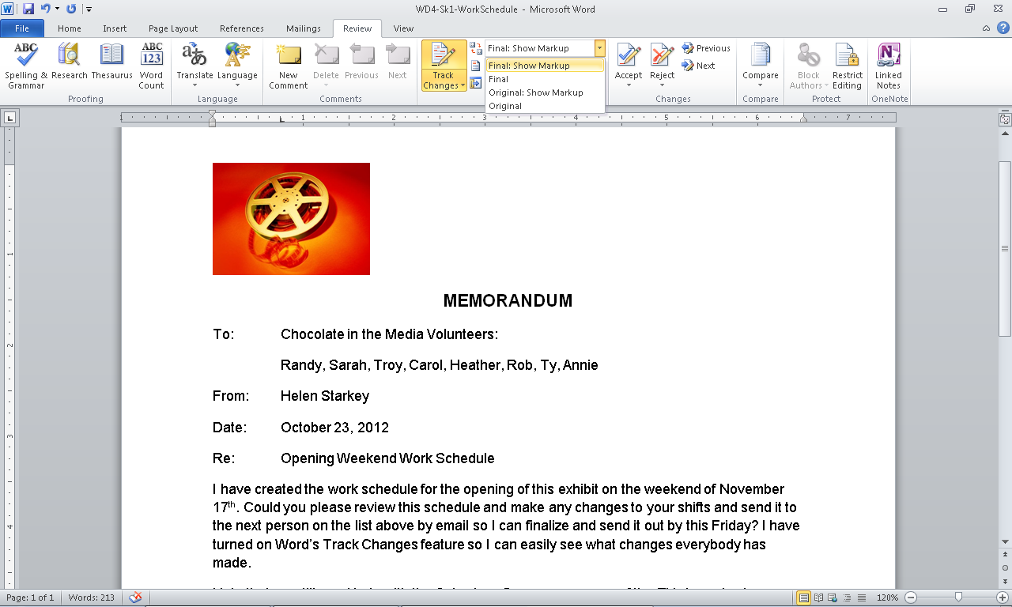
Final: Show Markup
Review tab selected
Track Changes
Notes:
Here, in M5-C4-S1-WorkSchedule.docx, you see the Review tab is selected. Clicking the Track Changes button allows Word to mark changes in the document. Notice the Final: Show Markup option is active in the Display for Review option box in the Tracking group.

Slide 7
Comparing Documents The Compare feature on the Review tab is useful if you want to compare two versions of a document but have not turned on Track Changes.
Notes:
To view the changes made to the original document, click the Compare button. You can then select two documents to compare, review the differences between them, and incorporate or reject those changes. You can also merge multiple documents into a single document using the Compare feature.

Slide 8
Skill 2: Send a Document via Email
Click the File tab.
Click the Save and Send tab.
Click the Send Using E-mail option in the Save & Send category.
Click the Send as Attachment option in the Send Using E-mail category. An email form appears.
Enter your email information in the appropriate fields and click the Send button.
Notes:
When you have created a document, you may want to ask a few people to review it. A quick and easy route is to email a copy of the Word file to others and ask them to review and return the marked-up file via email.
Note: If you are unable to use Outlook, skip this skill and check with your instructor for alternate tasks.

Slide 9
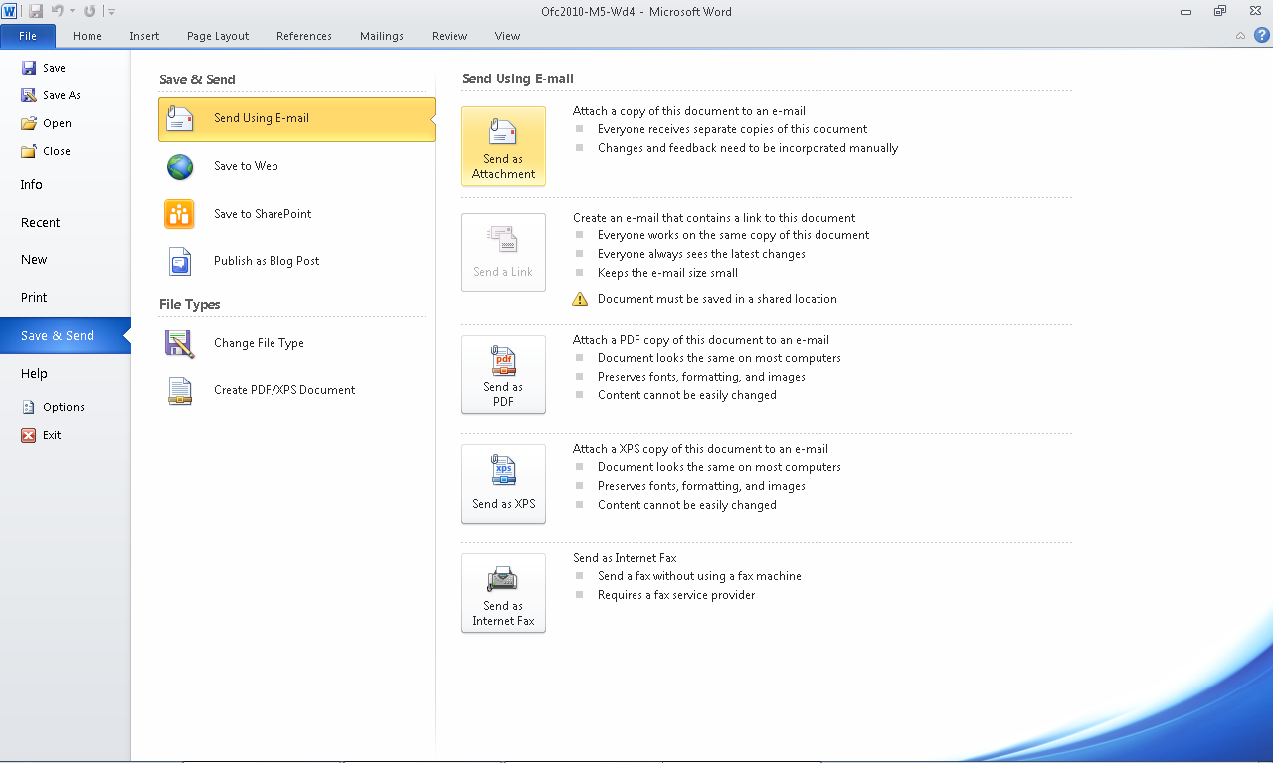
Send as Attachment option
Send Using Email option
Save and Send tab
Notes:
In the File tab of this document (M5-C4-S1-WorkSchedule.docx), notice the Save and Send tab is selected. Click the Send Using E-mail option in the Save & Send category. An email form will appear after clicking the Send as Attachment option in the Send Using E-mail category.

Slide 10
Controlling the Review of the Files In cases where you might have too many versions of a reviewed document, consider routing a single version of the document from person to person with direction to have the last person in the chain return the document to you. Or post one version on an online document-sharing space, such as Google docs, OfficeLive.com, or KeepandShare.com.
Notes:
Many online document sharing sites are free and enable you to allow only one person at a time to “check out” the document to work on it.

Slide 11
Skill 3: Make Changes and Add Comments
Confirm that the Track Changes button in the Tracking group on the Review tab is active.
Select and make changes to text.
To add a comment, click the New Comment button in the Comments group on the Review tab.
Type the comment in the comment balloon that appears.
Notes:
When you work in a document that has Track Changes turned on, any changes you make to it are automatically recorded. As an alternative to directly changing the document text, you can add comments to suggest changes, explain your edits, or ask the document author questions.

Slide 12
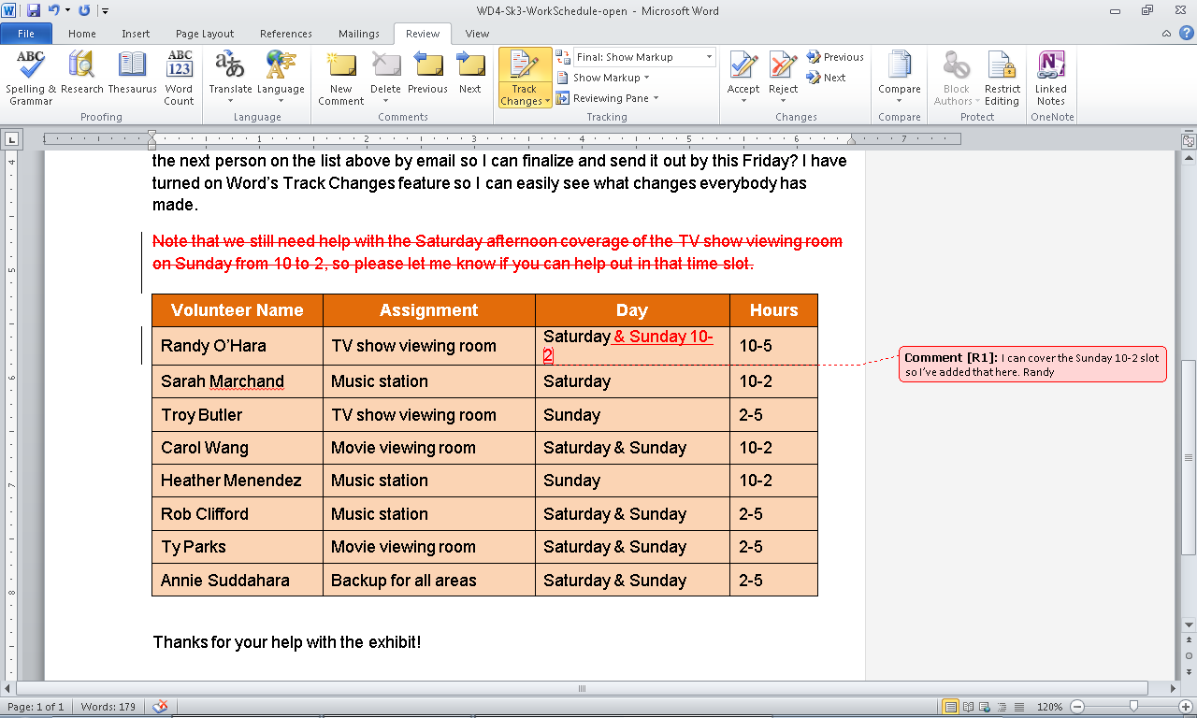
Track Changes button
Comment added
Text changes have been tracked.
Notes:
In this document (M5-C4-S3-WorkSchedule.docx), notice the Track Changes button is active. Text changes in red have been tracked and a comment has been added.

Slide 13
Changing Your User Name When you hover your mouse over a change in a document that has Track Changes activated, a small box appears with details about who made the change and on what date. To change the author name associated with a document, click the arrow on the Track Changes button, choose Change User Name, and then enter a new user name in the dialog box that appears.
Notes:
When comments are inserted, the reviewer’s initials are added to the beginning of the comment and a number keeps count of the number of comments added by that person.
This user information comes from the document’s properties. By default, the user name is entered for your computer when you first set up Windows.

Slide 14
Skill 4: Accept or Reject Changes and Review Comments
Click the Reviewing Pane button in the Tracking group in the Review tab. This will open the Reviewing pane.
Click the Accept or Reject button in the Changes group to make the appropriate change.
Click Comment in the Reviewing pane.
Click the Delete button in the Comments group.
Click the Reviewing pane button in the Tracking group to close the Reviewing pane.
Save the file.
Notes:
After you have gathered feedback on your document, you must take a few more steps to finalize it. You will review the feedback and decide which suggestions to incorporate and then delete the comments. In this skill, you review everybody’s changes and make choices about accepting or rejecting them. You can either accept or reject the changes one at a time or make a global decision to accept or reject all document changes at once.

Slide 15
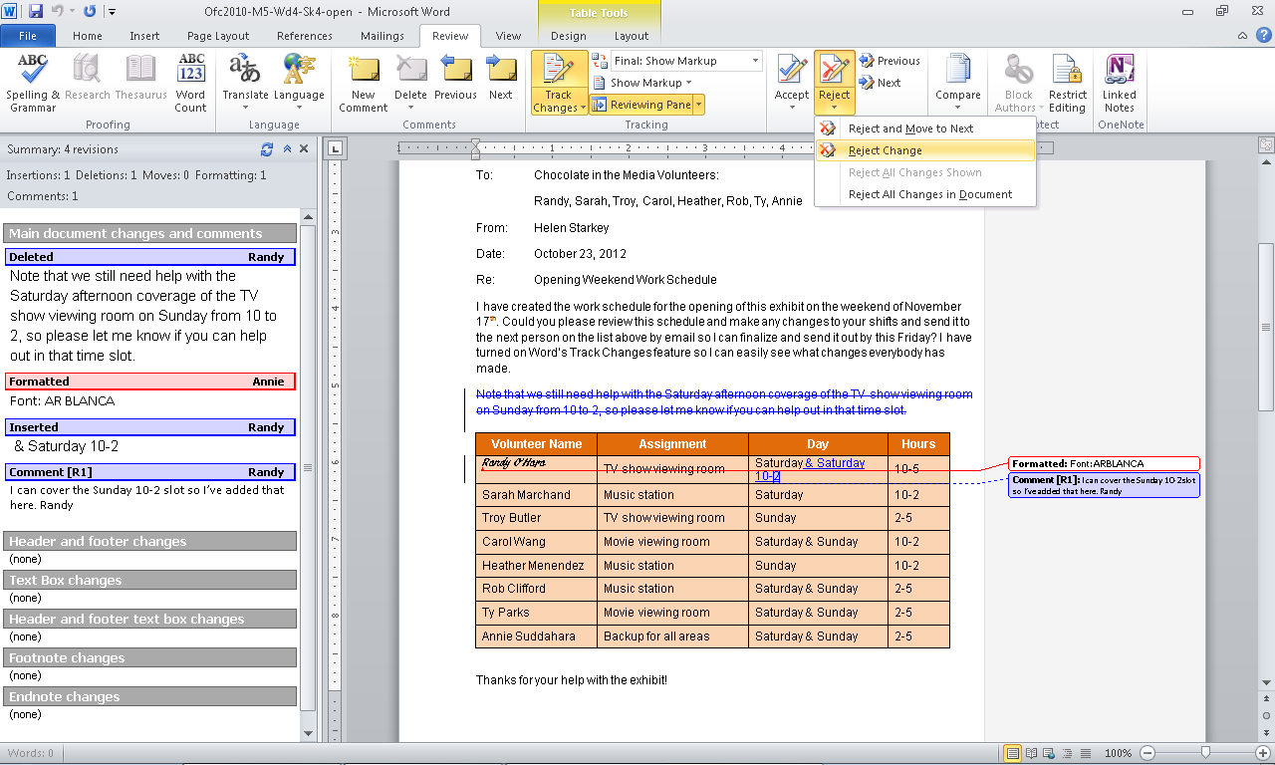
Reviewing pane active
Reject button
Reject change option
Notes:
In Lastname-M5-C4-S4-WorkSchedule.docx , you see the Reviewing pane is active. Click the Accept or Reject button in the Changes group to make the appropriate change. Here the Reject change option is being used.
If you want to reject or accept all changes in a document, you can use the Accept/Reject All Changes in Document option in the Accept or Reject button menus. If you want to delete all comments in a document, click the arrow on the Delete button and choose Delete All Comments in Document.

Slide 16
Protecting Files If you find that some of the changes made by your document reviewers are not useful, the Protect group on the Review tab provides two tools for limiting what reviewers can do when looking over your future documents: Restrict Editing and Block Authors.
Notes:
In cases where you do not want people to directly change your text or only make comments on it so you can decide what to do, you would click the Restrict editing button and choose Comments from the four Editing restrictions offered. The Block Authors button allows you to prevent certain people (whether a family member or a co-worker) from making any changes at all.
Before sending out any document as “final,” be sure that the copy is clean by double-checking that you have accepted or rejected each change (which removes the small callout bubbles from the margin) and deleted all comments.

Slide 17
Checkpoint 1
To turn on Review features in Word, click this button on the Review tab.
Show Markup
Reviewing Pane
Track Changes
Review
If several people add comments to a Word document, Word indicates this by
using different colors and commenter initials.
saving the comments in separate files.
using different colors and shading.
None of the above
Answer
Answer
Word’s Send as E-mail option is set up to send an attachment via email using
Internet Explorer.
Yahoo! Mail.
Outlook.
All of the above
When you review comments in a document, you can accept them or
highlight them.
turn off Track Changes.
reject them.
refuse them.
Answer
Answer
Next Slide
Notes:
In Slide Show View, click the Answer button for Question 1 after you believe that you know the correct answer. The correct answer will be displayed. Then click the Answer button for Question 2 and the answer will appear. Continue repeating these steps for all four questions in order. When complete, click the Next Slide button.
These Checkpoints are designed to provide you with an opportunity to reflect on a few concepts at a time.

Slide 18
Skill 5: Create a PDF Document
Click the File tab.
Click the Save and Send tab.
Click the Create PDF/XPS Document option in the File Types category.
Click Create PDF/XPS.
In the Publish as PDF or XPS dialog box, locate your working folder on your storage medium and save the file.
Note that the Save as type option is set to PDF (*.pdf).
Click the Publish button. You can now share the file as an email attachment or use any of the methods described in the next skill.
Notes:
Using the free Adobe Reader program, anybody can view a PDF file, whether or not they have Word installed on their computer. A PDF version of your document is in some ways like a picture, in that what people see is an accurate image of what you created at the moment of capture.

Slide 19
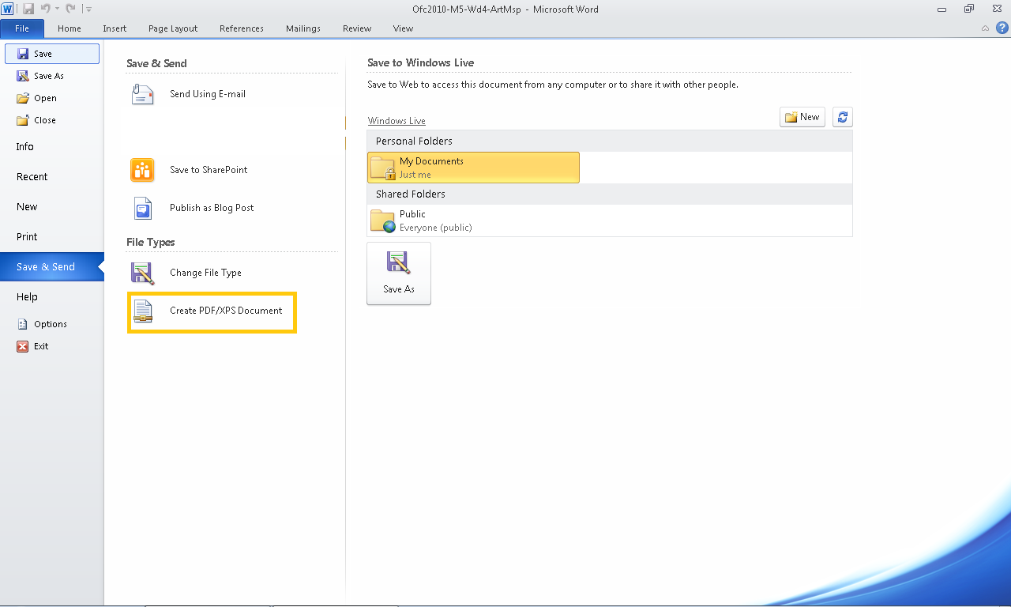
Save & Send tab active
Create PDF/XPS Document active
Notes:
In M5-C4-S5-WorkScheduleFinal.docx, you see the Save & Send tab active. To create a PDF document, click Create PDF/XPS Document and save your file to the appropriate folder.
Another way to save to the PDF format is to simply use the Save As button on the File tab. In the Save As dialog box that opens, select PDF (*.pdf) in the Save as type option box and then click the Save button.

Slide 20
Viewing PDFs Adobe Acrobat offers both the free Adobe Reader software and a more robust software program for purchase. The Reader version allows you to read a document in PDF format, while the full Adobe Acrobat program allows you to edit PDF files, add comments to them, and more.
Notes:
To get the free Adobe Reader software used to view PDF files, go to www.adobe.com.

Slide 21
Skill 6: Publish to the Web
Save to the Web
Click the File tab.
Click the Save & Send tab.
Select the Save to Web option.
Publish as a Blog Post
Click the File tab.
Click the Save & Send tab.
Select the Publish as Blog Post option.
Notes:
Sharing documents on the Web is a great way to disseminate information, educate others, and get feedback from them. Today it is easy to post your files, and all Microsoft Office products have methods to help you do so.
There are three ways to post a document on the Web using Word. Each requires that you have first established an online location to which you can save the document. Using the Save to Web feature of Word, you can share your documents after you have set up a Windows Live account. Once your account is established, you upload the document file by following this command sequence: File tab, Save & Send tab, Save to Web option. You then sign into your Windows Live account, save your document to your Windows Live workspace, and are ready to share a link to the document with others.
Word 2010 is set up to save files as blog postings using several popular blogging sites, including WordPress, SharePoint Blog, Blogger, Windows Live spaces, Community Server, and TypePad, as of this textbook’s publication. Because the Web is ever-changing, additional blog sites may now be available. After you establish an account on one of these (or similar) services, you simply use the File tab, Save & Send tab, Publish as Blog Post option sequence to post your document to a blogging site.

Slide 22
Skill 6: Publish to the Web
Save to SharePoint
Click the File tab.
Click the Save & Send tab.
Select the Save to SharePoint option.
Notes:
SharePoint is a software tool typically used by companies to set up online file sharing sites. If your company or organization has set up a SharePoint site, you can use the File tab, Save & Send tab, Save to SharePoint option sequence to save a file to the site.

Slide 23
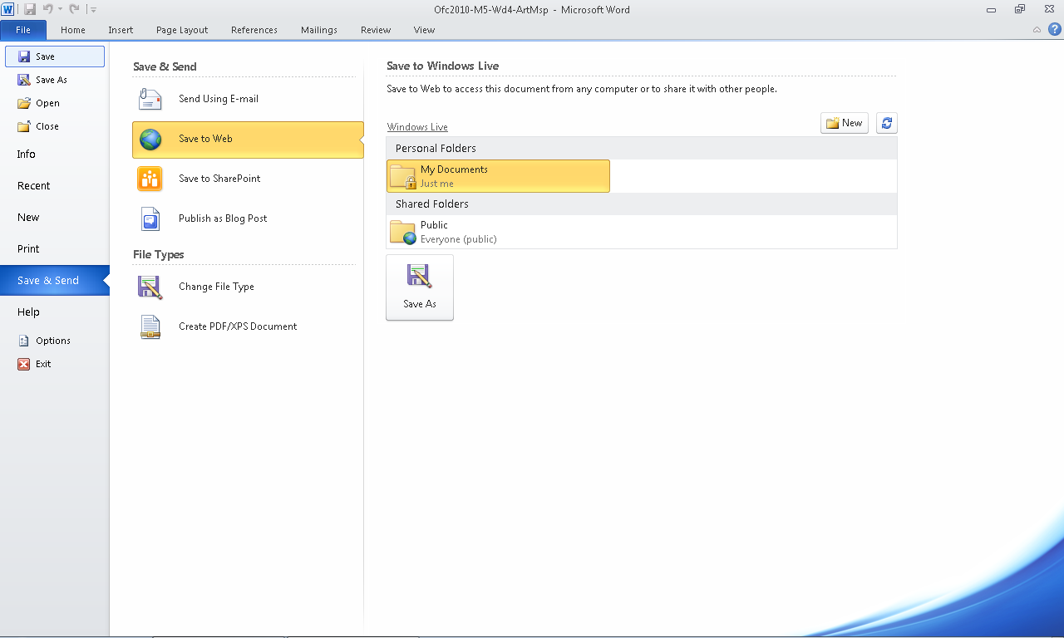
File tab
Save to Web
Save & Send tab
Notes:
Click the file tab to bring up the Save & Send tab. Click Save to Web and select the appropriate folder for your document.

Slide 24
Checkpoint 2
The three methods you can access for sharing documents on the Web using Microsoft Word can be accessed through this tab.
Print
Home
Save & Send
Share
Saving a document to the Web uses
Yahoo! Workspaces.
Windows Live workspaces.
Outlook.
Google Docs.
Answer
Answer
The company that created the PDF file format is
Microsoft.
Adobe.
Apple.
Acrobat.
The Restrict Editing button on the Review tab allows you to
turn off the Track Changes feature.
prevent people from adding pictures to documents.
limit changes that reviewers can make.
None of the above
Answer
Answer
Next Slide
Notes:
In Slide Show View, click the Answer button for Question 5 after you believe that you know the correct answer. The correct answer will be displayed. Then click the Answer button for Question 6 and the answer will appear. Continue repeating these steps for all four questions in order. When complete, click the Next Slide button.
These Checkpoints are designed to provide you with an opportunity to reflect on a few concepts at a time.

Slide 25
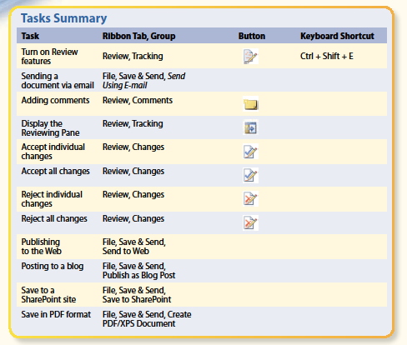
Task Summary
Notes:
Here is a list of the tasks covered in Word Chapter 4.

