Slide 1
Microsoft Word 2010
MODULE 5
Chapter 1: Creating Documents
Chapter 2: Formatting Documents
Chapter 3: Working with Tables and Objects
Chapter 4: Polishing and Publishing Your Documents
Notes:
In Module 5, you learn about Microsoft Word 2010. Chapter 1 covers creating documents including entering and editing text. Chapter 2 deals with formatting tools that help improve the look of your documents. In Chapter 3, you work with tables to help organize information and objects to add visual appeal. Finally, Chapter 4 covers features for reviewing and finalizing your document and printing it or publishing it online.

Slide 2
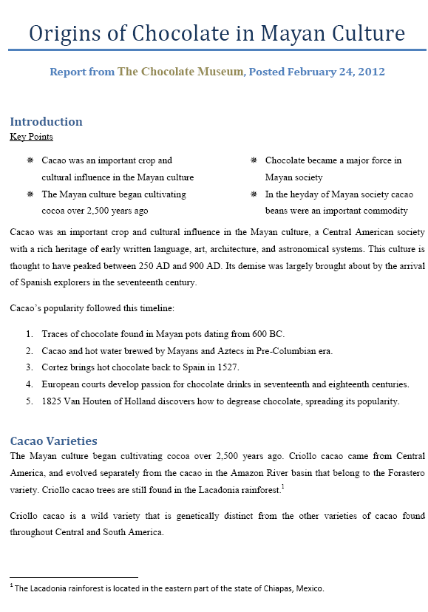
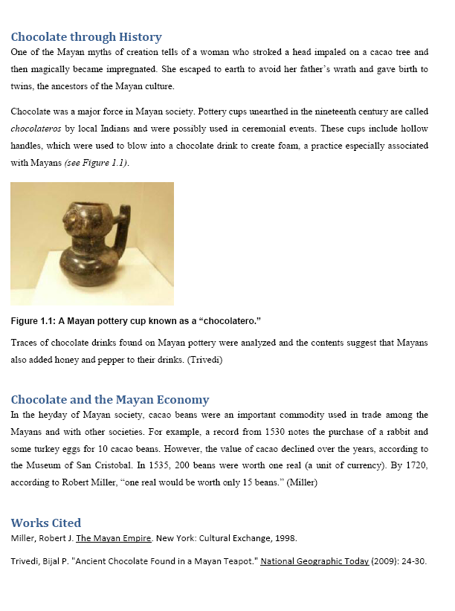
Formatting Documents
Chapter 2
Notes:
The second chapter in the Word module deals with formatting documents.

Slide 3
Skills You Learn
Change font and font size
Use formatting tools
Apply styles
Align text
Format paragraph and line spacing
Create bulleted or numbered lists
Copy formatting with Format Painter
Notes:
Using Word, you will learn how to format text so that it is attractive and easy to read. The ability to consistently apply formatting settings is convenient and gives your documents a cohesive look. Formatting involves working with fonts and effects, such as bold, italic, and underlining along with applying styles and aligning text.
Formatting tools enable you to organize text by aligning it on the page or putting it into bulleted or numbered lists. Word also includes the Format Painter, which allows you to copy formats from one section of text to another.

Slide 4
Skills You Learn
Insert a footnote
Insert citations using professional styles
Create a Works Cited page
Format text in columns
Notes:
When writing reports or research papers, it is important that you include the appropriate citations for the sources you have used to create your document. Word offers tools to help you cite sources properly, using accepted, professional styles for endnotes, citations, and Works Cited pages.

Slide 5
Chapter 2: Formatting Documents
Formatting
Allows you to make your text attractive and easy to read
Involves working with fonts and effects, such as bold, italic, and underlining
Includes the Format Painter, which allows you to copy formats from one section of text to another
Tools enable you to organize text by aligning it on the page or putting it into bulleted or numbered lists
Citations
Are important to designate sources you have used to create writing reports or research papers
Help you cite sources properly, using accepted, professional styles for endnotes, citations, and Works Cited pages
Notes:
In this chapter, you will work with Word formatting tools to refine the report’s appearance and with references tools to make sure that all sources are accurately credited.

Slide 6
Skill 1: Change Font and Font Size
To change a font
Select the text you wish to change.
In the Font group on the Home tab, click the down-pointing arrow next to the Font text box and then click the new font from the All Fonts category of the drop-down list.
To change font size
Click the down-pointing arrow next to the Font Size text box and click a size from the drop-down list.
Another way to change Font Size is to click in the Font Size text box and type the number of the font size you want.
Notes:
Fonts are character sets for the text you type and can add tremendous visual appeal to your documents. Word comes with many built-in fonts that you can apply to some or to all of the text in your document. You can also modify the font size to add emphasis or increase readability.
To change the font, you will first select the text you wish to change. In the Font group on the Home tab, click the down-pointing arrow next to the Font text box and then click the new font you wish to use from the All Fonts category of the drop-down list. Click anywhere in the document to deselect the text.
To change the font size, you must also select the text you wish to change. Click the down-pointing arrow next to the Font Size text box and click a size from the drop-down list. Another way to change Font Size is to click in the Font Size text box and type the number of the font size you would like.

Slide 7
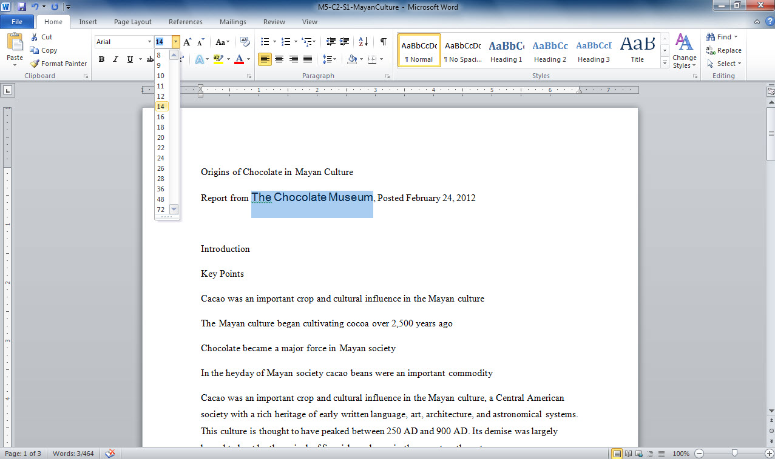
2. Click down-pointing arrow
3. Select size
1. Select text
Notes:
In this document (M5-C2-S1-MayanCulture.docx), you can see the text “The Chocolate Museum” is selected. Clicking the down-pointing arrow to the right of the font size text box allows you to change the font size by selecting a new size from a list. Select the size you wish to use from this list.
Tip: It’s a good idea to save your files frequently so you don’t lose valuable work.

Slide 8
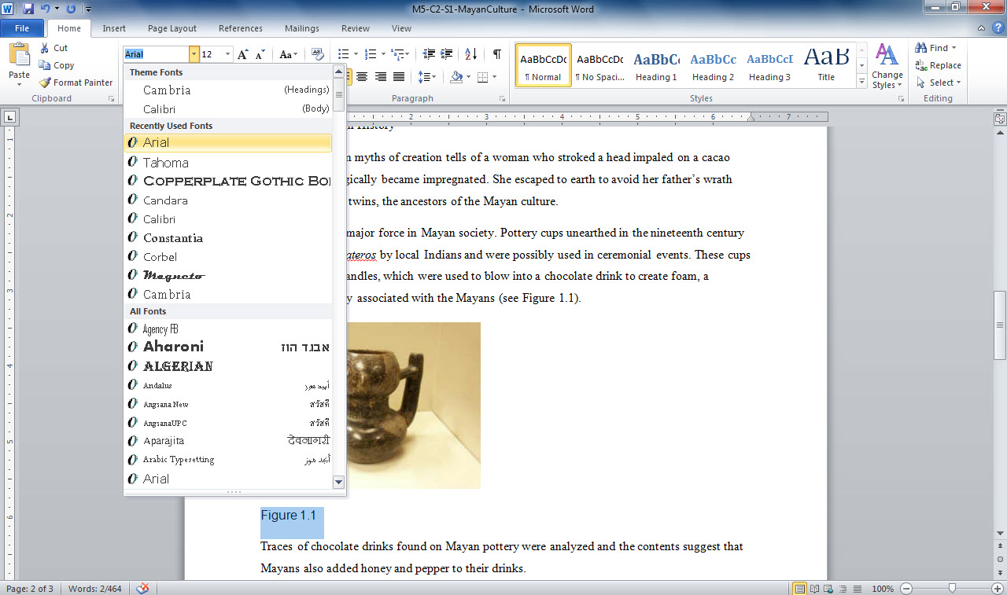
2. Click down-pointing arrow
3. Select font
1. Select text
Notes:
In the same document (M5-C2-S1-MayanCulture.docx), the text “Figure 1.1” is selected. To change the font, click the down-pointing arrow to the right of the Font text box and select the new font from the list that appears. Fonts listed under All Fonts are alphabetical.

Slide 9
Skill 2: Use Formatting Tools
Select text.
Click the Home tab, then the formatting you wish to apply in the Font group.
Click anywhere in the document to remove the selection.
Notes:
There are several ways you can format text beyond the font and font size. You can apply effects such as bold, italic, underlining, and color. Bold and italic add emphasis. Italics and underlining are used for widely accepted styles, such as for book and movie titles. You can also change the font color to add visual interest and affect the tone of your document.
You will first select the text to which you wish to apply formatting. Click the Home tab, then the formatting button in the Font group for the appropriate format. Click anywhere in the document to remove the selection.

Slide 10
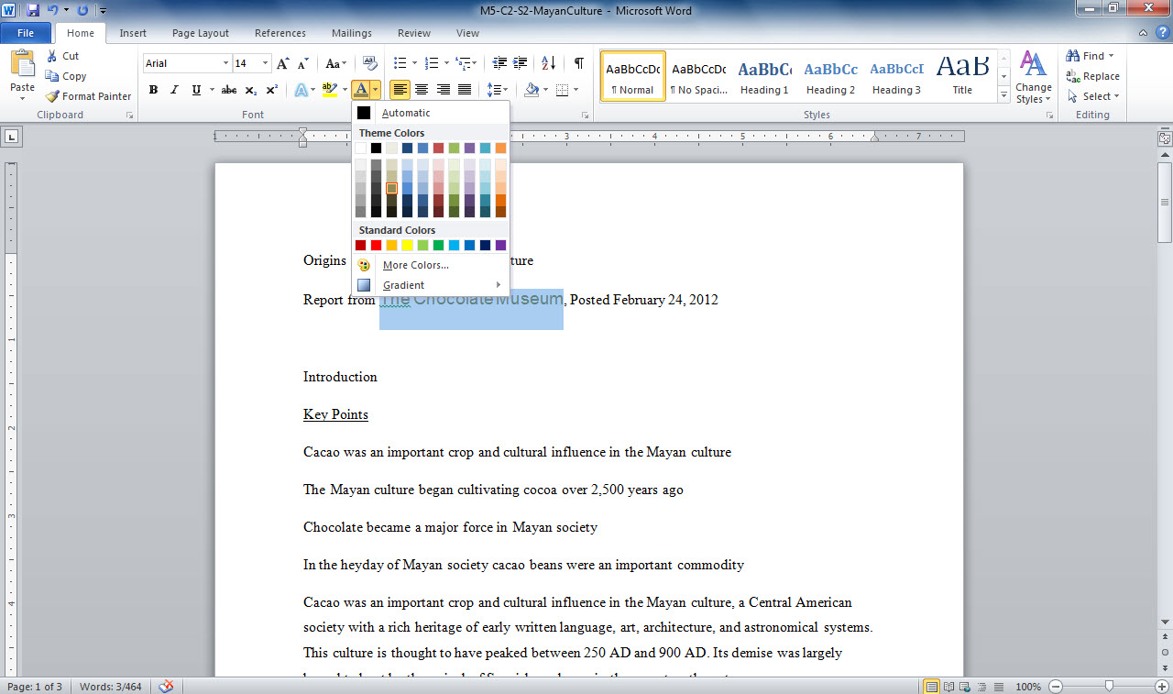
Font color drop-down arrow
Selected text
Notes:
This document (M5-C2-S2-MayanCulture.docx) has the text “The Chocolate Museum” selected. Clicking the down-pointing arrow to the right of the font color button allows you to change the font color by selecting a new color from a list. Select the color you wish to use from this list or select More Colors to choose from a color palette.

Slide 11
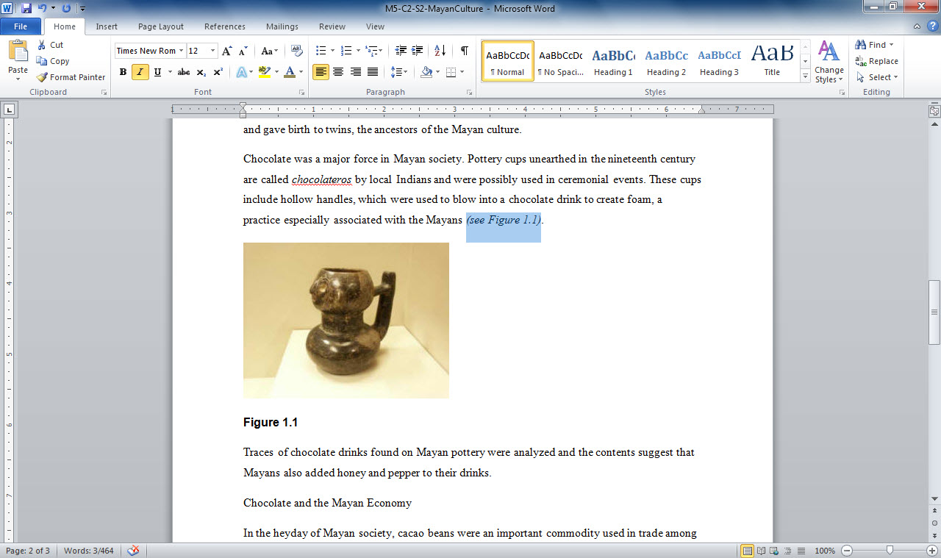
Font group formatting
Selected text
Notes:
This same document (M5-C2-S2-MayanCulture.docx) has the text “(see Figure 1.1)” selected. Clicking the Italic button in the Font Group allows you to change to italics.

Slide 12
Skill 3: Apply Styles
Click anywhere in the document heading.
Click Heading 1 in the Styles group on the Home tab to apply the style.
Apply other styles to document headings and subheadings as appropriate.
Save document.
Notes:
Styles are built-in groups of formatting settings that you can apply to text with one action rather than having to perform multiple, separate formatting actions. Styles are useful for creating headings in your documents or for formatting your company name in a unique way.
To apply a style, click anywhere in the text that you wish the style to be applied. Click the style name in the Styles group on the Home tab to apply the style. Apply other styles to document headings and subheadings in the same manner as appropriate.

Slide 13
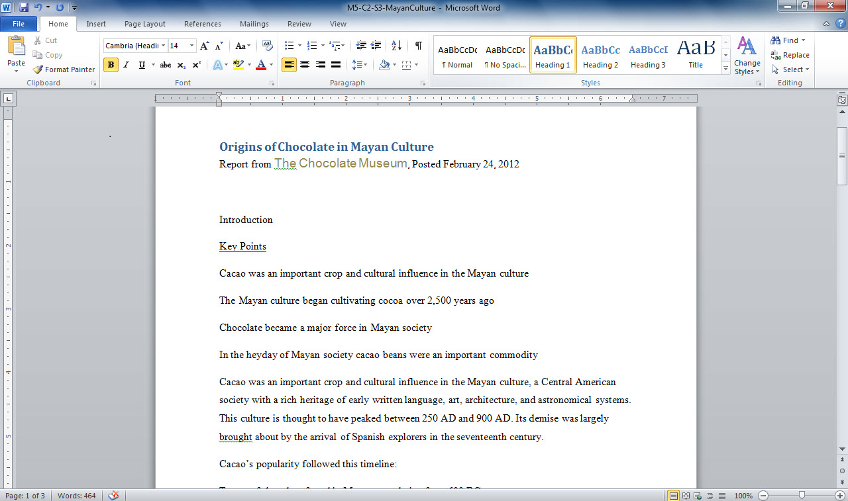
Click Heading 1 style
Click in heading
Notes:
In this document (M5-C2-S3-MayanCulture.docx), click anywhere in the document heading Origins of Chocolate in Mayan Culture. Click Heading 1 in the Styles group on the Home tab to apply the style. Continue applying styles in the same manner when needed.

Slide 14
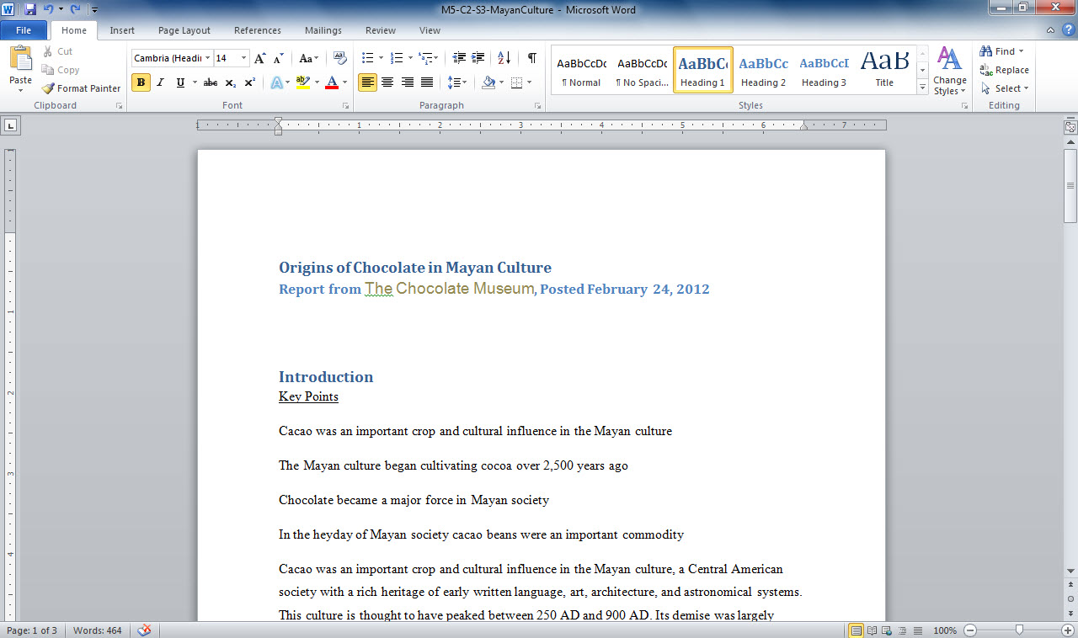
Click appropriate style
Click other headings or subheadings
Notes:
Here you see the same Heading 1 style applied to the text Introduction in M5-C2-S3-MayanCulture.docx.
If you don’t see the style you want, you can click the More button in the bottom right corner of the Styles gallery to display all styles. To quickly apply a style to more than one line of text, select the first line, press and hold down Ctrl and select the others, and then apply the style to all selected text with one click.

Slide 15
Saving Formats as a Style To save a set of applied formats as a style, select the formatted text and click the More button on the Styles gallery. In the list of links at the bottom, click Save Selection as a New Quick Style, give the style a name, and then click the OK button.
Notes:
You may wish to save a set of applied formats as a style. Select the formatted text and click the More button on the Styles gallery. In the list of links at the bottom, you can click Save Selection as a New Quick Style and give the style a name.

Slide 16
Skill 4: Align Text
Select text to be aligned.
Click the appropriate alignment button in the Paragraph group on the Home tab.
To select non-consecutive lines of text for alignment, select the first line, then press and hold down the Ctrl key and select subsequent text.
Release the Ctrl key.
Click the appropriate alignment button.
Save the file.
Notes:
Word allows you to align text in your document in four ways relative to the margins that are set: at the left, at the right, in the center, or justified. A document’s default alignment is alignment at the left margin.
Select the text you wish to align. On the Home tab in the Paragraph group, click the alignment button you wish to use. Use the Ctrl key to select non-consecutive lines of text for alignment by holding down the Ctrl key and selecting subsequent text. Release the Ctrl key and click the appropriate alignment button.

Slide 17
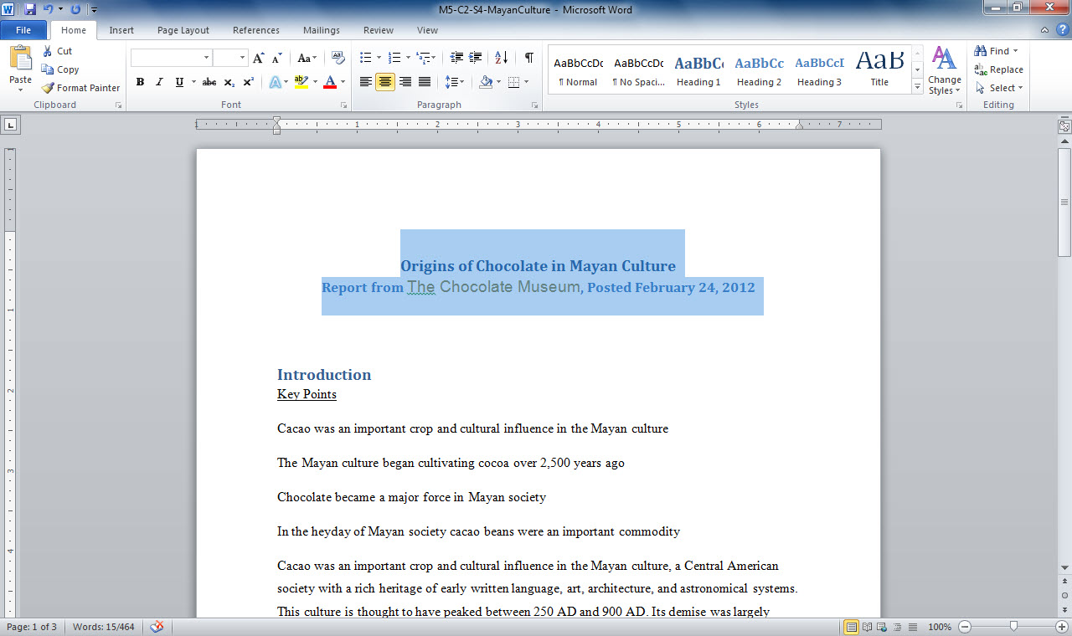
Select alignment button
Select text
Notes:
In M5-C2-S4-MayanCulture.docx, you see the first two lines of text selected. Select the center alignment button in the Paragraph group in the Home tab to center align the text.
If necessary, use the single down arrow near the bottom of the scroll bar to navigate through the document.

Slide 18
Formatting with Tabs You can only apply one alignment setting to a paragraph. To align an address on the left and a phone number on the right, left align the text and set a right tab at the right margin. Enter the address, press the Tab key, and then enter the phone number.
Notes:
You can format using tabs, if necessary. Since you can only apply one alignment setting to a paragraph, you can use the Tab key to move to a right tab at the right margin.

Slide 19
Skill 5: Format Paragraph and Line Spacing
To format spacing between the lines of a paragraph
Select the first paragraph, then press and hold down the Ctrl key and select subsequent paragraphs.
Click the Line and Paragraph Spacing button in the Paragraph group on the Home tab and click the appropriate spacing from the drop-down list.
To format spacing before or after a paragraph
Select the paragraph.
Click the dialog box launcher in the bottom right corner of the paragraph group.
In the Paragraph dialog box that appears, click the arrows in the After box until the appropriate value appears.
Notes:
Word enables you to adjust spacing between the lines of a paragraph. The amount of white space you provide between lines can affect the readability of your document. It can also provide a visual break between the paragraphs in your text.

Slide 20
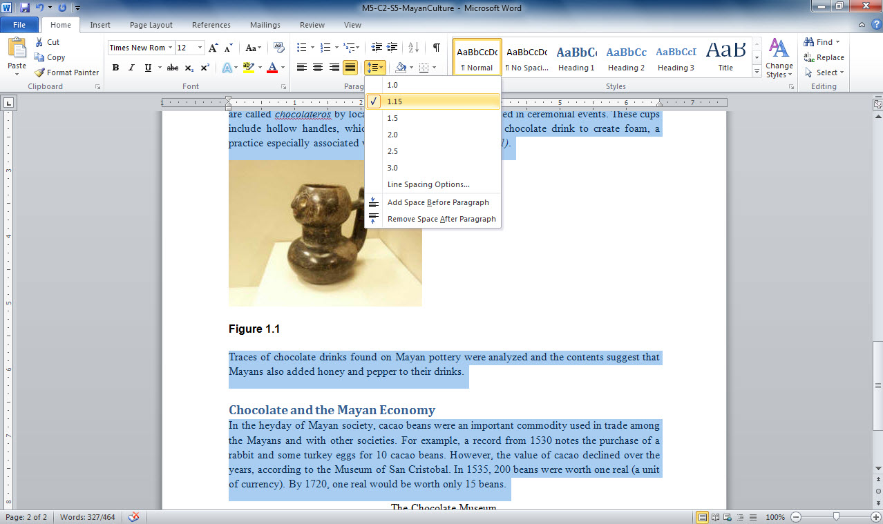
Line and Paragraph spacing button
Selected text
Notes:
In M5-C2-S5-MayanCulture.docx, you see the paragraphs selected. To select more than one paragraph, press and hold down the Ctrl key, and then select the paragraphs. Click the Line and Paragraph Spacing button in the Paragraph group on the Home tab to bring up the line spacing options.
To change paragraph spacing, select the text within the paragraph and click the dialog box launcher in the bottom right corner of the Paragraph group. In the Paragraph dialog box that appears, click the up-pointing arrow on the After field in the Spacing section to set the value. Click OK to close the dialog box.
Notice that extra space will have been added after the selected lines of text.

Slide 21
Formatting Line Spacing You can further customize line spacing by using the Before field in the Spacing section in the Paragraph dialog box. By choosing a value in this field, you can set how much space appears before a paragraph rather than within or after a paragraph.
Notes:
Another way to further customize line spacing is to open the Paragraph dialog box by clicking the dialog box launcher in the Paragraph group in the Home tab. In the Spacing section, click the arrow next to the At text box and select the number from the drop-down list.

Slide 22
Checkpoint 1
Fonts are defined as
effects such as bold and underline.
character sets for type.
the way Word formats text.
either italic or bold.
Using alignment tools, text is aligned relative to
tabs.
the ruler.
left and right margins.
headers and footers.
Answer
Answer
Heading 1 is a
Font.
Template.
Style.
None of the above
Paragraph settings are found on this tab.
Page Layout
Home
File
View
Answer
Answer
Next Slide
Notes:
In Slide Show View, click the Answer button for Question 1 after you believe that you know the correct answer. The correct answer will be displayed. Then click the Answer button for Question 2 and that answer will appear. Continue repeating these steps for all four questions in order. When complete, click the Next Slide button.
These Checkpoints are designed to provide you with an opportunity to reflect on a few concepts at a time.

Slide 23
Skill 6: Create Bulleted or Numbered Lists
Apply a bulleted style
Select the text you would like to bullet.
On the Home tab, click the Bullets button in the Paragraph group.
Apply a numbered style
Select the text you would like to number.
On the Home tab, click the Numbering button in the Paragraph group.
Notes:
In documents, lists help to set off similar items such as product parts, indicate steps in a procedure, and draw the reader’s attention to your listed items. Bulleted lists and numbered lists are two common types of lists that are easy to set up in Word.
Bulleted lists are used for items that have no particular sequence, such as the books or magazines on your bookshelf or a list of your favorite movies. Numbered lists suggest an order to the items within them, as with the sequential steps in a process.

Slide 24
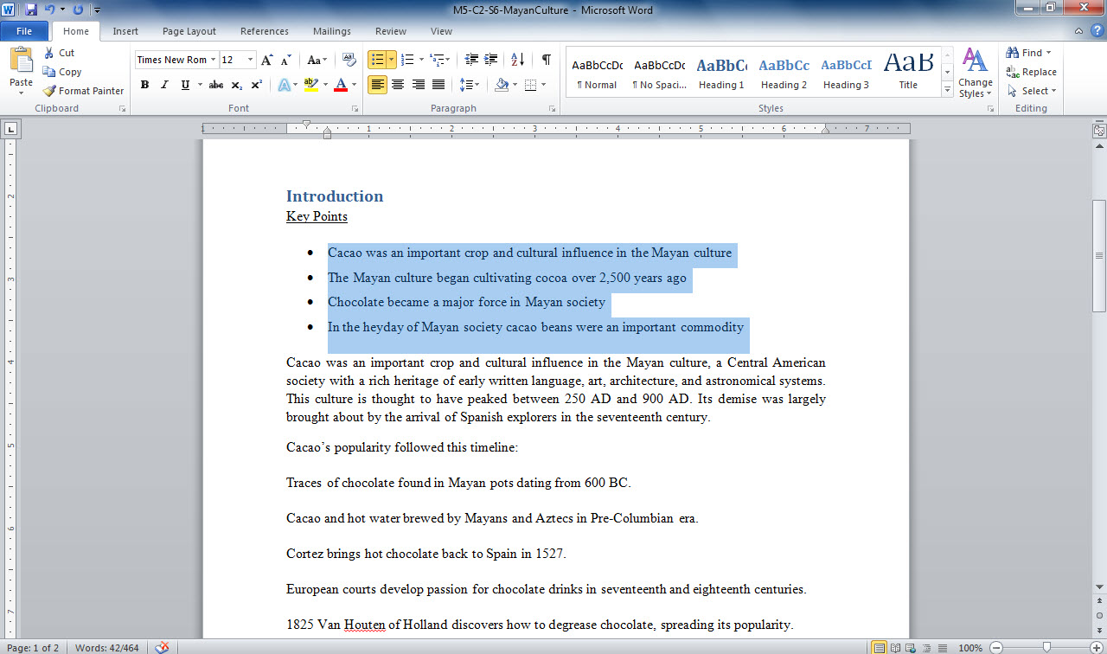
Click Bullet button
Select text
Notes:
Here, in M5-C2-S6-MayanCulture.docx, you see the lines of text selected. To apply the bullets, click the Bullets button in the Paragraph group on the Home tab.

Slide 25
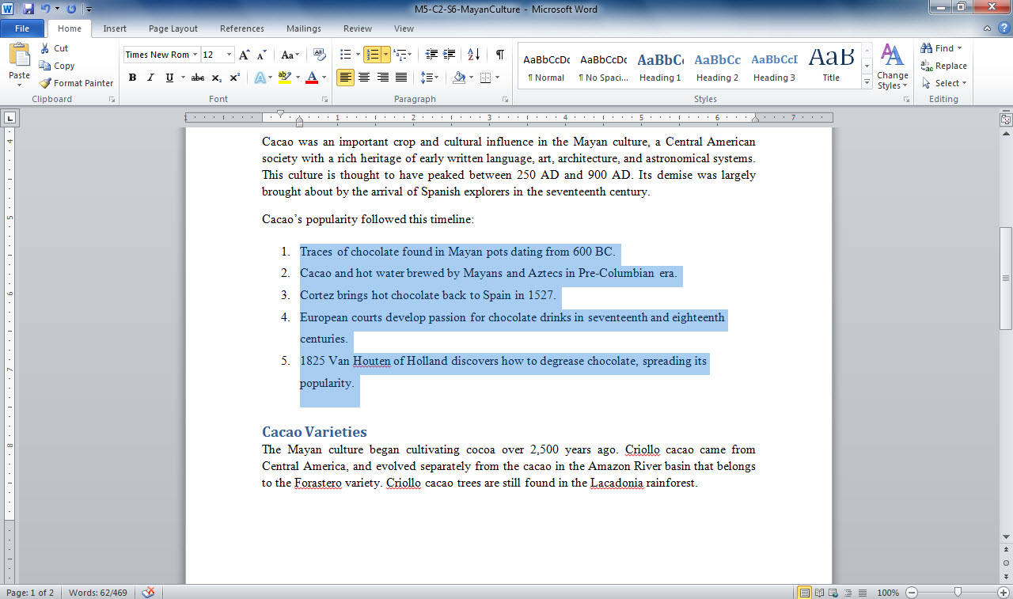
Click Numbering button
Select text
Notes:
Again, in M5-C2-S6-MayanCulture.docx, you see the lines of text selected. To apply the numbers, click the Numbering button in the Paragraph group on the Home tab. The default numbered list style is applied to the selected steps.

Slide 26
Skill 6: Apply a Custom Bullet Style
Select the bulleted text.
Click the down-pointing arrow on the Bullets button.
In the gallery that appears, click Define New Bullet.
Click the Symbol button to open the Symbol dialog box.
Click the down-pointing arrow next to the Font field and scroll down the list.
Select the symbol you wish to use and in the character code field, type the character code.
Notes:
Clicking the Bullets button applies the default bullet style at the beginning of each selected paragraph. You can choose different bulleted list styles such as square or diamond shapes rather than circles, by clicking the arrow on the Bullets button. You can click on any symbol rather than enter its character code.
As is true for bullets, you can choose different styles for numbered lists by clicking the arrow on the Numbering button. You might prefer using letters rather than numbers, or at times choose Roman numerals over Arabic numerals.

Slide 27
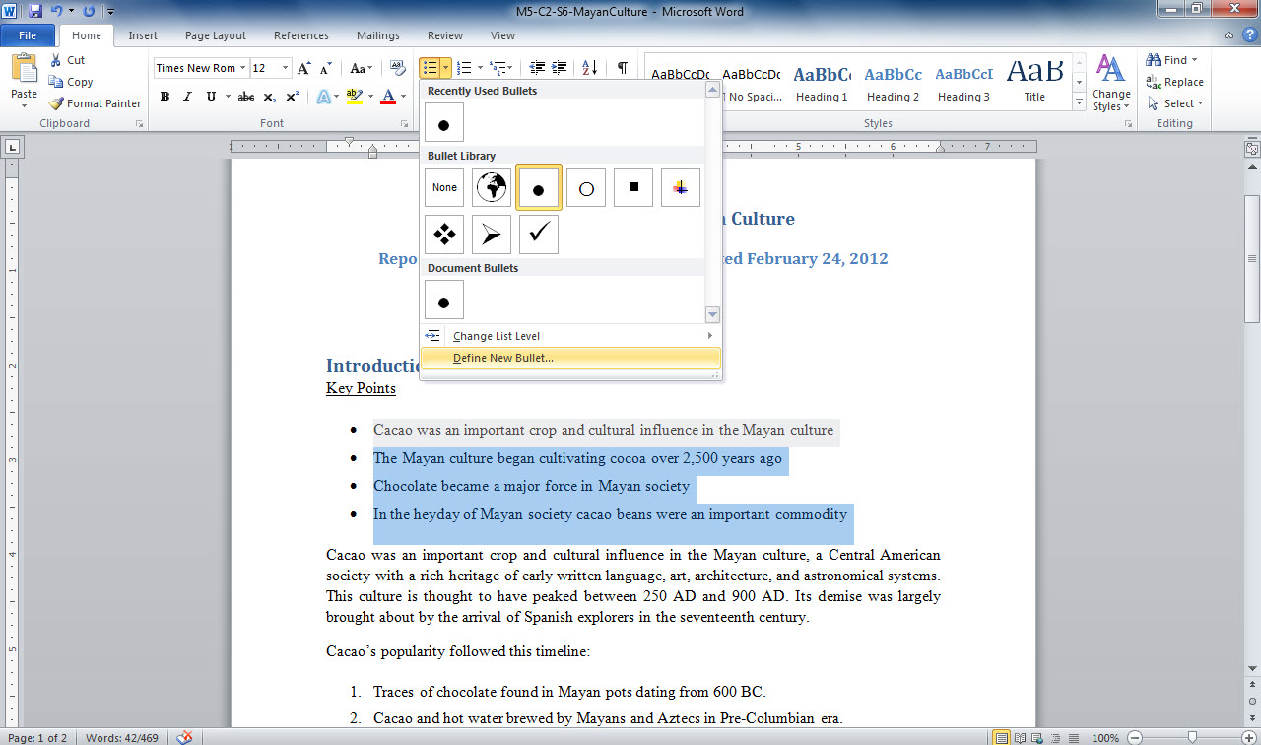
2. Click down-pointing arrow on bullets button
3. Click Define New Bullet
1. Select bulleted text
Notes:
Select the bulleted text under the Key Points heading on the first page of M5-C2-S6-MayanCulture.docx and click the down-pointing arrow on the Bullets button. Click Define New Bullet, click the Symbol button to open the Symbol dialog box, and either type the character code in the Character Code field or click the symbol you wish to use.

Slide 28
Creating Lists with Multiple Levels To create a multilevel numbered or bulleted list, use the Increase Indent and Decrease Indent buttons in the Paragraph group on the Home tab to move the item lower or higher in the outline.
Notes:
Another way to change levels is to press the Tab button, and the item will indent one level. If you enter text and then press Enter, your cursor will automatically be placed at the start of a new line at the same indent level. Press Shift + Tab or the Decrease Indent button to move an item up by one level. Using these methods, you can modify any numbered or bulleted list to contain multiple levels.

Slide 29
Skill 7: Copying Formatting with Format Painter
Click anywhere in the formatted area you wish to copy.
In the Clipboard group on the Home tab, click the Format Painter button.
Select the text you are formatting.
Notes:
Format Painter allows you to copy the format settings of selected text and apply them to another selection, which could be a single character, word, or entire pages of text. Format Painter saves you time and helps ensure that formatting settings are consistent throughout your document.

Slide 30
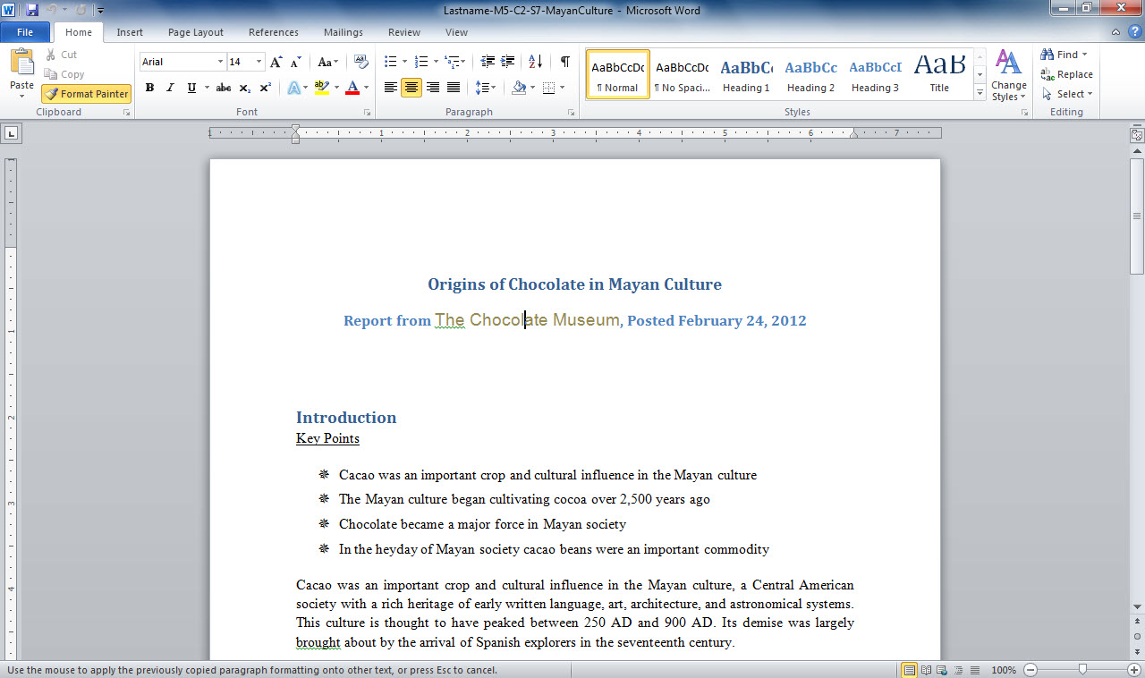
2. Click Format Painter button
1. Click in formatted area you wish to copy
Notes:
In Lastname-M5-C2-S7-MayanCulture.docx , click anywhere within the text formatting you wish to copy. In the Clipboard group on the Home tab, click the Format Painter button. Select the text to which you wish to apply the formatting. Note that the formatting is copied to the destination text.

Slide 31
More on Format Painter To copy formatting to more than one area, double-click the Format Painter button, and then apply the format to as many paragraphs, words, or phrases as you like. When you are done, click the Esc key on your keyboard to deactivate Format Painter.
Notes:
If you prefer to place your notes at the end of the document rather than at the bottom of each page, use an endnote. Insert an endnote by clicking the Insert Endnote button in the Footnotes group on the References tab, or press Alt + Ctrl + D.

Slide 32
Skill 8: Insert a Footnote
Click in the document where you want the footnote to occur.
Click the References tab.
In the Footnotes group, click the Insert Footnote button. A footnote reference number is inserted and the footnote at the bottom of the page opens for editing.
Type the footnote text.
Notes:
Footnotes place information at the bottom of a page, in contrast with endnotes, which place them at the end of a document. You can use the References tab in the Ribbon to insert a footnote or an endnote reference wherever your cursor is placed in your document.

Slide 33
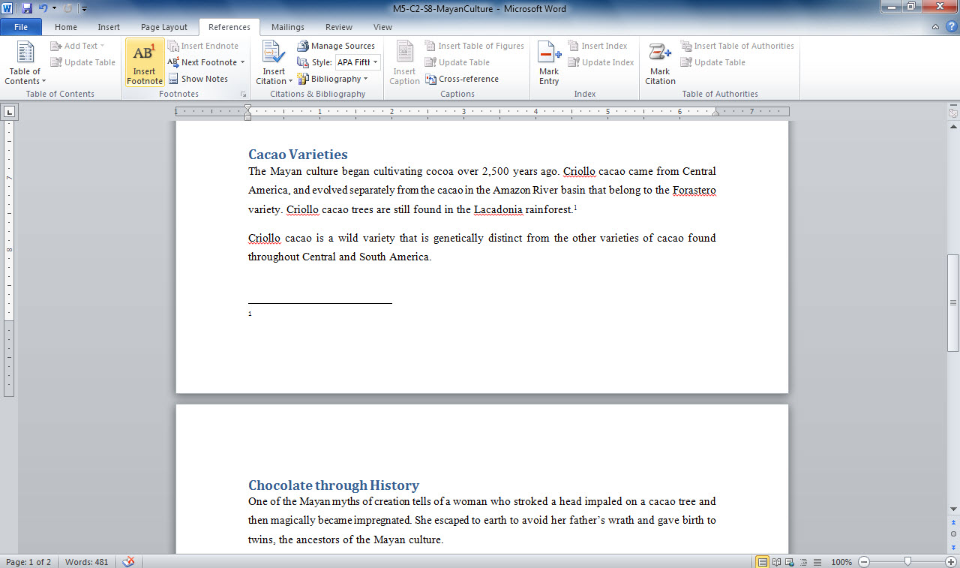
2. Click References tab
3. Click Insert Footnote button
1. Click in document to place footnote
4. Type footnote text
Notes:
Here you see M5-C1-S8-MayanCulture.docx with the footnote placement selected by clicking in the document. In the Footnotes group on the Paragraph tab, click the Insert Footnote button. A footnote reference number is inserted and the footnote at the bottom of the page opens for editing.

Slide 34
Navigating Footnotes and Endnotes To locate footnotes or endnotes in a document, you can use the Next Footnote button on the References tab.
Notes:
If you prefer to place your notes at the end of the document rather than at the bottom of each page, use an endnote. Insert an endnote by clicking the Insert Endnote button in the Footnotes group on the References tab, or press Alt + Ctrl + D.

Slide 35
Skill 9: Insert Citations Using Professional Styles
Click in the document where you want the citation to occur.
In the Citations & Bibliography group on the References tab, click the Style drop-down arrow and select the professional citation style.
Click the Insert Citation button in the Citations & Bibliography group.
From the drop-down list, click the Add New Source option.
Select the Type of Source text box and then type the appropriate information in the Create Source dialog box.
Click OK to insert citation.
Notes:
Citations give appropriate credit to sources you have quoted or taken information from when creating your document. You can use Word’s Citation feature to create sources and insert their information within your text according to one of several accepted professional styles, such as MLA or APA.

Slide 36
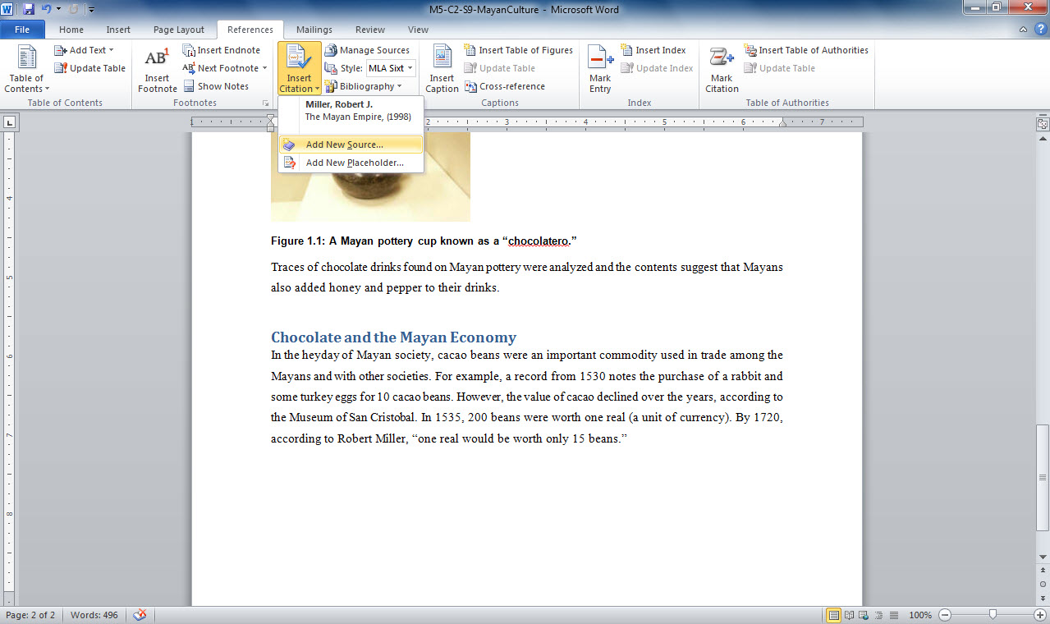
2. Click Insert Citation button
3. Click Add New Source
1. Click for citation placement
Notes:
In M5-C2-S9-MayanCulture.docx, click within the document for citation placement. In the Citations & Bibliography group on the References tab, click the Style drop-down arrow and select the professional style you wish to use. This option will apply the professional style for your citations. Click the Insert Citation button in the Citations & Bibliography group. From the drop-down list, click the Add New Source option. Make sure that the citation type is selected for the Type of Source text box and then type the citation information in the Create Source dialog box. Click OK to insert the citation.

Slide 37
Editing Sources Once you have entered source information, you may change it, either by deleting sources or managing which sources are available to your current document. Click the Manage Sources button in the Citations & Bibliography group on the References tab.
Notes:
Once you enter information about a resource, you can insert it again by choosing it from the list that appears when you click Insert Citation.

Slide 38
Skill 10: Create a Works Cited Page
Place your cursor at the end of your document.
Press Enter and type an appropriate heading.
Click the Home tab and apply a style to the heading.
Click the References tab.
Click the Bibliography button in the Citations & Bibliography group and then click Insert Bibliography from the drop-down menu that appears. This action inserts the cited works under the Works Cited heading.
Notes:
Once you have inserted citations in your document, you can create a Works Cited page, which appears at the end of your document and gives detailed information about your quoted sources.

Slide 39
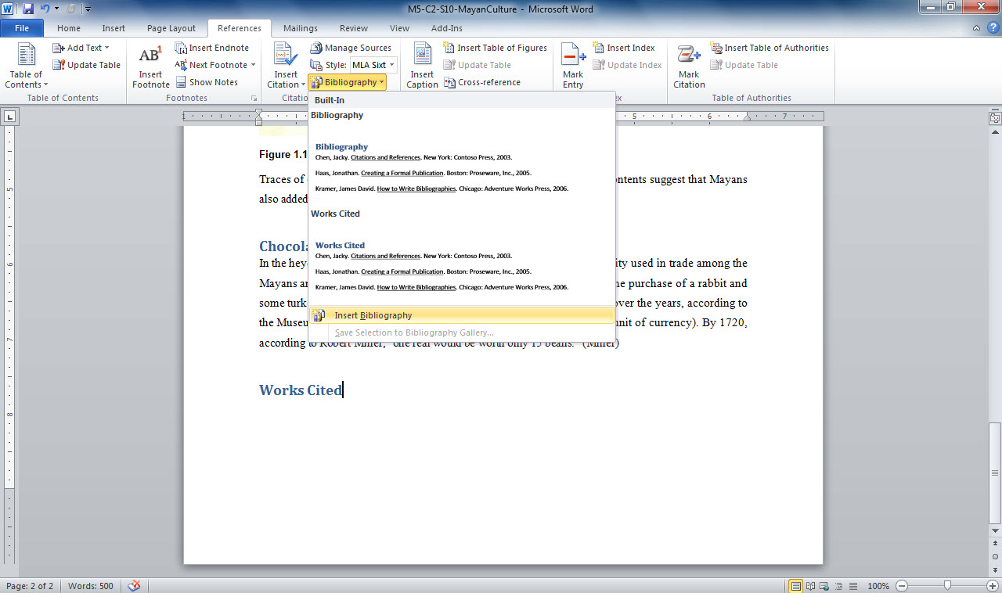
2. Click Bibliography button
3. Click Insert Bibliography
1. Add heading at end of document
Notes:
In M5-C2-S10-MayanCulture.docx, place your cursor at the end of the document and type your Works Cited title. Click the Home tab and apply the appropriate style to the title. Click the References tab. Click the Bibliography button in the Citations & Bibliography group and then click Insert Bibliography from the drop-down menu that appears. This action inserts the cited works under the Works Cited heading.

Slide 40
Selecting Citation Styles The format of your citations will vary based on the professional standard for publication that you use.
Notes:
Three of the most commonly used standards are MLA (Modern Languages Association), most commonly used in English and humanities publications; APA (American Psychological Association), most commonly used in scientific publications; and Chicago, based on The Chicago Manual of Style.
Some instructors may prefer that you place the Works Cited on its own page. To do so, press Ctrl + Enter instead of Enter.

Slide 41
Skill 11: Format Text in Columns
Select the text you wish to be divided into columns.
Click the Page Layout tab.
Click the Columns button in the Page Setup group.
Select the number of columns from the drop-down list.
Notes:
Sometimes, you may want to use columns to save space or arrange text or lists in a more interesting or helpful pattern. To do this, you simply select the text you want to arrange in columns and then specify how many columns you need by using the Columns feature in Word.

Slide 42
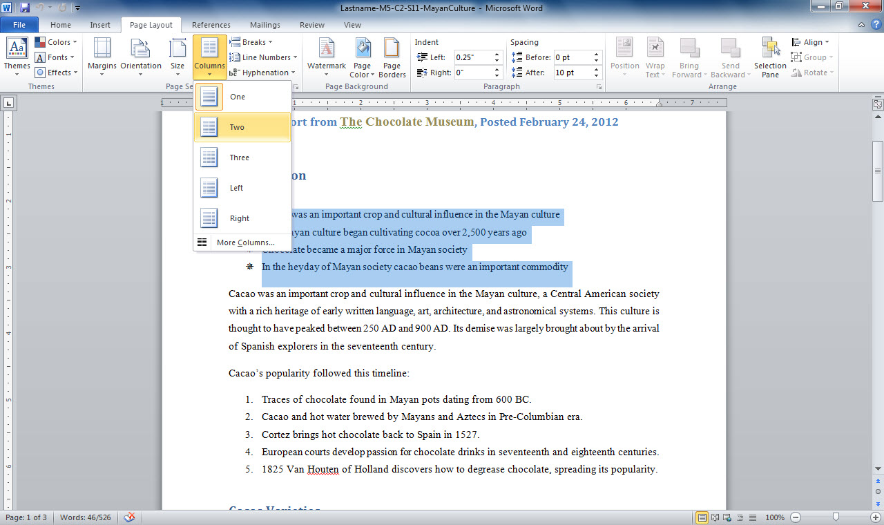
2. Click Columns button
3. Click number of columns
1. Select text
Notes:
Lastname-M5-C2-S11-MayanCulture.docx shows the lines of text selected. Click the Page Layout tab. Click the Columns button in the Page Setup group. Click the number of columns from the drop-down list.
If you need more than three columns, you can click the More Columns option in the drop-down menu and adjust the settings in the dialog box that appears.

Slide 43
More Options for Formatting Columns If you wish to have two columns of unequal width, you can choose the Left or Right style in the Columns dialog box. Left makes the left column smaller; right makes the right column smaller.
Notes:
If column options do not suit your needs, consider instead using a table to organize text. Tables give you great flexibility in making columns of varying widths.

Slide 44
Checkpoint 2
Bulleted lists are typically used for
a list of items that has no sequence.
a list of items that has a particular sequence.
Endnotes place information
at the bottom of a page.
at the end of a document.
in a footer.
in a header.
Answer
Answer
Format Painter is used to
copy text.
copy pictures.
copy formatting from one piece of text to another.
None of the above
One common professional style used in documents is
MLB
MLA
ABA
Illinois
Answer
Answer
Next Slide
Notes:
In Slide Show View, click the Answer button for Question 5 after you believe that you know the correct answer. The correct answer will be displayed. Then click the Answer button for Question 6 and that answer will appear. Continue repeating these steps for all four questions in order. When complete, click the Next Slide button.
These Checkpoints are designed to provide you with an opportunity to reflect on a few concepts at a time.

Slide 45
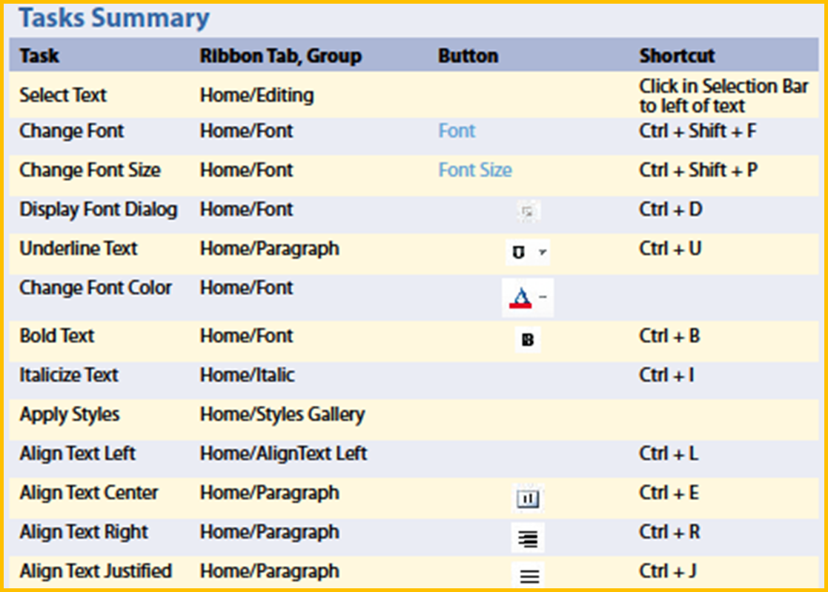
Notes:
Here is a summary of the Word Chapter 2 tasks.

Slide 46
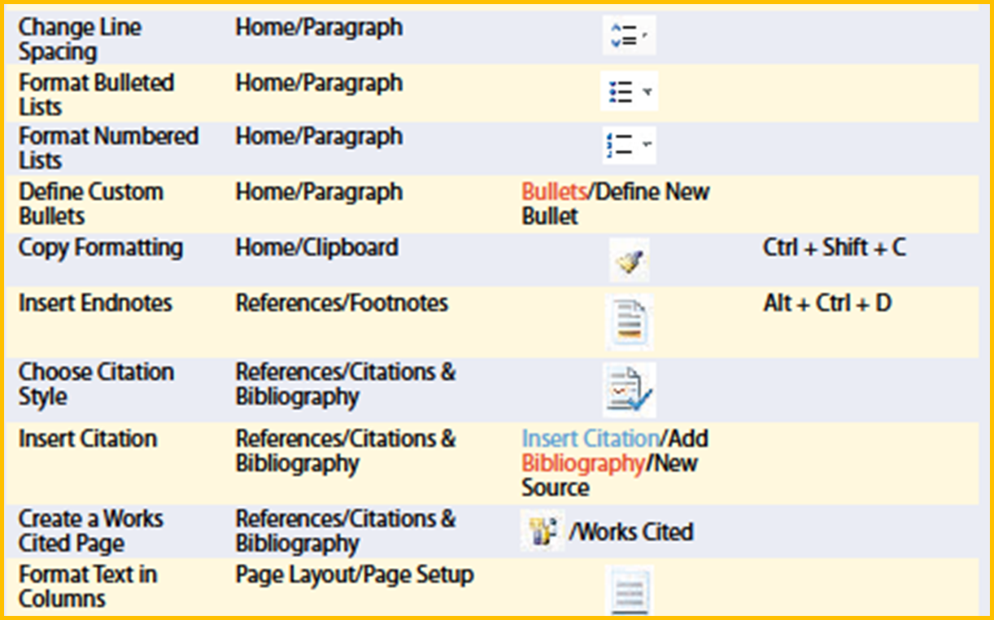
Tasks Summary, continued
Notes:
Here is a continuation of the tasks summary.

