Slide 1
Microsoft Word 2010
MODULE 5
Chapter 1: Creating Documents
Chapter 2: Formatting Documents
Chapter 3: Working with Tables and Objects
Chapter 4: Polishing and Publishing Your Documents
Notes:
In Module 5, you learn about Microsoft Word 2010. Chapter 1 covers creating documents including entering and editing text. Chapter 2 deals with formatting tools that help improve the look of your documents. In Chapter 3, you work with tables to help organize information and objects to add visual appeal. Finally, Chapter 4 covers features for reviewing and finalizing your document and print or publishing it online.

Slide 2
Microsoft Word Overview
Use Word to create a variety of documents.
Work with pre-designed templates.
Plan your document’s message.
Understand who your audience is.
Fit the type of document to its purpose.
Notes:
Using Word, you can create a variety of documents, such as business letters, reports, and recipe cards. You can also use pre-designed templates to create visually appealing versions of documents such as agendas, brochures, expense reports, and flyers.
Whatever type of document you create, take the time to plan the message to help ensure clear and effective communication. Planning involves deciding on a purpose, identifying your audience, selecting the topic, and choosing a format. Your purpose, or reason for writing, might be to make a point, to inform, to convince others to believe as you do, or to entertain.
“Audience” is the person or group of people you expect to read what you write. The more you know about your audience, the better you can target your message.
Often, the type of document you are creating and the features available in Word help shape your decisions about how much to write and how to present it. For example, if you were writing a memo to a group of museum volunteers about an exhibit work schedule, you would want to keep the memo short and visually attractive while making sure the information can be read quickly and easily.

Slide 3
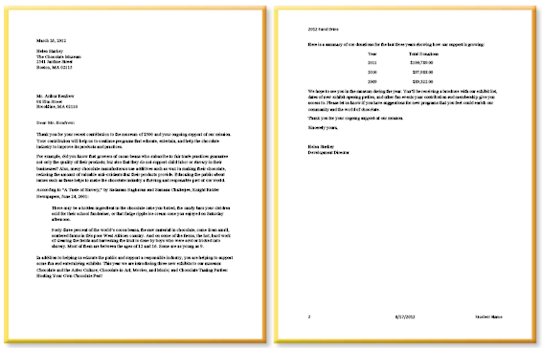
Creating Documents
Chapter 1
Notes:
The first chapter in the Word module deals with creating basic documents.

Slide 4
Skills You Learn
Enter and edit text
Use cut, copy, and paste
Perform a spell check
Open a document based on a template
Indent and add tabs using the Ruler
Set margins
Insert a page break
Add headers and footers
Notes:
This chapter is all about creating your document by opening a blank document, opening an existing document, or working with a pre-designed template.
Once you create a document, you will add and edit text. With some text in place, you can work with the Ruler to indent text and set margins. Finally, you discover how to insert a page break when certain text must begin on a new page, and to add information about the document in headers and footers.

Slide 5
Chapter 1 Introduction: Creating Documents
To create a new document
Start with a blank document
Start with a document template
Open an existing document
Enter and edit text
Change text
Select text and move or copy it
Add indents and tabs
Check spelling, margins, and page breaks
Notes:
In Word you can start from scratch with a blank document, open existing documents, or open documents based on templates (pre-designed documents). In this chapter you will practice a combination of these three methods.
With a document open, the next logical step is to enter and edit text. (This is the computer version of writing text on a piece of paper, scratching out what you do not like, and adding more words as needed.) Word offers tools that help you enter text, select text and make changes to it, and move or copy text from one place to another in that document.
If you are not a spelling expert, you will appreciate the spelling check feature, which we cover in this chapter. You will also change various properties of your document pages,
such as the margins (these determine the width of the white space bordering your text) and
where breaks occur between one page and another, such as between the title page and the
first page of a report.

Slide 6
Skill 1: Enter and Edit Text
Open Word, which displays a new, blank document or open an existing document.
Enter text.
To edit text, click in text to place the insertion point, then:
Press Delete to delete to the right
Press Backspace to delete to the left
Type to enter additional text
Notes:
When you open Word, a new blank document is displayed. Note that if you have used Microsoft Word recently, the program name will appear in the recently used programs list along the left side of the Start menu. Simply click on it there to open it.
If the text you enter includes a date, note that Word suggests the current date as you type and when it does, you can press Enter to accept it, rather than typing the entire date.
When entering text, you only press the Enter key at the end of a paragraph. Within paragraphs, Word wraps your text to a new line automatically. Pressing Shift + Enter inserts a soft return, which prevents Word from creating a new paragraph and keeps the line spacing that would appear within a paragraph, rather than between paragraphs, keeping the block of text together.

Slide 7
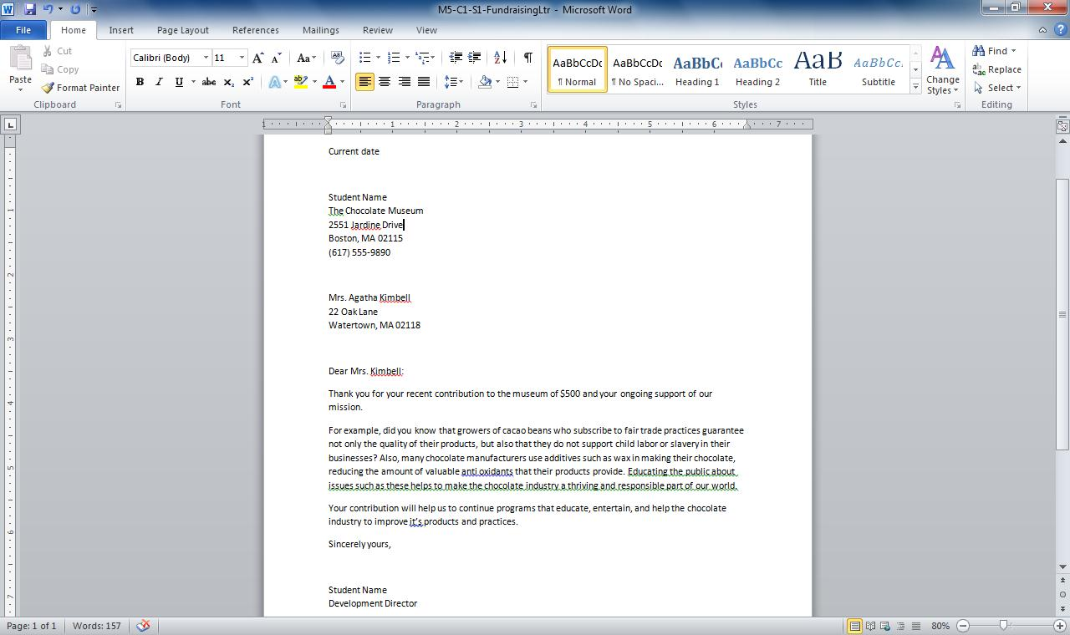
Insertion Point
Notes:
In this fundraising letter (WD1-Sk5-LongFundraisingLtr.docx), you can see where the insertion point is resting from the vertical line within the text. Whatever action you perform, such as backspacing or entering new text, takes place starting from the insertion point.
Tip: It’s a good idea to save your files frequently so you don’t lose valuable work.

Slide 8
What Are Those Wavy Underlines? Wavy lines under text indicate possible misspellings based on Word’s built-in dictionary. You can use Word’s Spell Check feature to make corrections.
Notes:
You may wonder about the red, blue, or green wavy lines that appear under some text in Word documents as you type. These are part of the Word’s Spell Check feature that indicate to you a possible spelling, grammar, or contextual error. You learn more about using the Spell Check feature in Skill 3 in this chapter.

Slide 9
Skill 2: Use Cut, Copy, and Paste
Select text.
Click the Home tab, then the Cut or Copy button in the Clipboard group.
Click in the document where you want to place text.
Click the Home tab, then the Paste button.
Notes:
Beyond simple text editing such as deleting and adding text, you might also need to take a sentence or block of text from one place in a document and move it or place a copy of it in another location. For example, you might decide that a paragraph on the first page of a letter really works better on the second page. Or you could copy the opening sentence of the letter, place it also at the end, and edit it slightly to summarize the letter’s purpose.
First you select the text to let Word know what content you want to perform an action on. Here are some shortcuts for selecting text: Single-clicking in the selection area at the left of a Word document selects a single line of text, double-clicking in the same area selects the whole paragraph, and triple-clicking selects all of the text in the entire document. To select a word, place your mouse cursor over the word and double-click. To select a paragraph, click within it and then triple-click your mouse.
Once you’ve selected text, you can use either the cut or copy tool along with the paste tool. These tools are located on the Home tab of the Word Ribbon.

Slide 10
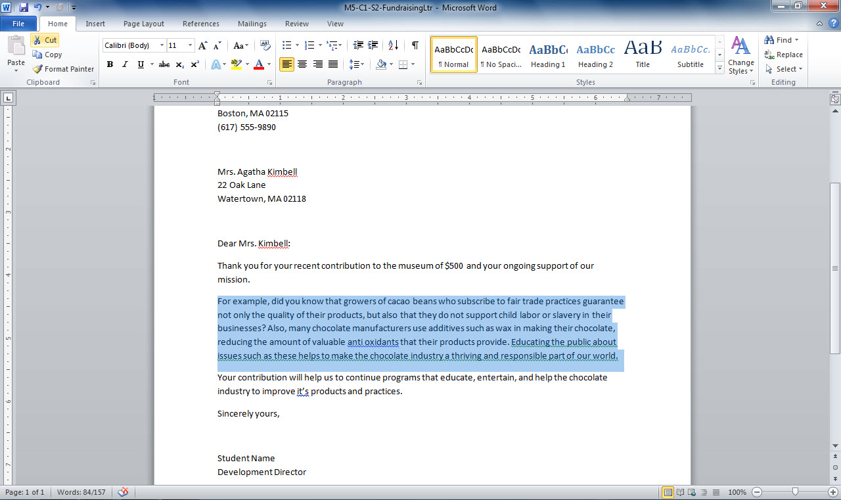
Cut, Copy, and Paste buttons
Selected text
Notes:
Selected text in this fundraising letter (WD1-Sk5-LongFundraisingLtr.docx) can be cut or copied using the buttons in the Clipboard group on the Home tab. After cutting or copying, you can place the insertion point where you want to place the text in the document by clicking there, and then use the Paste button to paste the text.

Slide 11
Where Does Cut and Copied Text Go? Cut or copied text is stored on the Windows Clipboard. You can paste an item as many times as you like until you copy another selection to the Clipboard.
Notes:
When you cut or copy text, it is placed on the Windows Clipboard, a holding area for cut or copied text or objects such as pictures. You can click in any document and use the paste function to place an item on the Clipboard immediately after cutting or copying it. You can paste that item as many times as you want, until you cut or copy another item to the Clipboard.
If you want to paste an item you copied to the Clipboard earlier, you can click the dialog box launcher in the Clipboard group of tools on Word’s Home tab to display the Clipboard pane. Note that the Clipboard is cleared when you save your document and exit Word.

Slide 12
Checkpoint 1
When you open Word, it displays:
The last document you worked on.
A list of available templates.
A blank document.
The open dialog box.
Pressing the Delete key deletes what text?
Text to the right of the insertion point
Text to the left of the insertion point
The last word you entered
None of the above
Answer
Answer
The Save command is accessed via which tab?
Home
View
Page Layout
File
When you cut text, what happens to it?
It is placed on the Windows clipboard.
It is deleted and irretrievable.
It is placed on the Word clipboard.
It is placed in the Recycle Bin.
Answer
Answer
Next Slide
Notes:
In Slide Show View, click the Answer button for Question 1 after you believe that you know the correct answer. The correct answer will be displayed. Then click the Answer button for Question 2 and that answer will appear. Continue repeating these steps for all four questions in order. When complete, click the Next Slide button.
These Checkpoints are designed to provide you with an opportunity to reflect on a few concepts at a time.

Slide 13
Skill 3: Perform a Spell Check
Click the Review tab.
Click the Spelling & Grammar button in the Proofing group.
Choose to Change/Change All or Ignore Once/Ignore All for each suggested correction.
Click Next to continue through document.
Click OK when spell check is complete.
Notes:
The Spell Check feature can help you to catch typos or other spelling-based mistakes. Knowing how to use this important tool ensures that your documents are correct and polished to create the best impression. Spell Check also checks common grammar mistakes. You can choose to make the suggested corrections or ignore them.
Remember that Spell Check isn’t foolproof. It will not flag mistakes with sound-alike words, such as using the word fair when you mean fare, so you should also proofread your document carefully after you run Spell Check.
When running a spelling check, it’s important to understand the difference between Ignore Once and Ignore All. If you use a term, such as a person’s name, several times in a document, choose Ignore All. If there is only one instance of a misspelling or misuse—say you are quoting someone who said ain’t, but you do not want that word anywhere else in your document—choose Ignore Once. The difference between Change and Change All is similar to that between Ignore Once and Ignore All.

Slide 14
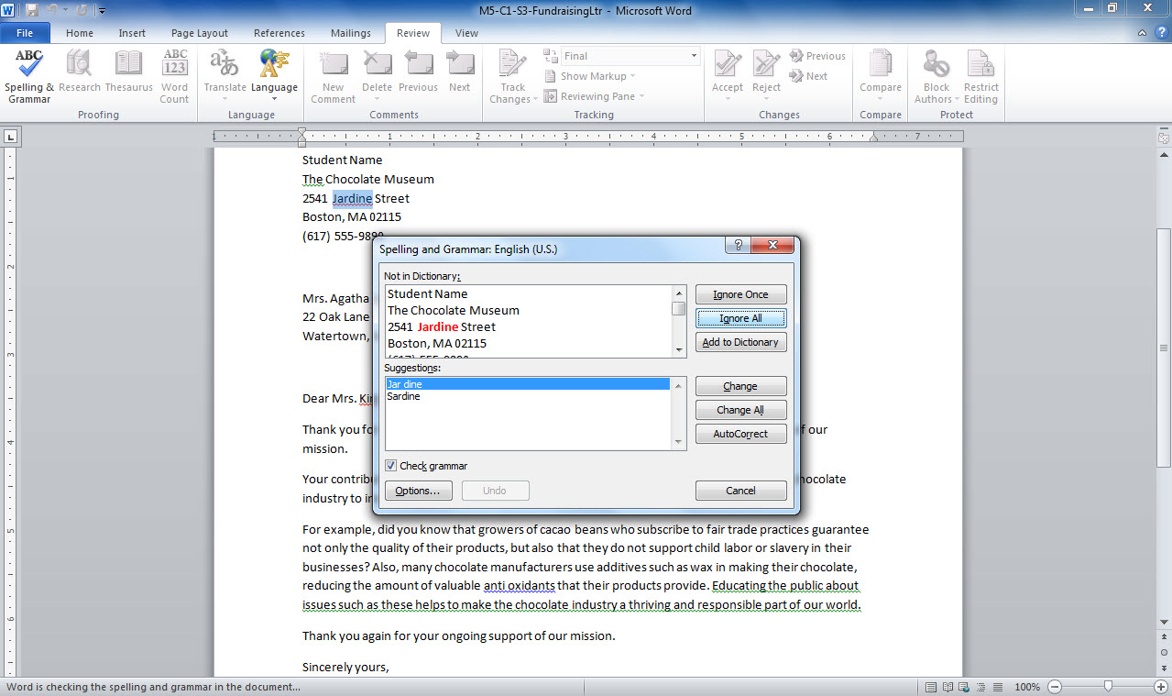
Ignore options
Change options
Suggested spelling
Notes:
In this fundraising letter (WD1-Sk5-LongFundraisingLtr.docx), the Spell Check reveals a possible error in a street name. It provides a suggested spelling. You can choose to change an item using the Change or Change All buttons. In this case, however, the street name is spelled correctly, so you can choose to ignore it using the Ignore or Ignore All button.

Slide 15
Adding a Word to Your Dictionary If you use a word or name that Word flags as misspelled, add it to the dictionary during a spell check so it’s never flagged again.
Notes:
While performing a spell check, you may encounter a word that you know to be correct, but that keeps getting flagged by Word because it is not in the built-in dictionary. In that situation, you will save yourself the time spent checking the word over and over again in each spell check by adding it to your dictionary. For example, let’s say your family name is Steele. While performing a spell check, Word may flag this as a misspelling of “steel”. Simply click the Add to Dictionary button when the word is challenged and you will never have to verify it again.

Slide 16
Skill 4: Create a Document Based on a Template
Click the File tab, and then click New.
Click a category under Available Templates and Themes.
Click a template.
Click Create.
Save the file.
Notes:
You can begin a document in a blank document and then apply formatting and add graphical elements to make it look more appealing. However, a handy shortcut to achieve a more professional-looking document is to open a document based on a pre-designed template. Several such templates come built into Office 2010.
A template includes text formatting such as a specific font, font formatting such as bold, and font size, as well as graphical elements. Choose a template that provides a look that matches your organization’s style or the tone of your content.
Explore the templates available with each Office application to discover the possibilities!

Slide 17
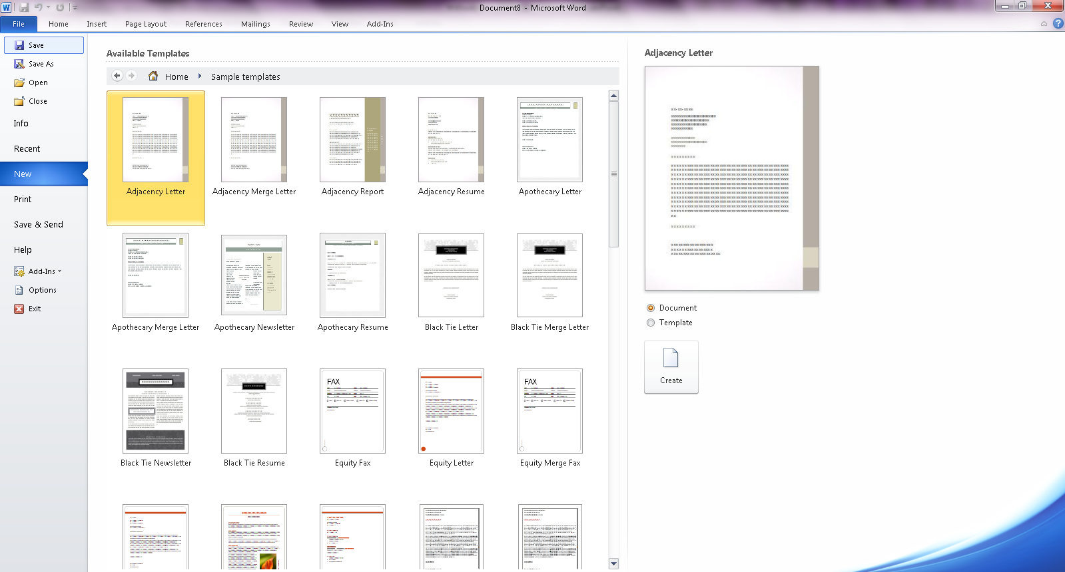
Template preview
New
Templates in the Sample Templates category
Notes:
You find templates by clicking the New tab in the File menu. When you choose a category of template, such as those in the sample Templates folder, the individual templates are displayed as thumbnails, along with a larger preview on the right side of the window.

Slide 18
Creating Your Own Template To create your own template that you can use again and again, make settings to a document and then save it as a template using the Save as type field in the Save As dialog box.
Notes:
If you have created a document that you consider a good starting point for other documents of the same type, why not create your own template? You can do so by saving your original file using Word Template as the Save as Type option in the Save As dialog box. Then, when starting a new document, click File, New, and choose the New from Existing option. Locate your template file and click Create. A new file opens, based on the template layout, ready for your changes.
The file can be saved in the same manner as any other Word document that was created from scratch. Using this method, you can reuse the text, formatting, and graphics that you applied to the first file. You will also save time and add consistency to your documents.

Slide 19
Skill 5: Indent Text
Click the View tab and click the Ruler check box.
Select text.
Drag the left indicator to a new location.
Notes:
In certain situations, you will want to indent a block of text in a document. For example, according to standard document format, a long quote should always be indented. Or you might want to set off a block of text, such as a price list on an order form, to call attention to it. You can use the Ruler in Word to indent text, set margins (which is discussed in Skill 6), and set tabs.
The Ruler helps you to see how items on your page line up. You can also display gridlines on your page, which is like graph paper applied to your document. Gridlines be used to help you align objects or text on the page. To display gridlines, click the View tab and then click the Gridlines check box to insert a check mark.

Slide 20
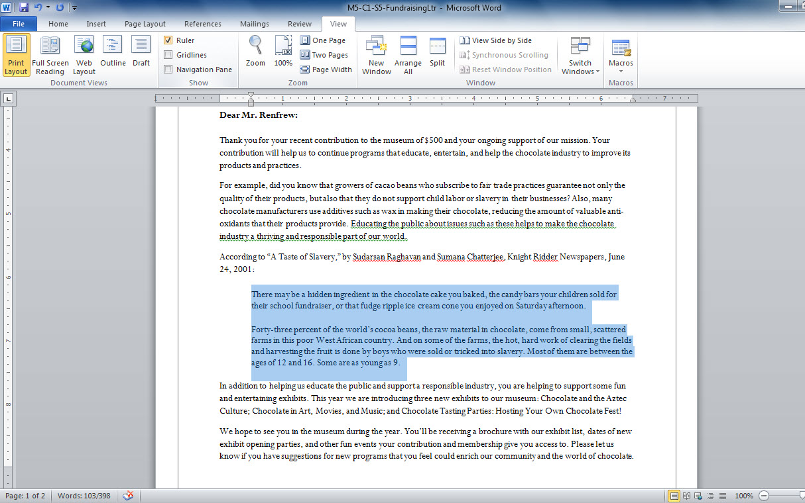
View tab
Ruler check box
Left indicator
Selected text
Notes:
In this letter (Wd1-Sk8-FinalFundraisingLtr.docx), you can indent a long quote by first selecting the text and then using the Left indicator to indent it. To display the ruler, you use the Ruler check box on the View tab.

Slide 21
Indenting Text in Paragraphs You may want to indent the first line of each paragraph. Do so using the Paragraph dialog box.
Notes:
In the letter example used in this chapter, you use a block style, which does not require the first word of each paragraph to be indented. Other document formats may require you to indent the first word in each paragraph. To do so, open the Paragraph dialog box by clicking the dialog launcher button in the Paragraph group on the Home tab. Adjust the measurement for the left indentation, choose First Line from the Special drop-down list, and then click OK to save the changes. Note that you can also adjust indentation from the right side of the page by using a right indentation setting.

Slide 22
Skill 5: Add Tabs
Click the tab selector to choose a tab type.
Click a measurement on the Ruler to place a tab.
Notes:
Tabs allow you to align text using a specific spot on the Ruler. Tabs are set by default at every half inch, but you can set additional tabs and set new tabs to replace preset tabs. The four kinds of tabs people use most often are: left, right, center, and decimal. Left, right, and center tabs place the left edge, right edge, or center of the text you enter at the tab location. Decimal tab is used for columns of numbers and it places the decimal point at the specified tab location, thereby lining up those numbers vertically.

Slide 23
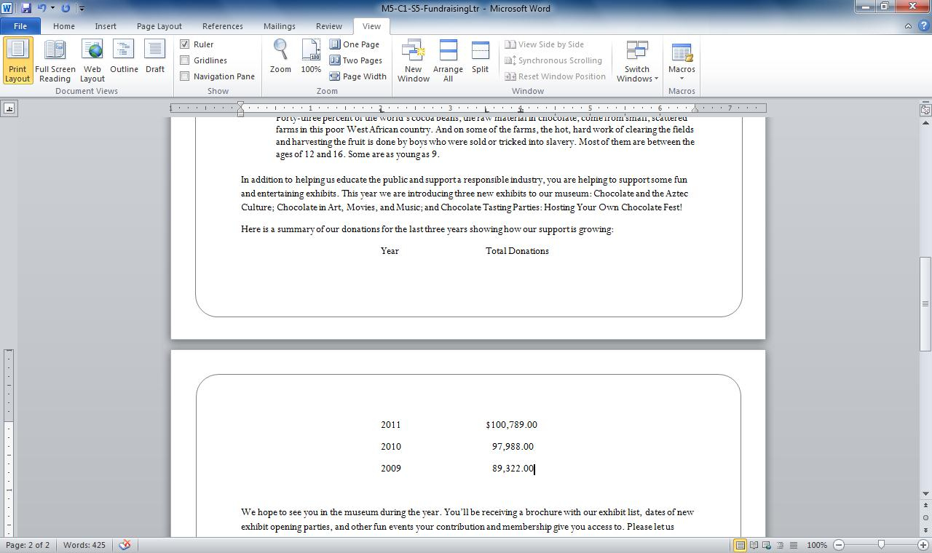
Set tab
Tab selector
Notes:
In this letter (WD1-Sk8-FinalFundraisingLtr.docx), tabs help create a mini-table, including a column that uses a decimal tab to line up currency amounts correctly. First select the type of tab you want to insert, and then click on the Ruler to set the tab at the right spot.

Slide 24
Adding Tabs to Existing Text You can change tabs on existing text by selecting it and changing settings on the Ruler.
Notes:
If you have already typed a list using existing tabs and decide you would like to change those tabs—for example, because your columns of text seem too close together to be easily read—you can. Select all the text whose tab settings you wish to change. To move the tab, drag the tab symbol to the new location on the Ruler. To remove a tab, drag the tab marker off the Ruler. To insert a new tab for the selected text, click on the Ruler where you want it to appear.

Slide 25
Skill 6: Set Margins
Click the Page Layout tab.
Click the Margins button in the Page Setup group.
Click a preset margin option.
Notes:
Margins are the areas of white space that surround the text on your page. The four margins in any document are: top, bottom, left, and right.
The preset margins for Word documents work in most cases, but you might choose to use narrower margins to fit more text on a page or use a wider top margin to accommodate a pre-printed corporate heading on stationery, for example. Preset margin settings are available, and you can easily apply them to any document. Use the Page Layout tab and the Margins button to select a preset margin option.

Slide 26
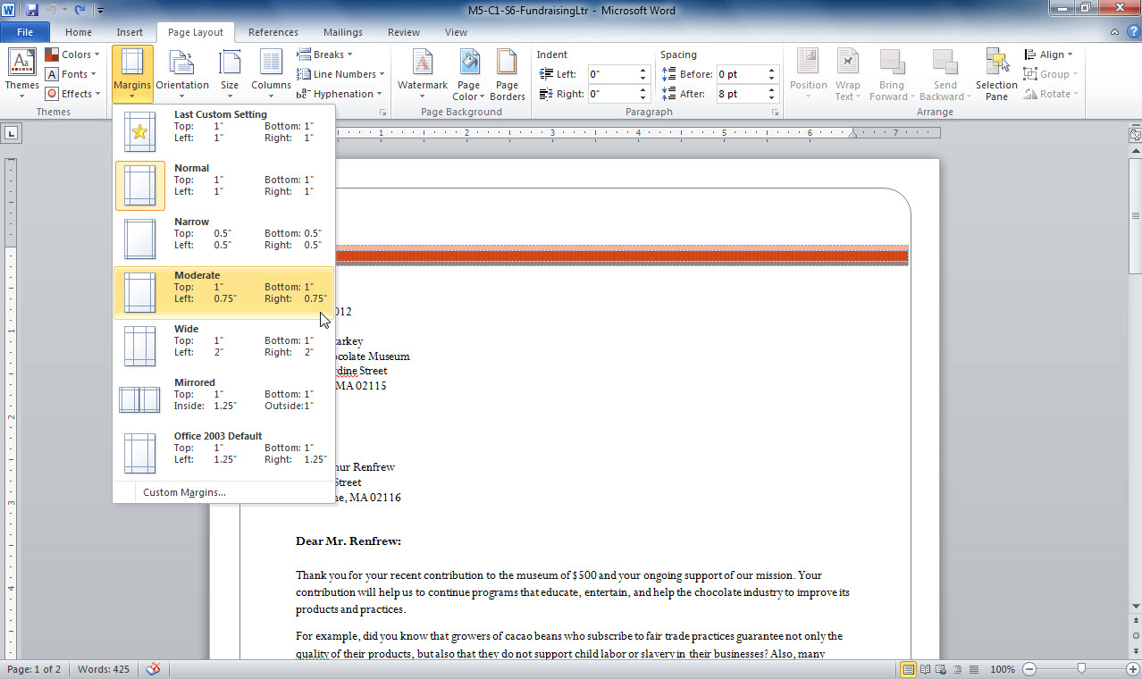
Page Layout tab
Margins button
Preset margin options
Notes:
In this fundraising letter (WD1-Sk8-FinalFundraisingLtr.docx), you use the Page Layout tab and the Margins button to select a preset margin option.
You can also adjust the top, bottom, and side margins in your document by using the vertical or horizontal ruler. Hover your mouse over the area of the Ruler where the dark gray and light gray areas meet, until the margin label appears. Drag to the right or left to adjust the margin size on the Ruler across the top of the page. Drag up or down to adjust margins on the Ruler along the left side of the page.

Slide 27
Creating Custom Margins To create custom margins choose that option from the Margins button drop-down list. Set a number for each of the four margins and click OK.
Notes:
If none of the preset margin options works for you, you can create your own margin option by clicking the Custom Margins command at the bottom of this list. Use the dialog box that appears to make your custom margin settings.

Slide 28
Skill 7: Insert a Page Break
Click in the document where you want the break to occur.
Click the Insert tab.
Click the Page Break button in the Pages group.
Notes:
When you are working on a document, you may find that the automatic page breaks that Word inserts do not work for you. For example, you might find that a paragraph breaks across a page so that a single line of text or a single row in a list is left dangling. Or you might want a new section of a report or new chapter of a book to start on a new page. In your fundraising letter, for example, the page breaks in the middle of the short tabbed list, making it hard to follow. The solution is simple: insert a manual page break using the Page Break button in the Pages group.
If you insert a page break in the wrong place, don’t worry. You can delete it by using either the backspace key (placed just after the page break) or the delete key (placed just before the page break).

Slide 29
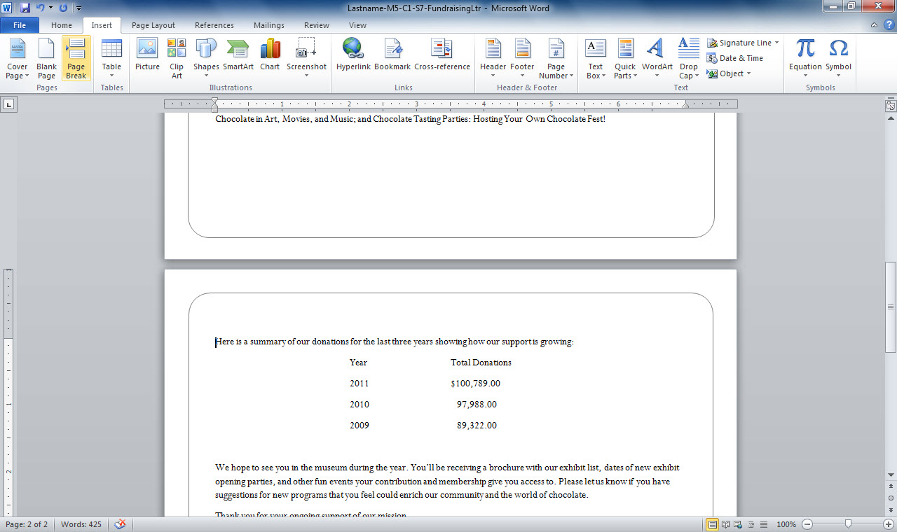
Insert tab
Page Break button
Notes:
This letter (WD1-Sk8-FinalFundraisingLtr.docx) naturally had a break in the middle of a short table, which would make the last entry hard to understand. Using the Page Break button on the Insert tab, you can easily insert a manual page break. You can also use the keystroke shortcut Ctrl + Enter to insert a page break.

Slide 30
Using Page Breaks Effectively Don’t use page breaks to force breaks on every page―let Word flow the text for you. Only break where a page must end, such as after the cover page of a report.
Notes:
Page breaks should be used sparingly. If you place breaks throughout a longer document, and then edit it by deleting or adding text, the page breaks may not make sense anymore. For example, say you were working on a 20-page report instead of the two-page letter in this skill. If you had placed a page break at the end of each page, you would have to go through the lengthy report and adjust several page breaks if you added or deleted text.
Instead, only use page breaks in situations where you truly have to start a new page. For example, to separate the cover page of a report from the first page, the end of a chapter from the start of the next chapter, or the last page of your report from the first page of its index. If you know your document is essentially final, you might also use page breaks as you did in this skill to adjust awkward breaks between pages, or remove breaks that split tables or lists.

Slide 31
Skill 8: Insert Headers and Footers
Click the Insert tab.
Click the Footer or Header button in the Header & Footer group.
Choose a style option from the drop-down list.
Click buttons, such as Page Number, to enter an automatically updating entry; or, enter text, such as “Confidential”.
Continue to make entries by pressing tab and repeating steps 4 or 5.
Click OK.
Notes:
If you want text or graphics to appear at the top or bottom of most of the pages in a document, you can add them in either the header (top) or footer (bottom) areas. Word makes it easy to add text, such as your company name or logo, document identifier, page number, or date, to a document. You can also choose not to have your header or footer appear on the first page of your document—for example, on the cover sheet of a report. Or, you can place different header or footer content on odd and even pages, or place the page numbers in different locations, as is often true for a book, where the page numbers
should appear opposite each other in the left and right corners.
The advantage of using buttons like Page Number and Date & Time to insert text in your header or footer is that they automatically update. So whenever you print the letter, the current date will appear, and however many pages you add to your document, each will be numbered correctly.

Slide 32
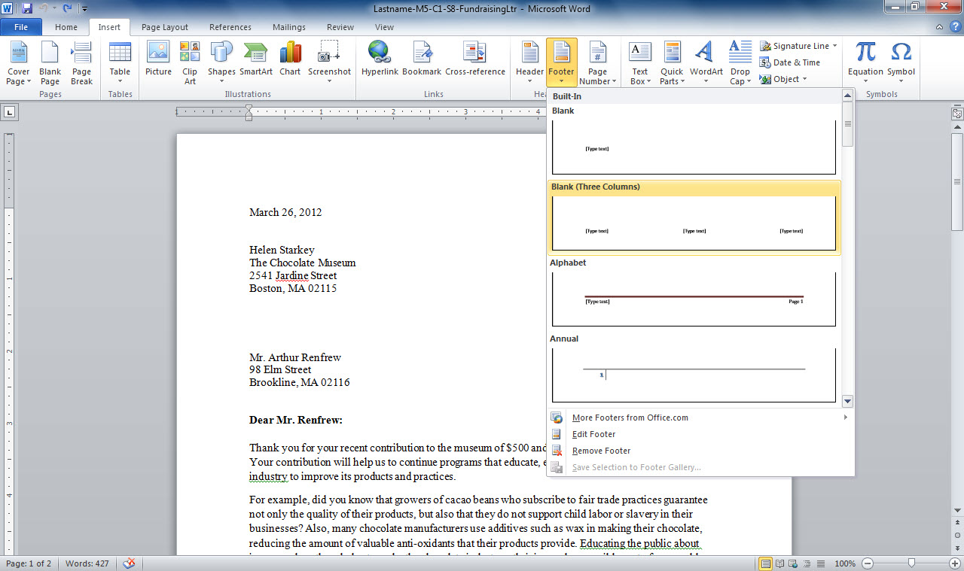
Header button, Footer button
Insert tab
Header/Footer styles
Notes:
Use the Header or Footer buttons on the Insert tab to add information about your document. For this letter (WD1-Sk8-FinalFundraisingLtr.docx), you might choose a footer style that includes three placeholders and use them to note the date the letter was created, who created it, and the page number, for example.
You can quickly open a header or footer for editing by double clicking in the top or bottom margin of a page.

Slide 33
Inserting Document Properties in a Header/Footer The Quick Parts button in the Header & Footers group on the Insert tab provides a way to quickly insert items from a list at any position in your headers and footers.
Notes:
If you click the Quick Parts button in the Insert group on the Header & Footer Tools tab and choose Document Property, a drop-down list of possible properties appears. This list gives you a handy way to quickly insert fields for information, such as the author or company, drawn from the document properties. You can review the document properties by clicking the File tab. Document properties are listed on the right of the Info pane. You can edit some of these properties, but others are automatically generated (such as the date last modified).

Slide 34
Checkpoint 2
The Spell Check feature
is not infallible.
doesn’t flag correctly spelled words that may not have been the correct word choice for your sentence.
checks both grammar and spelling.
All of the above
Templates may contain settings for
the buttons available on the ribbon.
text formatting and graphics.
the location for storing the file.
the maximum number of pages in the document.
Answer
Answer
You initiate a spell check from which tab?
Home
References
Review
None of the above
You can set tabs in your document using which Word feature?
The Page Layout tab
Options accessed through the File Menu
Word Styles
Ruler
Answer
Answer
Next Slide
Notes:
In Slide Show View, click the Answer button for Question 5 after you believe that you know the correct answer. The correct answer will be displayed. Then click the Answer button for Question 6 and that answer will appear. Continue repeating these steps for all four questions in order. When complete, click the Next Slide button.
These Checkpoints are designed to provide you with an opportunity to reflect on a few concepts at a time.

Slide 35
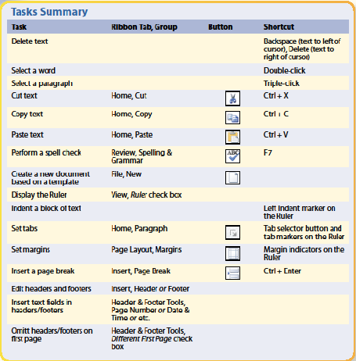
Notes:
Here is a summary of the Word Chapter 1 tasks.

