Slide 1
Microsoft® Office 2010 Suite Overview
MODULE 4
Notes:
In Module 4, you learn about the Print tab Backstage view and other features common in the Office 2010 Suite of applications. Many of the commands are the same for Excel, Word, and PowerPoint. Becoming familiar with common interface elements and commands now, before starting the skills in the Word, Excel, Access, and PowerPoint modules, will speed up your learning in each application.

Slide 2
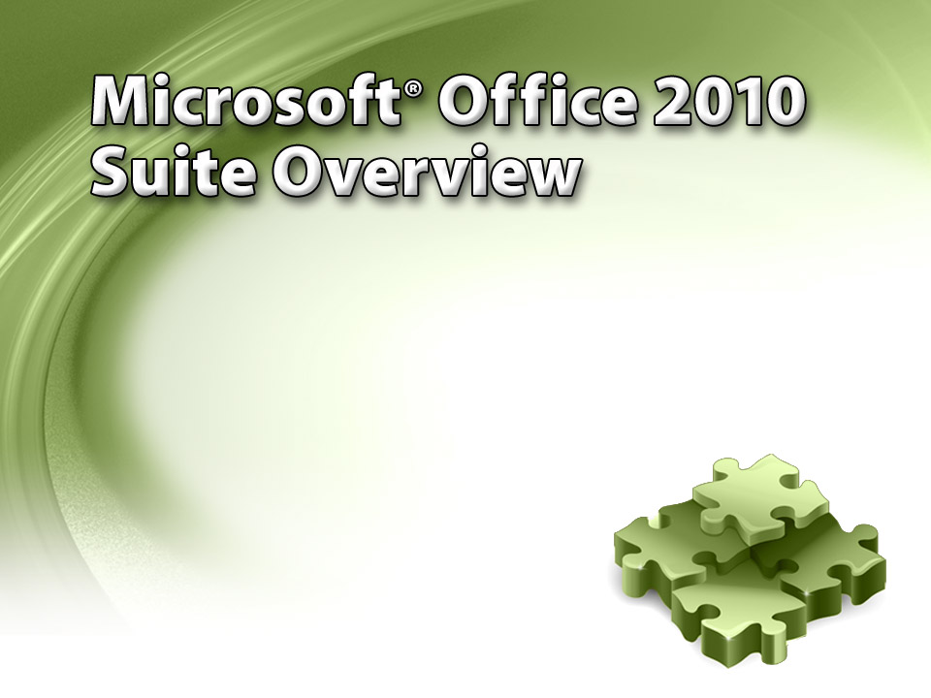
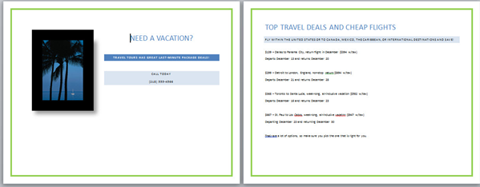
Notes:
This module covers using features common across several applications in the Office 2010 Suite.

Slide 3
Skills You Learn
Create a file and display Backstage view
Open and save a file
Understand the ribbon
Navigate within a file
Use Find and Replace
Use Undo and Redo
Change views and zoom percentage
Check spelling and grammar
Use formatting tools
Print a file
Use Help
Use Microsoft Office 2010 Web Apps
Notes:
In this module, you edit a travel agency flyer by using features common across several applications. When learning to open and save files, you work with an Excel Sales workbook. You also learn to add images and illustrations to a document, giving it a professional look.

Slide 4
Microsoft 2010 Office Overview
The Microsoft Office 2010 suite is made up of several applications. These include:
Outlook 2010 to manage your schedule and contacts list
OneNote 2010 to create a digital notebook
Access 2010, a database application used to store and organize large amounts of data
Excel 2010, a spreadsheet application used to enter numbers or other data into a grid of rows and columns
Word 2010, a word processor application used to produce professional looking documents
PowerPoint 2010, a presentation application used to create slides that support an oral presentation
Notes:
Even though each application in the Office suite is designed to perform a specific task, all applications have some common interface elements and commands. Learning about the shared features of the applications—their common “look and feel”—reduces the time you need to master the entire Office suite.

Slide 5
Microsoft 2010 Office Overview
Shared Interface Elements
The Quick Access Toolbar
The ribbon
Shared Commands
The Print tab Backstage view
Notes:
The Quick Access Toolbar allows you to add icons for the actions you use often, such as undoing a change and saving a file. You can place your own choices on this toolbar for most-often-used commands. The ribbon is the main interface feature. The File tab on the ribbon displays the Backstage view, which includes file management options, such as opening, printing, and saving. The ribbon offers other tabs and groups of commands that are related to each other—for example, the Page Layout tab contains a Page Setup group and a Themes group. In the Print tab Backstage view, many of the commands are the same for Excel, Word, and PowerPoint.

Slide 6
Skill 1: Create a File and Display Backstage View
Click the Start button on the Windows Taskbar.
Click All Programs.
Scroll down the program list and click Microsoft Office.
Click Microsoft Excel 2010 in the list of applications that appears in the menu.
Excel starts a blank workbook and Book1 - Microsoft Excel displays in the Title bar.
Click the File tab.
Notes:
When you open Excel, the program automatically opens a blank workbook. Similarly, Word automatically opens a document, and PowerPoint automatically opens a presentation. Access starts in Backstage view. You will move to Backstage view in Word, Excel, and PowerPoint, and see it again in Access, when you work with files, send data to the printer, and use Help.

Slide 7
Skill 1: Create a File and Display Backstage View, continued
Click the New tab to see options for creating a blank workbook or a workbook based on a template.
The Blank workbook option is active and a preview of the blank workbook displays at the right side of the screen.
Click the Create button in the right-hand pane to display a new blank workbook in the Excel window.
Book2 - Microsoft Excel displays in the Title bar.

Slide 8
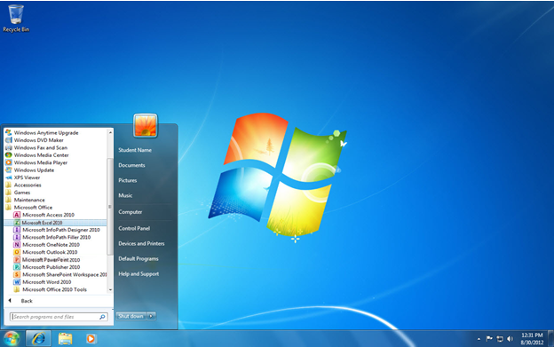
Microsoft Office
Microsoft Excel 2010
Start button
Notes:
If you have used Microsoft Excel recently, the program name will appear in the recently used programs list along the left side of the Start menu above All Programs. Simply click it in the list to open it.
The Title bar displays the file and program name.

Slide 9
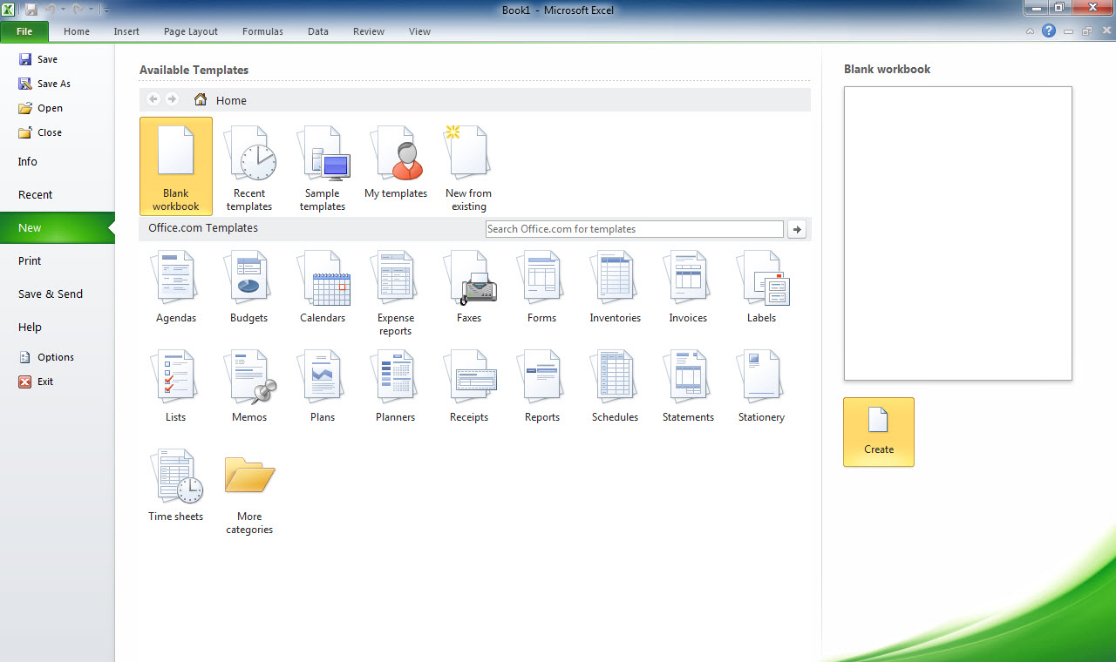
File tab
New tab
Create button
Notes:
To Open a New Document, Workbook, or Presentation, use the shortcut Ctrl + N. Each application in the Office suite has a different colored Backstage view. Excel’s color is green.

Slide 10
Skill 1: Create a File and Display Backstage View, continued
Click the File tab.
Click the Help tab to view the Help options that are displayed in Backstage view.
Click the File tab to display the blank Book2 Excel file and to make the Home tab active.
Click the Close window button below the red Close button to close the unsaved Book2 blank file while keeping Excel open.
Unsaved Book 2 closes and Book 1 displays.
Click the Close window button again to close the unsaved Book1 blank file while keeping Excel open.
Notes:
In all of the programs, the Backstage view contains a set of commands that allows you to manage your files and perform file tasks, such as saving or printing. Backstage view contains four Quick Command buttons at the top left— Save, Save As, Open, and Close. Just below these Quick Commands, the Backstage view presents six tabs—Info, Recent, New, Print, Save & Send, and Help. Two buttons display below the Help tab—Options and Exit.

Slide 11
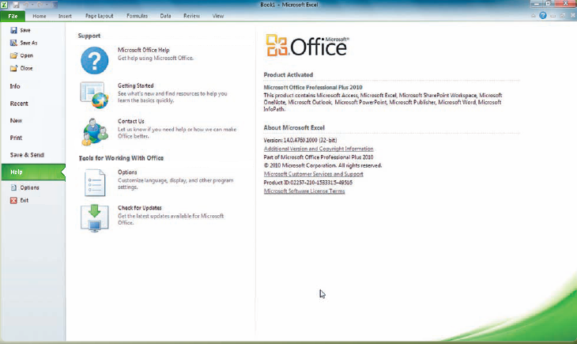
File tab
Help tab
Notes:
Note that your Backstage view might have additional buttons below the Help tab, based on whether you have downloaded additional Office add-ins to your computer.

Slide 12
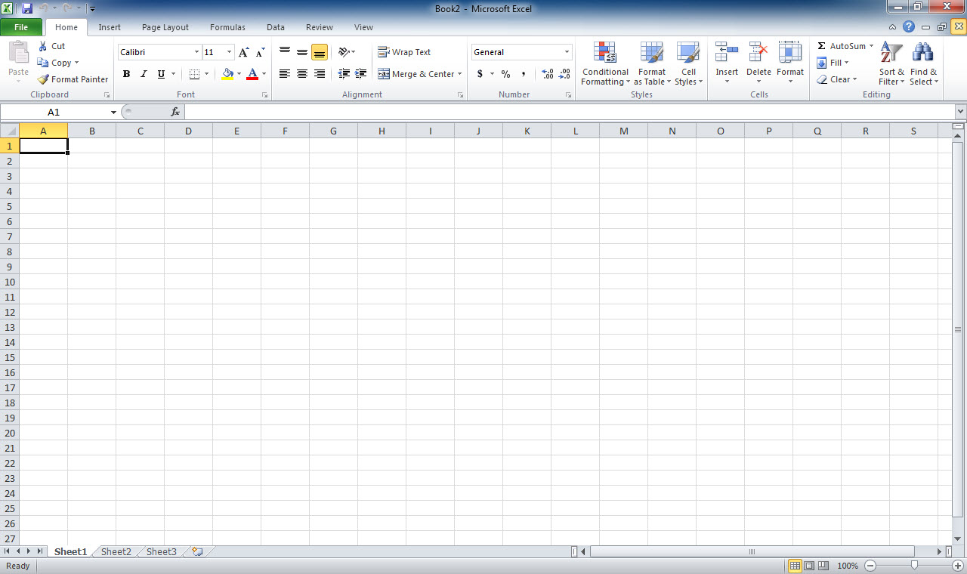
Close window button
File tab
Notes:
To display the blank Book2 Excel file and to make the Home tab active, click the File tab.

Slide 13
Customizing the Quick Access Toolbar The applications in the Office suite have a Quick Access toolbar in the top left corner of the window.
Notes:
The standard buttons include Save, Undo, and Redo. You can customize the toolbar by clicking the Customize Quick Access Toolbar button and selecting from the options on the drop-down list. If you want more commands organized by the tab of the ribbon on which they reside, click More Commands to see a dizzying number of additional options. Customizing the Quick Access toolbar is just one example of the many ways you can customize the Office applications to help you do your work more efficiently.

Slide 14
Skill 2: Open and Save a File
With the Excel window active, click the File tab.
Click the Open button and select a file to open.
With the file selected in the File name text box in the Open dialog box, click the Open button. The selected file appears in your Excel window.
Click the File tab.
Click the Save As button.
In the File name text box, type a new file name. Be sure to save the file to your working folder on your storage medium.
Click the Save button.
Click the File tab.
Click the Exit button to close the file and Excel.
Notes:
Files can be created by selecting a blank workbook or from a template available in Backstage view. You can also find the commands for opening an existing file in the Backstage view. When you save a file, you can save it to a folder on the computer’s hard disk; on a CD, DVD, or flash drive; on the desktop; or on a network drive. You can also save the file in any one of a variety of file formats.

Slide 15
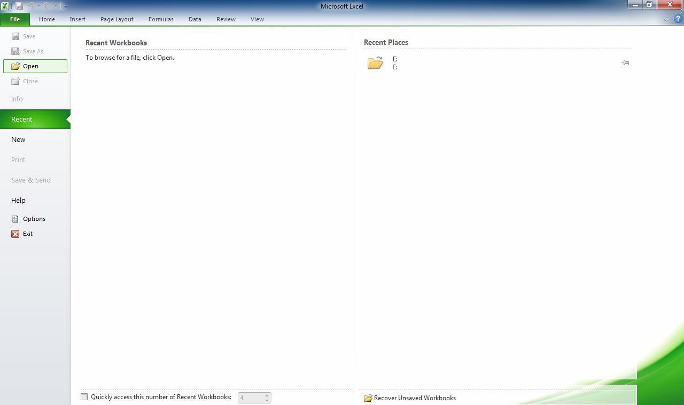
File tab
Open button
Notes:
Here you see Excel open in the Backstage view. Select Open to search for a file to open. A shortcut to open a Document, Workbook, or Presentation is Ctrl + O.

Slide 16
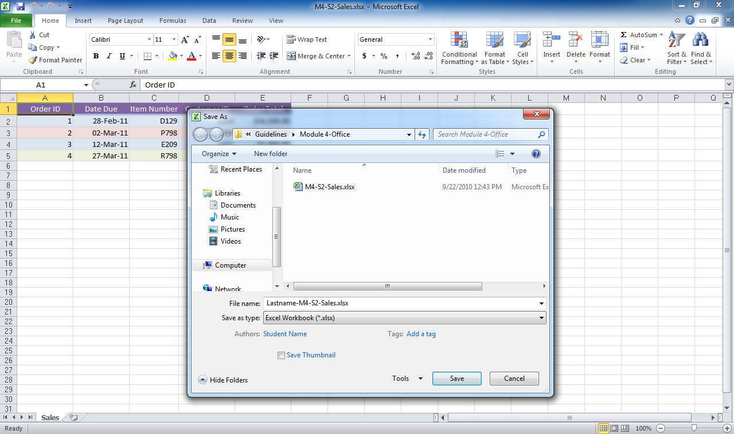
Save As Dialog box
Save button
Notes:
File names should be descriptive of the file’s contents so you can find them easily. A valid file name cannot contain certain characters. Colons (:), asterisks (*), or question marks (?) are examples of these characters.

Slide 17
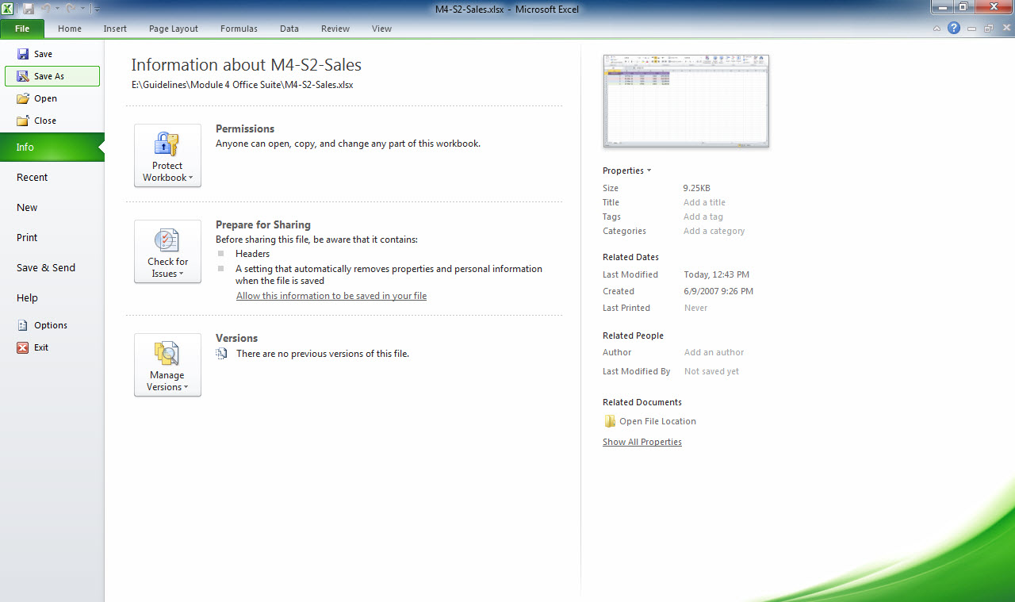
Exit button
Notes:
Select the Exit button to exit the application.

Slide 18
Saving Files in Alternate Formats By default, documents, workbooks, presentations, and databases are saved as files in their native format: .docx in Word, .xlsx in Excel, .pptx in PowerPoint, and .accdb in Access.
Notes:
However, you can save files in an alternate format, such as PDF, by selecting a different format in the Save as type drop-down list in the Save As dialog box. PDF is the format used by a document reader program called Adobe Reader. You can download the free Adobe Reader program, which allows those without the original software to view the file with formatting intact. You can also save files in an alternative format by selecting an option in the Save & Send tab in Backstage view.

Slide 19
Skill 3: Understand the Ribbon
Open a Word document that contains a picture.
Click the Insert tab on the ribbon.
Click the picture in the document. The Picture Tools Format tab is added to the ribbon when the picture is selected.
Click the Picture Tools Format tab to view the four groups that contain the picture editing commands: Adjust, Picture Styles, Arrange, and Size.
Click the Minimize the Ribbon button to minimize the ribbon and display only the ribbon’s tabs.
Click the Expand the Ribbon button to redisplay the entire ribbon.
Close Word if you are not continuing on to the next skill.
Notes:
The ribbon is an interface element that is displayed in the application window. It is designed to help you quickly find the commands that you need to complete a task. The ribbon is organized into a series of tabs. Each tab relates to a type of activity, such as inserting objects or formatting the visual or text elements on a page. In a tab, commands are organized in logical groups. For example, the Bold, Italic, and Font Color buttons are in the Font group on the Home tab. In order to reduce screen clutter, some tabs, known as contextual tabs, are shown when you select certain types of objects such as tables or pictures. The Picture Tools Format tab is an example of a contextual tab.

Slide 20
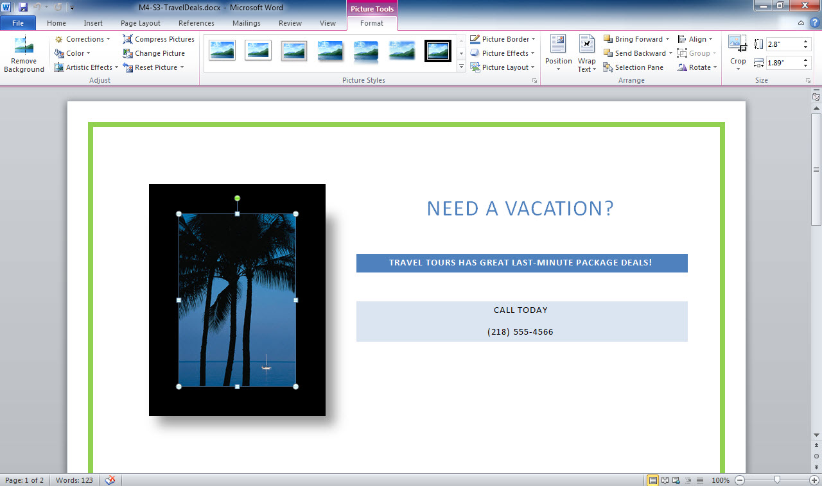
Picture Tools Format tab
Insert tab
Minimize the Ribbon button
Selected Picture
Notes:
When a Word, Excel, or PowerPoint file opens, the Home tab is active.

Slide 21
Using the Keyboard with Ribbon Tabs Office 2010 provides keyboard access keys for the ribbon so you can quickly perform tasks without using the mouse.
Notes:
When you press the Alt key in any of the Office 2010 applications, letters—called KeyTips—are displayed on each tab. Depending on which letter you press, you may be shown additional KeyTips. For example, if the Home tab is the active tab and you press N, the Insert tab displays along with the KeyTips for the groups on that tab. Press the letter of the task you want to complete. To cancel the action that you are taking and hide the KeyTips, press the Alt key.

Slide 22
Skill 4: Navigate within a File
Move the insertion point to the beginning of a two-page document.
Position the mouse pointer on the down scroll arrow on the vertical scroll bar. Click the left mouse button several times until you see the top of the second page of the document.
Press the Page Down key on the keyboard. The insertion point moves within the text on page 2.
Press the Home key. The insertion point moves to the start of the first line on page 2.
Notes:
Many files you create in each of the Office applications will be more than one page long. Your monitor is a fixed size and may not be able to display the entire document at once. To navigate around these longer documents, it helps to know how to scroll. Scrolling helps you quickly find information or reach a specific location in the file so that you can then make edits or apply additional formatting. You can use both the keyboard and the mouse to navigate to specific locations in a file.

Slide 23
Skill 4: Navigate within a File, continued
Press the End key. The insertion point moves to the end of the first line.
Press the Down Arrow key twice. The insertion point moves down two lines.
Drag the scroll bar to the top of page 1. The insertion point remains on page 2.
Notes:
If it is not already open, open the student data file named M4-S3-TravelDeals.docx, the file used in Skill 3.

Slide 24
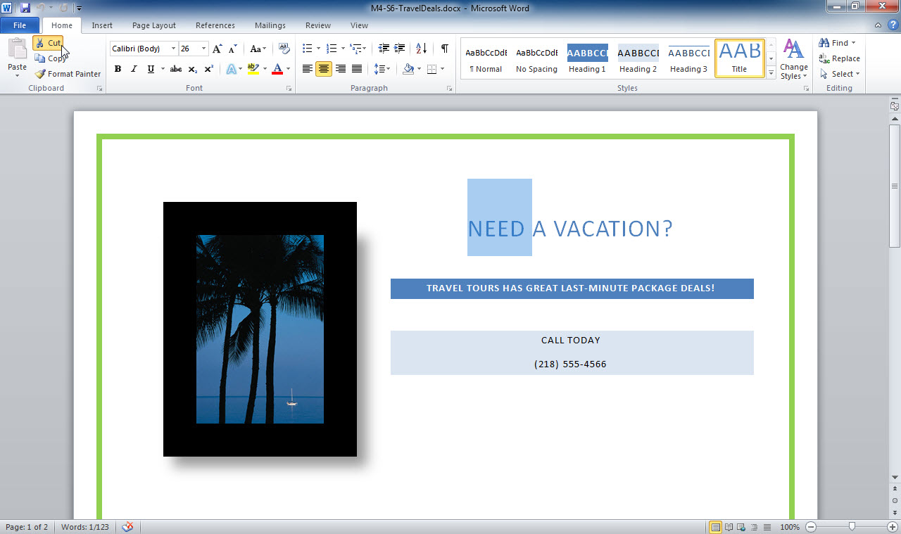
Down scroll arrow
Notes:
To move the insertion point to the top of a file, use the shortcut Ctrl + Home. When you open a Word document, the insertion point is automatically at the beginning of the document.

Slide 25
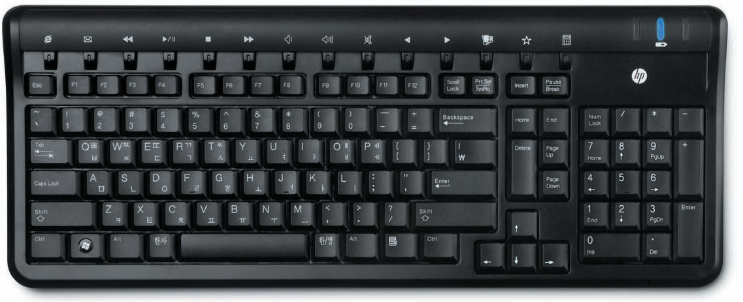
Home key
End key
Down Arrow key
Page Down key
Notes:
If your mouse has a scroll wheel, you can roll the wheel to scroll through the document. Scrolling does not move the insertion point. Your keyboard may not look exactly the same as the keyboard shown. Certain keys may be in different locations.

Slide 26
Navigating with Keyboard Shortcuts You can use key combinations to move the insertion point to a specific location in a file. Press Ctrl + Home to move to the start of a document in Word.
Notes:
In Excel, press Ctrl + Home to move to the first cell in the worksheet. Press Ctrl + End to move to the end of a document in Word or to the last cell in the worksheet in Excel. Press the F5 key in Word to display the Find and Replace dialog box with the Go To tab selected. Pressing F5 in Excel will open the Go To dialog box. In Word, you can type a page number to move the insertion point to a specific page, and in Excel, you can type a cell address to move quickly to that cell.

Slide 27
Skill 5: Use Find and Replace
Open a Word document.
Click the Find button in the Editing group on the Home tab.
Type a word you wish to find in the Navigation pane Search box. Search text matches are highlighted in the document and listed in the Navigation pane.
Click the Close button in the upper right corner of the Navigation pane.
Scroll to the top of the document and click at the beginning of the page. You decide to update the document by replacing all occurrences of one word with another.
Notes:
The Find feature enables you to search for specific characters or formatting. When the Find feature locates items that match your search terms, the results are displayed in the Navigation pane. Similarly, the Find and Replace feature allows you to search for specific characters or formatting and replace them with other characters or formatting.

Slide 28
Skill 5: Use Find and Replace, continued
Click the Replace button in the Editing group. This opens the Find and Replace dialog box and the word you just searched for is in the Find what text box.
Type a replacement word in the Replace with text box.
Click the Replace All button.
In the dialog box saying that replacements have been made, click OK.
Click the Close button to close the Find and Replace dialog box.
Save the file by clicking the Save button on the Quick Access toolbar.

Slide 29
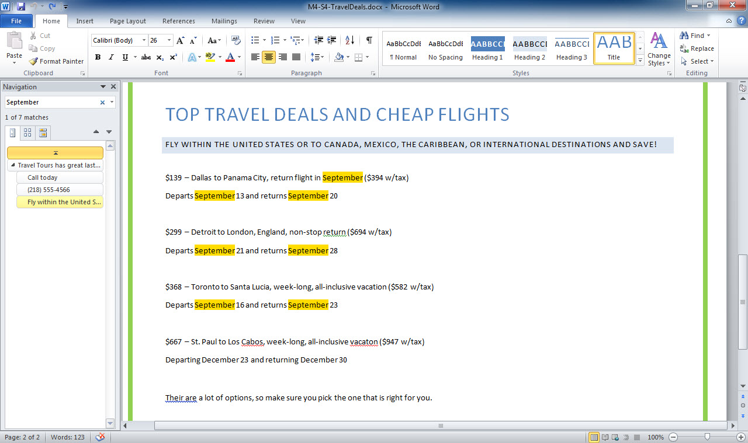
Find button
Close button
Replace button
Navigation pane Search box
Notes:
The shortcut for Find is Ctrl + F.

Slide 30
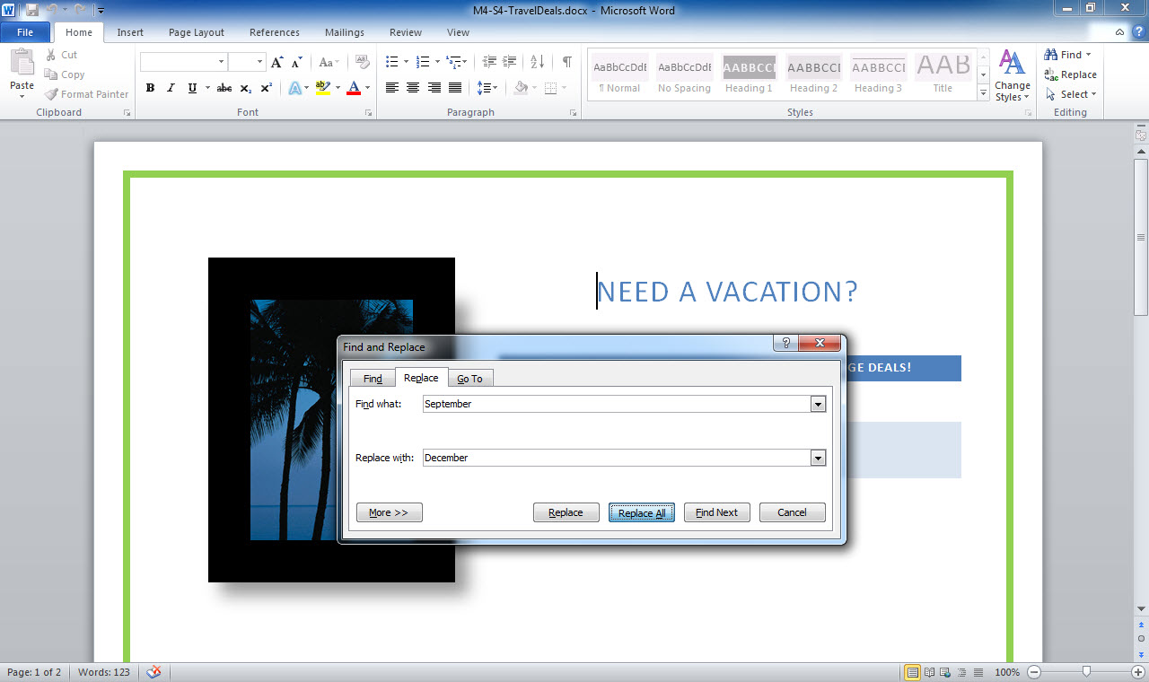
Replace with text box
Notes:
Use Replace with to move through the document, replacing the designated text in the Find what text box with the text in the Replace with text box.

Slide 31
Finding with Narrower Limits Click the More button in the Find and Replace dialog box to display additional search options.
Notes:
Select the Match case option to locate text with the same capitalization as that of the search text. For example, a search for “January” will not find “JANUARY.” Select Find whole words only to locate text that entirely matches the search text. Also, a search for “every” will not find “everyone”. Use the Format button in the Find and Replace dialog box to search for formatting, such as a specific font.

Slide 32
Skill 6: Use Undo and Redo
Double-click a word on the first page of the document.
Click the Cut button in the Clipboard group on the Home tab. This removes the word.
Click the Undo button in the Quick Access toolbar. The last action is reversed so that the word appears in the document.
Press the End key.
Type ?. (Do not type the period.)
Click the Redo button in the Quick Access toolbar.
Click the Undo button arrow.
In the drop-down list, click the second action, Typing “?”. This leaves just one ? in the document.
Notes:
Have you ever deleted text and then changed your mind? Fortunately, you can restore the text you deleted during your current work session by clicking the Undo button on the Quick Access toolbar. The Undo button reverses the last action you performed, including formatting, deletions, insertions, and so on. You can even undo several actions at a time by clicking the arrow on the Undo button and selecting the actions you want to delete. When you want to repeat the last action performed, click the Redo button.

Slide 33
Redo button
Undo button
Cut button
Notes:
Double-click to select an entire word. Triple-click to select an entire paragraph.

Slide 34
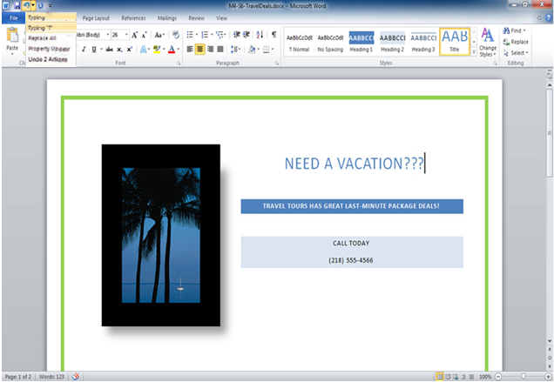
Undo button arrow
Drop-down list
Save button
Notes:
You can undo two actions at once by selecting the second item on the Undo list, three actions by selecting the third, and so on. The default number of available undos varies in each Office application and can be changed if needed.

Slide 35
Skill 7: Change Views and Zoom Percentage
Open a Word document that contains two pages.
Click the View tab.
Click the Two Pages button in the Zoom group.
Click the One Page button in the Zoom group.
Click the Zoom button in the Zoom group to open the Zoom dialog box.
Click the 75% option in the Zoom to section of the dialog box.
Click the OK button.
Drag the Zoom slider bar on the Status bar to 100%.
Notes:
The View tab in Excel, PowerPoint, and Word contains buttons for changing the view. You will also find buttons for changing the zoom percentage while you are viewing a file. By default, a file is viewed at 100% of its normal size. However, you may want to zoom in or zoom out to view different parts of a document.

Slide 36
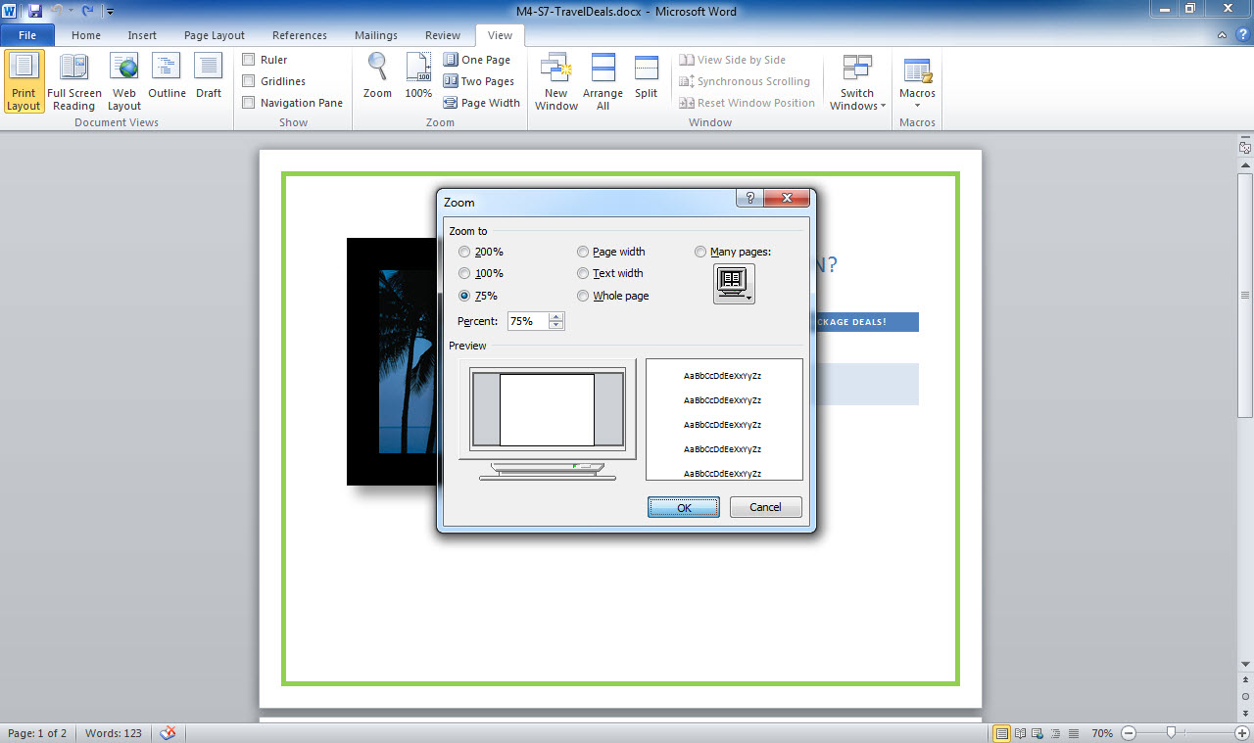
View tab
Zoom button
Zoom dialog box
Zoom slider bar
Notes:
Excel, PowerPoint, and Word also contain a Zoom slider bar on the Status bar that allows you to adjust the zoom percentage.

Slide 37
Experimenting with Views Additional information about views is presented later in the book, but you can experiment now with the different views by clicking the various view options.
Notes:
For example, in Word, click the Web Layout button in the Document Views group on the View tab to view the document as a web page. In Word, you can also click the Full Screen Reading button to view the document in a full screen, which maximizes the screen space available and makes a document easier to read. In Excel, click the Page Layout button in the Workbook Views group on the View tab to view the worksheet as a printed page. In PowerPoint, click the Notes Page button in the Presentation Views group on the View tab to view and edit the speaker notes.

Slide 38
Skill 8: Check Spelling and Grammar
Click the Review tab.
Click the Spelling & Grammar button in the Proofing group.
The Spelling and Grammar dialog box identifies possible subject-verb agreement errors. If you are sure you have not made an error, click the Ignore Once button so a change is not made.
The spelling checker indicates that a word is misspelled. The word may be a proper name but is not in the dictionary file, so Word’s spelling checker flags it as an error. Click the Ignore Once button so a change is not made.
Notes:
The Office applications include a spelling checker that verifies that words are correctly spelled by comparing them to a built-in dictionary. In Word and PowerPoint, if a word is spelled incorrectly or is not in the dictionary file, a red wavy line appears below it. In Excel and Access, the spelling check is not automatic but you can start it by clicking the Spelling button, which is on the Review tab in Excel and on the Home tab in Access. Grammar is also checked during this process. A green wavy line indicates a possible grammatical error.

Slide 39
Skill 8: Check Spelling and Grammar, continued
At the screen showing a misspelled word, click the Change button to correct the error.
When the spelling checker identifies a possible contextual error, such as using Their are rather than There are, click the Change button to correct the problem.
Click OK when prompted that the spelling and grammar check is complete.
Notes:
The spelling checker also looks for contextual errors, such as the use of there instead of their, and flags possible problems with a wavy blue line. Because of the limitations of the spelling checker, always carefully proofread your files.

Slide 40
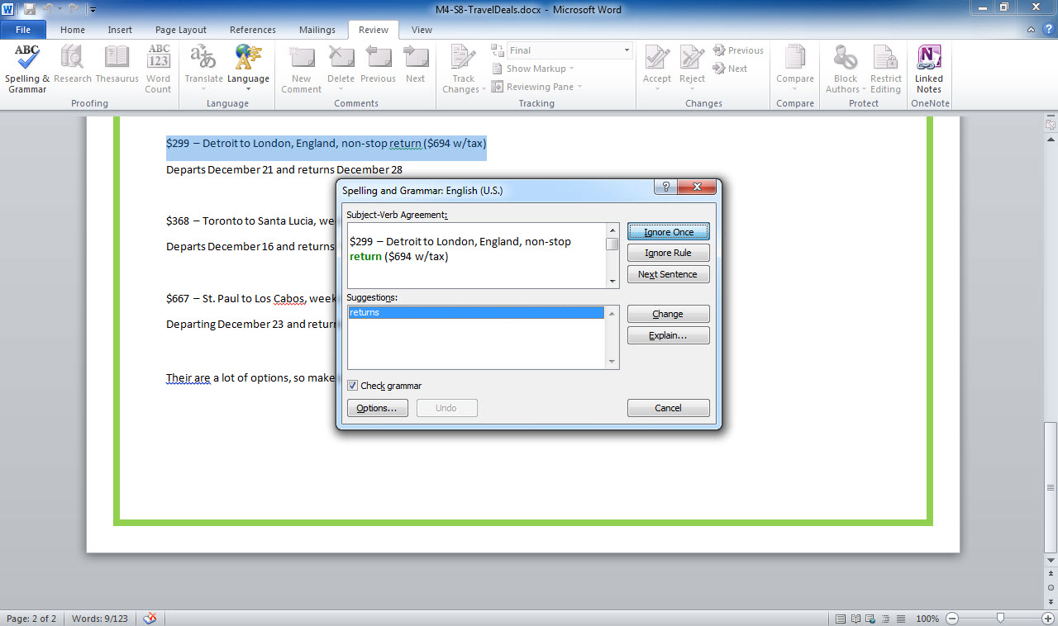
Review tab
Spelling & Grammar button
Spelling and Grammar dialog box
Notes:
Right-click a word with a red, green, or blue wavy line and select the correct replacement from the popup menu. When the spelling checker presents several suggestions, select the correct choice before clicking Change.

Slide 41
Skill 9: Use Formatting Tools
Select a line of text in a Word document.
Click the Home tab.
Click the Font text box arrow in the Font group.
Click Cambria in the drop-down gallery.
Click the Bold button in the Font group on the Home tab.
Click the Font Size text box arrow.
Click 14 in the drop-down list.
Click at the end of the last line of text, press Enter, and type your name on a new line.
Save the file.
Notes:
The way text appears on a page is called its format. The Home tab Font group in Excel, PowerPoint, and Word and the Text Formatting group in Access contain many of the same formatting buttons, such as Bold, Italic, Underline, Font, and Font Size. These buttons can all be used to apply character formatting. You need to select text before applying character formatting.

Slide 42
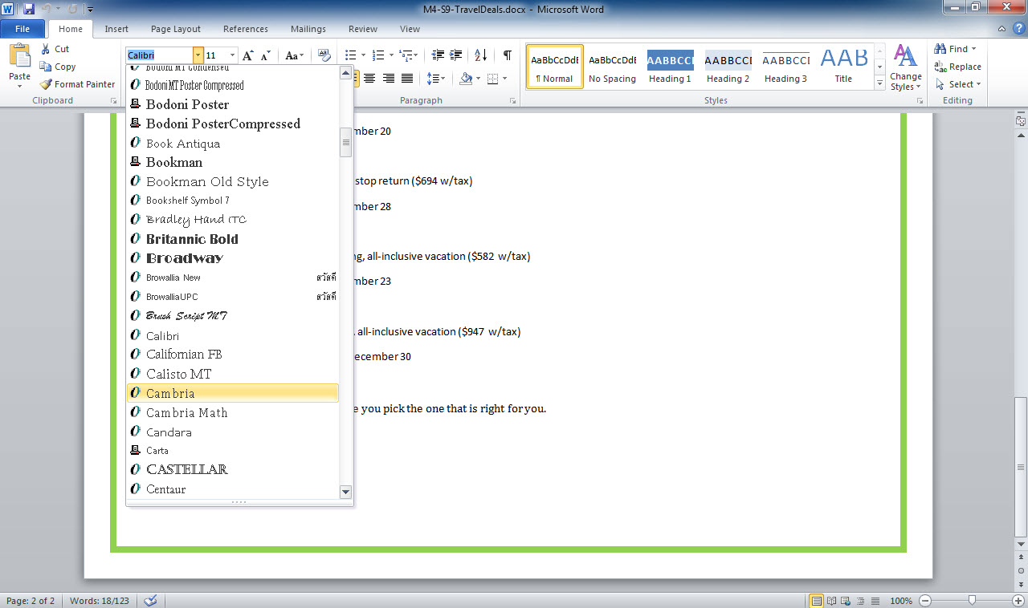
Home tab
Font text box arrow
Font drop-down gallery
Notes:
Triple-clicking selects a whole paragraph of text. The default font used by all of the Office applications is Calibri.

Slide 43
Using Other Formatting Buttons Other Font group buttons are available, such as the Grow Font and Shrink Font buttons. You can quickly increase or decrease the text size with these buttons.
Notes:
You can change the color of your text with the Font Color button. The Italic button applies italic formatting and the Underline button applies underlining to the selected text. If you apply formatting and then decide you would like to remove it, just click the Clear Formatting button.

Slide 44
Skill 10: Print a File
Place the insertion point at the beginning of the document.
Click the File tab.
Click the Print tab. A preview of the first page of the document appears in the preview area.
Click the Next Page button on the bottom of the window to preview page 2 of the document.
Click the Copies measurement box up arrow. The number of copies to be printed changes from 1 to 2.
Type 1 in the Copies measurement box. Click Normal Margins in the Settings category.
Click Wide in the option list.
Verify that your instructor would like you to submit a printed copy of the document. Click the Print button if you need a printout.
Notes:
Print settings are on the Print tab in Backstage view. The Print tab displays a preview of what your printed file will look like and also lets you make print settings, such as the number of copies to print, the page orientation, page size, and page margins. You can also zoom in on the preview image to make sure all settings are correct prior to printing a copy. Previewing your document carefully and printing only the final copy saves you time, money, and paper.

Slide 45
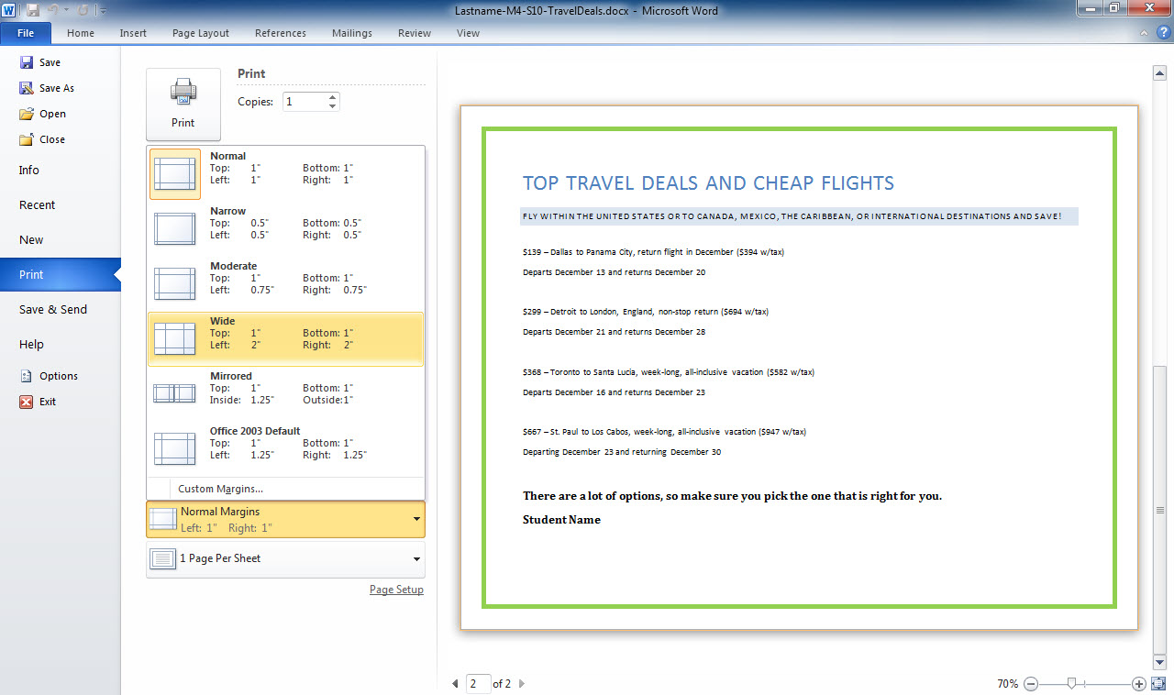
File tab
Copies measurement box
Option list
Print tab
Next Page button
Notes:
To go back to your file and make changes before you print it, click any tab.

Slide 46
Experimenting with Print Settings When you change a print setting in Backstage view, the preview adjusts to show you what impact the change you have chosen will have on the printed file.
Notes:
Try changing the paper size, the page orientation (e.g., portrait versus landscape), and the margins. You can also click the Printer Properties link to display printer options, such as the type of paper (e.g., plain paper or photo paper), print quality (e.g., draft or high), and color options (e.g., sepia or grayscale).

Slide 47
Skill 11: Use Help
Start Excel.
Click the Microsoft Excel Help button to display the Excel Help window.
Click the Charts hyperlink in the Browse Excel 2010 support section.
Click the Creating charts hyperlink.
Click the Available chart types hyperlink and then read about the Available chart types.
Click the Back button to return to the previous page.
Click the Home button to go to the initial Help window.
Type conditional formatting in the Search box near the top of the window and then press Enter.
Click a link to read information about conditional formatting.
Click the Close button to close the Help window.
Close Excel.
Notes:
Each Microsoft Office application has its own Help window. The Help window functions similarly to a web browser. You can click links to view Help topics and use Navigation buttons to move among previously visited pages. You can also search for specific keywords.

Slide 48
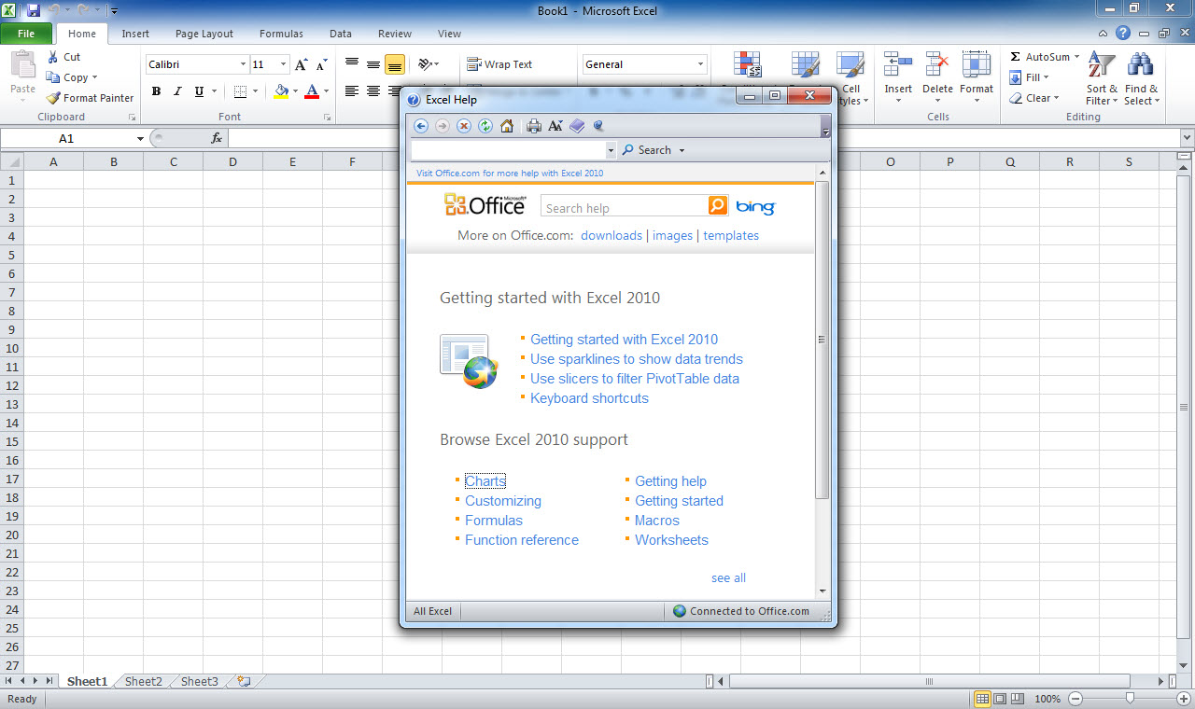
Help button
Back button
Search box
Browse Excel 2010 support section
Notes:
You can print Help topics by clicking the Print button on the Help window toolbar.

Slide 49
Taking Advantage of the Office.com Website If you have an Internet connection, the Help window provides links to the Office.com website.
Notes:
You can click the images link to connect to the Office.com site and download images to enhance your documents, workbooks, and presentations. You can click the templates link to connect to the Office.com site and download templates for creating documents, worksheets, and presentations. The downloads link takes you to a page in the Office.com site where you are able to access additional downloads to complement the applications in the Office suite.

Slide 50
Skill 12: Use Microsoft Office 2010 Web Apps
Start your web browser and, if you do not already have one, create a Windows Live ID at skydrive.live.com. Once you have your SkyDrive account, log in.
Click New.
Click Word document from the drop-down list.
Type M4-S12-WebApps in the Name text box.
Click the Save button to create a new Word Web App document and simultaneously save it on your SkyDrive.
Click the Insert tab. The Word Web App is a “light” version of Word and not all ribbon tabs and buttons are available.
Click the File tab.
Click Close.
Click the Close button to close the browser window.
Notes:
The Microsoft Office 2010 Web Apps are cloud-based versions of Word, Excel, PowerPoint, and OneNote, which means you can access them online. The Web Apps allow you to work on your PC, laptop, or mobile device from anywhere that provides you with an Internet connection. You do not have to install or download any extra software and the Web Apps are compatible with most major web browsers, including Internet Explorer, Firefox, and Safari. In order to use the Web Apps, you will need to first create a Windows Live ID. Once you have set up a Windows Live ID, you can save your Office documents from your computer to your SkyDrive account. This account is handy if you want to access your files on a different computer. Note that you do not have to have Office installed on a computer in order to use the Office Web Apps.

Slide 51
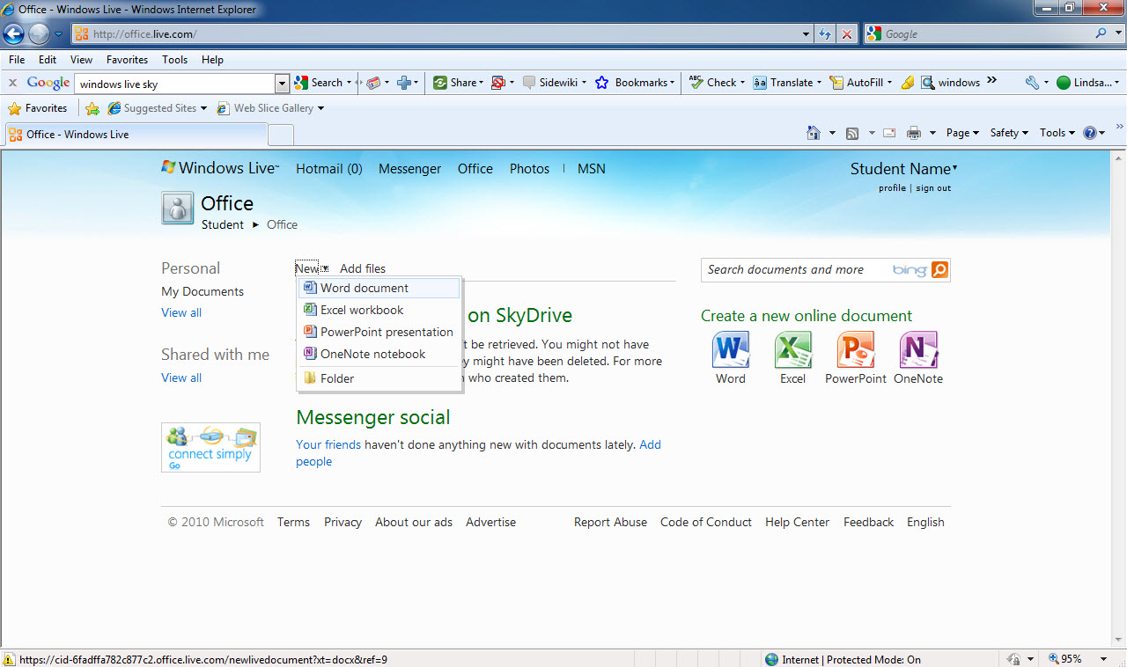
New
Drop-down list
Notes:
You get 25 GB of free personal storage with your SkyDrive account.

Slide 52
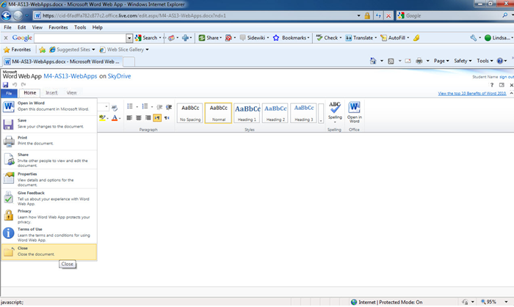
File name
Insert tab
Close tab
Notes:
The first step when creating a Web App document is to name it.

Slide 53
Saving to the Web To save a document that already exists on your hard drive to your SkyDrive account, click File, click Save & Send, and then click Save to Web.
Notes:
You can then select your SkyDrive account and the appropriate folder.

