Slide 1
MODULE 3
Internet Basics
Notes:
In Module 3, you will learn about Internet basics.

Slide 2
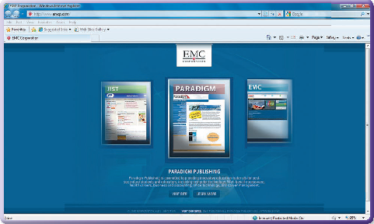
Notes:
This module discusses Internet basics.

Slide 3
Skills You Learn
Explore the Internet Explorer 8.0 Interface
Explore the Mozilla Firefox Interface
Navigate among web pages
Use tabbed browsing
Set up a home page
Follow links and history
Save sites as Favorites/Bookmark
Download Files
Print a web page
Use search engines
Notes:
This module is about Internet basics. You will learn to use two of the most popular web browsers, Microsoft Internet Explorer and Mozilla Firefox, to quickly navigate among web pages and become familiar with tabbed browsing. You can designate a home page that displays every time you start your browser and you save or bookmark sites that you would like to return to at a later date. You learn to download files and print a web page. You also learn tips for specifying search criteria in order to find the information you are looking for on the Internet.

Slide 4
Guidelines for Using the Internet
The Internet is the largest computer network in the world.
Use the Internet to communicate and share data with others all over the world.
In order to use the Internet, you need:
A hotspot or an account with an Internet Service Provider
Communications hardware on your computer
A network card in your computer to support connectivity
A web browser
Notes:
You can use the Internet to communicate with others all over the world.

Slide 5
Internet Service Provider
An Internet Service Provider (ISP) is a company that provides access to the Internet.
ISPs usually charge a monthly fee.
ISPs provide instructions and may provide necessary equipment.
They may also provide email accounts and other information services.
Notes:
If you use a school computer or connect to the school’s network, you will use the school’s ISP and should ask your instructor how to connect to the Internet. You can find hotspots at many colleges and some retail locations that offer wireless Internet connection, often without a fee.

Slide 6
Connection Options
Types of connections
Cable modem
Digital Subscriber Line (DSL)
Satellite modem
Wireless modem
Wireless access point
Mobile broadband stick
Notes:
The way you connect to the Internet varies according to the kind of Internet connection you have.

Slide 7
Web Browsers
A Web browser is a software program that allows you to locate and view web pages.
Web page refers to a single page
Website refers to all of the web pages that make up a site.
Most browsers look similar, so browser choice is usually a matter of preference.
Internet Explorer has approximately 45% market use
Firefox has approximately 30%
Others include Safari, Chrome, and Opera
Portable devices, such as cell phones, use mobile browsers.
Notes:
A web browser is a software program that allows you to locate and view web pages. Most browsers have similar interfaces and features, so browser choice is usually a matter of individual preference. Browser usage statistics vary depending on the information source, but a recent estimate states that Internet Explorer has approximately 45% of the market and Firefox, approximately 30%.

Slide 8
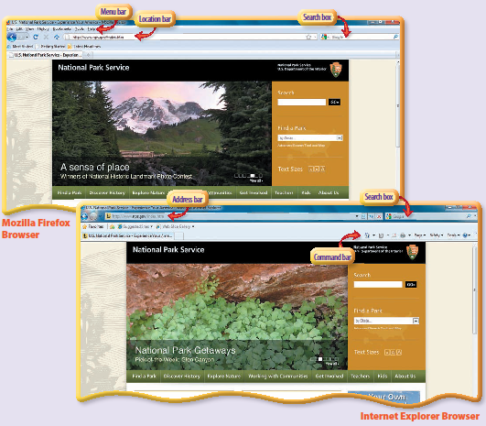
Notes:
Here are screen captures of the National Park Service’s website, accessed using Mozilla Firefox and Internet Explorer. Notice the similar features, including the Address/Location bars (where you type the address of a website), the Search boxes, and the Command/Menu bar options.

Slide 9
Skill 1: Explore the Microsoft Internet Explorer 8.0 Interface
Internet Explorer is a web browser developed by Microsoft and included with the Windows operating system.
The interface has several toolbars, including the Menu bar and the Command bar.
Additional toolbars are
Address bar, where you can type a web address
Status bar, which displays messages such as the download progress of a web page
Notes:
The Status bar is located along the bottom of the Internet Explorer window.

Slide 10
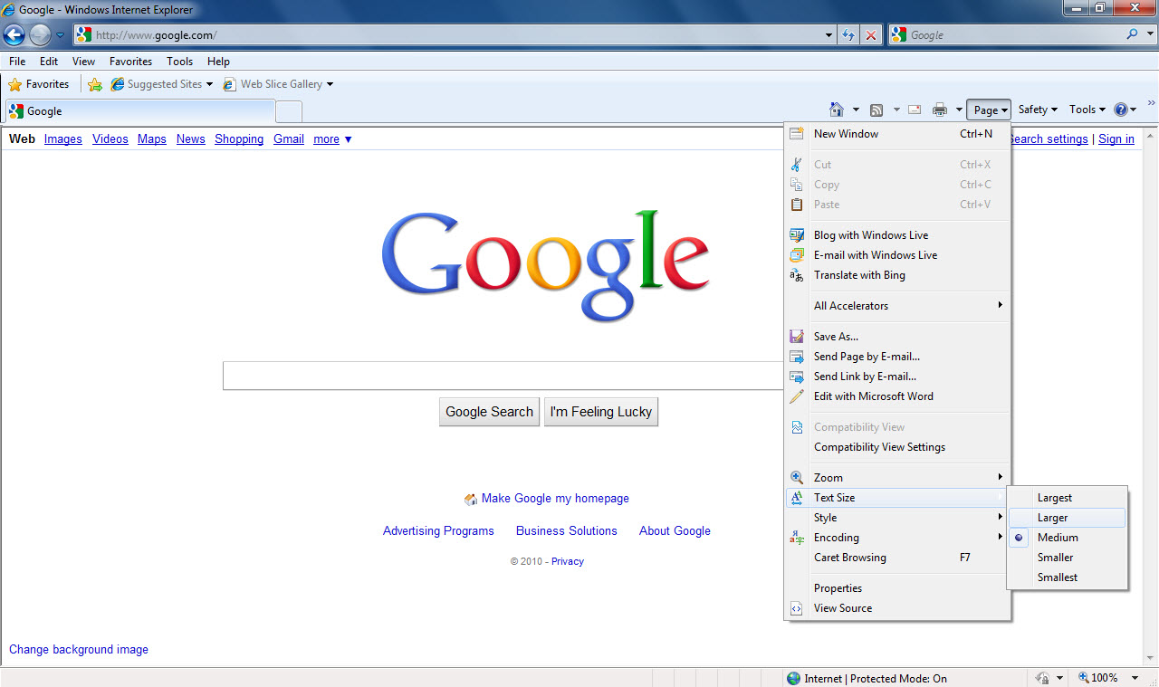
Address bar
Page command
Internet Help
Notes:
In this skill, you become familiar with Internet Explorer’s user interface. You also display and locate information on a web page, use the Command bar to access commands and settings, browse Internet Explorer Help, and display the Menu bar. Tip: Depending on your system configuration, the steps to start Internet Explorer may vary.

Slide 11
Using the Refresh and Stop Buttons Many websites, such as newspaper websites, refresh or update their site content on a regular basis. Some websites do so automatically, but others require action on your part. To refresh website content, click the Refresh button, located to the right of the Address bar.
Notes:
Pressing the F5 key will also refresh website content. If you start to load a website and change your mind, or if the website is taking a long time to load, you can stop the loading process by clicking the Stop button. The Stop button is located next to the Refresh button.

Slide 12
Skill 2: Explore the Mozilla Firefox Interface
Firefox is a web browser developed by Mozilla.
A free download is available from www.mozilla.com.
Firefox interface includes:
Menu bar
Navigation bar, which also contains the Location bar where you can type a web address
Status bar, which displays messages that alert you to current activities
Notes:
The Status bar is located along the bottom of the Firefox window.

Slide 13
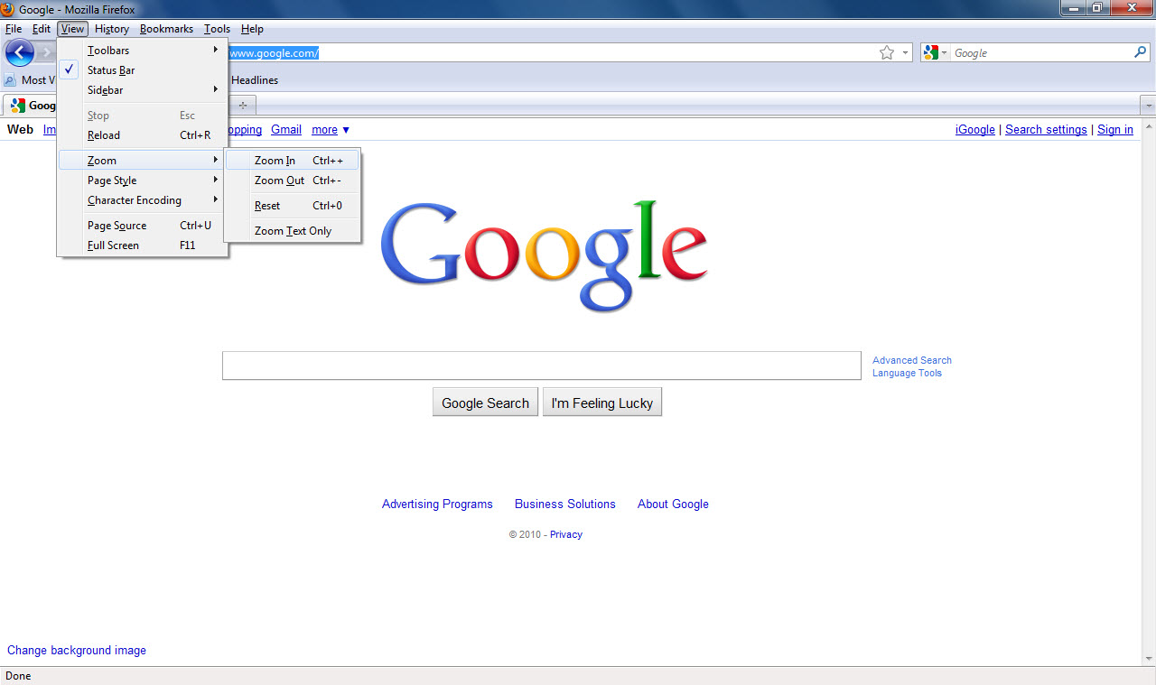
Help on the Menu bar
Location bar
Menu bar
Notes:
In this skill, you become familiar with Firefox’s user interface. You also display and locate information on a web page, use the Menu bar to access commands and settings, and browse Firefox Help. Tip: Use the down arrow key, the wheel on your mouse, or the vertical scroll bar to scroll down the Firefox Help window.

Slide 14
Skill 3: Navigate among Web Pages
The Uniform Resource Location (URL)
Specifies the address of a web page on the Internet
Type an address into the Address or Location bar of a browser and go directly to the web page
Web Pages contain links
Each link displays another web page
Links are usually underlined but may also include other forms, such as buttons.
Notes:
You can click the Back and Forward buttons on the browser’s interface to navigate through web pages you have already visited. Click the Home button to display the Home page, which is the page displayed when you start the web browser.

Slide 15
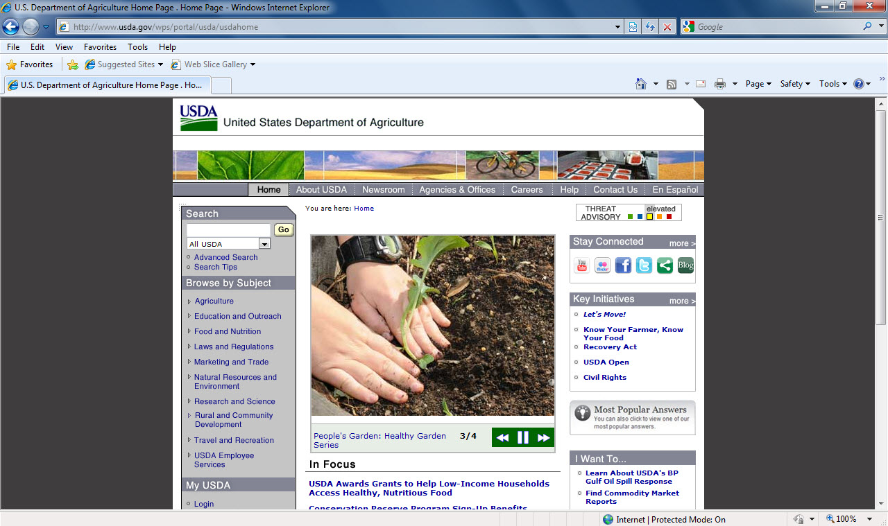
URL in the Address bar
Back button
Hyperlink
Notes:
When you enter the upper-level URL for a site (www.emcp.com), the page that appears is that website’s home page. Tip: You can click the Back button and the Forward button to navigate back and forth through locations you have already visited.

Slide 16
Browsing on a Mac The Safari browser is
provided with the Mac operating system,
although anybody can download it and use it on any computer.
Notes:
Safari provides a slightly different browsing experience from the more PC-centric browsers like Internet Explorer. There is no menu bar, only a row of icons at the top of the browser. The first two are forward and backward buttons; the third button sends you to a page of thumbnail representations of recently visited sites; the fourth displays a Bookmark menu where you can access your browsing history or sites you have bookmarked; and the last displays a short menu for adding a bookmark. This less-cluttered interface is preferred by some and is in line with Apple’s tendency to produce well-designed, graphical interfaces.

Slide 17
Skill 4: Use Tabbed Browsing
Tabbed browsing
Allows you to open more than one website in a single browser window
Type a new address in the Address bar of the new tab to open another site
Notes:
You can switch between websites by clicking the tab you want to view.

Slide 18
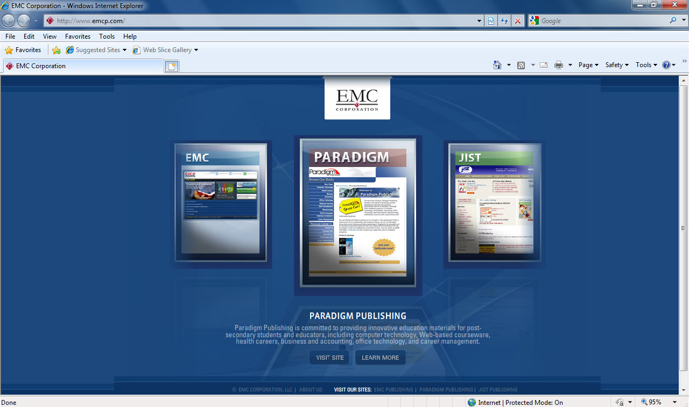
2. Type a new address in the Address bar
1. Select a new tab
Notes:
To open a new tab from a link on a web page, right-click the link and click Open in New Tab (IE) or Open Link in New Tab (Firefox). Tip: When you close Firefox, a prompt asks if you want to save your tabs for the next time you start Firefox. Click Save and Quit to save them or click Quit to close without saving them.

Slide 19
Exploring New Tab Options Internet Explorer has two sections, Use an Accelerator and Browse with InPrivate. Accelerators allow you to select text on a web page and then use that text to complete additional tasks. InPrivate browsing will clear your website history when you close the browser window.
Notes:
Private browsing is also available in Firefox by clicking Tools on the Menu bar and then clicking Start Private Browsing.

Slide 20
Skill 5: Set Up a Home Page
A Home Page
is the page you see when you start your web browser.
also displays when you click the Home button in your web browser.
should be a web page that you visit often.
Notes:
You might want your home page to be your company’s website or one of your favorite news and information sites.

Slide 21
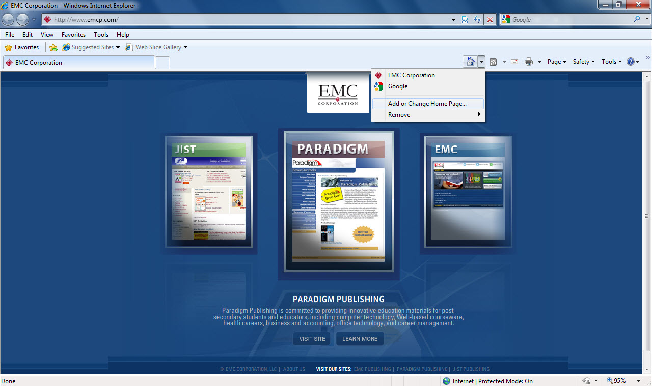
1. Type the address in the Address bar
2. Click the Home button arrow
3. Add or Change Home Page option
Notes:
If you are using this skill to change the home page on your personal or home computer, rather than entering www.emcp.com, navigate to the web page that you plan to use as your home page. Tip: To set up a home page in Firefox, display the website you want as your home page, press the web page icon that displays at the left of the web address in the Location bar, and then drag it to the Home button. Click Yes in the Set Home Page window.

Slide 22
Choosing Multiple Home Pages You may maintain more than one home page by having a set of two or more tabs display when you start your browser.
Notes:
To create a set of tabs in Internet Explorer, navigate to the selected web page, click the arrow next to the Home button, and then click Add or Change Home Page. Next, click the Add this webpage to your home page tabs option. Repeat these steps for each page you want to add to your home page tab set.

Slide 23
Skill 6: Follow Links and History
Internet Explorer stores information about the websites you visit.
It can improve your web browsing speed.
It will also help you to find sites you have already visited.
Notes:
Previously visited sites are displayed in the Address bar and you can also access them through the History tab in the Favorites Center. Tip: When you type the first few letters of a web address in the Address bar, Internet Explorer displays a list of previously entered web addresses that begin with those letters. Click one and press Enter to go to it.

Slide 24
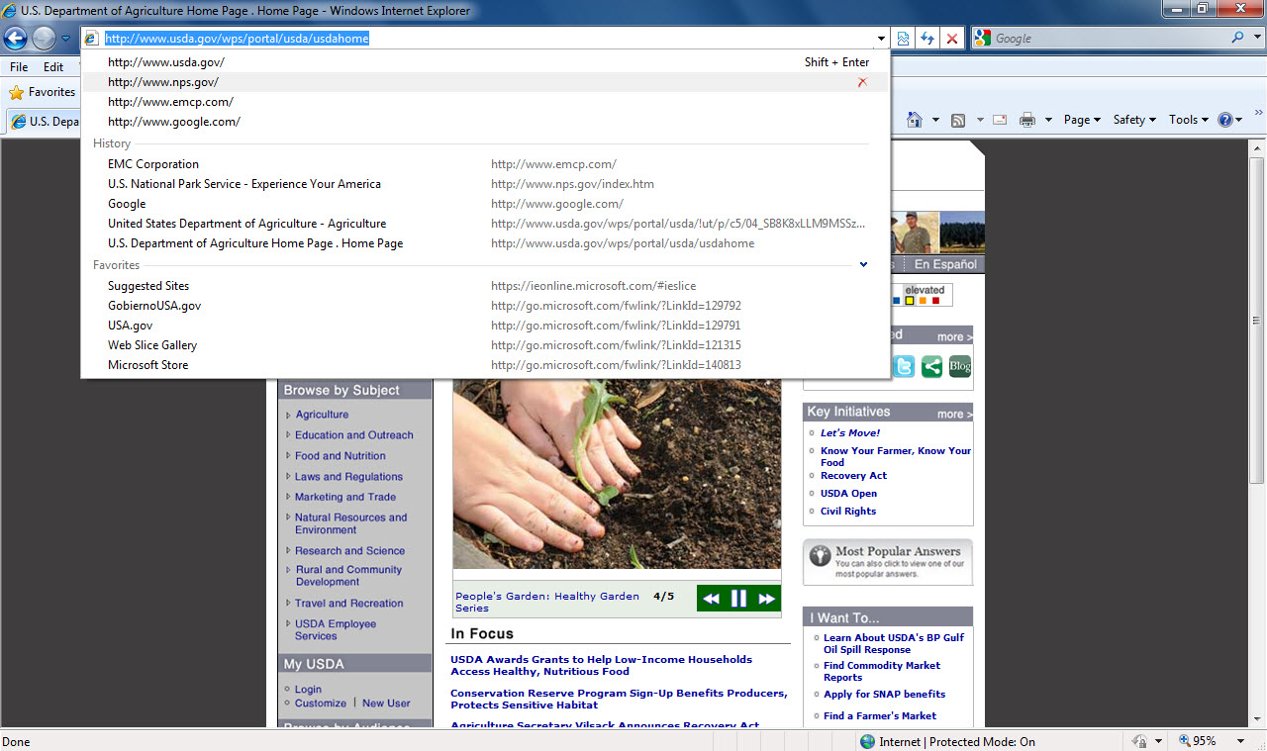
Previously visited sites listed
Show Address Bar Autocomplete arrow
Favorites Button to display the Favorites Center
Notes:
The History tab in the Favorites Center allows you to see the sites you have previously visited.
In Firefox, you can type keywords in the Location bar and it will make suggestions based not only on your previously visited URLs, but also on similar web page titles and on the tags in your bookmarks and history. Mozilla refers to this feature as the “Awesome Bar.”

Slide 25
Changing History Duration By default, Internet Explorer keeps a 20-day history of the web pages you have visited. You can change the number of days that Internet Explorer keeps your web page history.
Notes:
After 20 days, Internet Explorer automatically deletes history entries. To change the number of days, click Tools in the Menu bar and then click Internet 0ptions. In the Internet Options dialog box, click the General tab and then click the Settings button in the Browsing history section. In the History section of the Temporary Internet Files and History Settings dialog box, specify the number of days you prefer. If you do not want a web page history kept, set the number of days to 0.

Slide 26
Skill 7: Save Sites as Favorites/Bookmarks
Internet Explorer favorites are links that you save to websites you visit frequently.
Firefox has a similar feature, but refers to these favorite sites as bookmarks.
Notes:
In Internet Explorer, when you add a website to your Favorites bar, you can then go to that site by simply clicking its name, instead of having to type its web address. If you add a large number of sites to favorites/bookmarks, you can organize them within folders to easily find the site you are looking for. Click the New Folder button to create a new folder within your Favorites folder. You can create new folders, as needed, to organize your favorites.

Slide 27
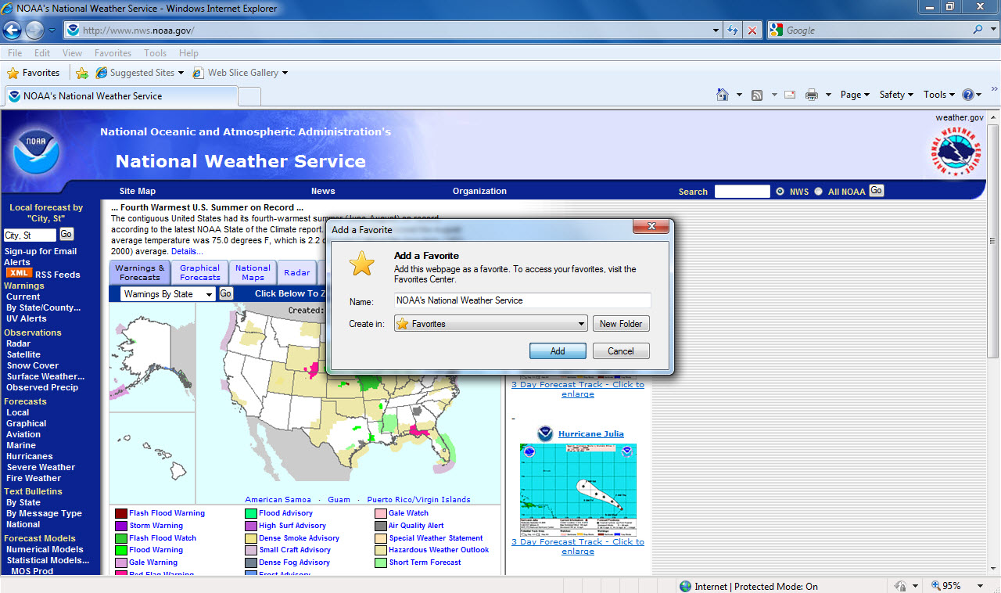
Address Bar with web site address
Favorites Button to display the Favorites Center
Add button in Add to Favorites dialog box
Notes:
In Firefox, click Bookmarks and then click Bookmark This Page to add a bookmark. To view suggestions for other websites based on the web page you are currently viewing, click the See Suggested Sites link at the bottom of the Favorites bar. You may need to click Turn on Suggested Sites first.

Slide 28
Cleaning Out Your Favorites Periodically review and delete listed sites that you no longer visit very often.
Notes:
In Internet Explorer, to delete listed sites that you no longer wish to use, click Favorites to display the Favorites Center, right-click an item, and then click Delete from the shortcut menu.

Slide 29
Skill 8: Download Files
When you download a file, you transfer it from the Internet to your computer or another digital device.
When you upload a file, you transfer it from your computer or other device to a site on the Internet.
Notes:
Commonly downloaded files include programs, software updates, images, and music files. When you download a file, you take a risk that the file will contain a virus or a program that can damage your computer or your stored information. Be sure to install and use an antivirus program and only download files from sites you trust.

Slide 30
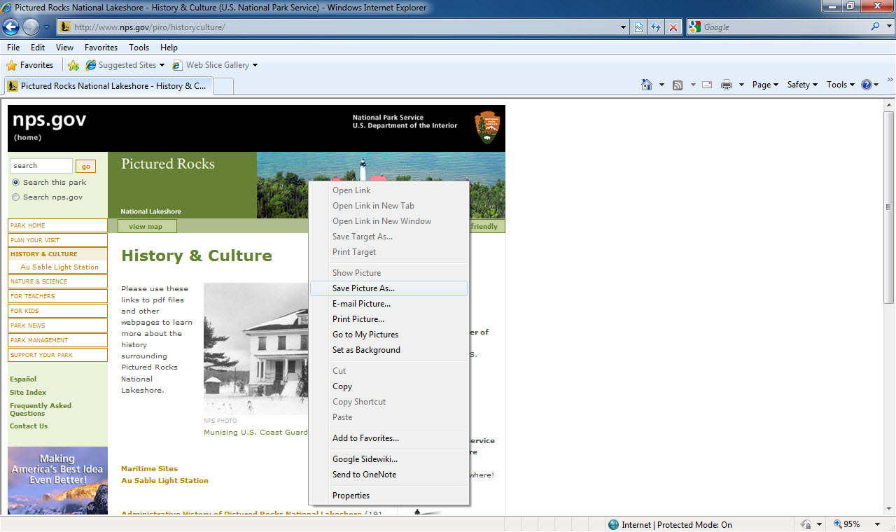
Select Save Picture As to save file
Right-click item you wish to save
Notes:
To save a picture as a file, right click on the image you wish to save. The Pictures library is usually the default location for saving images. Copyright laws protect much of the information on the Internet. Before using files you have downloaded from the Internet, check the source site for restrictions.

Slide 31
Installing Adobe Reader Adobe Reader is a useful program for people who share files frequently. The program is free and is installed with the Windows Operating System.
Notes:
No matter the originating program, if a file is saved in PDF format, Reader allows you to view it. If you enable comments in the PDF using Adobe Acrobat, people with Adobe Reader can provide input on a PDF file, making it a great tool for group reviews of files. To get and install Adobe Reader, go to http://get.adobe.com/reader/ and click the Download Now button. If you have certain security settings in place, you may first have to agree to install an
ActiveX Control on your computer or give Windows permission to download the software.

Slide 32
Skill 9: Print a Web Page
Web pages are not typically designed to fit on a printed page.
It is a good idea to preview the document before you print.
Page orientation, scaling, and margins can be adjusted in the Print Preview window.
Notes:
Previewing the document before printing will show you exactly what the printed document will look like and how many pages are required for the printout.

Slide 33
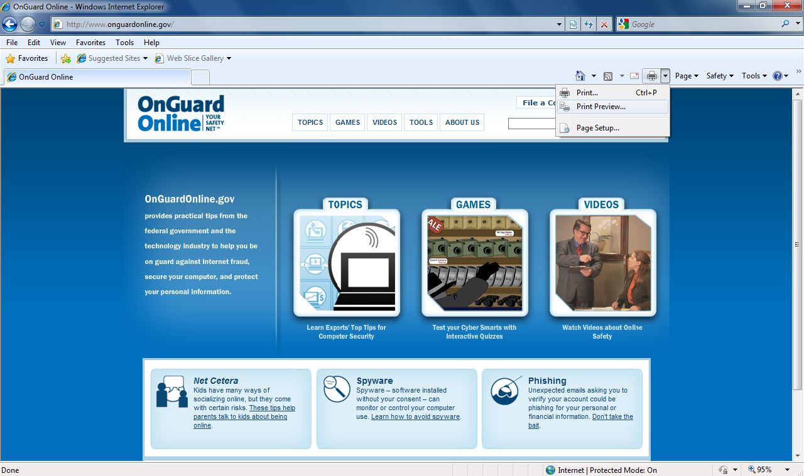
Print Arrow button
Print Preview
Notes:
You can also press the Alt key to display the menu bar, click the File tab, and then click Print Preview. In Firefox, click File and then click Print Preview to display the Print Preview window.

Slide 34
Adding Headers and Footers to Printed Web Pages Place additional information at the top and bottom of your web page printouts by using headers and footers.
Notes:
You can add the current date or time, page numbers, the window title, or the web page address in a header or footer.

Slide 35
Skill 10: Use Search Engines
Search Engines
locate information on the Web
look through web pages for words or phrases and return a list of matches
can include Google, Yahoo, Bing, and Ask along with a variety of others
Notes:
To search for information in a search engine, type your search criteria in the Search box and then press the Enter key or click the Search button. Most search engines include tools to help you specify search criteria in order to narrow your search.

Slide 36
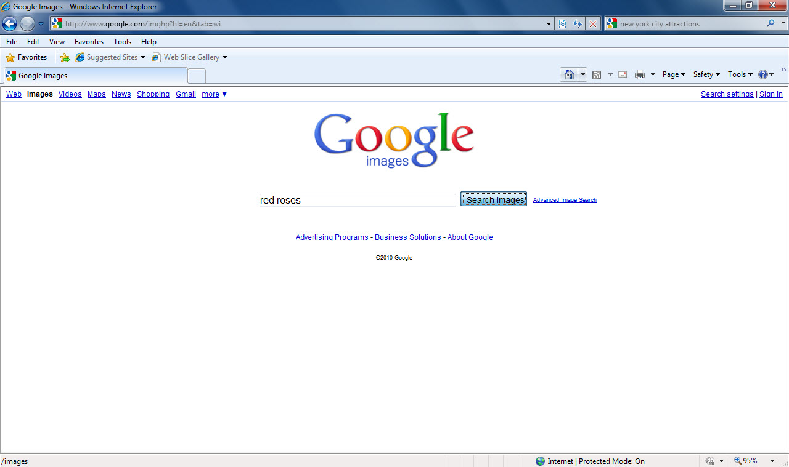
Search button
Search box
Notes:
Internet Explorer displays suggestions as you type words into the Search box. Click a suggestion to start the search without having to type the rest of the word or phrase. In both Internet Explorer 8.0 and Firefox, search engines are accessible from the Search box at the right of the Address bar or Location bar. You can change the default search engine listed in this box by clicking the arrow at the right of the Search box and then choosing your preferred search engine.

Slide 37
Using Advanced Search To help you search more successfully, most search engines offer an Advanced Search link with options for narrowing your search.
Notes:
Advanced Search empowers you with many options, including specifying that your search take place within a particular site or domain, such as at the site youtube.com or at sites ending with the domain destination .gov.

