Slide 1
Microsoft® Windows 7
MODULE 2
Chapter 1: Navigating around Windows
Chapter 2: Managing Files and Folders
Chapter 3: Working with Windows Settings, Gadgets, and Accessories
Notes:
In Module 2, you learn about Microsoft Windows 7. Chapter 1 covers navigating around Windows. Chapter 2 deals with managing files and folders. In Chapter 3, you work with Windows settings, gadgets, and accessories.

Slide 2
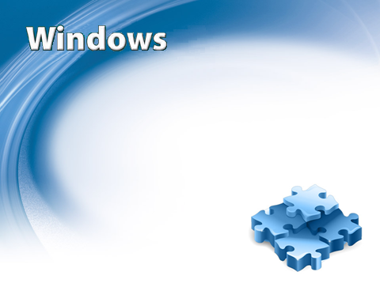
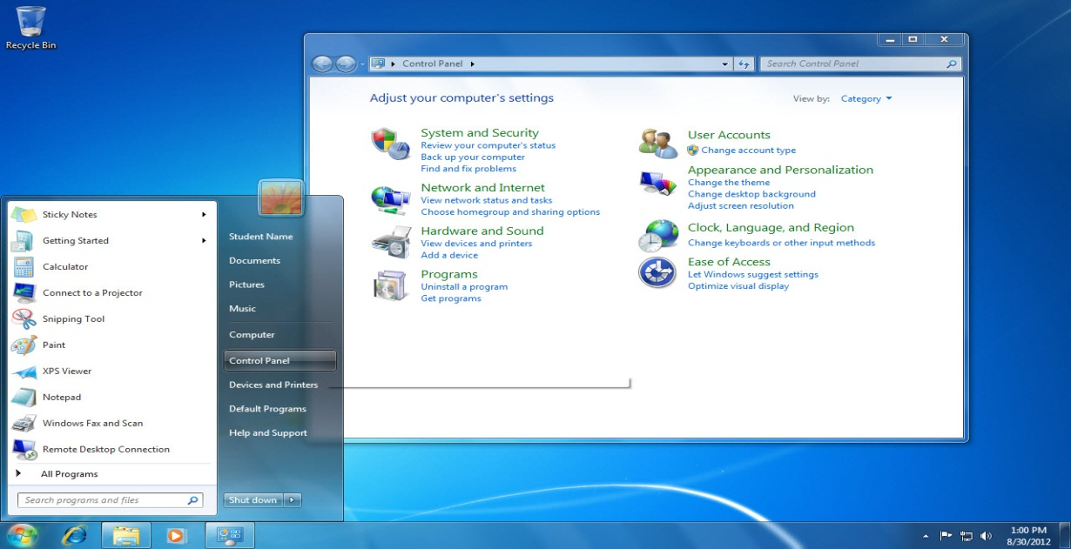
Chapter 3
Working with Windows Settings, Gadgets and Accessories
Notes:
Typically, when you purchase a computer, Windows has already been installed for you. Therefore, many of the Windows settings on your computer are the default settings applied during the installation process. You can, however, change many of the Windows 7 settings in order to personalize your computer. You can access and adjust most system settings for your computer through the Control Panel.
Along with exploring the Control Panel, you learn in this chapter about the gadgets that you can add to your desktop. You also become familiar with some handy programs that are located in the Accessories folder. These programs come with Windows 7.

Slide 3
Skills You Learn
Explore the Control Panel
Set the date and time
Modify the appearance of Windows
Change the Windows theme
Use Windows Accessories
Review firewall settings
Manage Windows Update settings
Use Windows Help
Use Gadgets
Notes:
This chapter is all about working with Windows settings, gadgets, and accessories.

Slide 4
Skill 1: Explore the Control Panel
Click the Start button on the Taskbar.
Click Control Panel to display the Control Panel window and view the Control Panel categories.
Click the Review your computer’s status link under the System and Security category link and review the displayed information.
Click the Back button to redisplay the Control Panel category links.
Click the Adjust screen resolution link under the Appearance and Personalization category link. The computer’s current screen resolution settings display.
Notes:
The Control Panel is organized into categories and subcategories. Click a category link, such as Appearance and Personalization, to display additional subcategories and tasks. Follow the links to display and modify settings for your computer.

Slide 5
Skill 1: Explore the Control Panel, continued
Click the Back button.
Click the Hardware and Sound category link to display the subcategories and tasks.
Click the Back button.
Click the Close button to close the Control Panel.

Slide 6
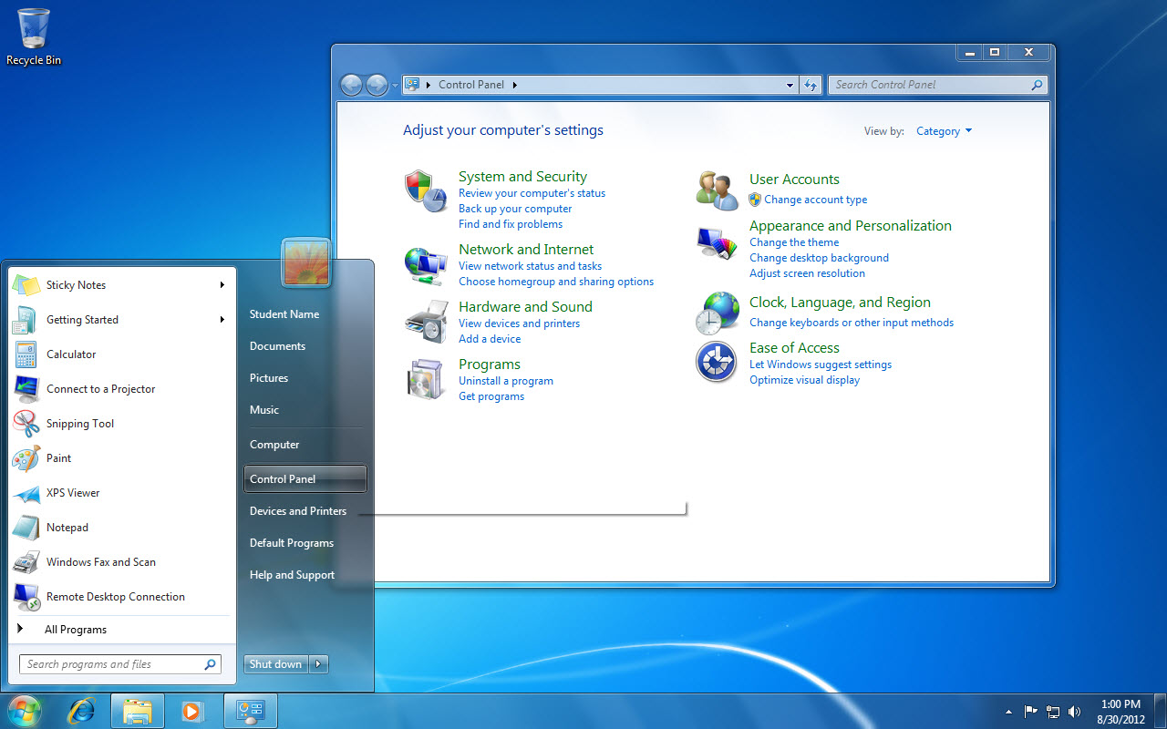
Control Panel window
Control Panel option
6
Notes:
Click Control Panel to display the Control Panel window and view the Control Panel categories. Shortcut: To display the Start menu use Ctrl + Esc.

Slide 7
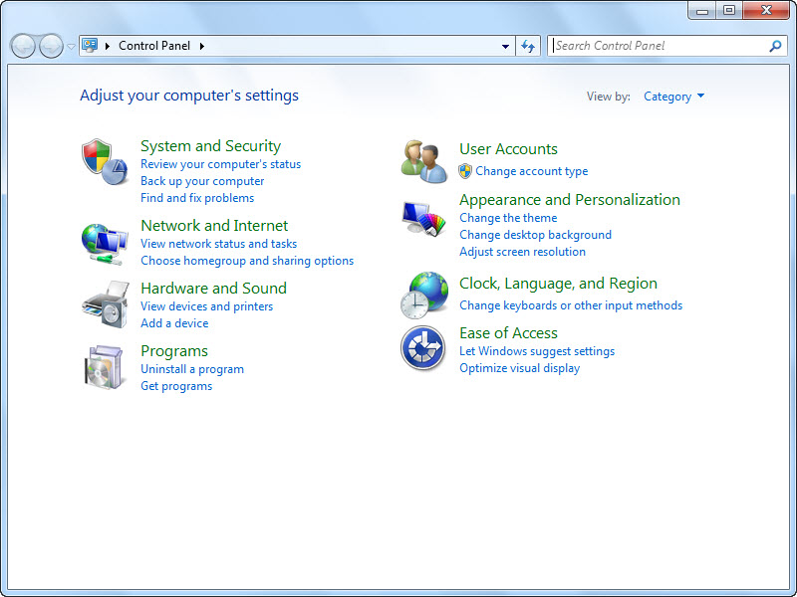
Back button
Control Panel categories
7
Notes:
Click the Review your computer’s status link under the System and Security category link and review the displayed information. Click the Back button to redisplay the Control Panel category links.
Click the Adjust screen resolution link under the Appearance and Personalization category link.
Click the Back button.
Click the Hardware and Sound category link to display the subcategories and tasks.
Click the Back button.
Click the Close button to close the Control Panel.
Category should be selected in the View by list at the upper-right corner of the window. If Large icons or Small icons are displayed instead,
click the drop-down arrow and select Category.
Click the Control Panel Home link in the left-hand pane.

Slide 8
Exploring Ease of Access The Control Panel’s Ease of Access category link displays links to accessibility tools and options.
8
Notes:
One of the tools found in the Optimize visual display link is the Magnifier. This tool displays a magnified version of the screen above the regular screen to help users with vision challenges. Another tool replaces sounds with visual cues. You can also change how your mouse and keyboard work. Changes made in the Ease of Access Center will apply automatically each time you log on to your computer.

Slide 9
Skill 2: Set the Date and Time
Click the Start button on the Taskbar.
Click Control Panel.
Click the Clock, Language, and Region category link to display tasks in that category.
Click the Set the time and date link under the Date and Time subcategory link to display the Date and Time dialog box.
Click the Change date and time button. You can change the date by clicking a different date on the calendar and change the time by typing or selecting a new time.
Notes:
You use the Clock, Language, and Region category link in the Control Panel to set the computer’s date, time, and time zone. The date and time must be set correctly because your computer includes those settings in a time stamp that it adds to your email messages and to the files you save. You may also rely on the clock that displays in the notification area of the Taskbar to show you the correct local time. Also, if you bring your computer when you travel to different time zones, you should know how to change the various date and time settings.

Slide 10
Skill 2: Set the Date and Time, continued
Click Cancel to close the Date and Time Settings dialog box.
Click the Change time zone button. The current time zone is selected in the Time zone option box and the Automatically adjust the clock for Daylight Saving Time option is also selected.
Click Cancel to close the Time Zone Settings dialog box.
Click Cancel to close the Date and Time dialog box.
Click the Close button to close the Control Panel window.

Slide 11
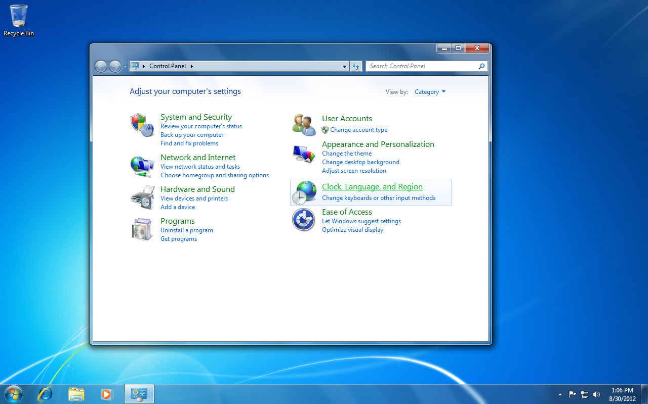
Clock, Language, and Region category link
11
Notes:
Click the Start button on the Taskbar.
Click Control Panel.
Click the Clock, Language, and Region category link to display tasks in that category.
Be sure that Category is selected in the View by list. To do so, click the arrow next to the View by list and click Category.
You can also change the date, time, and time zone by right-clicking the clock in the notification area on the Taskbar and clicking Adjust date/time.

Slide 12
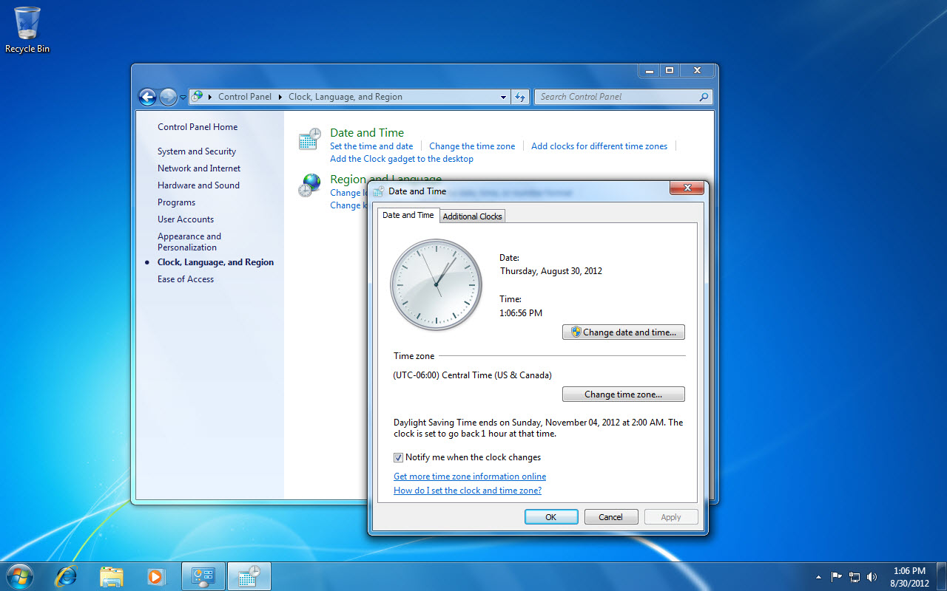
Set the time and date link
Date and Time Settings dialog box
12
Notes:
A check mark placed in the box before the option Automatically adjust clock for Daylight Saving Time means the option is turned on.

Slide 13
Adding Clocks for Different Time Zones You can add one or two additional clocks to the Windows 7 Taskbar.
13
Notes:
You may want these clocks in view if you are corresponding with family or business contacts in different time zones and need to be aware of their time schedules. To add an additional clock, click the Clock, Language, and Region category link in the Control Panel and then click the Set the time and date link. Next, click the Additional Clocks tab. Click the Show this clock option and then select a time zone for the new clock.

Slide 14
Skill 3: Modify the Appearance of Windows
Right-click the desktop to display a shortcut menu.
Click Personalize.
Click the Window Color link in the bottom of the window.
Select a color.
To enable transparency, click the Enable transparency option to remove the check mark.
Drag the Color intensity bar slightly to the right to add intensity.
Notes:
Windows 7 has a default appearance and uses a default color scheme. It applies a specific color, not only to the window borders, but also to the Start menu and Taskbar. The transparent setting, which is referred to as glass, is designed to help you focus on the content of your open windows. You can choose a different color for these elements and enable or disable transparency.

Slide 15
Skill 3: Modify the Appearance of Windows, cont.
Click the arrow button next to Show color mixer.
Drag the Brightness bar slightly to the left or right, depending on your preferences.
Click the Cancel button.
Click the Close button to close the Control Panel window.
Notes:
Windows 7 has a default appearance and uses a default color scheme. It applies a specific color, not only to the window borders, but also to the Start menu and Taskbar. The transparent setting, which is referred to as glass, is designed to help you focus on the content of your open windows. You can choose a different color for these elements and enable or disable transparency.

Slide 16
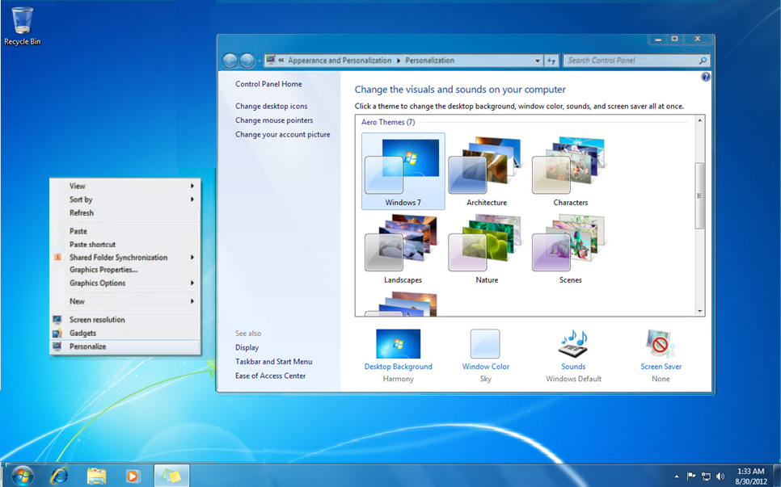
The desktop
Window Color option
Personalize option
16
Notes:
If you are working at your personal computer and you wish to save the changes made to the appearance of Windows, click the Save changes button.

Slide 17
Changing Screen Savers A screen saver is a moving picture or pattern that displays automatically when the computer has been idle for a specified period of time.
17
Notes:
Screen savers were originally intended for saving CRT monitors from screen burn-in, but now are frequently used to personalize a computer. You can also use a screen saver to hide your work when you’re away from your computer, or use one with a password to enhance your computer’s security. To change your screen saver and specify when it should be displayed, right-click the desktop, click Personalize, and then click Screen Saver. The Screen Saver Setting dialog box displays for you to specify settings for your screen saver.

Slide 18
Skill 4: Change the Windows Theme
Click the Start button on the Taskbar.
Click Control Panel to display the Control Panel window.
Click the Change the theme link under the Appearance and Personalization category link.
Scroll to view the themes and then click one you prefer.
Click the Minimize button to see the new background.
Click the Control Panel button on the Taskbar to redisplay the Control Panel window.
Click Windows 7 to restore the default Windows theme or click the default theme for your computer.
Click the Close button to close the Control Panel window.
Notes:
Windows comes with several predesigned themes. A theme includes a desktop background, screen saver, window border color, and sound scheme. Windows applies the Aero Windows 7 theme by default, but you can change it. You can choose another installed theme, choose a high-contrast theme if you have vision challenges, or even create and save your own theme.

Slide 19
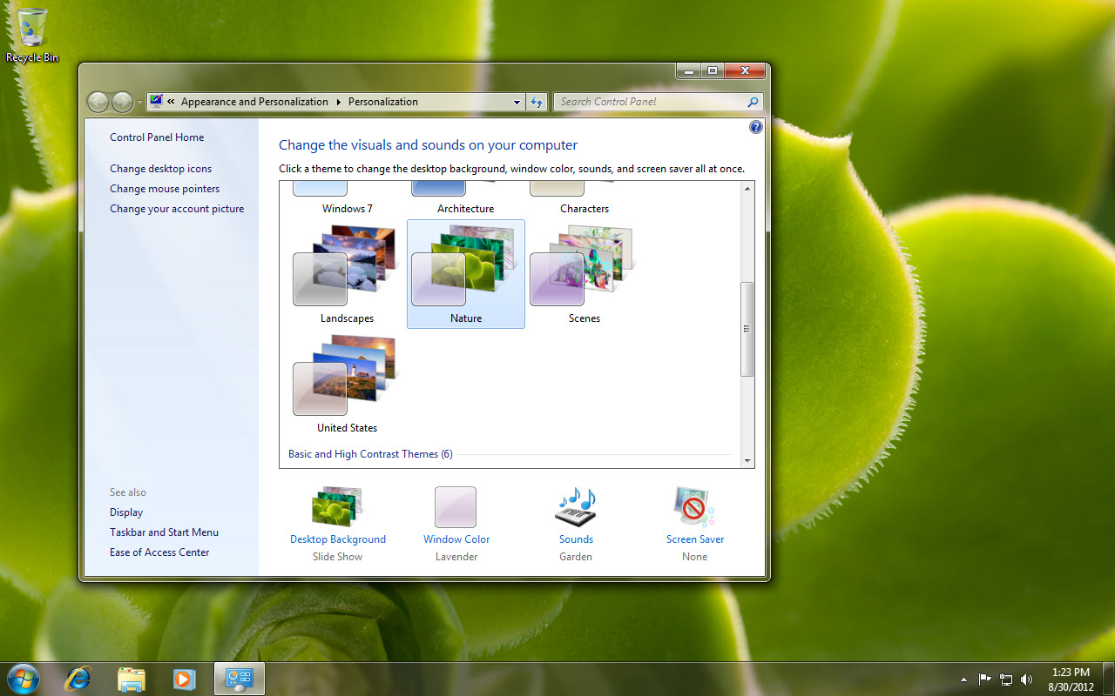
Appearance and Personalization category
Themes section
19
Notes:
Click the Start button on the Taskbar.
Click Control Panel to display the Control Panel window.
Click the Change the theme link under the Appearance and Personalization category link.
Scroll to view the themes in the Aero Themes section and then click Nature.
Click the Minimize button to see the Nature background.
Turn on your computer’s sound to hear the sounds associated with the different themes. If necessary, first plug your speakers or headphones into the output jack.
Click the Show desktop button on the Taskbar.

Slide 20
Creating a Customized Theme Once you select a theme, you can customize it by changing the theme’s background, window color, sounds, and screen saver.
20
Notes:
Click the Change the theme link under the Appearance and Personalization category link in the Control Panel. Click any theme to apply it to your desktop, then click the links at the bottom of the window (Desktop Background, Window Color, Sounds, and Screen Saver) to display options for those settings. Review your preferences within each category, select what you like, and when each option looks just the way you want it to, click Save Changes or Apply. Your new theme then appears under My Themes as an Unsaved Theme. Save the theme and give it a name by clicking the Save theme link.

Slide 21
Skill 5: Use Windows Accessories
Click the Start button on the Taskbar.
Click All Programs.
Click Accessories to display the Accessories menu.
Click Calculator and the Calculator program starts. Try a calculation—for example, divide your total textbook costs of $475 by 5 to find the average cost per book.
Click the Close button to close the Calculator window.
Click the Start button on the Taskbar.
Type sticky in the Search programs and files box. Notice that Sticky Notes is highlighted under the Programs section of the Start Menu.
Notes:
Windows 7 comes with some handy extra utility programs that are located in the Accessories folder. These programs include the Snipping Tool, which you can use to capture information on the screen; Sticky Notes, which lets you create electronic “sticky notes;” Connect to Projector, which helps you hook up your computer to a projector; Sync Center, which lets you sync any folder in your computer with a folder in an external drive; Paint, which is image editor software; Calculator, which you can use to perform calculations; the text editor NotePad; and WordPad, a simple word processor.

Slide 22
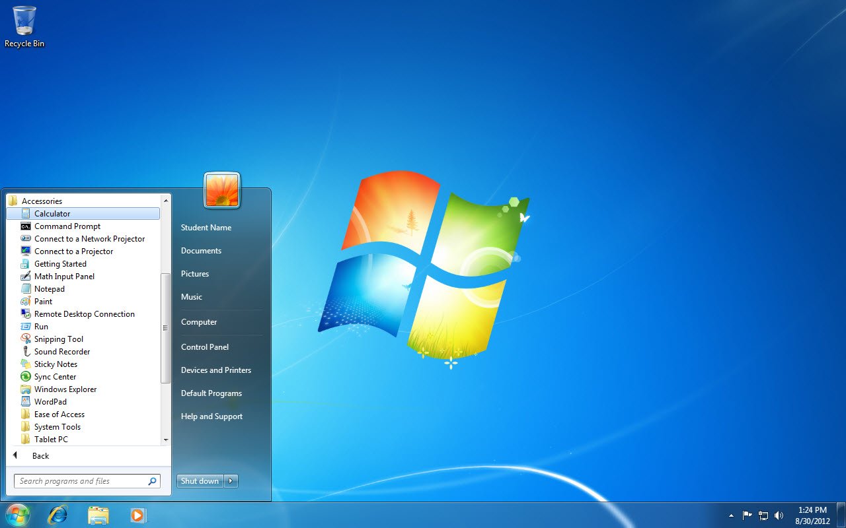
Accessories
Calculator
22
Notes:
Here you see the Calculator option listed under Accessories selected. The Calculator view can be changed to Scientific to provide access to mathematical functions like sin and cos.

Slide 23
Skill 5: Use Windows Accessories, continued
Press Enter to start the Sticky Notes program.
Type Meeting at 2 p.m.
Right-click the text you typed in the sticky note to display a shortcut menu.
Click Pink and the sticky note’s color changes.
Click the Close button on the sticky note.
Click Yes to delete the sticky note.
Notes:
You can leave the sticky note on your desktop to remind you of important dates or tasks.

Slide 24
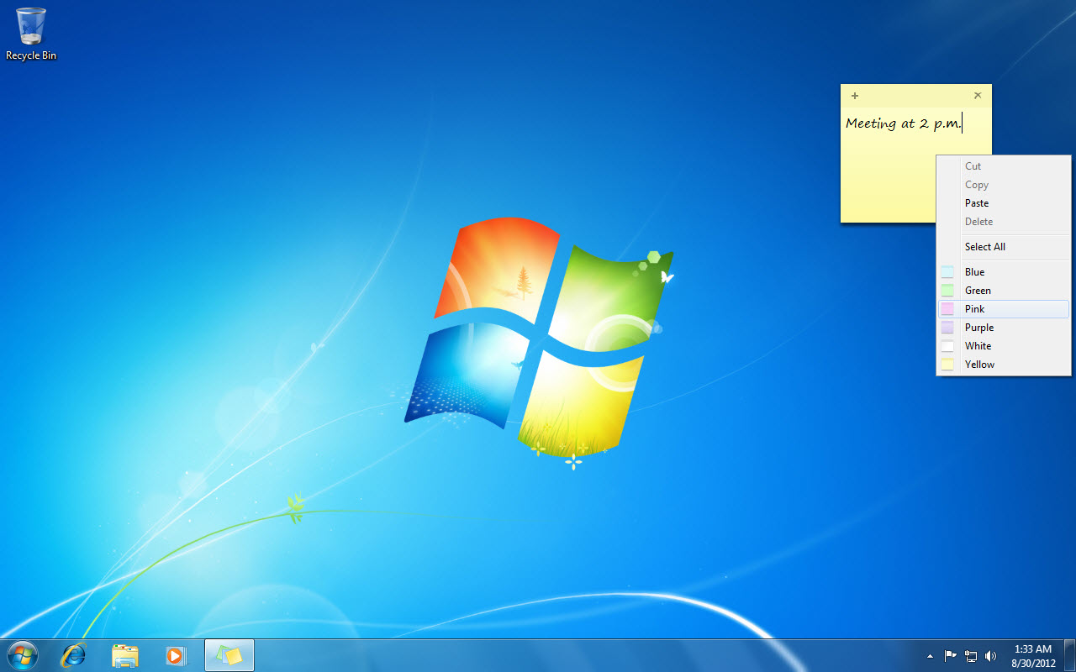
Sticky note close button
Sticky note
24
Notes:
Click the Close button on the sticky note and then Yes to delete the sticky note.

Slide 25
Trying the Paint Program You can use the Paint program to draw, color, and edit pictures.
25
Notes:
The Paint program contains a toolbox with a variety of drawing tools, such as the Line tool and the Pencil tool, which can be used to create lines and curves. You can change the effect of the drawing tools. For example, you can make the lines you draw using the Line tool thicker or thinner. You can also change the color of the tool. Images you edit or create in Paint can be saved in a variety of graphic formats, including GIF, JPG, TIF, and PNG.

Slide 26
Skill 6: Review Firewall Settings
Click the Start button on the Taskbar.
Click Control Panel.
Click the System and Security category link.
Click the Check firewall status link under the Windows Firewall subcategory link to review your firewall status.
In the left pane, click the Turn Windows Firewall on or off link.
Review the firewall settings but do not make changes. Your settings may look different from the settings shown in the textbook.
Click Cancel.
Click the Close button to close the Control Panel window.
Notes:
A firewall is software or hardware that checks information coming to your computer from a network such as the Internet. The firewall then either blocks the information or allows it to pass through to your computer, depending on your firewall settings. The Windows Firewall is enabled by default. You can check your Windows Firewall status and settings in the Control Panel.

Slide 27
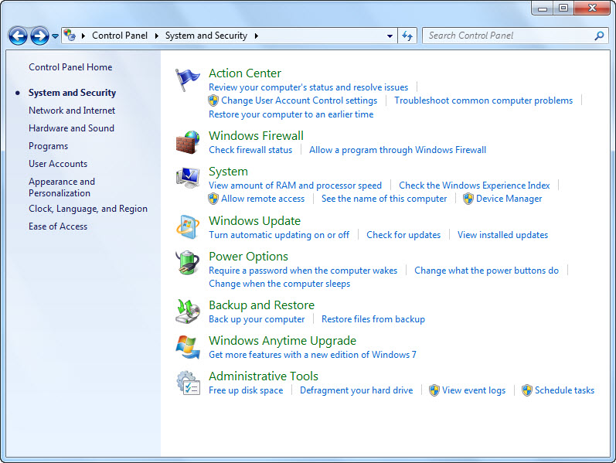
Check firewall status link
27
Notes:
Click the Check firewall status link under the Windows Firewall subcategory link to review your firewall status. In Windows 7, you can have separate firewall settings for public and private networks. Also, the firewall may be turned off because another firewall program is installed on the computer or because the computer is connected to a network with another firewall program installed.

Slide 28
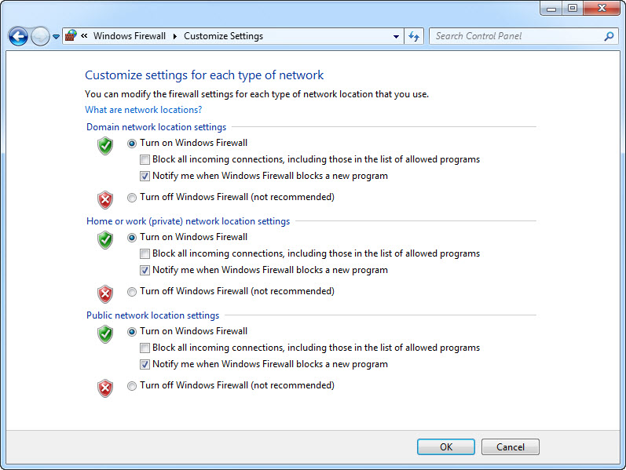
Review the firewall settings
28
Notes:
Your settings may look different from the settings shown here. Click Cancel so you do not make any changes.

Slide 29
Keeping Spyware Under Control Spyware is a type of program that can be installed on your computer, without your knowledge, to collect information about you and your online activities.
29
Notes:
Spyware may be downloaded when you click a link or go to an untrusted site. Keylogging spyware is one of the most dangerous types, as it allows its creator to track your keystrokes, for example as you enter passwords or account numbers. It’s important that you use a spyware detection program to detect and remove spyware.

Slide 30
Skill 7: Manage Windows Update Settings
Click the Start button on the Taskbar.
Click Control Panel.
Click the System and Security category link.
Click the Windows Update subcategory link and review the Windows Update information.
Click the View update history link in the left pane and review the update history information.
Click the Back button.
Click the Change settings link in the left pane and review the settings.
Click Cancel to close the dialog box without saving changes.
Click the Close button to close the Control Panel window.
Notes:
Microsoft has a feature called Windows Update that allows you to download the latest updates to Windows 7 and other Microsoft products. Windows Update is set to run automatically by default. It downloads updates for you as these items become available. To check your Windows Update settings and review which updates have been installed, you can click the System and Security category link in the Control Panel.

Slide 31
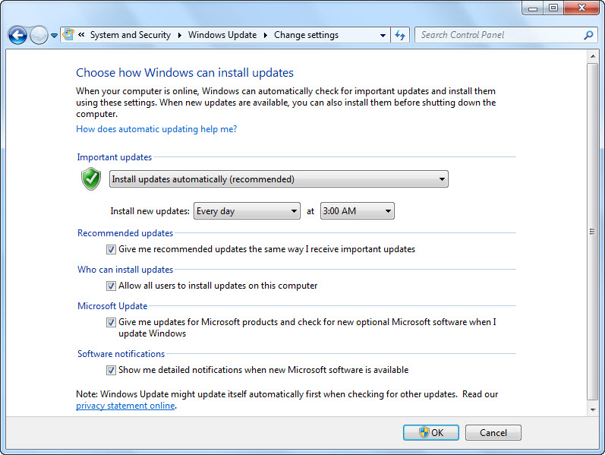
Windows Update settings options
31
Notes:
The update settings may be different on your computer. The Optional updates section targets elements of Windows 7 that you may or may not use, such as specific drivers or foreign language packs.

Slide 32
Understanding Windows Update Settings It is useful to understand some of the Windows update options so you can make informed choices about which updates to install.
32
Notes:
Depending on your current update needs, you may see different types of suggested updates. The Important updates section provide updates that affect your computer’s security, privacy, and reliability. The Recommended updates section offers updates that improve your computer’s performance but do not address fundamental issues with your computer or with the Windows 7 software. You must run all of these types of updates manually.

Slide 33
Skill 8: Use Windows Help
Click the Start button on the Taskbar to display the Start menu.
Click Help and Support.
Click the Learn about Windows Basics link.
Scroll down and click the Learn about Windows games link in the Pictures and games section. Review the information about Windows games.
Click in the Search Help box.
Type install fonts and press Enter to display the search results.
Click the Install or delete fonts link and review the information.
Click the Help and Support home button.
Click the Close button to close the Windows Help and Support window.
Notes:
Windows has many more features, tools, and accessories than this textbook covers. However, the Windows Help and Support system can help you troubleshoot and explore other features and settings. The Windows Help and Support system uses both the help files that are stored on your computer and online help to find answers to your questions. You can either browse through help topics or search for help on a particular topic.

Slide 34
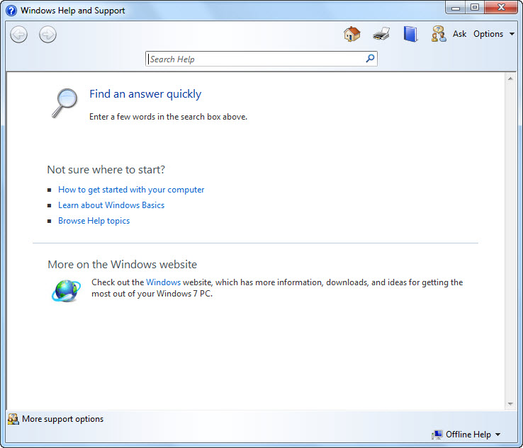
Search Help text box
Learn about Windows Basics link
34
Notes:
The Windows Help and Support shortcut is F1.

Slide 35
Seeking More Support If you cannot find the answer you are looking for, click the More support options button at the lower left corner of the Windows Help and Support window.
35
Notes:
Clicking this button displays links and resources that you can use to access additional support. For example, you will find information about using Windows Remote Assistance to let a friend access your computer over the Internet and help you fix a problem. You will also find a link to the Microsoft Answers website, which is an online community of experts who may be able to help you.

Slide 36
Skill 9: Use Gadgets
With the desktop displayed, right-click the desktop to display the shortcut menu.
Click Gadgets.
Double-click Clock to add the Clock gadget to your desktop.
Move the mouse pointer over the Clock gadget to display the toolbar to the right of the gadget.
Click the Options button to display the Options for the Clocks gadget.
Scroll through the Clock options.
Notes:
Windows 7 includes mini-programs called gadgets that you can add to your desktop. Once placed on the desktop, these gadgets display information, such as the time or date, current weather, or breaking news headlines, which you can monitor while working in other programs. You can even set up a slide show of your favorite photos.

Slide 37
Skill 9: Use Gadgets, continued
Click Cancel.
Double-click Calendar to add the Calendar gadget to your desktop.
Click the Larger size button to increase the size of the Calendar gadget.
Click the Close button in the Calendar toolbar to remove the gadget from the desktop.
Click the Close button to close the Gadgets window.
Notes:
Windows 7 includes mini-programs called gadgets that you can add to your desktop. Once placed on the desktop, these gadgets display information, such as the time or date, current weather, or breaking news headlines, which you can monitor while working in other programs. You can even set up a slide show of your favorite photos.

Slide 38
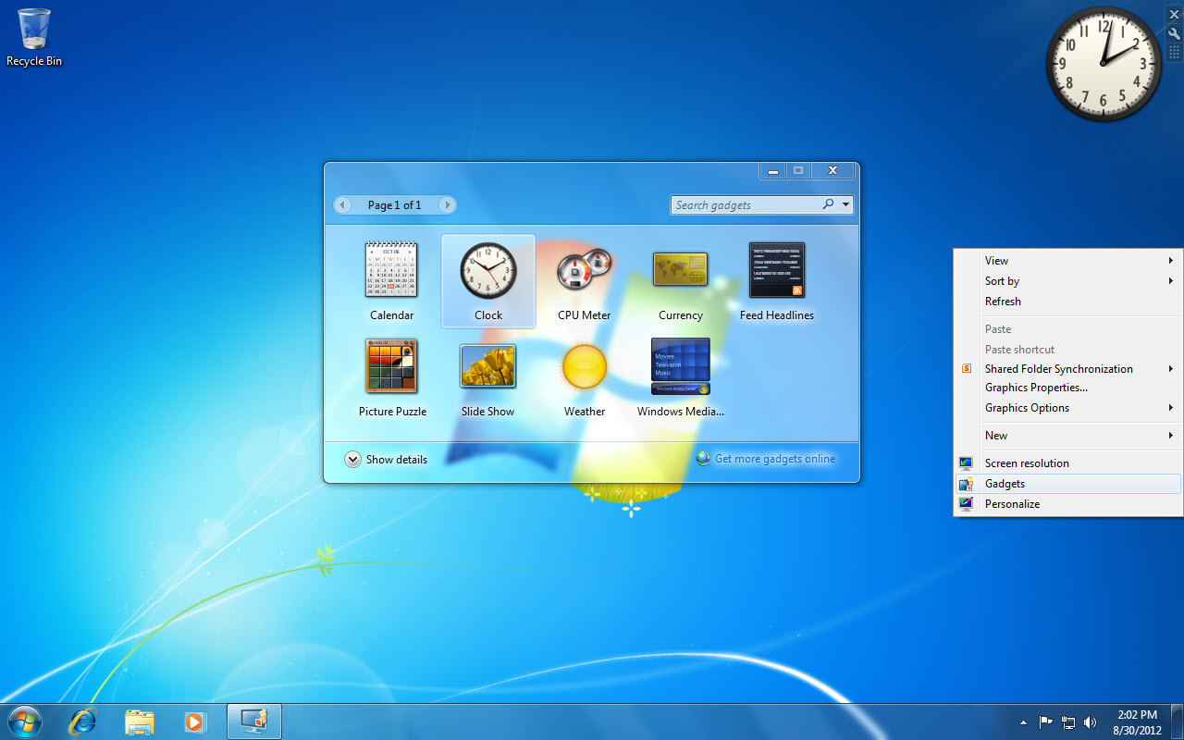
Clock gadget
Options button
Gadgets
38
Notes:
With the desktop displayed, right-click the desktop to display the shortcut menu and click Gadgets. Select the gadget of your choice and double-click it to display it on your desktop.

Slide 39
Trying More Gadgets You can use the standard gadgets or you can download additional gadgets online.
39
Notes:
To view the available gadgets, right-click the desktop and then click Gadgets in the shortcut menu. In the Gadgets window, click the Get more gadgets online link. This link takes you to a Microsoft Windows website where you can view and download additional gadgets. At this site you will find a variety of gadgets, including those that monitor traffic, translate foreign languages, convert measurements, and search the Internet.

