Slide 1
Microsoft® Windows 7
MODULE 2
Chapter 1: Navigating around Windows
Chapter 2: Managing Files and Folders
Chapter 3: Working with Windows Settings, Gadgets, and Accessories
Notes:
In Module 2, you learn about Microsoft Windows 7. Chapter 1 covers navigating around Windows. Chapter 2 deals with managing files and folders. In Chapter 3, you work with Windows settings, gadgets, and accessories.

Slide 2
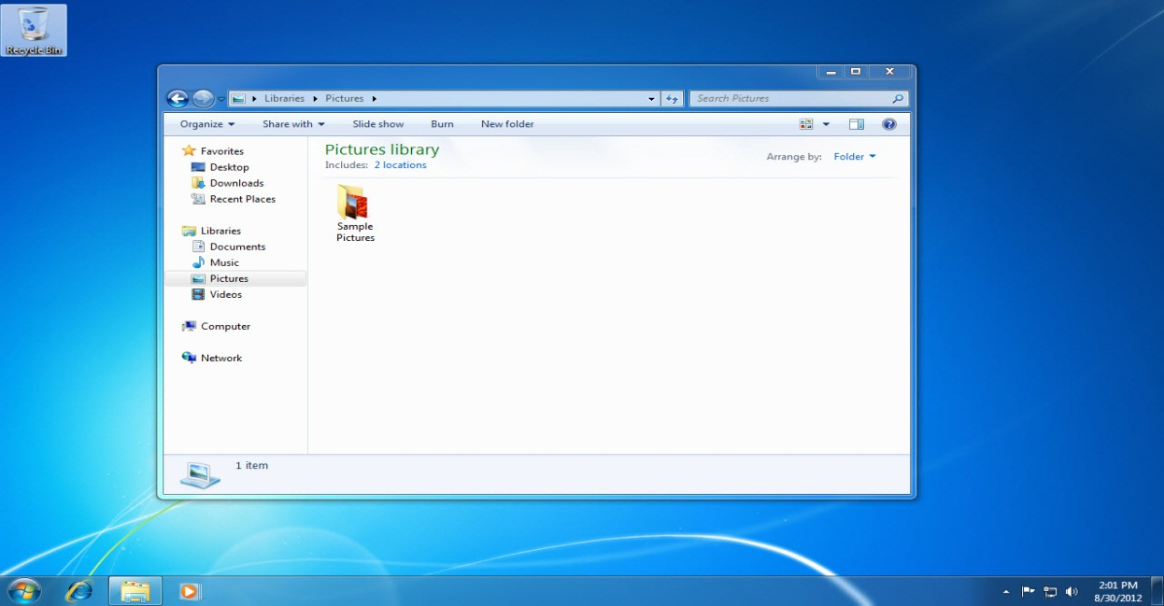
Managing Files and Folders
Chapter 2
Notes:
The second chapter in the Microsoft Windows 7 module deals with managing files and folders.

Slide 3
Skills You Learn
Use Windows Explorer
Copy a folder from the Student Resources CD
Create a folder
Rename files and folders
Compress and extract files
Search for files
Delete files and folders
Use the Recycle Bin
Notes:
In this chapter, you learn to manage the files and folders on your computer. You start to create a folder structure on
your removable USB flash drive that reflects the modules in this textbook by copying a folder from the Student Resources CD. As you work through this module and the other modules in the textbook, you will use this folder structure to organize your files.

Slide 4
Skill 1: Use Windows Explorer
With the desktop displayed, right-click the Start button.
Click Open Windows Explorer to open the Windows Explorer window.
Double-click Pictures in the Libraries section of the Navigation pane.
The path in the Address bar changes to show that you are viewing the Pictures library.
The Details pane shows how many items are in the Pictures library.
Click the View button arrow on the toolbar.
Notes:
Windows Explorer is the file management interface in Windows 7. A Windows Explorer window lets you view the folders and files in a selected storage location, such as your hard drive, DVD drive, server, or removable USB drive. Features of a Windows Explorer window include a Navigation pane, an Address bar, a toolbar, a Search box, and a Details pane.

Slide 5
Skill 1: Use Windows Explorer, continued
Click Details to display details about each file, including its size and date last modified, in the Windows Explorer window.
Click the View button and return your computer to its original setting if you made a change to the setting in Step 7.
Click Desktop in the Favorites section in the Navigation pane to display desktop files and folders.
Click the Back button to redisplay the Pictures library.
Close the Windows Explorer window.

Slide 6
Address bar
Back button
View button arrow
Libraries section
Details pane
Notes:
Notice the path in the Address bar shows that you are viewing the Pictures library. The Details pane shows how many items are in the Pictures library. The Pictures library on your computer will contain different files from those shown.
Libraries are a structure for organizing and managing your files in Windows 7. They are similar to folders, but different in that a library gathers together files that may be stored in several locations on your computer.
Return your computer to its original setting by clicking the View button in the Windows Explorer window.

Slide 7
Browsing a Location When a Windows Explorer window opens, the Address bar displays the current location, such as the Pictures library.
Notes:
The path to reach the current location is shown on the Address bar as links with arrows between them, for example, Libraries → Pictures. You can jump to a location by clicking its name in the Address bar or you can jump to other locations in the path by clicking the arrow to the right of a link. For example, clicking the arrow to the right of Libraries displays a menu that lists all of the available libraries. Click a library in the displayed menu to jump to that location.

Slide 8
Skill 2: Copy a Folder from the Student Resources CD
Click the Start button.
Click Computer to display the Windows Explorer window. This window displays all of the storage locations on your computer.
Double-click the disk drive, which displays as Guidelines-Student-Resources, in the Content pane.
Click the Module2-Windows folder in the Content pane.
Click the Organize button on the toolbar.
Notes:
Some of the work you do in this course involves opening student data files. These files are organized by module in folders on the Student Resources CD. The first page of each module in this book, provides (when necessary) instructions for copying the folder you need from the CD to your storage medium. In this skill, you practice this procedure using a USB flash drive.

Slide 9
Skill 2: Copy a Folder, continued
Click Copy in the drop-down list.
Click the Back button.
Double-click the removable disk drive that corresponds to your USB flash drive in the Content pane.
Click the Organize button on the toolbar.
Click Paste in the drop-down list.
Close the Windows Explorer window.

Slide 10
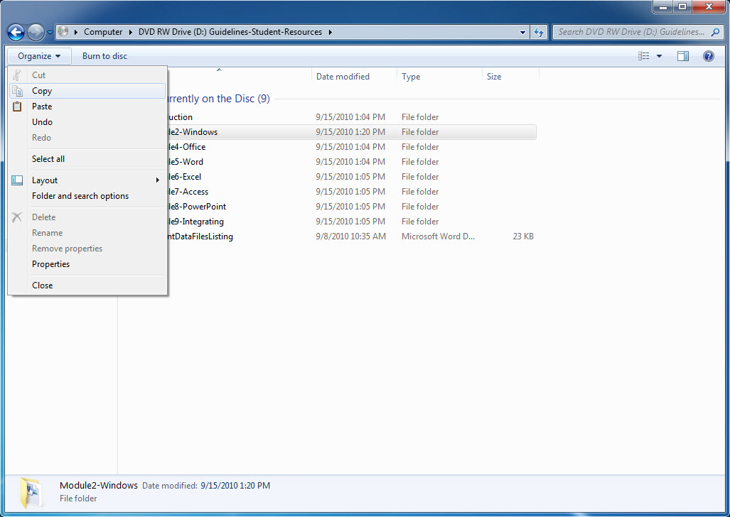
Back button
Copy
Paste
Notes:
Here you see the copy and paste buttons displayed.

Slide 11
Copying Folders Another Way Folders can also be moved and copied by using the drag-and-drop method. With both folders visible on the screen, you can drag a folder from one window to another.
Notes:
This method will either copy or move the folder, depending on the destination location. If you drag the folder to a different disk location, the folder will be copied. If the new folder location is on the same disk, the folder will be moved.

Slide 12
Skill 3: Create a Folder
With your USB flash drive inserted and the desktop displayed, click the Start button to display the Start menu.
Click Computer to display the Windows Explorer window.
Double-click the removable disk drive to see the list of files or folders saved there.
Click the New folder button on the toolbar to create a new folder.
Type a folder name and press Enter.
Double-click the new folder, which is currently empty.
Click the Back button.
Close the Windows Explorer window.
Notes:
Just as you store printed documents that relate to each other in a single manila folder, you can store related computer files in virtual folders. For example, you might want to make a folder called Job Search to store your resume, cover letters, and portfolio documents. You can create a folder in a Windows Explorer window. Once you create the folder, you can save or move files to the folder.

Slide 13
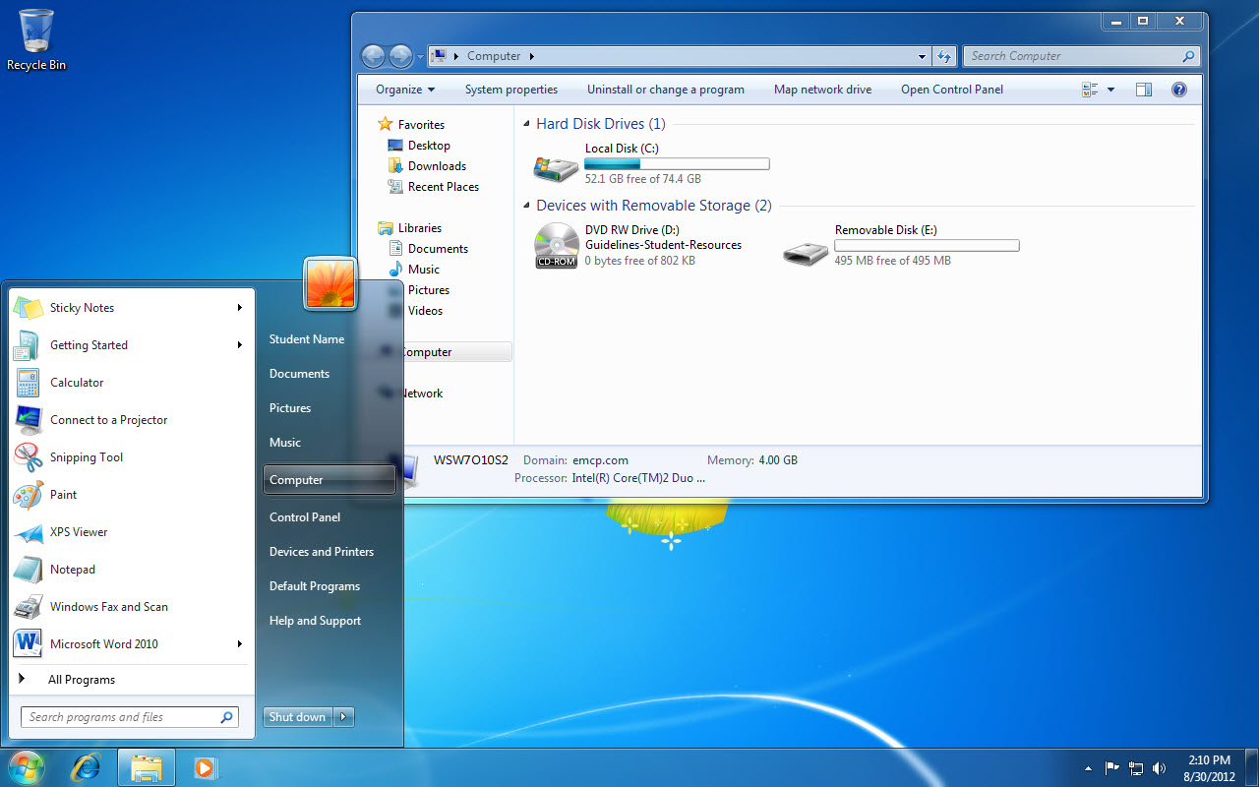
Removable Disk drive
Computer
Notes:
Here you see the Removable Disk drive listed in the Windows Explorer window.

Slide 14
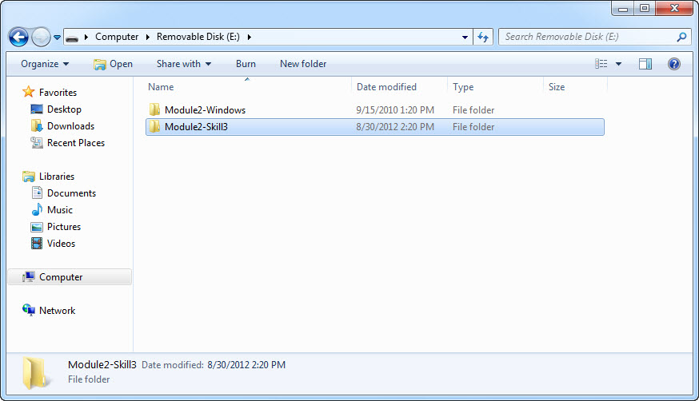
New folder button
Notes:
Create a new folder by clicking the New folder button on the toolbar.

Slide 15
Creating a New Library By default, Windows has four pre-defined libraries (Music, Pictures, Documents, and Video). You can create additional libraries from the Windows Explorer window by clicking the New Library button.
Notes:
A new library appears with its name open for editing. Type a unique name for your library. Remember, a library is different from a folder in that it is a place to compile like types of files. To set the library type, right-click the new library and in the dialog box that appears, click Optimize this Library for and choose a type from the list. For example, if you want to use the new library for podcasts, Music would be a good fit because it would include audio files. Use the Include a Folder button and choose changes.

Slide 16
Skill 4: Rename Files and Folders
With your USB flash drive inserted and the desktop displayed, click the Start button and then click Computer.
Double-click the removable disk drive to see the list of files or folders already saved to your USB flash drive.
Right-click a folder to display the Shortcut menu.
Click Rename. At this point the folder name becomes available for editing.
Type a new folder name and press Enter. The folder is renamed.
Make sure the new folder is selected and then click the Organize button on the toolbar to display the menu.
Click Rename to make the folder name available for editing.
Type a new name and press Enter. The folder is renamed.
Close the Windows Explorer window.
Notes:
You may need to rename a file or folder after you create it. File and folder names can be up to 255 characters in length and can include spaces. Certain characters, including \ / : * ? ” < > |, cannot be used in file and folder names. File names have an extension, such as .docx, which the computer program adds automatically when the file is saved. You should not change the file extension when you rename a file because the extension tells the computer which application to use to open the file.

Slide 17
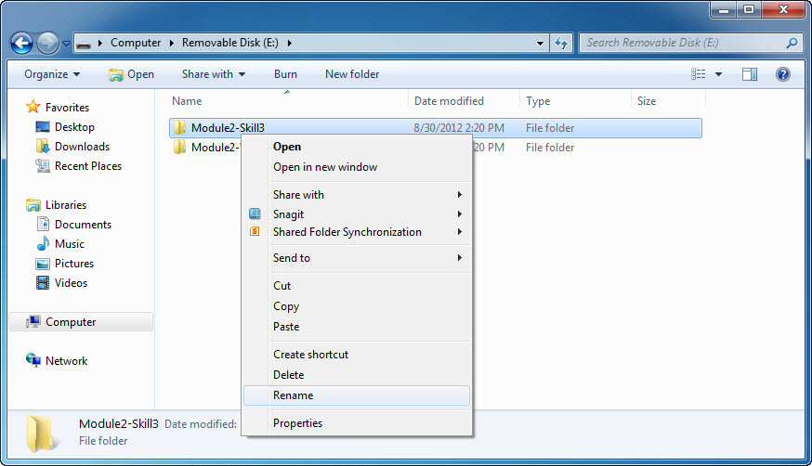
Selected folder
Shortcut menu
Notes:
Right-click the folder to display the shortcut menu and click Rename. At this point, the folder will be available for renaming.

Slide 18
Renaming Multiple Files If you want to rename a series of files, such as photo files (.jpg) from a digital camera, you can do so quickly if you use a specific prefix to name each of the files.
Notes:
For example, you could use the prefix photo to rename a batch of files photo(1).jpg, photo(2).jpg, photo(3). jpg, photo(4).jpg, and so forth. To do so, in a Windows Explorer window, hold down the Ctrl key and click each file you want to rename. Press the F2 key, type the prefix you will use to rename the files, and then press Enter. The computer automatically adds the parenthetical numbers after your prefix to differentiate the files.

Slide 19
Skill 5: Compress and Extract Files
With your USB flash drive inserted, click the Start button and then click Computer.
Double-click the removable disk drive to see the list of files or folders already saved there.
Right-click the Module2-Windows folder to display a shortcut menu.
Point to Send to and click Compressed (zipped) folder. The zipped folder appears with a folder icon with a zipper image on it.
Double-click the zipped Module2-Windows folder.
Notes:
If you have large files that you need to email or transfer to another computer, you may want to first compress, or zip, the files. Compressed, or zipped, files take up less storage space and can be transferred to other computers more quickly than uncompressed files. Folders can also be compressed. Compressing a folder combines all of the files in the folder into a single compressed file, which is smaller in size than the total of the individual file sizes.

Slide 20
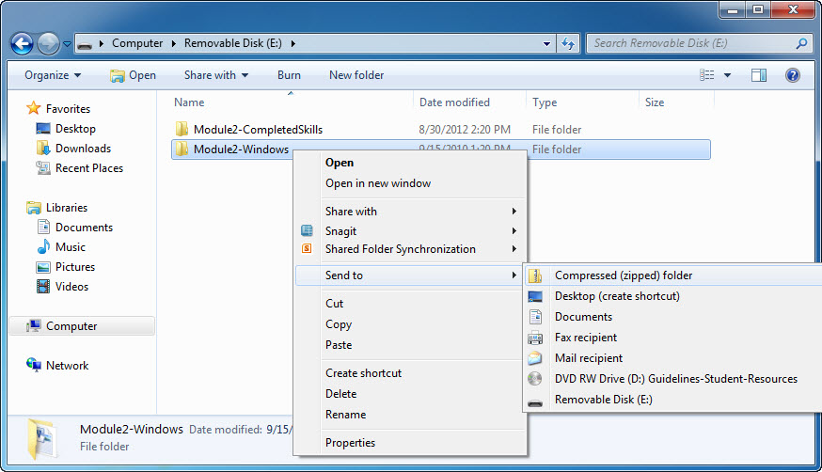
Selected folder
Send to option
Notes:
Here you see a shortcut menu displayed by right-clicking the selected folder. Point to Send to and click Compressed (zipped) folder. Be aware that you will probably hear both terms, compressed and zipped, used to describe such files.

Slide 21
Skill 5: Compress and Extract Files, continued
Click the Extract all files button on the toolbar to open the Extract Compressed (Zipped) Folders dialog box.
Click the Browse button.
Browse to the Module2-CompletedSkills folder on your USB flash drive and click it.
Click the OK button.
Click the Extract button. When the Module2-CompletedSkills folder window opens, the compressed folder has been extracted and is located within the Module2-CompletedSkills folder.
Close the two open windows.
Notes:
In order to edit a compressed file, you must first extract the files. Extracting essentially means to reverse the process, or to uncompress or unzip the file once you are ready to use it.

Slide 22
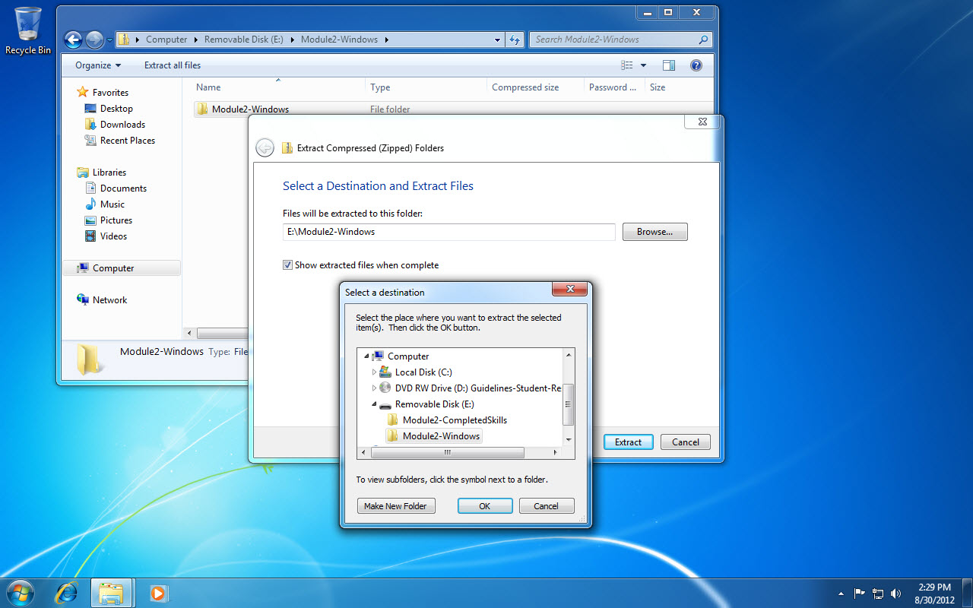
Extract all files button
Select a destination box
Extract button.
Notes:
To open the Extract Compressed (Zipped) Folders dialog box, click the Extract all files button on the toolbar. Open the Select a destination box by clicking the Browse button. Browse to the destination folder on your USB flash drive and click it. Many compressed files have a .zip extension. Others have an .rar extension or other special extension, depending on the compression application used.

Slide 23
Displaying File Extensions In a default Windows Explorer window, file extensions are not displayed. However, some users prefer to have Windows display file extensions.
Notes:
To turn on the display of file extensions, click the Organize button in a Windows Explorer window and select Folder and search options. Click the View tab and then click the check mark in the Hide extensions for known file types check box to display extensions.

Slide 24
Skill 6: Search for Files
With your USB flash drive inserted and the desktop displayed, click the Start button and then click Computer.
Double-click the removable disk drive name in the Navigation pane.
Click the Search Removable Disk box and type your search criteria. Search results display in the window.
Click the Clear button next to the Search box.
You can also search for file extensions in the Search Removable Disk box.
Click the Clear button next to the Search box.
Close the Windows Explorer window.
Notes:
You can use the Search box in a Windows Explorer window to quickly locate a specific file or folder. When you type a file or folder name in the Search box, Windows searches the currently open Windows Explorer window for a match. If you want to search a different location, use the Navigation pane to change the search location. For example, to search your USB drive, click Removable Disk in the Computer category in the Navigation pane and then enter the file or folder name in the Search box.

Slide 25
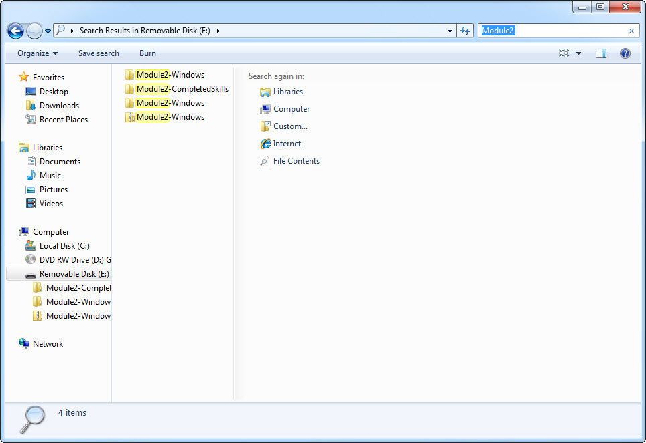
Search Removable Disk box
Clear button
Navigation pane
Notes:
The asterisk (*) is a wildcard that can be used to specify any combination of characters. In this case, you are searching for all files with a .zip file extension because * tells the computer to retrieve files with any name appearing to the left of the .zip extension.

Slide 26
Repeating a Search and Using Search
Filters When you click in a Search box in a Windows Explorer window, previous searches are displayed in a drop-down list. You can click a previous search to repeat it.
Notes:
The drop-down list also contains filter categories, such as Date modified, that you can use to refine your search. For example, if you know that you updated a particular file last Tuesday or Wednesday, you can click the Date modified filter category and then click a date or date range to narrow the search for files or folders that were saved on a specific date or within a specific date range.

Slide 27
Skill 7: Delete Files and Folders
With your USB flash drive inserted, click the Start button and then click Computer.
Double-click the removable disk drive name in the Navigation bar.
Right-click the zipped Module2-Windows folder to display a shortcut menu.
Click Delete.
At the warning dialog box, click Yes. The Module2-Windows.zip file is deleted.
Notes:
If you have files that you no longer need on your computer, you should delete them. Regularly deleting such files will help keep your files organized and free up disk space. You can also delete a folder. When you delete a folder, all of the files and folders within that folder are deleted. Be sure to look within all subfolders to remind yourself of the complete contents before deleting the outer folder.

Slide 28
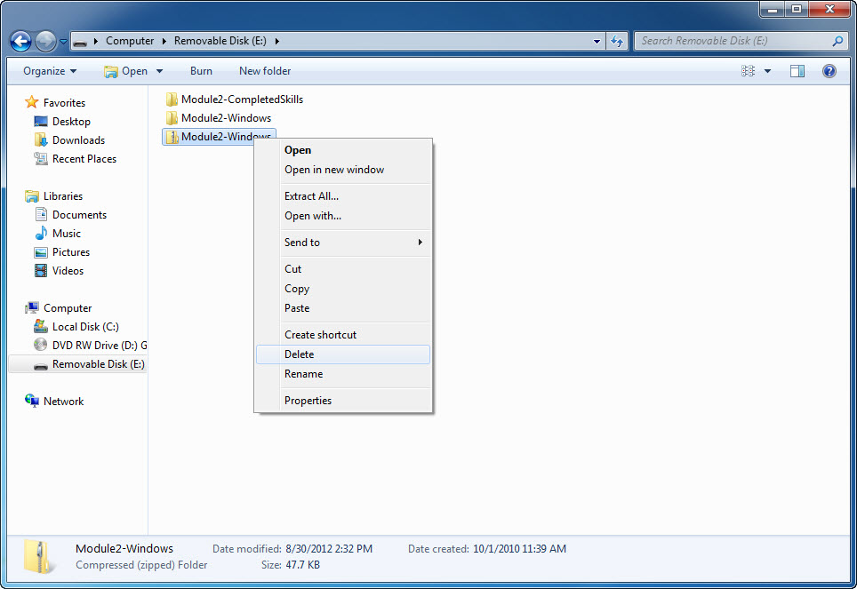
Selected folder
Delete option
Notes:
Here you see a shortcut menu displayed by right-clicking the selected folder. To delete the folder, click Delete. At the warning dialog box, click Yes. The folder is deleted. You can also use the Delete key on your keyboard to delete a folder or file.

Slide 29
Deleting Multiple Files You can delete
multiple files by first selecting them.
Notes:
If you want to delete a series of files listed one after the other, select those adjacent files by clicking the first file and then holding down the Shift key while clicking the last file. Select nonadjacent files by clicking the first file and then holding down the Ctrl key while clicking the other files. Once you’ve selected several files, click the Organize button and then click Delete in the drop-down menu. Alternatively, once you have selected the files, you can press the Delete key to delete those multiple files.

Slide 30
Skill 8: Use the Recycle Bin
With your USB flash drive inserted, click the Start button and then Computer.
Double-click the removable disk drive.
Double-click the file you wish to delete in the Content pane.
Drag the file onto your desktop.
Right-click the file on the desktop and click Delete. A warning dialog box displays.
Notes:
In Windows 7, when you delete a file from the hard drive, it does not, in fact, get deleted. It is instead moved to the Recycle Bin. The Recycle Bin is a temporary holding area for deleted files and folders. The Recycle Bin protects you from accidental loss of files because, if you change your mind about deleting the file that was stored on your hard drive, you can restore it back to its original location. When you are absolutely sure the file is no longer needed, you can empty the Recycle Bin. The Recycle Bin stores deleted files until it runs out of storage space. Then it will start deleting files, beginning with the files that have been in the bin the longest.

Slide 31
Skill 8: Use the Recycle Bin, continued
At the warning dialog box, click Yes to send the file to the Recycle Bin.
Click the Show desktop button.
Double-click the Recycle Bin icon to open the Recycle Bin window.
Locate and then click the file you just deleted in the Recycle Bin window.
Click the Restore this item button on the toolbar. Notice that the file is restored to its previous location on your desktop.

Slide 32
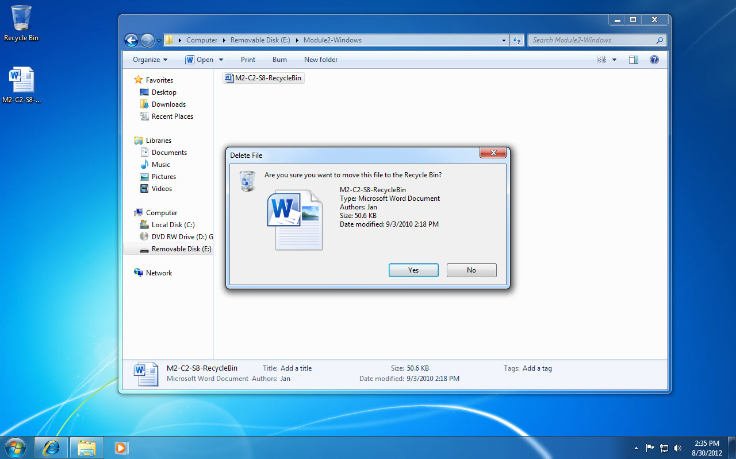
A word file on your desktop
Delete File confirmation box
Notes:
When you delete a file or folder that is saved on a removable disk, it is not sent to the Recycle Bin. It is permanently deleted.

Slide 33
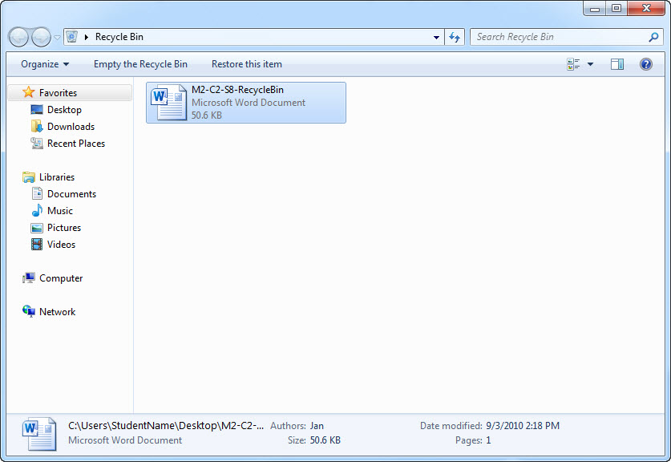
Restore this item button
Recycle Bin window
Notes:
The Recycle Bin displays on the desktop by default. If the icon is not on your desktop, right-click the desktop, click Personalize, click Change desktop icons, and then click the Recycle Bin check box. You may not be able to personalize the desktop in a public lab.

Slide 34
Adjusting the Recycle Bin Properties The
maximum storage size of the Recycle Bin can be adjusted by right-clicking the Recycle Bin icon, clicking Properties, then entering a different number in the Maximum size box.
Notes:
You can also turn the Recycle Bin off (although doing so is not recommended) by selecting the option Don’t move files to the Recycle Bin. Remove files immediately when deleted.

