Slide 1
Microsoft® Windows 7
MODULE 2
Chapter 1: Navigating around Windows
Chapter 2: Managing Files and Folders
Chapter 3: Working with Windows Settings, Gadgets, and Accessories
Notes:
In Module 2, you learn about Microsoft Windows 7. Chapter 1 covers navigating around Windows. Chapter 2 deals with managing files and folders. In Chapter 3, you work with Windows settings, gadgets, and accessories.

Slide 2
Microsoft Windows 7 Overview
Windows 7 is an operating system.
The operating system performs basic tasks.
How did Windows get its name?
Earlier operating systems
Learning how to manage files and folders
Control Panel component
Utility programs
Notes:
Your computer must have an operating system installed before it can function and before you can install other application programs, such as Microsoft Word.
The basic tasks include recognizing input from the keyboard and the mouse, sending output to the monitor, keeping track of saved files and folders, and controlling disk drives and printers. Microsoft chose the term windows to describe the graphical user interface (GUI) that it developed for use on personal computers. Earlier operating systems had used word-based commands. With Windows (as with Apple’s Mac OS that came before it), users worked within a window-like frame that included pull-down menus, icons, and dialog boxes. All of these features were designed to create a simple way for users to interact with computers.
Much of the work you do on a computer involves creating a document or some other kind of file that you want to save for reference or for later use. Your computer’s operating system provides the tools for organizing files into folders and for copying, moving, or deleting files and folders. Windows 7 offers a Control Panel component where you can add or remove printers and other hardware devices. You can also change the screen resolution, change the date and time settings, and uninstall programs. If you have any visual or hearing impairments, you can request that Windows suggest the best settings choices.
With a Windows 7 installation, several handy utility programs are installed and stored in the Accessories folder. Notepad and WordPad, for example, perform basic word processing functions. With the Snipping Tool, you can create screen captures (images) of parts of a screen. Windows Explorer offers file and folder management features.
Understanding what an operating system does and learning to use some of the Windows 7 tools and features will help you to become a more productive and efficient computer user.

Slide 3
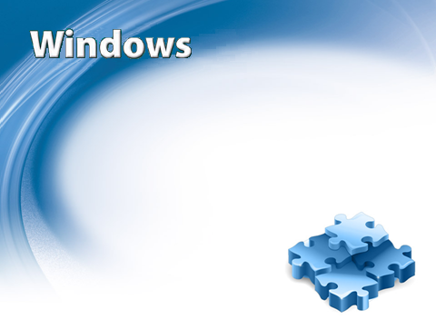
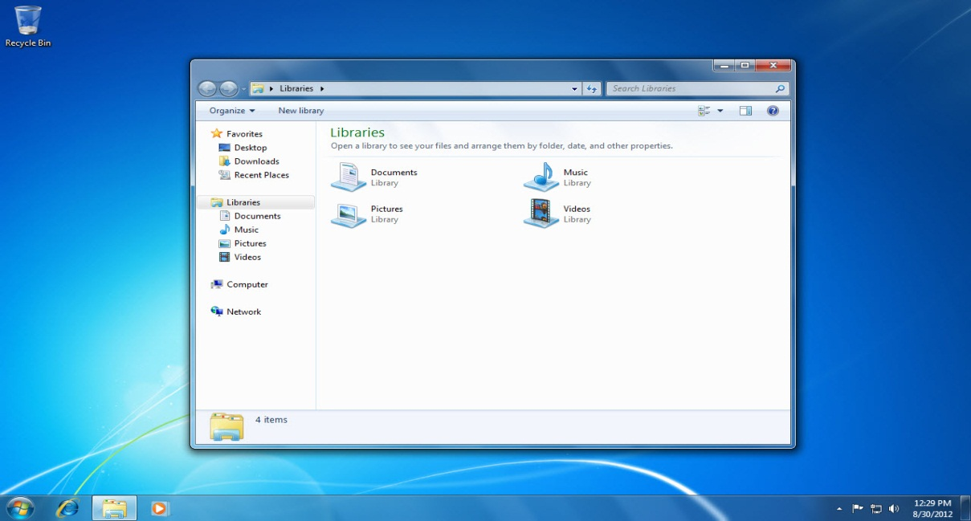
Navigating around Windows
Chapter 1
Notes:
The first chapter in the Microsoft Windows 7 module deals with navigating around Windows.

Slide 4
Skills You Learn
Start and log on to Windows 7
Work with a pointing device
Work with tools on the Taskbar
Open and close programs
Manipulate windows
Move among open windows
Work with menus and toolbars
Use keyboard shortcuts
Make selections in dialog boxes
Shut down or put Windows to sleep
Notes:
In this chapter, you gain an understanding of what an operating system does and learn how to use some of the Windows 7 tools and features. You learn what to do when you are finished working on your computer for the day. You also become familiar with the applications, such as Internet Explorer and Notepad, that come with the Windows 7 operating system.

Slide 5
Skill 1: Start and Log on to Windows 7
Turn on your computer. The Windows introductory screen displays. (If the desktop displays immediately, skip to Step 5.)
Click the appropriate user icon (if user icons display).
Type your user name and password in the text boxes (if required).
Press Enter or click the arrow button to the right of the text box. The desktop displays.
Click the Start button in the lower-left corner of your screen. The Start menu appears, displaying a list of applications you can launch by clicking on the appropriate icon. Click a blank area of the desktop to close the Start menu.
Move your mouse to the bottom of the screen, just to the right of the Start button. This horizontal band is called the Taskbar, containing program icons you can click to open programs.
Move your mouse over the far right area of the Taskbar. This is the notification area, containing button icons and showing the status of certain system functions, such as speakers, network connections, and battery power for a laptop. Leave your desktop displayed.
Notes:
When you turn on a Windows-based computer, the operating system starts up automatically. If you have set up separate users for the computer, an introductory screen displays where you can click an icon to log on, entering a password if required. If your computer is connected to a network, you may also be asked to enter a network password.
If only one user is set up on the computer and that user has no password, the desktop displays when the user turns on the computer. Once the windows desktop displays, you can access all your files and applications from the desktop. Note: Check with your instructor if you have problems logging in.
The desktop also contains icons for tools and features similar to what you might find on a typical work desk, such as a clock and a calendar. You will become familiar with the desktop interface as you complete the steps in this slide.

Slide 6
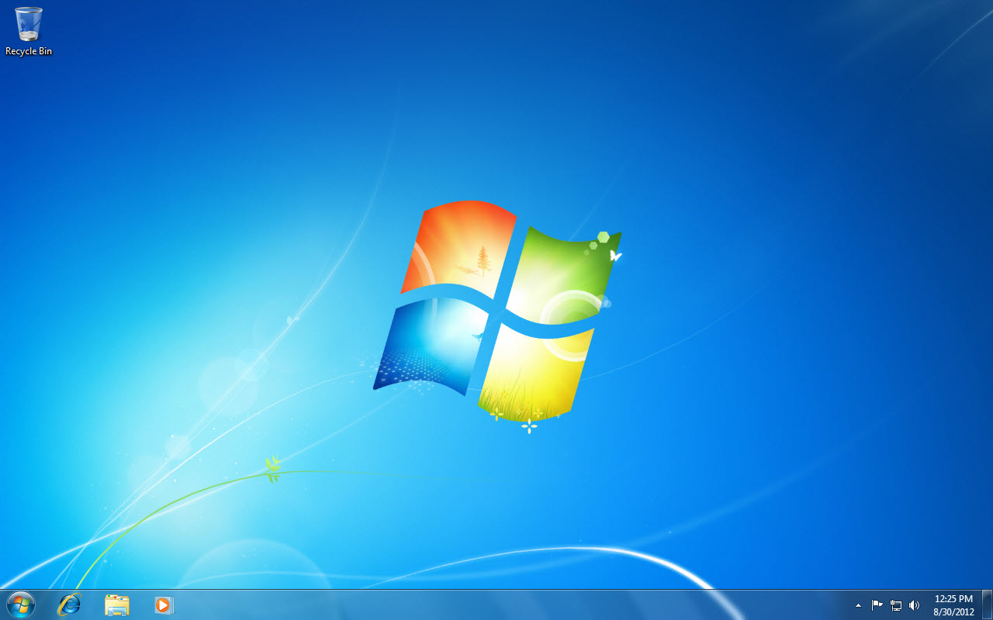
The Start button
The Taskbar
The notification area
Notes:
Passwords in Windows 7 are case sensitive, meaning that the computer “sees“ an uppercase A and a lowercase
a as different characters.

Slide 7
Skill 2: Work with a Pointing Device
With the desktop displayed, move the mouse around on top of the mouse pad or other surface to move the pointer around the screen.
Move the pointer over the current time and date in the notification area of the Taskbar. The current date displays in a ScreenTip.
Move the mouse pointer to the Recycle Bin icon to highlight and display a ScreenTip explaining the function of the icon.
Right-click (press the right mouse button) the Recycle Bin icon to display a short-cut menu.
Click in a blank area of the desktop to close the menu.
Double-click the Recycle Bin icon. A window opens, displaying a list of files and folders you have deleted. You can still retrieve files or folders if you need to use them, because they remain in the bin until you permanently delete them.
Click the Close button (red X) in the top-right corner of the Recycle Bin window to close it.
Notes:
The mouse is a type of input device typically referred to as a pointing device. Input devices are used to communicate with an application. You can use the mouse to identify the names and functions of buttons, icons, and other desktop locations; select commands, text, and objects; and respond to application prompts. The mouse pointer commonly takes the shape of an arrow, but it changes shape depending on the task. Usually, you click the left mouse button once to select a command within a menu. For some features or tools, you double-click an icon to open a menu or window. You can display a short-cut menu by moving your mouse over a button or icon and clicking the right mouse button. Some mice have a scroll wheel on top for scrolling through a file.
Tip: Laptop computers include a touchpad, which can be used instead of a mouse. Drag your finger on the touchpad to move the mouse pointer.

Slide 8
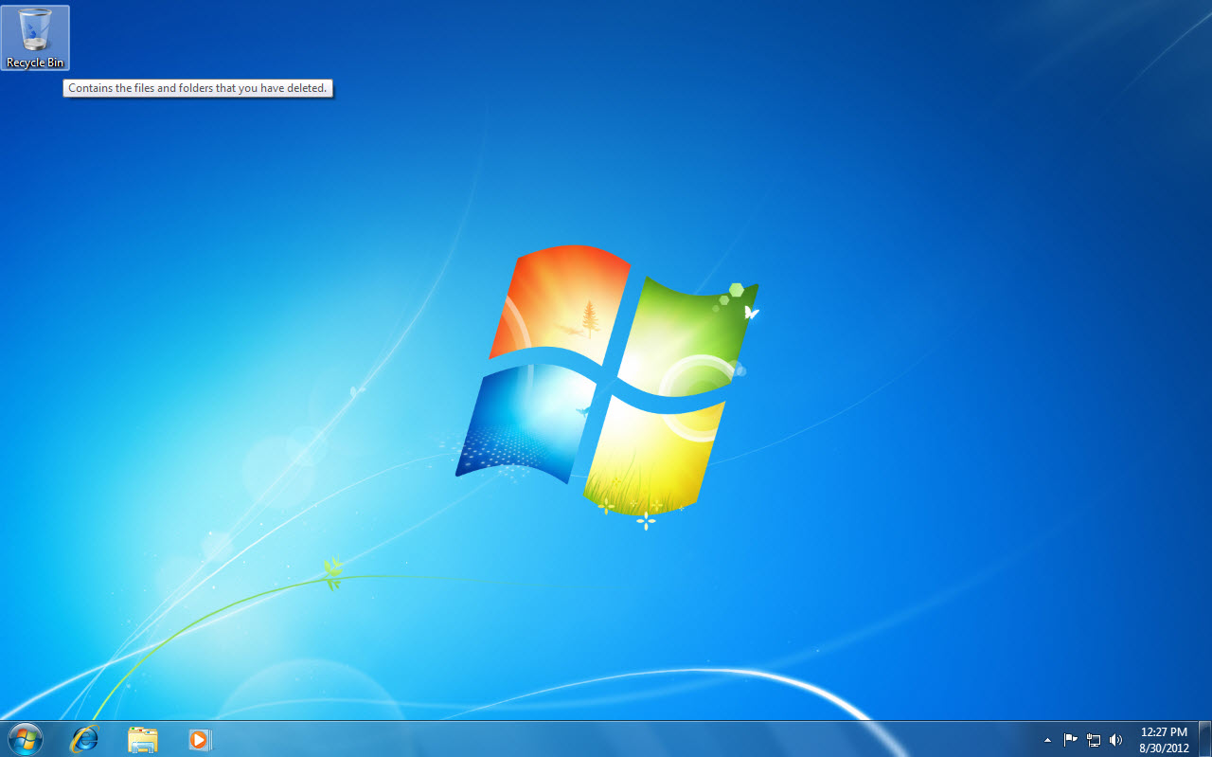
Recycle Bin icon
Notes:
When the mouse pointer is moved over the Recycle Bin icon, a ScreenTip appears explaining the function of the icon. ScreenTips provide the name of the item and sometimes include a brief description of what the item does.

Slide 9
Close button
Notes:
When you double-click the Recycle Bin icon, a window opens, which displays a list of files and folders you have deleted. You able to retrieve files or folders if you need to use them, because they remain in the bin until you permanently delete them. Close the Recycle Bin window by clicking the Close button (red X) in the top-right corner of the Recycle Bin window. Permanently delete the contents of the Recycle Bin by clicking Empty Recycle Bin in the Recycle Bin shortcut menu.

Slide 10
Reviewing Mouse Technology You’ll find
many types of mouse devices.
Notes:
A traditional mouse has a trackball that you roll on a flat smooth surface to move the mouse pointer. This type of mouse works best with a mouse pad. Newer mouse types use technologies such as optical sensors, infrared light, radio signals, and Bluetooth to eliminate the need for trackballs, cords, and mouse pads.

Slide 11
Skill 3: Work with Tools on the Taskbar
With the desktop displayed, click the Start button to open the Start menu.
Click a blank area of the desktop to close the Start menu.
Click the pinned Windows Explorer button in the task buttons area on the Taskbar to open the Windows Explorer window and view your Libraries. (Libraries are discussed in Chapter 2.)
Click the Close button in the Libraries window.
Click the Speaker button in the notification area on the Taskbar to display the Speaker volume controls.
Press the left mouse button and drag the speaker volume control lever to the mid-point mark on the bar (50), releasing the mouse button to set the level there.
Notes:
The Taskbar along the bottom of the desktop contains the Start button. Just to the right of the Start button are program icons that are pinned to the Taskbar. A pinned icon is always displayed on the Taskbar, and you can open the associated program by clicking on such icons.

Slide 12
The Speaker icon
Windows Explorer button
Notes:
Open the Start menu by clicking the Start button. Close the Start menu by clicking in a blank area of the desktop. Open the Windows Explorer window and view your Libraries by clicking the pinned Windows Explorer button in the task buttons area on the Taskbar. Close the Windows Explorer window by clicking the Close button in the upper right hand corner of the Libraries window.
Open the speaker volume control menu by clicking on the Speaking icon. Press the left mouse button and drag the speaker volume control lever to the mid-point mark on the bar (50), and then release the mouse button to set the level there.
To pin a program to the Taskbar, right-click an open program icon on the Taskbar and select Pin this program to taskbar.

Slide 13
Skill 3: Work with Tools on the Taskbar, continued
Click the Action Center button (shaped like a small pennant) in the notification area on the Taskbar.
Review the information in the Action Center by clicking the Open Action Center link.
Close the Action Center window by clicking the Close button.
Click the current time and date in the Taskbar to display a calendar and clock.
Click the Show desktop button, a vertical bar at the right side of the Taskbar. Click this button to display the desktop at any time.
Notes:
Open applications also display an icon on the Taskbar. Another Taskbar area is the notification area, at the far right. Icons here show the status of certain system functions, such as the Action Center. The Action Center is a single area that displays important messages about security and maintenance settings.

Slide 14
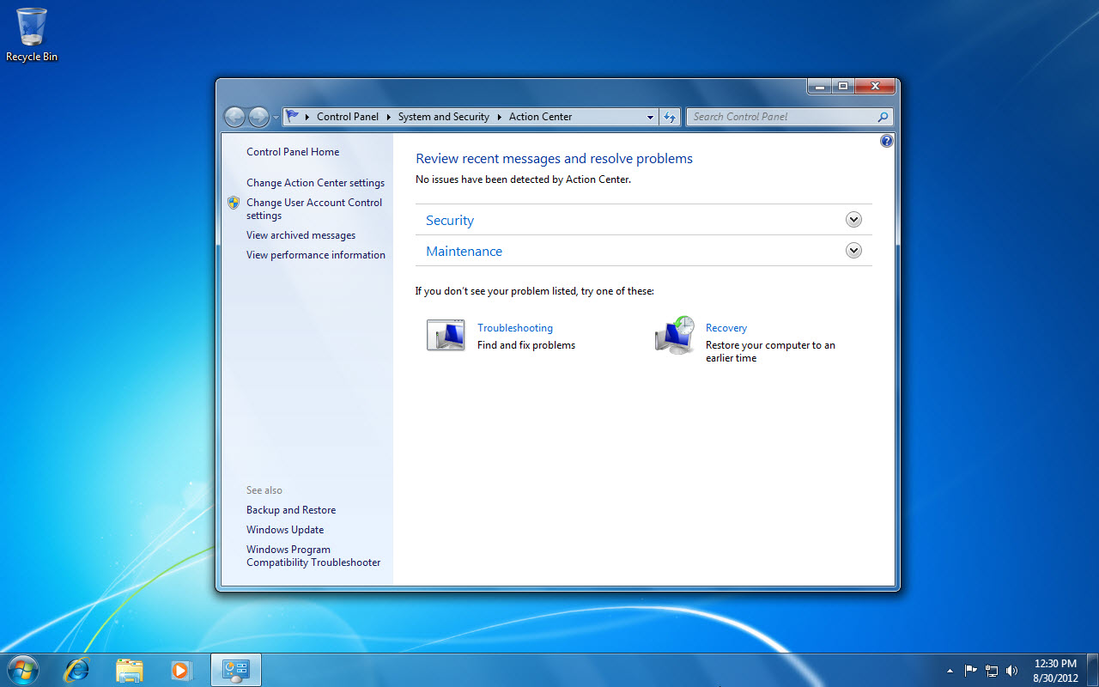
The Show desktop button.
The current time and date
The Action Center Start button
Notes:
Click the Action Center button (shaped like a small pennant) in the notification area on the Taskbar, and review the information in the Action Center by clicking the Open Action Center link. Close the Action Center window by clicking the Close button.
Display a calendar and clock by clicking the current time and date in the Taskbar.
Display the desktop at any time by clicking the Show desktop button, a vertical bar at the right side of the Taskbar.
To change the date and time, click the Change Date and Time Settings link.

Slide 15
Changing Notification Area Icons You
can add as many icons as you like to the
notification area of the Taskbar.
Notes:
To avoid clutter, display only those icons you want visible at all times. Keep the rest of the icons in the overflow area, which you can display by clicking the Show Hidden Icons button.

Slide 16
Skill 4: Open and Close Programs
Click the Start button to display the Start menu.
Click Microsoft Word 2010. The application starts and a button representing the open Word program appears on the Taskbar.
Click the Internet Explorer button on the Taskbar. Internet Explorer starts and the home page displays.
Click the Show desktop button on the Taskbar to display the desktop.
Double-click the Recycle Bin button on the desktop to open the Recycle Bin window.
Move the pointer over the Word button on the Taskbar to display a Live Preview thumbnail of the open Word window just above the Taskbar.
Notes:
The Start menu is one way to open programs or applications. Frequently used programs are displayed at the left side, or column, of the Start menu. You can click All Programs to view a menu of all of the programs installed on the computer. You can also start programs by double clicking a program icon on the desktop or clicking a program icon on the Taskbar. Programs open in an application window. Close a program by clicking the Close button (red X) in the upper-right corner of the window.

Slide 17
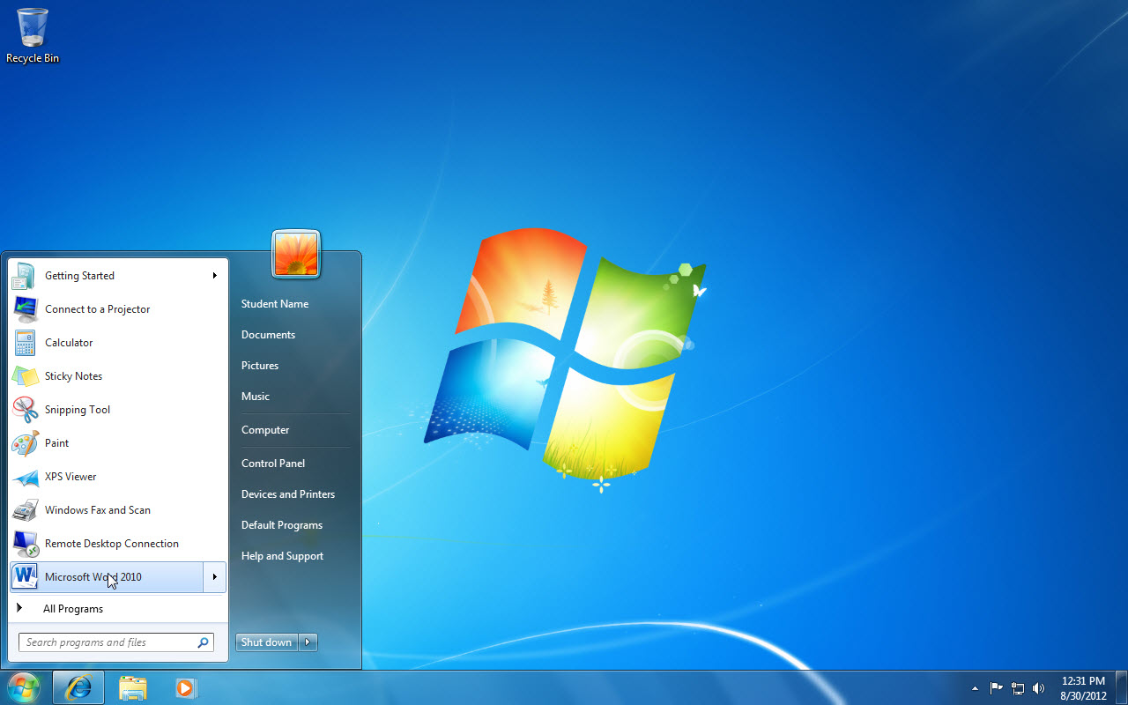
Start button
Microsoft Word 2010
Internet Explorer button
Notes:
Here you see that the Start menu has been displayed by clicking the Start button. Clicking on the Microsoft Word 2010 link in the Start Menu will open the application. A button representing the open Word program will appear on the Taskbar. Click the Internet Explorer button on the Taskbar and the home page displays. Display the desktop by clicking the Show Desktop button on the Taskbar.
Note: If Microsoft Word 2010 is not displayed in the list of frequently used programs on the left side of the menu, click All Programs, click Microsoft Office, and then click Microsoft Word 2010.

Slide 18
Skill 4: Open and Close Programs, continued
Click Document1 in the thumbnail preview to open the Word window.
Click the Close button to close Microsoft Word 2010.
Move the mouse back to the Recycle Bin window and click the Close button.
Hover the mouse pointer over the Internet Explorer button on the Taskbar to open the Live Preview thumbnail, hover the mouse pointer over the thumbnail until the Close button displays in the top-right corner, and then click the Close button. The Internet Explorer window closes.
Notes:
The Start menu is one way to open programs or applications. Frequently used programs are displayed at the left side, or column, of the Start menu. You can click All Programs to view a menu of all of the programs installed on the computer. You can also start programs by double-clicking a program icon on the desktop or clicking a program icon on the Taskbar. Programs open in an application window. Close a program by clicking the Close button (red X) in the upper-right corner of the window.

Slide 19
Close button
Word thumbnail
Notes:
Open the Word window by clicking Document1 in the thumbnail preview. Close Microsoft Word 2010 by clicking the Close button.
The Live Preview feature enables you to take a quick look at other open windows without clicking away from the window you are currently working in.

Slide 20
Using Jump Lists Jump Lists are a new Windows 7 feature. They display recent documents, tasks, or commands for a particular application.
Notes:
You can open a Jump List from the Taskbar or from the Start menu. For example, on the Taskbar, right-click the Internet Explorer button to display a list of frequently visited websites. Or right-click the Outlook button on the Taskbar to display a list of Outlook Tasks, such as New Contact. You then open items in a Jump List by clicking them. In the Start menu, click the arrow to the right of the program’s name to view the Jump List.

Slide 21
Skill 5: Manipulate Windows
Click the Internet Explorer button on the Taskbar. The Internet Explorer window opens and the home page displays.
Click the Minimize button to reduce the window to a button on the Taskbar.
Click the Internet Explorer button on the Taskbar to redisplay the window.
If the window does not currently fill the entire screen, click the Maximize button to enlarge the window size. The Maximize button turns into a Restore Down button when the window fills the entire screen.
Click the Restore Down button to reduce the size of the window.
Notes:
In the previous skill, you learned to open and close program windows. In this skill, you learn techniques for manipulating windows, including minimizing, maximizing, restoring, resizing, and moving windows. You will find these techniques useful when working with more than one window. For example, when you minimize a window, it is reduced to a button on the Taskbar. You can then work on other tasks without having to close the first program or file.

Slide 22
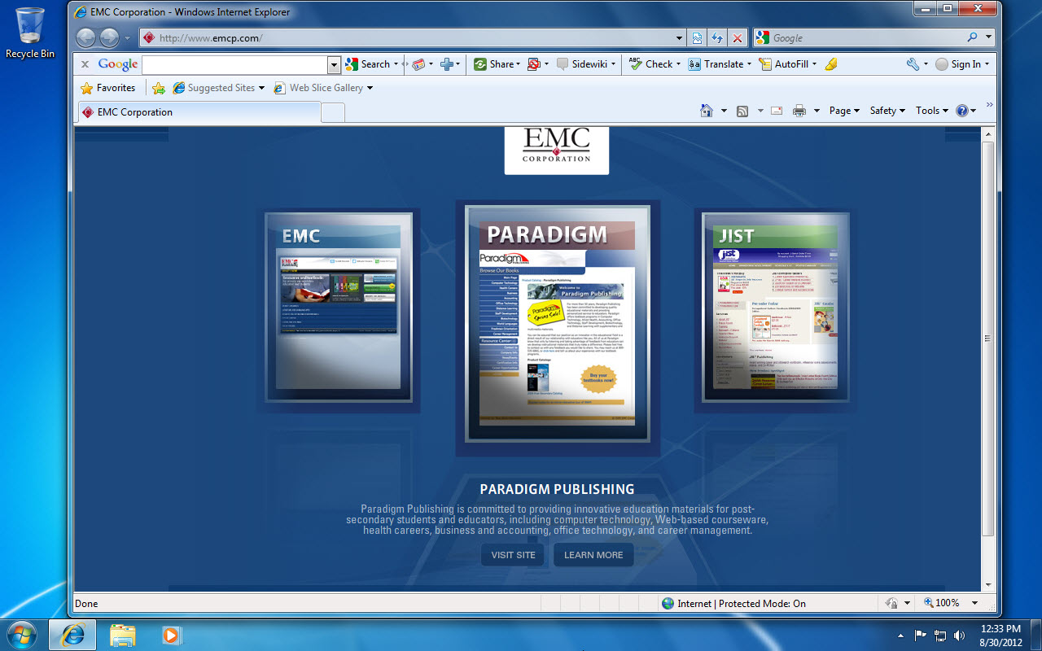
The Minimize button
The Maximize button
Notes:
Click the Internet Explorer button on the Taskbar and the home page displays. Reduce the window to a button on the Taskbar by clicking the Minimize button. Click the Internet Explorer button on the Taskbar to redisplay the window. If the window does not currently fill the entire screen, enlarge the window size by clicking the Maximize button.

Slide 23
Skill 5: Manipulate Windows, continued
Move the window slightly to the right by pressing the mouse button on the Title bar and dragging to the right.
Place your mouse pointer on the right window border and the pointer changes to a two-headed arrow. Resize the window to be smaller by pressing the mouse button on the window border and dragging to the left.
Place your mouse pointer on the bottom border of the window and the pointer changes to a two-headed arrow. Resize the window to be smaller by pressing the mouse button on the window border and dragging upward.
Click the Maximize button to increase the window size so it fills the screen.
Click the Close button to close the window.
Notes:
Maximizing a window increases the window to full-screen size so you can focus on that file or program. You can size and move windows that are not maximized so you can view other open windows at the same time.

Slide 24
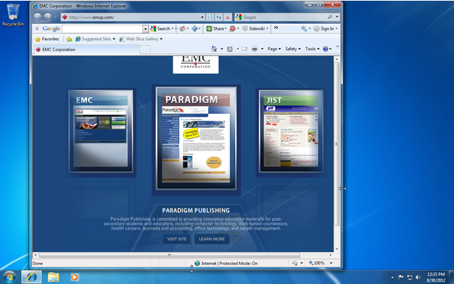
Title bar
Right window border
Bottom window border
Notes:
Move the window slightly to the right by pressing the mouse button on the Title bar and dragging to the right. Resize the window by placing your mouse pointer on the right window border and the pointer changes to a two-headed arrow. Resize the window to be smaller by pressing the mouse button on the window border and dragging to the left. Resize the window by placing your mouse pointer on the bottom border of the window and the pointer changes to a two-headed arrow. Resize the window to be smaller by pressing the mouse button on the window border and dragging upward.
Increase the window size so it fills the screen by clicking the Maximize button. Close the window by clicking the Close button.

Slide 25
Previewing Windows When you minimize a window, it is reduced to a Taskbar button or icon.
Notes:
The Taskbar button represents the minimized application. However, if you have two Word documents open and you minimize both of them, only one Word icon appears on the Taskbar. If you move your mouse over the Word button on the Taskbar, thumbnails of each minimized Word document appear. This new Windows 7 feature is called Live Preview. Click the thumbnail of the document you want to redisplay to open it. You can also close a document from the Live Preview feature by clicking the Close button (red X) that appears on a thumbnail in Live Preview.

Slide 26
Skill 6: Move among Open Windows
Click the Internet Explorer button on the Taskbar. The Internet Explorer window opens and the home page displays. If the window does not fill the entire screen, click the Maximize button to enlarge it.
Click the Windows Explorer button on the Taskbar to display your Libraries.
Right-click a blank area of the Taskbar to display the shortcut menu.
Click Cascade windows to display the Internet Explorer and Libraries windows in a cascade arrangement.
Right-click a blank area of the Taskbar to display the shortcut menu.
Notes:
You have probably noticed that Windows 7 lets you have more than one window open at a time and move among them. This flexibility is referred to as multitasking.

Slide 27
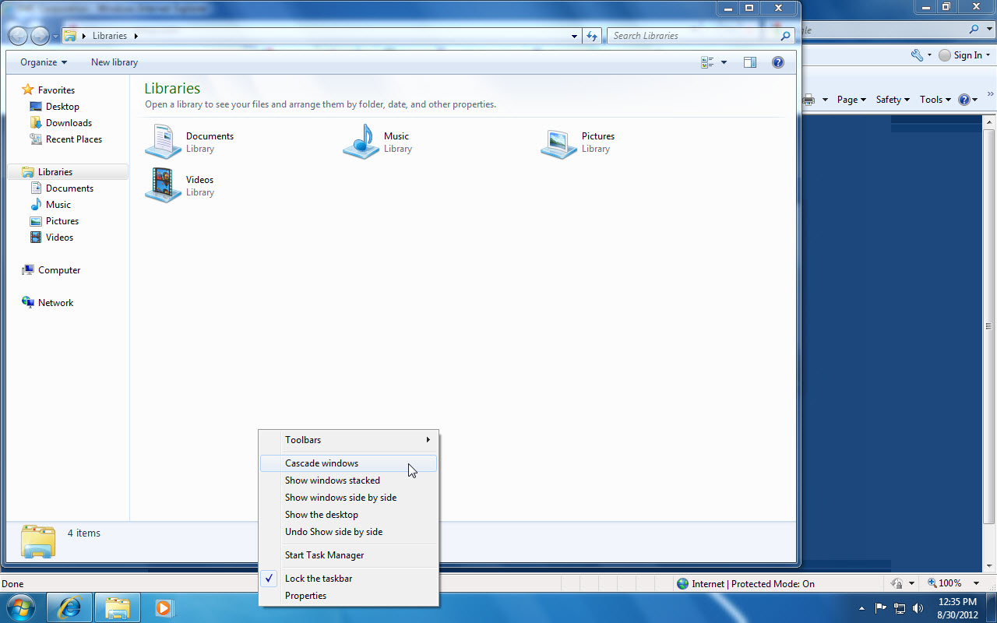
Shortcut Menu
Cascade windows option
Notes:
Click the Internet Explorer button on the Taskbar and the home page displays. Display your Libraries by clicking the Windows Explorer button on the Taskbar. To display the shortcut menu, right-click a blank area of the Taskbar. You can display the Internet Explorer and Libraries windows in a cascade arrangement by clicking Cascade windows.
Maximize the Internet Explorer window by clicking the Maximize button in the Internet Explorer window. The cascade arrangement only works with windows that are not minimized.

Slide 28
Skill 6: Move among Open Windows, continued
Click Show windows side by side to display the windows in a side-by-side arrangement.
Click the Maximize button in the Internet Explorer window.
Right-click the Windows Explorer button on the Taskbar.
Click Close window to close the Libraries window.
Click the Close button to close the Internet Explorer window.
Notes:
Knowing the techniques available to move among open windows can help you to manage your workload more efficiently.

Slide 29
Shaking Windows Windows 7 includes some new features for manipulating windows. One such feature is called Shake.
Notes:
To experiment with Shake, open at least three windows and use the Restore Down button to reduce the size of all three windows. Pick one of the windows and then press and drag that window side to side quickly. All of the open windows minimize except the one you are “shaking.” This feature provides a quick way to minimize multiple windows.

Slide 30
Skill 7: Work with Menus and Toolbars
Click the Windows Explorer button on the Taskbar.
Click the Organize button to display a menu.
Point to Layout to display a submenu.
Click the Close button to close the Libraries window.
Click the Start button in the Taskbar.
Click in the Search programs and files box and type Notepad. Notepad appears in the Programs list.
Click Notepad to display the Notepad window.
Notes:
In Windows 7 and other applications, you work with a variety of menus and toolbars. You can display shortcut menus by right-clicking an item on the screen. You can display other menus by using the keyboard. Still others display when you click a drop-down list or toolbar button.

Slide 31
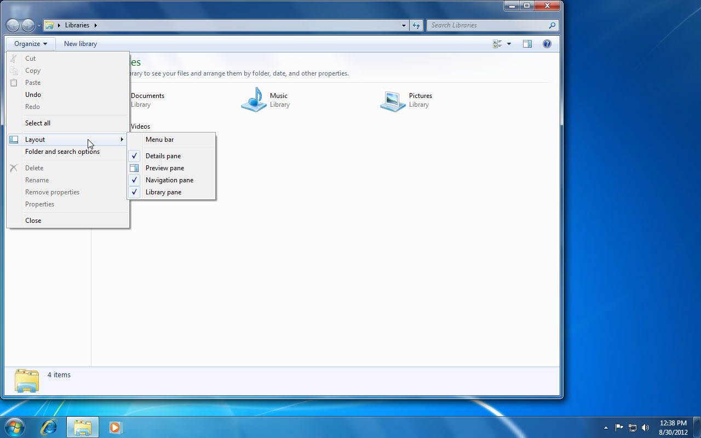
Organize button
Layout
Notes:
Here you see that a menu is displayed by clicking the Organize button. Display a submenu by pointing to Layout. When you point to a menu option that also contains a small arrow, a submenu appears.

Slide 32
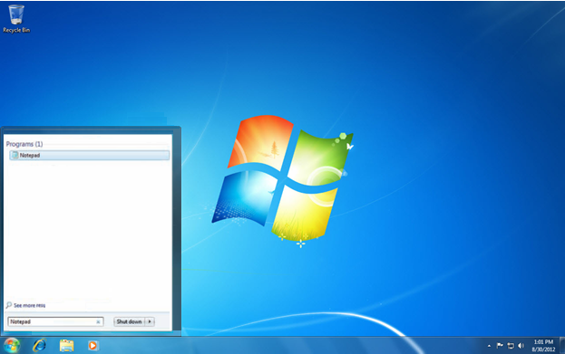
Search programs and files box
Notepad
Notes:
Notepad is a text editing program that comes with the Windows operating system. Here we have searched for Notepad using the Search programs and files box.

Slide 33
Skill 7: Work with Menus and Toolbars, continued
Click the File button at the top of the Notepad screen. Some of the options in the displayed menu have an ellipsis (. . .) after them. Ellipses signify that a dialog box displays when the option is selected.
Point to the Format button to display the menu.
If there is not a check mark next to Word Wrap, click the Word Wrap option. The menu closes. (If there is a check mark, indicating that the feature is active, click in the Notepad window to close the menu.)
Click the Format button. Word Wrap has a check mark beside it, indicating that the option has been turned on.
Click the Close button to close the Notepad window.
Notes:
Display the Notepad window by clicking Notepad.

Slide 34
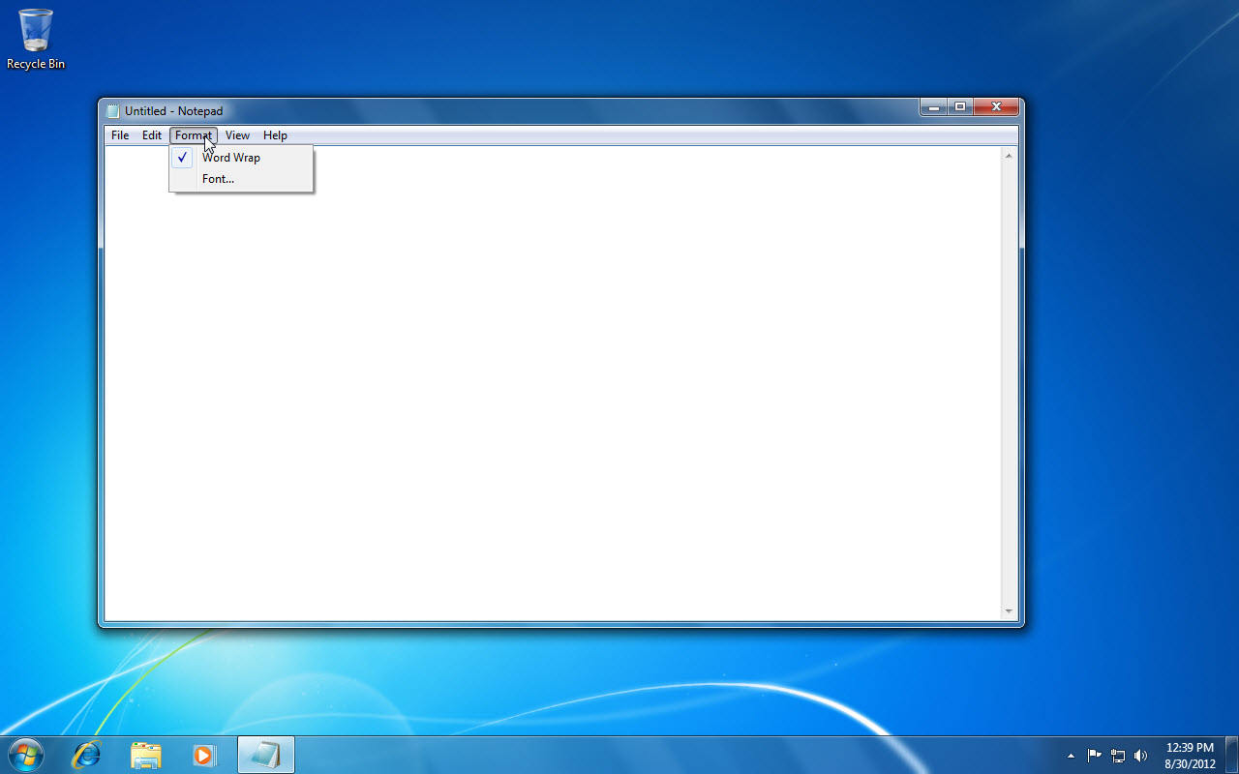
Format button
File button
Notes:
Here you see the Format menu displayed and Word Wrap has a check mark beside it, indicating that the option has been turned on. A check mark indicates that the feature toggles on and off when you click it.

Slide 35
Using Toolbars Toolbars are found in many Windows applications, including Internet Explorer. Toolbars with a check mark beside them are turned on and displayed.
Notes:
Typically, certain toolbars are turned on by default and others can be turned on by the user. Right-click a toolbar to see the other available toolbars you can display.

Slide 36
Skill 8: Use Keyboard Shortcuts
Click the Windows Explorer button on the Taskbar to open the window in Library view.
Press the Alt key to activate the menu bar. Each menu item contains an underlined letter.
Press the F key to display the File menu or press another accelerator key, such as V, to display a different menu.
Press Alt + F4 to close the Windows Explorer window.
From the desktop, press F1 to display the Windows Help and Support window.
Press the Tab key two times. A different command or link in the Help window is highlighted each time you press Tab.
Press Alt + F4 to close the Windows Help and Support window.
Press Ctrl + Esc to display the Start menu.
Press the Up Arrow key several times. A different menu item is highlighted each time you press the key.
Press Esc to close the Start menu.
Notes:
In working through tasks in this chapter, you have used the mouse to select commands. Keyboard shortcuts provide an alternative way to get things done. Keyboard shortcuts are combinations of keys that you press to perform a task, such as copying text. Because your hand does not have to move from the keyboard to the mouse to perform these shortcuts, some people find them easy to use. Most programs also provide accelerator keys. If you press the Alt key, certain letters in the menu items are underlined. Press the key that corresponds to the underlined
letter to select that menu item.

Slide 37
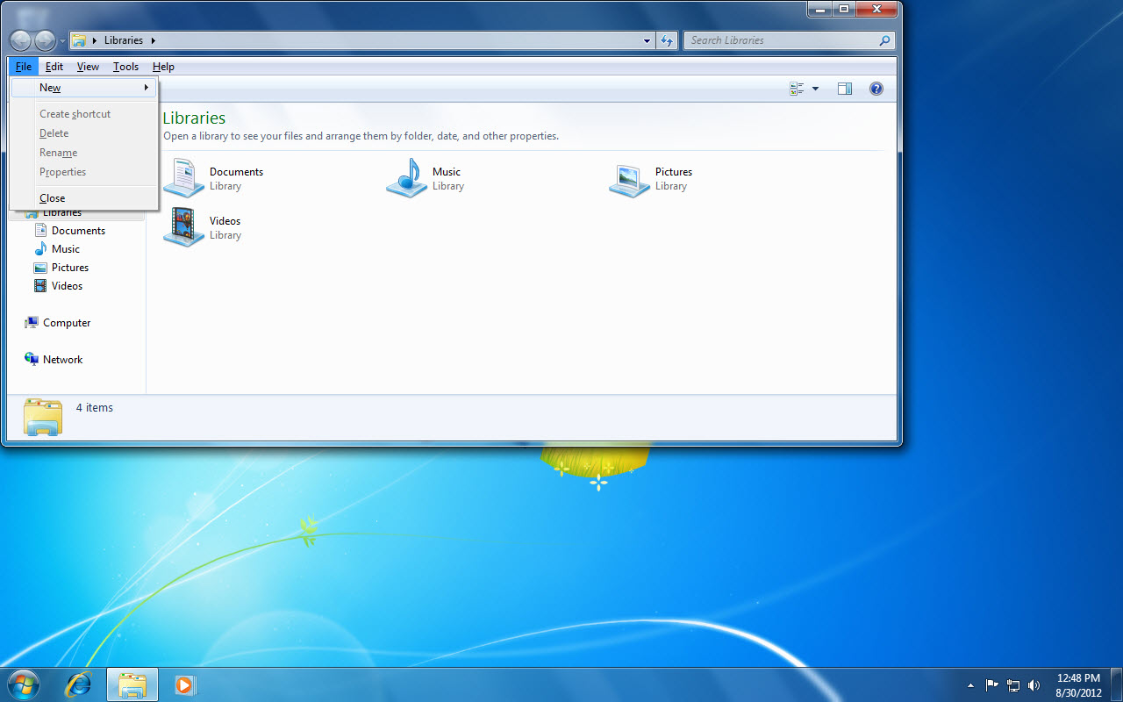
File button
Windows Explorer button
Notes:
Many keyboard shortcuts, such as Alt + F4, perform the same function in all Office applications. For example, Alt + F4 will close a Word window and it will also close an Internet Explorer window.

Slide 38
Memorizing Your Favorite Keyboard Shortcuts Memorizing common keyboard shortcuts can save you time and increase your productivity.
Notes:
For example, many Office users prefer using Ctrl + C and Ctrl + V to copy and paste information rather than selecting commands from a shortcut menu or from the ribbon. To learn more, display the Windows Help window and type keyboard shortcuts in the Search Help box. After pressing Enter, click one of the result links and then research keyboard shortcuts that could help you become more efficient.

Slide 39
Skill 9: Make Selections in Dialog Boxes
Click the Start button on the Taskbar to display the Start Menu.
Click Notepad to start the Notepad program.
Type your first name.
Click Format to display the Format menu.
Click Font to display the Font dialog box.
Click 18 in the Size list box.
Click Bold in the Font style list box.
Click OK. Your first name is now displayed in a larger font size and in bold text. Everything you type will be larger and also bold until you reset these settings in the Format menu. Every new or old text file opened in Notepad will display using these settings. The settings are not stored with the file.
Notes:
You can interact with Windows and other applications by using settings in dialog boxes. Dialog boxes allow you to specify details for a setting or to make choices about how an application performs a procedure. For example, you can interact with the Print dialog box to select a printer, designate which pages to print, and choose the number of copies to print. In this skill, you become familiar with common dialog box features by using the Notepad application that is built into Windows.

Slide 40
Your first name
Notes:
If Notepad is not in the recently used programs list in the Start Menu, click All Programs and then click Accessories.

Slide 41
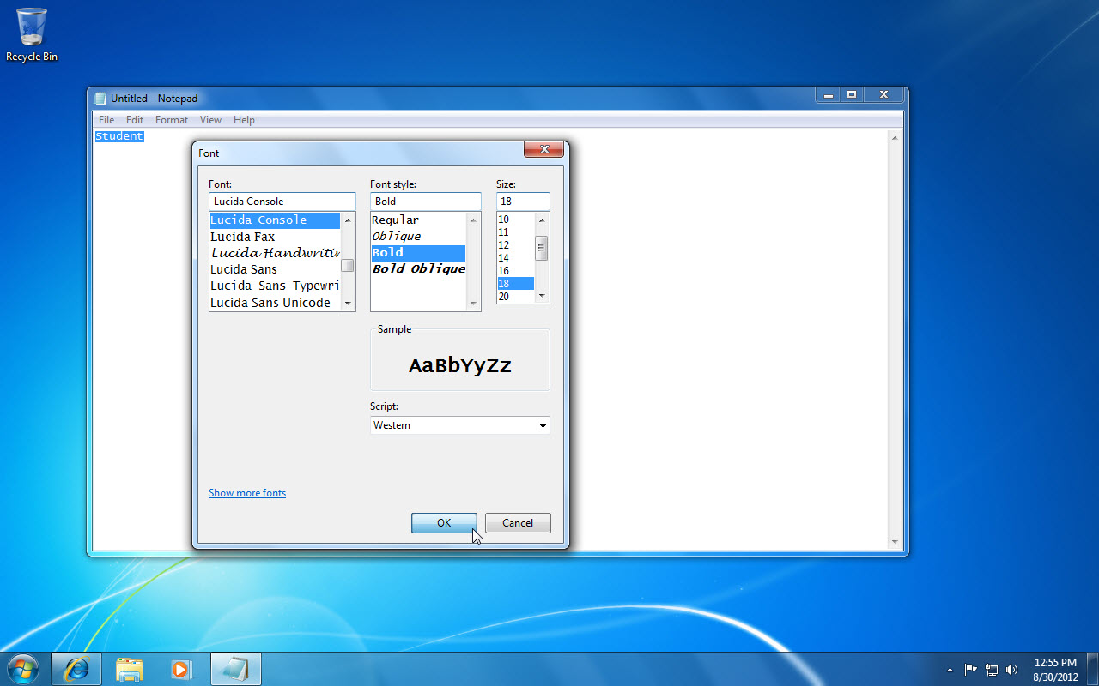
The Size list box
The OK button
Notes:
Here you see the Font dialog box open. When applying font changes in other Office programs, font formatting is applied only to selected text.

Slide 42
Skill 9: Make Selections in Dialog Boxes, continued
Click File to display the File menu.
Click Print to display the Print dialog box.
Click the Print to file check box to insert a check mark.
Click the up arrow next to the Number of copies box to increase the number of copies. The number increases with each click.
Click the down arrow next to the Number of copies box to decrease the number of copies. The number decreases with each click.
Double-click the number in the Number of copies box to select it and then type 5.
Click the Cancel button to close the dialog box without printing.
Notes:
Common dialog box features include check boxes, option buttons, list boxes, and boxes where you can select a value, such as the number of copies to print.

Slide 43
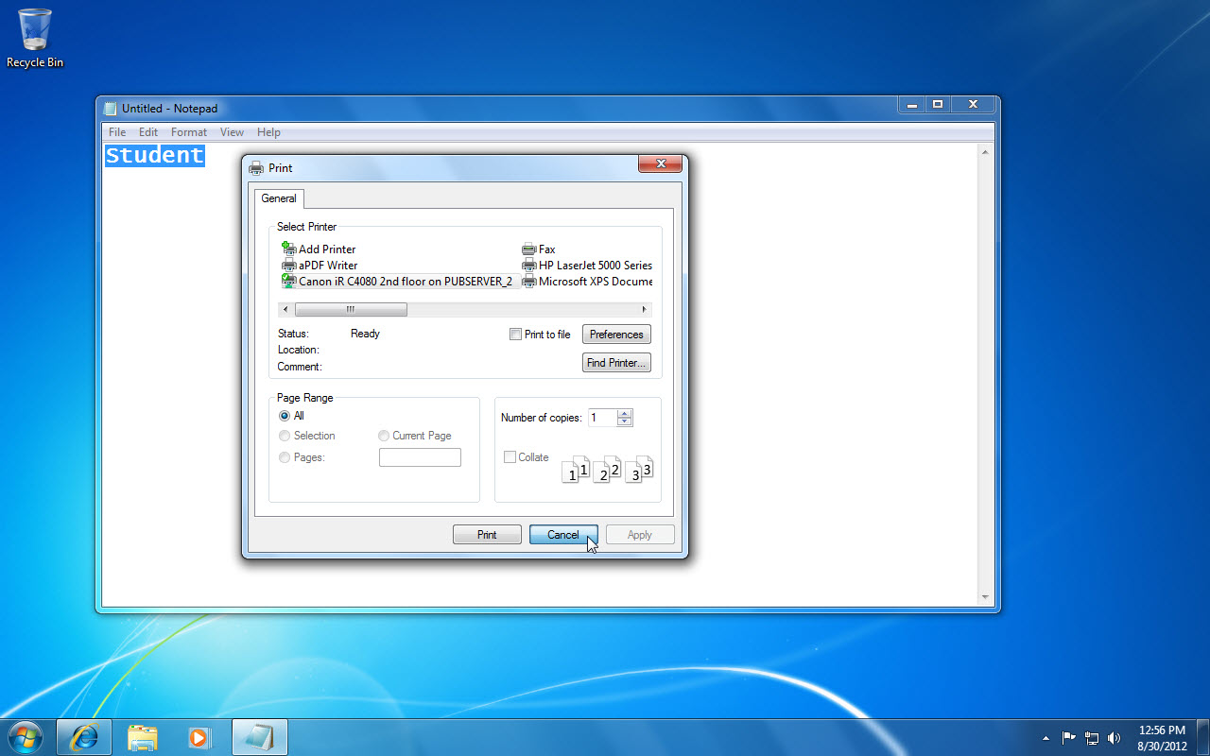
File button
Number of copes box
Cancel button
Notes:
Increase the number of copies by clicking the up arrow next to the Number of copies box and decrease the number of copies by clicking the down arrow next to the Number of copies box . You can also double-click the number in the Number of copies box to select it and then type the number of copies you wish to print.

Slide 44
Skill 10: Shut Down or Put Windows to Sleep
Click the Start button.
Click the Shut down button arrow.
Click Lock. The Windows 7 log on screen displays with your user account and the word Locked.
Click the icon for your user account.
Type your password in the Password text box and press Enter. This action unlocks the system and displays the desktop.
Click the Start button to display the Start menu.
Click the Shut down button arrow.
Click Sleep. Sleep places the computer in a power-conservation state that allows you to resume work quickly when you return. This setting is useful if you are working on a laptop.
Notes:
When you are finished working on your computer, you have a variety of settings to choose from. You can put your computer to sleep, which saves power without your having to close all of your files and shut down your system. You can lock your computer, which hides the desktop and requires you to enter a password to unlock the computer if your account is password protected. You can also log off or switch users if more than one user has an account on your computer. Or, if you prefer, you can shut the computer down completely.

Slide 45
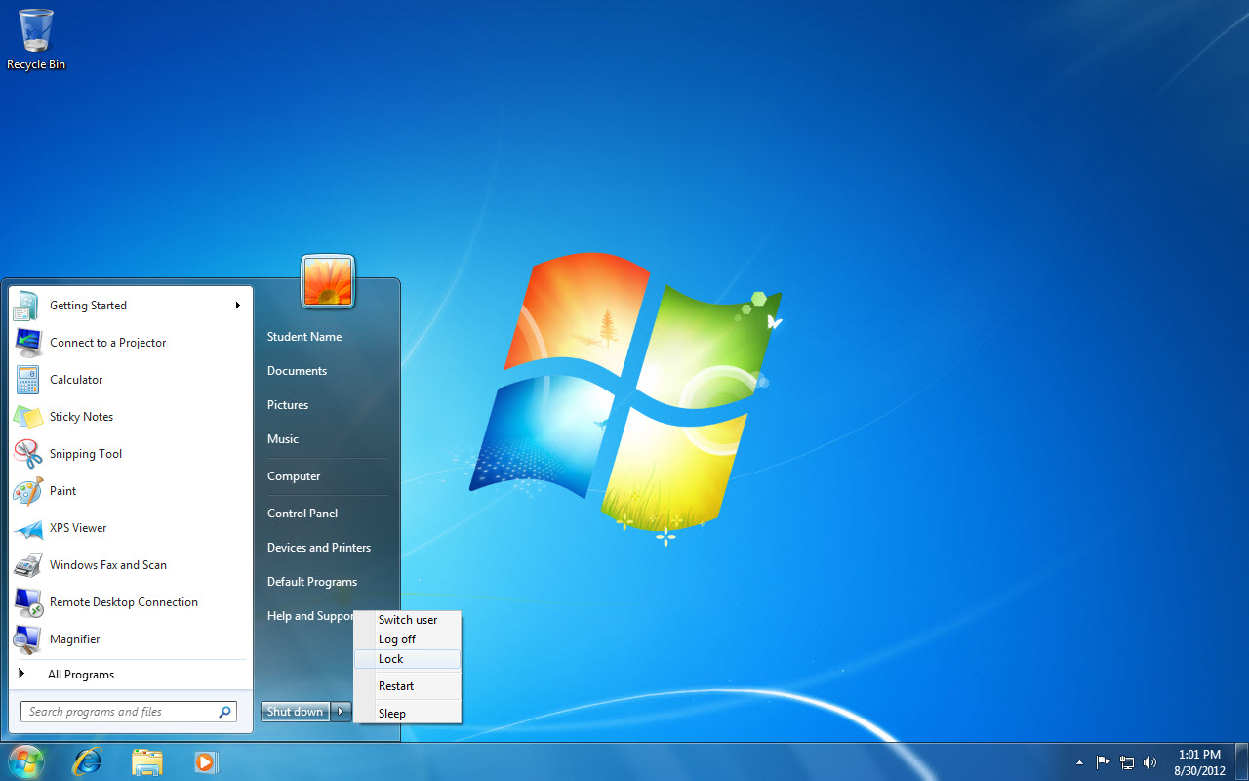
Shut down button arrow
Lock
Notes:
Click the Shut down button arrow to display your user account and the word Lock. To unlock your computer, you may have to press Ctrl + Alt + Delete and then enter your username and password to unlock your computer, if your computer is on a network.

Slide 46
Restarting Sometimes your computer stops working or freezes up and you need to restart it. You can restart the computer by pressing Ctrl + Alt + Delete or by selecting Restart in the Shut down menu.
Notes:
When you have finished working on your computer for a time, you can shut it down. You shut down the computer by clicking the Shut down button in the Start menu. Be sure you have saved and closed all files prior to shutting down the computer.

